Slide 1


Research Tasks, Methods & Data Structure
Kaloyan Haralampiev
Alexander Efremov

Slide 2
Agenda
Introduction
Why Data Analytics?
Examples
DM & Related Areas
DM Stages
DM Automation
Research Task & Data Structure
The Relationship
Data Structures
Descriptive Statistics
Segmentation
Dimension Reduction
Relations Analysis
Classification
Time Series Analysis

Slide 3
Agenda
Introduction
Why Data Analytics?
Examples
DM & Related Areas
DM Stages
DM Automation
Research Task & Data Structure
The Relationship
Data Structures
Descriptive Statistics
Segmentation
Dimension Reduction
Relations Analysis
Classification
Time Series Analysis

Slide 4
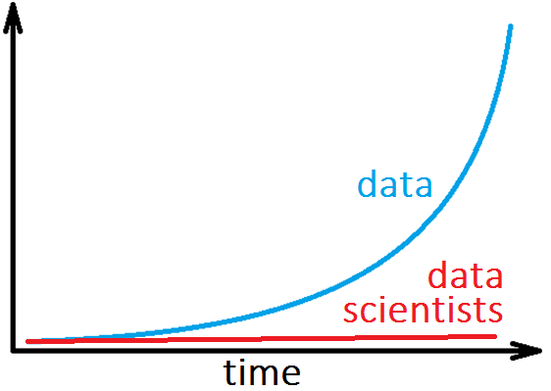
Why Data Analytics?
Premises: Data, Computation Power, Clouds, etc.
Reasons: Accurate, Fast, Cheep, Scalable, Measurable, etc.
Data Types
Structured Data
Unstructured Data
Text
Images
Audio
Video

Slide 5
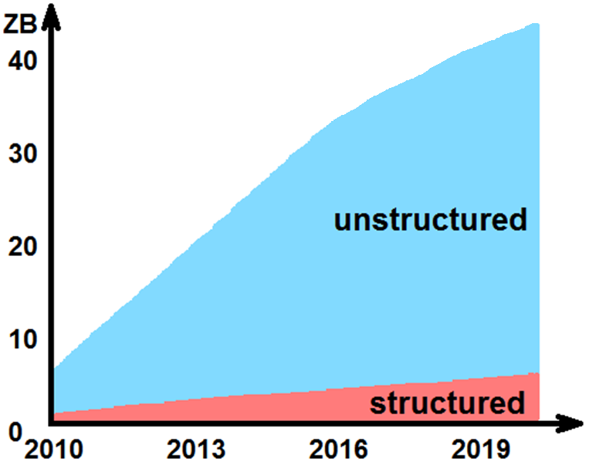
Why Data Analytics?
Premises: Data, Computation Power, Clouds, etc.
Reasons: Accurate, Fast, Cheep, Scalable, Measurable, etc.
Data Types
Structured Data
Unstructured Data
Text
Images
Audio
Video

Slide 6
Why Data Analytics?
Premises: Data, Computation Power, Clouds, etc.
Reasons: Accurate, Fast, Cheep, Scalable, Measurable, etc.
Challenges
Data size: big or small data
Data types: structured, unstructured data, mixed data
Data sources: CRM, SRM, Sales, PLM, SCM... /demogr., behav./
Dirty data: Missings and Outliers
System: multivariable, interconnections, dynamics, time-varying behavior...
Tasks: complex workflows
Notes:
ERP - управление на ресурсите и процесите в предприятие
CRM – Customer Relationship Management - interaction with current and potential customers
SRM – Supplier Relationship Management /support/
PLM – Production Line Management
SCM – Supply Chain Management
Accounting
HR
Corporate Performance and Governance

Slide 7
Agenda
Introduction
Why Data Analytics?
Examples
DM & Related Areas
DM Stages
DM Automation
Research Task & Data Structure
The Relationship
Data Structures
Descriptive Statistics
Segmentation
Dimension Reduction
Relations Analysis
Classification
Time Series Analysis

Slide 8
Examples
Churn Reduction for Service Providers, Mobile Operators
Target Market Offering in Retail Industry
Recommender Systems in E-commerce
Promotions Optimization in Supermarkets
Order Strategy Optimization in Storages
Optimal Accept/Reject Decision in Credit Risk
etc.

Slide 9
Agenda
Introduction
Why Data Analytics?
Examples
DM & Related Areas
DM Stages
DM Automation
Research Task & Data Structure
The Relationship
Data Structures
Descriptive Statistics
Segmentation
Dimension Reduction
Relations Analysis
Classification
Time Series Analysis

Slide 10
Terms
Areas
Statistics
Machine Learning (ML)
Information Technology (IT) /data bases, parallel computations, .../
Optimization
Numerical methods
...
DM
AI?
DS?
...
Optimization
Stat
Data Mining
Other
ML
IT

Slide 11
Agenda
Introduction
Why Data Analytics?
Examples
Terms
DM Stages
Automation
Research Task & Data Structure
The Relationship
Data Structures
Descriptive Statistics
Segmentation
Dimension Reduction
Relations Analysis
Classification
Time Series Analysis

Slide 12
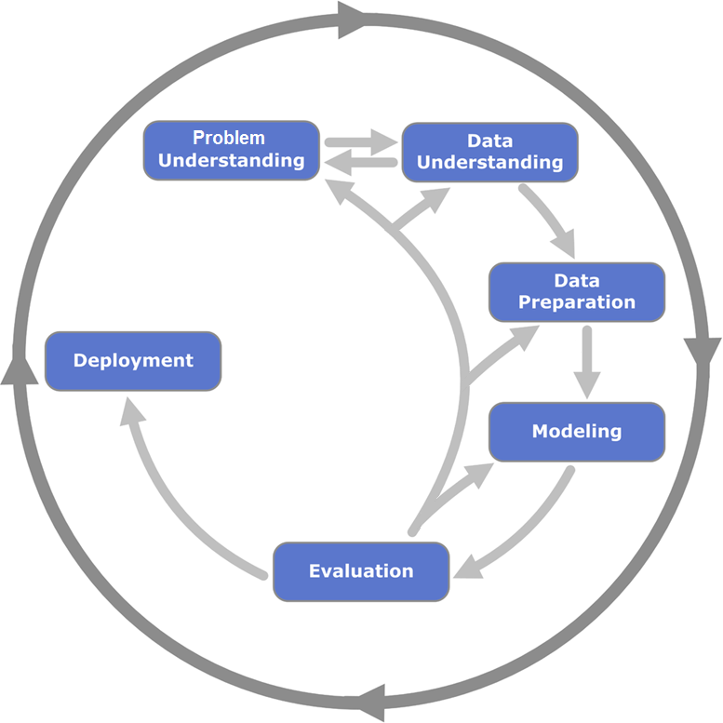
DM Stages
CRISP – DM
Cross Industry Standard Process for Data Mining

Slide 13
Agenda
Introduction
Why Data Analytics?
Examples
DM & Related Areas
DM Stages
Automation
Research Task & Data Structure
The Relationship
Data Structures
Descriptive Statistics
Segmentation
Dimension Reduction
Relations Analysis
Classification
Time Series Analysis

Slide 14
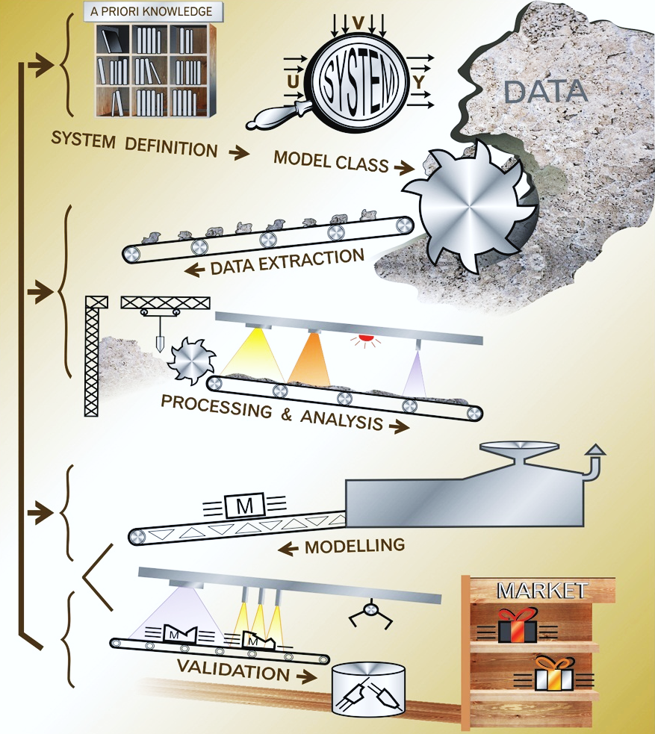
Automation
Automated DM Workflows
Many domain problems → One DM problem
Excluding Human Role
Many variables, fast, cheep... solution
Dangers
Wrong decisions and conclusions
How to Reduce Risk?
A-priori & a-posteriori balance (Gray Box)

Slide 15
Agenda
Introduction
Why Data Analytics?
Examples
DM & Related Areas
DM Stages
DM Automation
Research Task & Data Structure
The Relationship
Data Structures
Descriptive Statistics
Segmentation
Dimension Reduction
Relations Analysis
Classification
Time Series Analysis

Slide 16
Relationship Between Research Tasks and Data structure
Research tasks | Data structure
Descriptive statistics | Variables only
Segmentation
Dimension reduction
Relations Analysis | Dependent variable(s) and independent variable(s)
Classification
Time series analysis | Time as independent variable

Slide 17
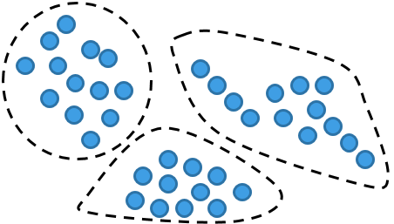
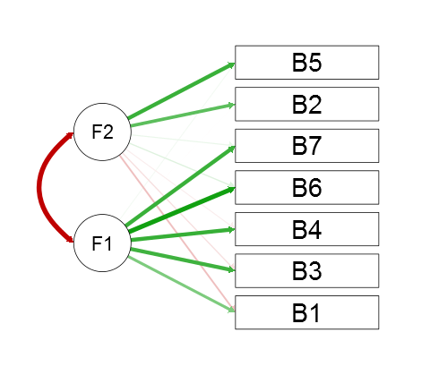
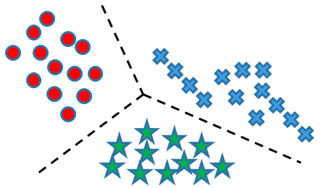

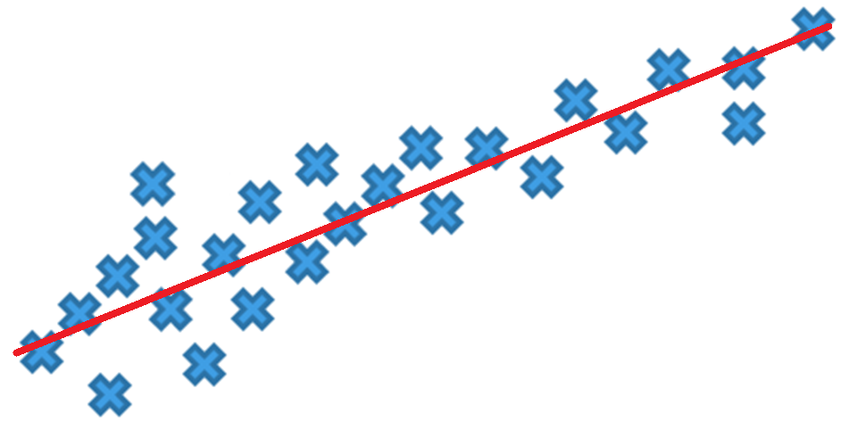
DM Tasks
Segmentation
Classification
Dimension reduction
Relations Analysis
Time series analysis

Slide 18
Agenda
Introduction
Why Data Analytics?
Examples
DM & Related Areas
DM Stages
DM Automation
Research Task & Data Structure
The Relationship
Data Structures
Descriptive Statistics
Segmentation
Dimension Reduction
Relations Analysis
Classification
Time Series Analysis

Slide 19
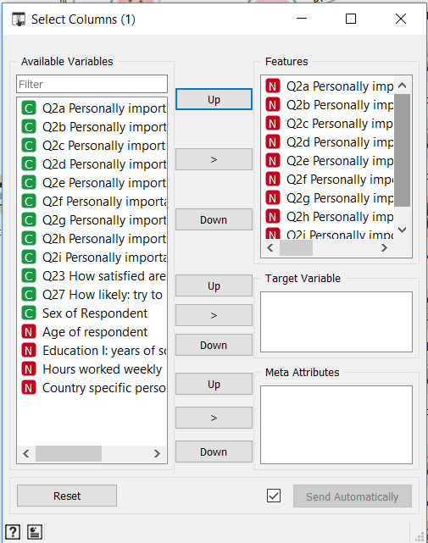
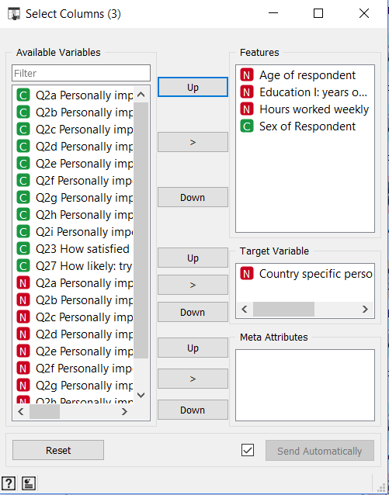
Data Structures / Examples
Variables only
Dependent variable(s) & independent variable(s)
Data: International social survey program (ISSP), 2015, China (http://zacat.gesis.org/webview/)
Software: Orange (https://orange.biolab.si/)

Slide 20
Agenda
Introduction
Why Data Analytics?
Examples
DM & Related Areas
DM Stages
DM Automation
Research Task & Data Structure
The Relationship
Data Structures
Descriptive Statistics
Segmentation
Dimension Reduction
Relations Analysis
Classification
Time Series Analysis

Slide 21
Descriptive Statistics
Scale | Statistical method
Nominal | Frequencies Percentages
Ordinal, rank or score | + Cumulative frequencies + Cumulative percentages
Interval | + Central tendency (mean, median, mode) + Dispersion (variance, standard deviation, range) + Skewness + Kurtosis + Quartiles, deciles, percentiles

Slide 22
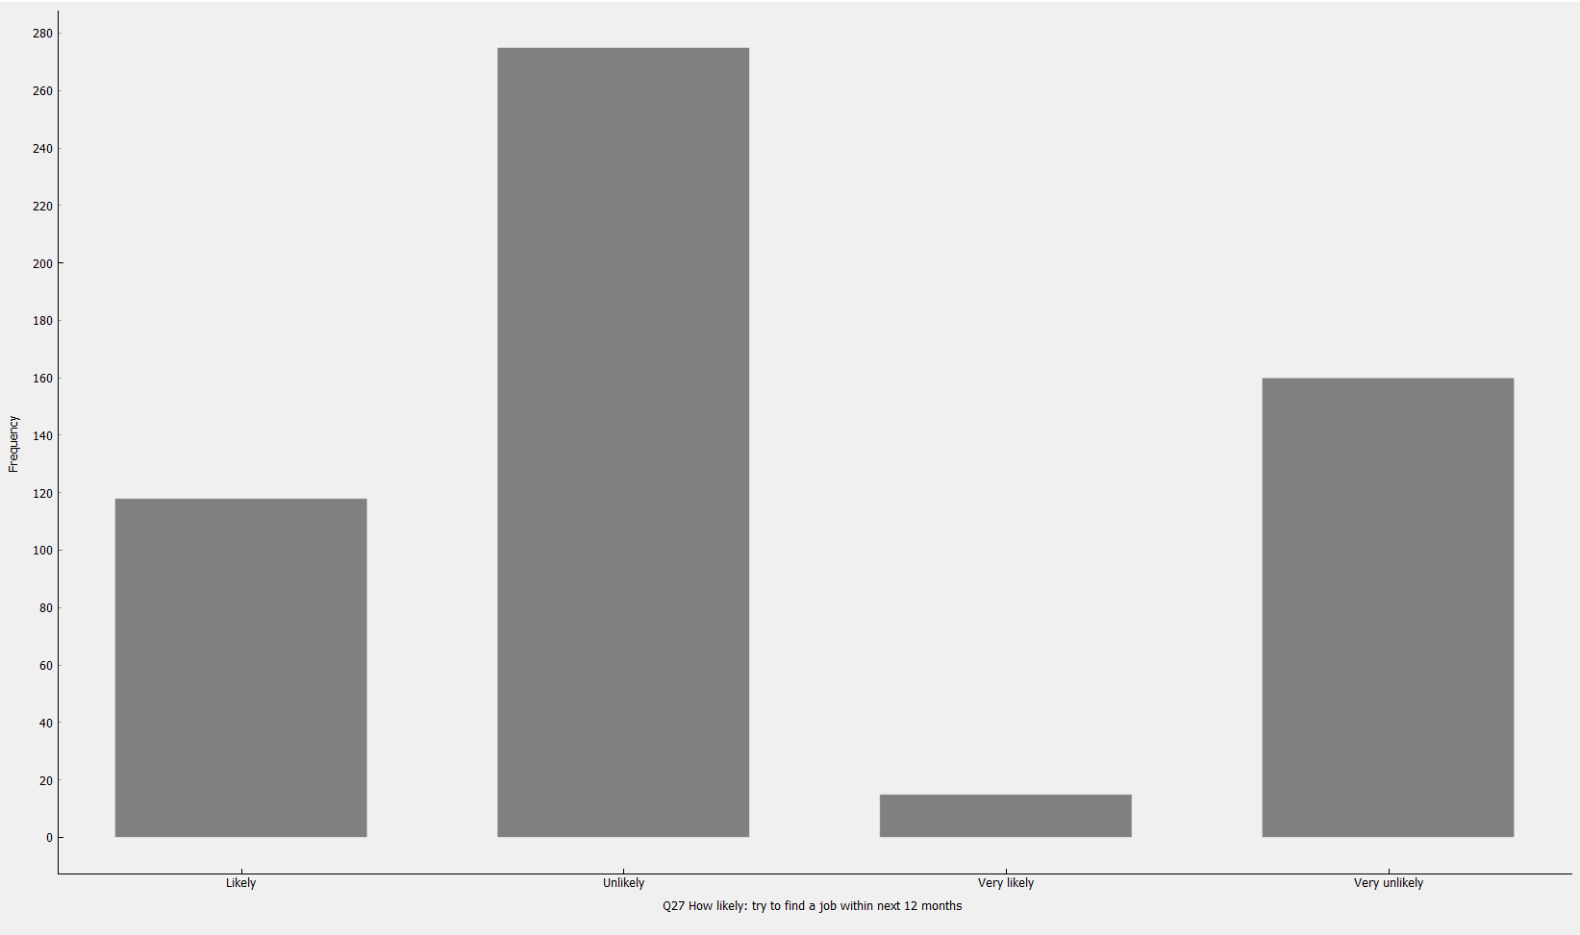
Descriptive Statistics / Example: Nominal & Ordinal Scales
Data: International social survey program (ISSP), 2015, China (http://zacat.gesis.org/webview/)
Software: Orange (https://orange.biolab.si/)

Slide 23
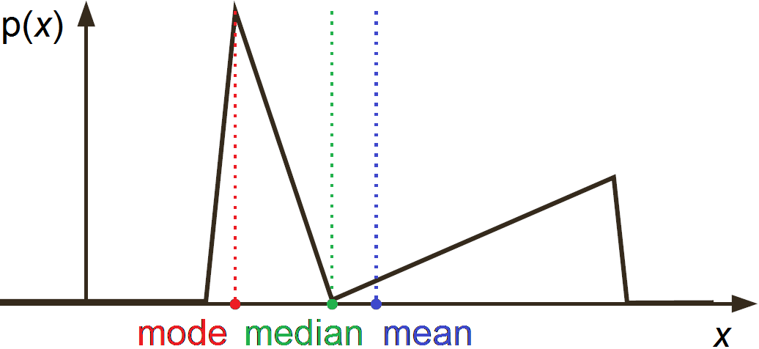
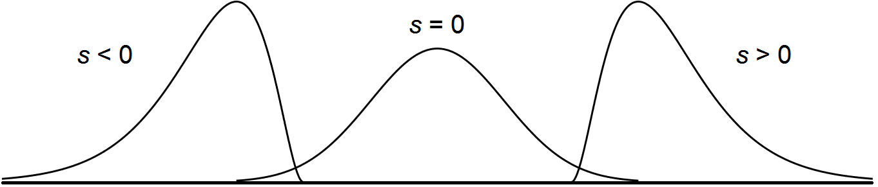
Descriptive Statistics
mean – arithmetic average x̄̄ = 1/N ∑_{k} x_{k}
mode – most frequent value(s) mo_{x} = argmax f(x)
median – middle value. Below & above me_{x} lies equal number of obs.
quantiles – values dividing a set into equal-sized groups
quartiles – values dividing a set into 4 equal (25%) groups
quintiles – values dividing a set into 5 equal (20%) groups
percentiles – values dividing an ordered set into 100 equal (1%) groups
/0.25 quantile = 1 quartile = 25 percentile/
variance – measures the spread of obs. around mean D_{x} = m₂ N/(N – 1)
standard deviation – sqrt(variance) σ_{x} = D_{x}^{1/2}
skewness – distribution asymmetry (positive – right, negative – left oriented) s = m₃ / m₂^{3/2}
kurtosis – peak sharpness relative to a normal distribution (positive – above, negative – below Normal peak) K = m₄ / m₂² – 3
m_{i} – i-th central moment

Slide 24
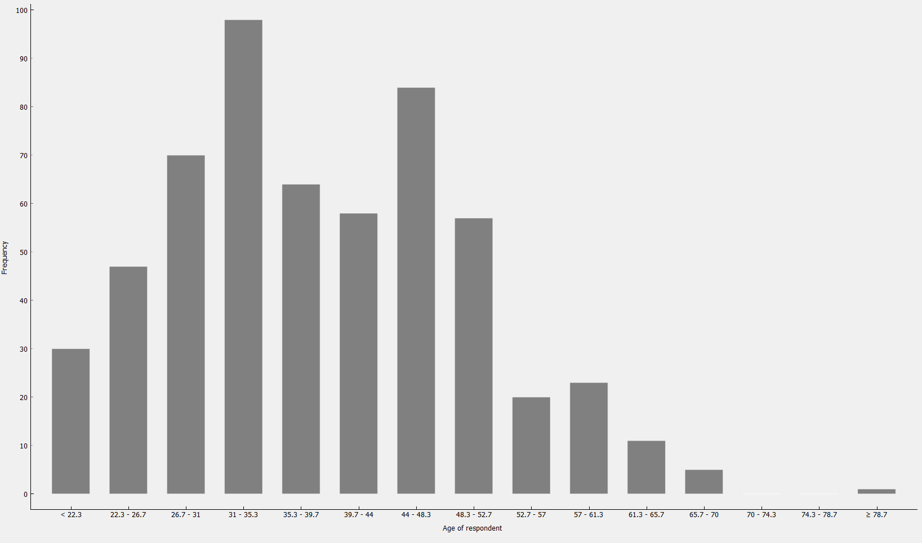
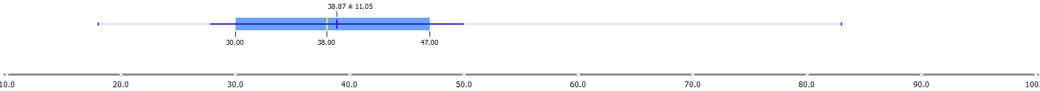
Descriptive Statistics / Example: Interval Scales
Data: International social survey program (ISSP), 2015, China (http://zacat.gesis.org/webview/)
Software: Orange (https://orange.biolab.si/)

Slide 25
Agenda
Introduction
Why Data Analytics?
Examples
DM & Related Areas
DM Stages
DM Automation
Research Task & Data Structure
The Relationship
Data Structures
Descriptive Statistics
Segmentation
Dimension Reduction
Relations Analysis
Classification
Time Series Analysis

Slide 26
Segmentation
Scale | Statistical method
Nominal Ordinal or rank | TwoStep cluster
Binary Score Interval | + Hierarchical cluster + Partitional cluster + Multidimensional scaling

Slide 27
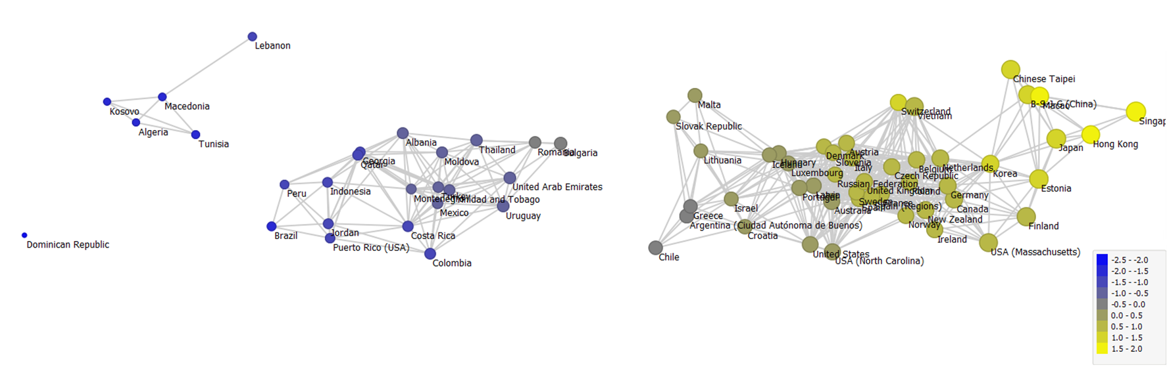
Segmentation / Example: Multidimensional Scaling
Data: PISA (http://www.oecd.org/pisa/)
Software: Orange (https://orange.biolab.si/)

Slide 28
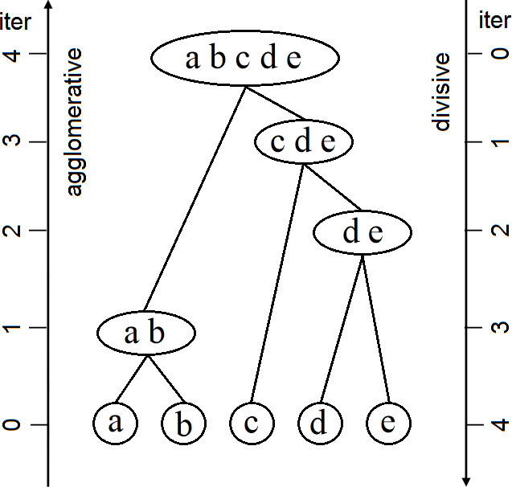
Clustering / Hierarchical
Hierarchical Clustering Approaches
Tree structure of clusters
Agglomerative: bottom-up approach
Start: each cluster is unique object
Clusters are merged into larger clusters
Until: all obj. are in one cluster / stopping rule is satisfied
Divisive: top-down approach
Start: one cluster with all objects
Clusters are divided into smaller clusters
Until: each cluster is unique object / stopping rule is satisfied

Slide 29

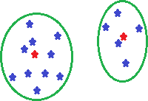
Clustering / Distances
Distance Between Objects
Euclidian distance
Manhattan
Mahalanobis
Simple match coefficient
Mixed (Gower) distance...
Distance Between Clusters
Single-link
Complete-link
Average-link...

Slide 30
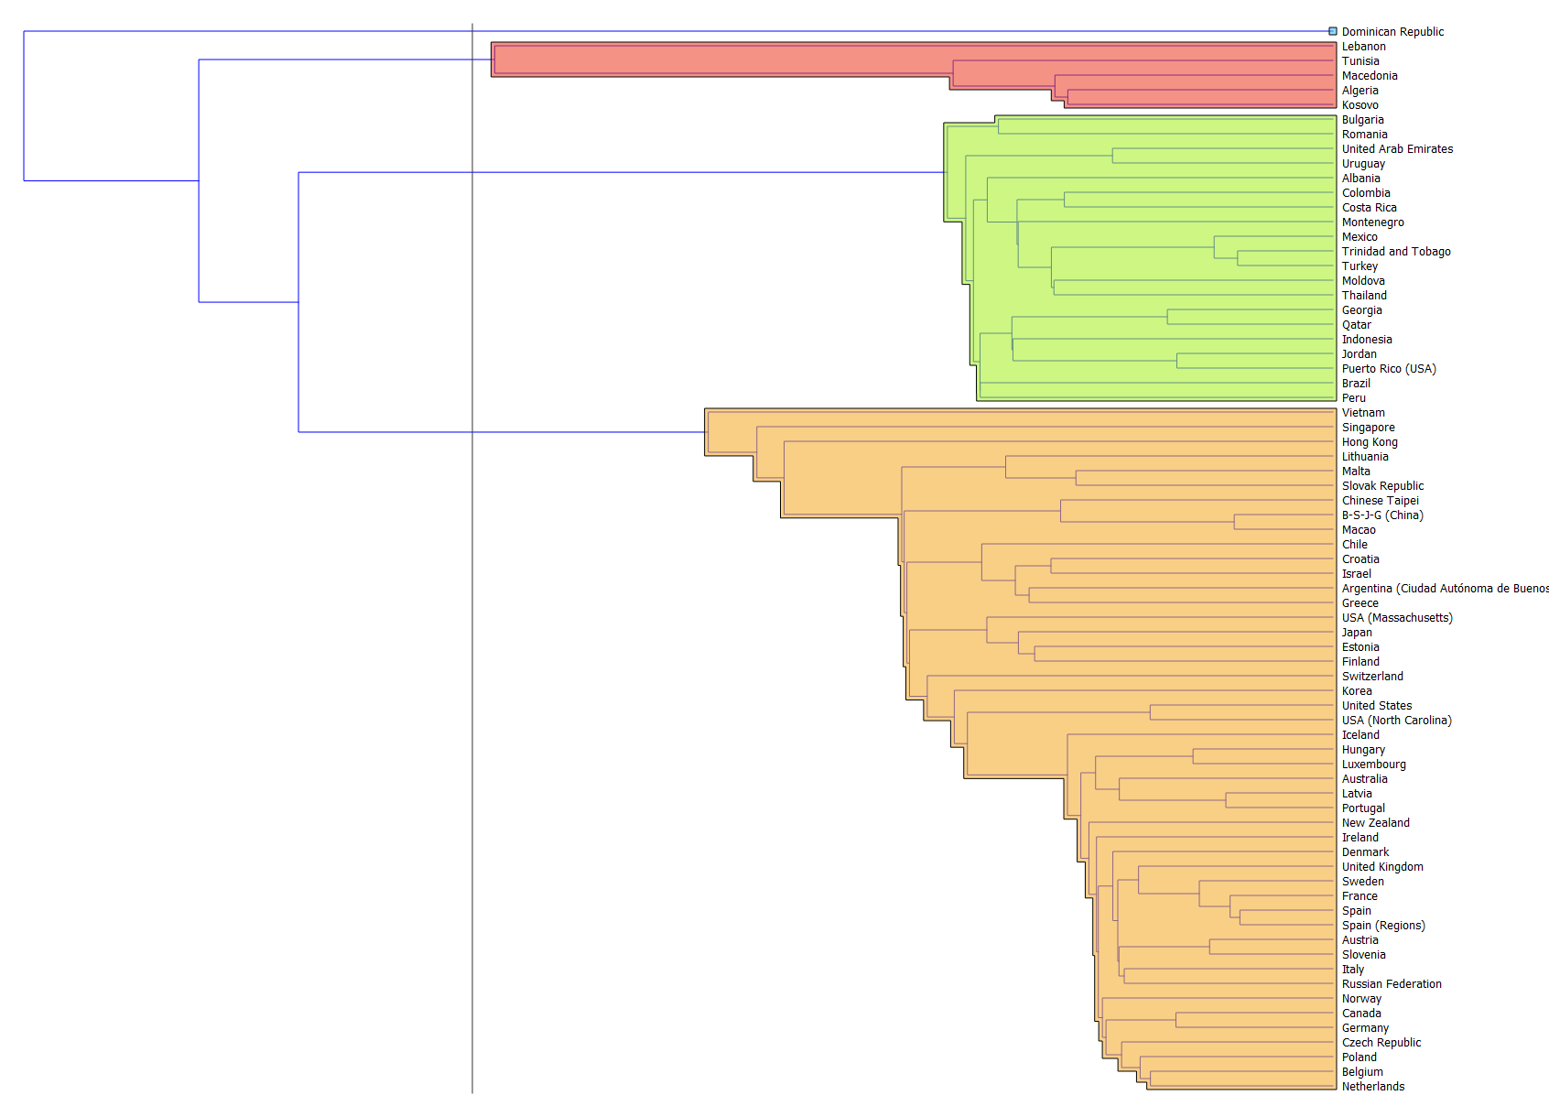
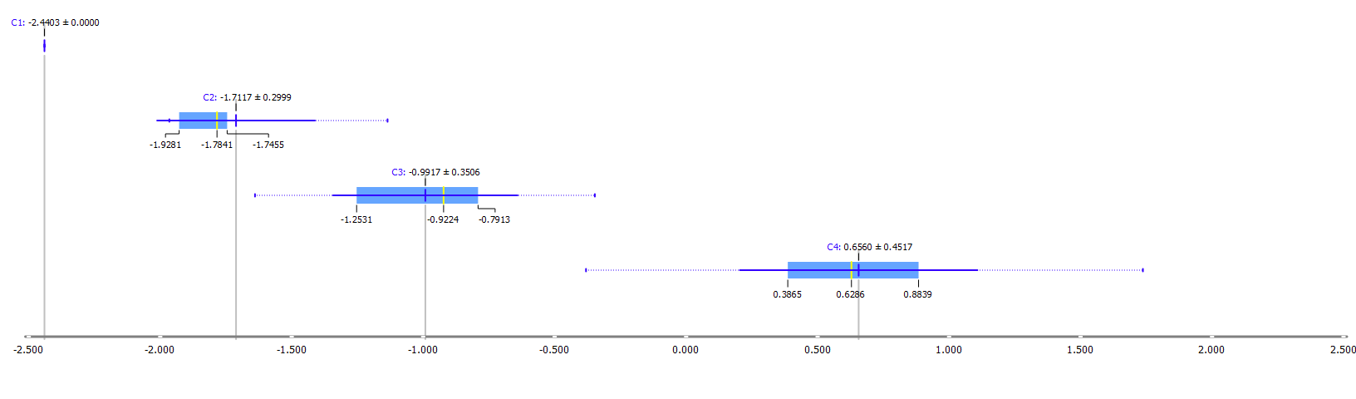
Segmentation / Example: Hierarchical Cluster
Data: PISA (http://www.oecd.org/pisa/)
Software: Orange (https://orange.biolab.si/)

Slide 31
Clustering / Partitional
Partitional Clustering
K-means (for numeric attributes)
K-modes (for ordinal and nominal attributes)
K-medoids (for ordinal and nominal attributes)

Slide 32
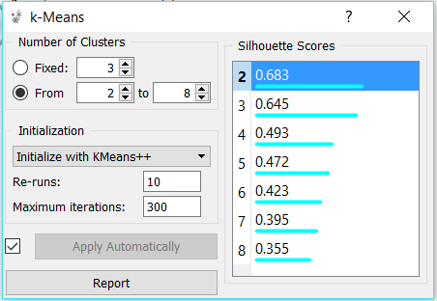
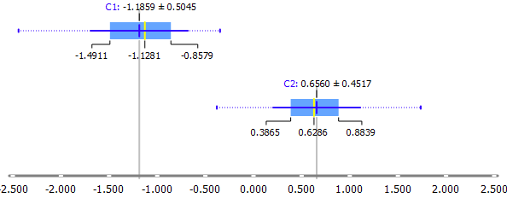
Segmentation / Example: K-Means Cluster
Data: PISA (http://www.oecd.org/pisa/)
Software: Orange (https://orange.biolab.si/)

Slide 33
Clustering / Comparison: Hierarchical & Partitional Approaches
Hierarchical
Number of clusters is not required
No backtracking => no corrections
Slow approach: O(N²)
Distances: (N² – N)/2 first iteration (aglomer. clustering)
(N = 1000 => D has 499 500 distances)
Partitional
Number of clusters is required
Cluster members are rearranged iteratively
Fast (k-means)
Distances: N x k per each iteration
(N = 1000, k = 5 => 5000 distances)

Slide 34
Agenda
Introduction
Why Data Analytics?
Examples
DM & Related Areas
Automation
DM Stages
Research Task & Data Structure
The Relationship
Data Structures
Descriptive Statistics
Segmentation
Dimension Reduction
Relations Analysis
Classification
Time Series Analysis

Slide 35
Dimension Reduction
Scale | Statistical method
Interval | Factor analysis
Binary | + Likert scale + Cronbach’s Alpha
Score | + Categorical principal components

Slide 36
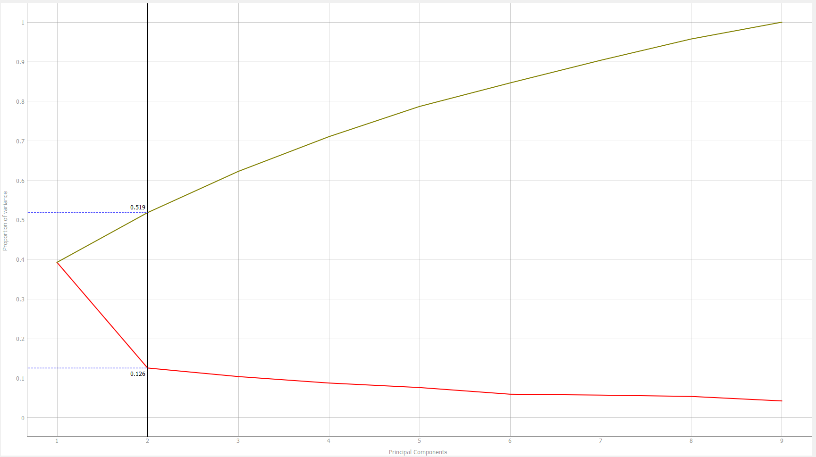
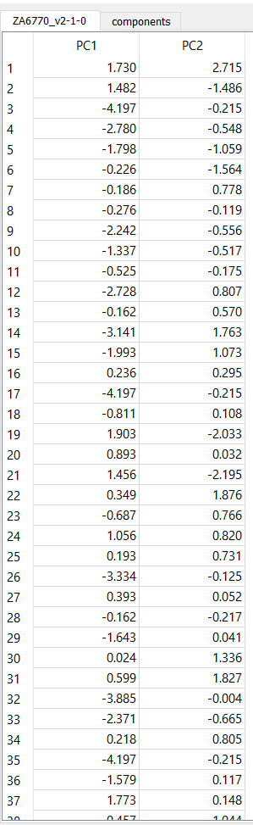
Dimension Reduction / Example: Factor Analysis
Data: International social survey program (ISSP), 2015, China (http://zacat.gesis.org/webview/)
Software: Orange (https://orange.biolab.si/)

Slide 37
Agenda
Introduction
Why Data Analytics?
Examples
DM & Related Areas
Automation
DM Stages
Research Task & Data Structure
The Relationship
Data Structures
Descriptive Statistics
Segmentation
Dimension Reduction
Relations Analysis
Classification
Time Series Analysis

Slide 38
Relations Analysis and/or Classification
Independent variable(s) | Dependent variable(s)
 | Nominal Ordinal | Interval
Nominal Ordinal | Contingency tables Correspondence Logistic regression Rank correlation Classification trees Neural Networks | ANOVA GLM Rank correlation Classification trees Neural Networks
Interval | Discriminant Logistic regression Rank correlation Classification trees Neural Networks | GLM Regression Correlation Classification trees Neural Networks
Mix of nominal and/or ordinal and/or interval | Logistic regression Rank correlation Classification trees Neural Networks | GLM Rank correlation Classification trees Neural Networks

Slide 39
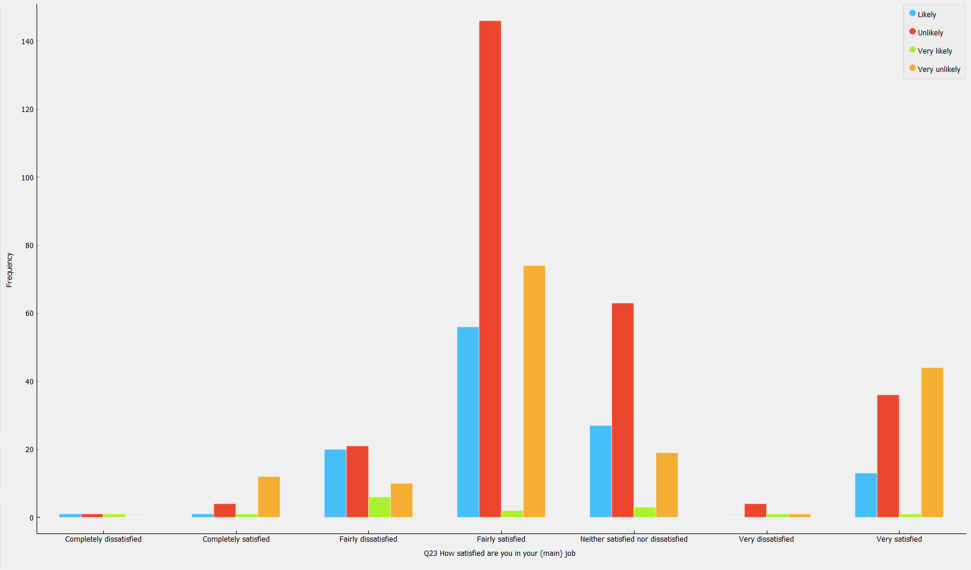
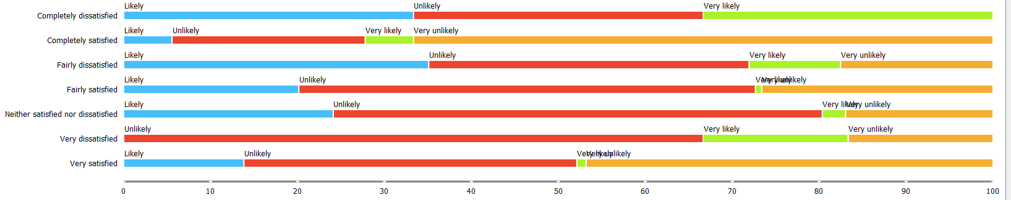
Relations Analysis, Classification / Ex: Contingency Tables
Data: International social survey program (ISSP), 2015, China (http://zacat.gesis.org/webview/)
Software: Orange (https://orange.biolab.si/)

Slide 40
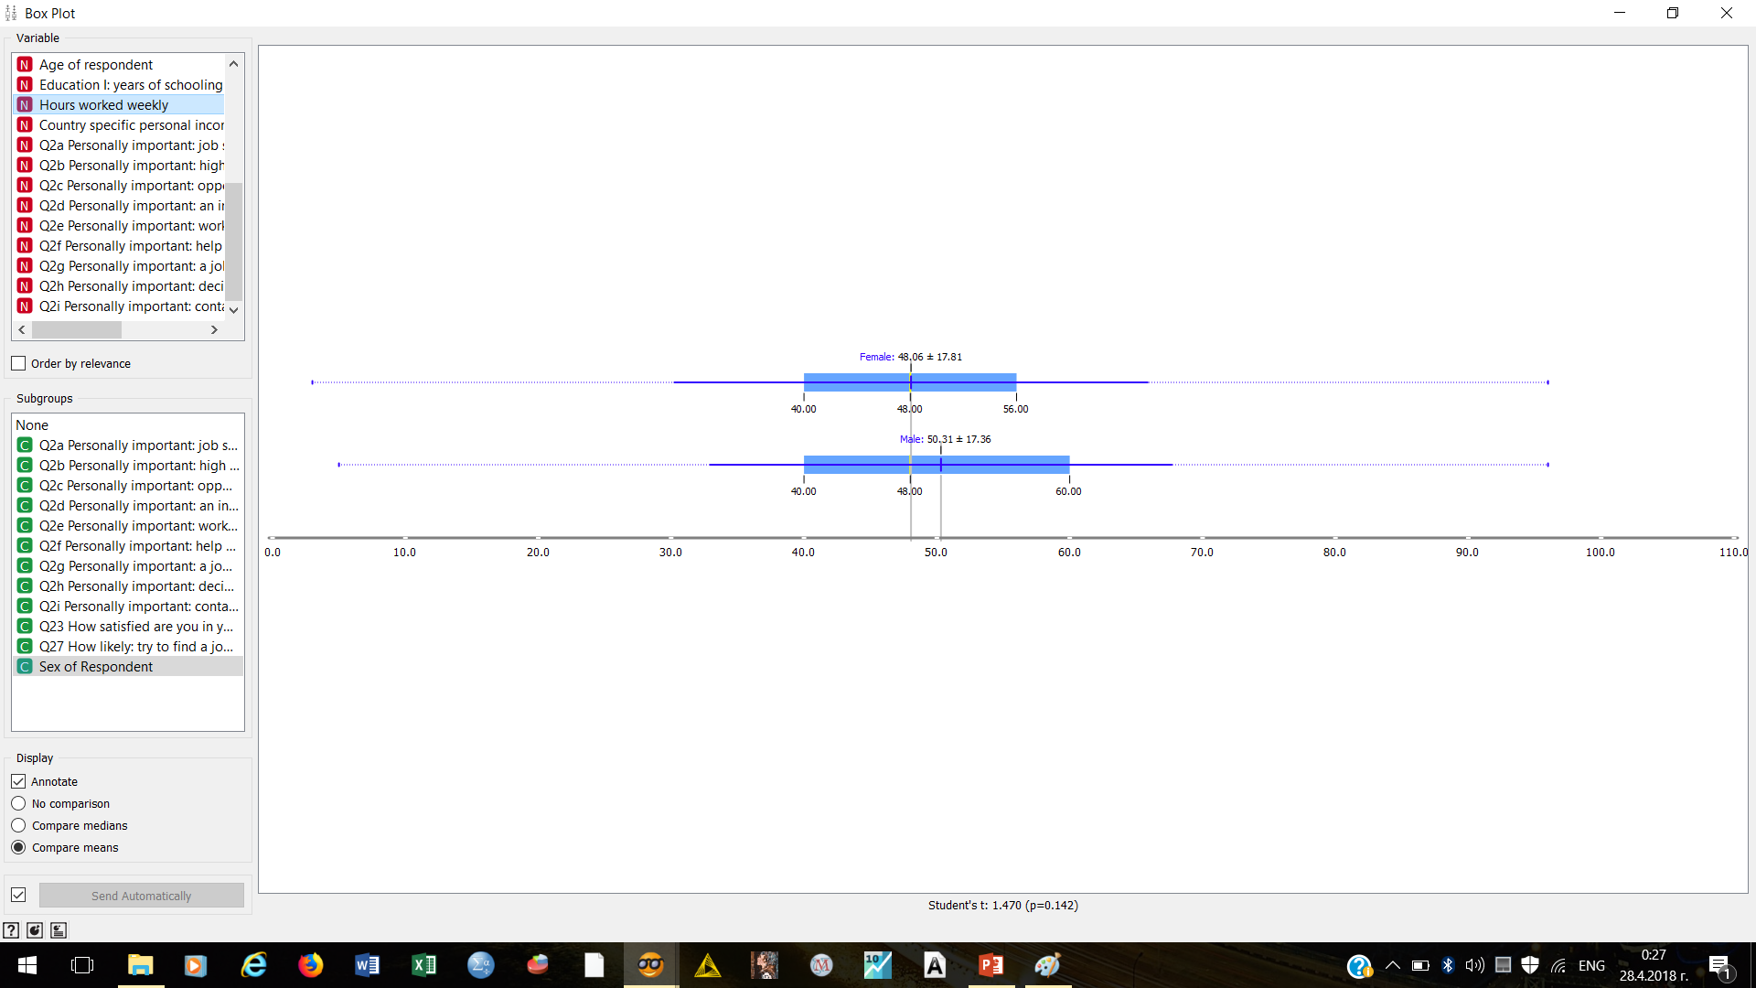
Relations Analysis, Classification / Ex: ANOVA
Data: International social survey program (ISSP), 2015, China (http://zacat.gesis.org/webview/)
Software: Orange (https://orange.biolab.si/)

Slide 41
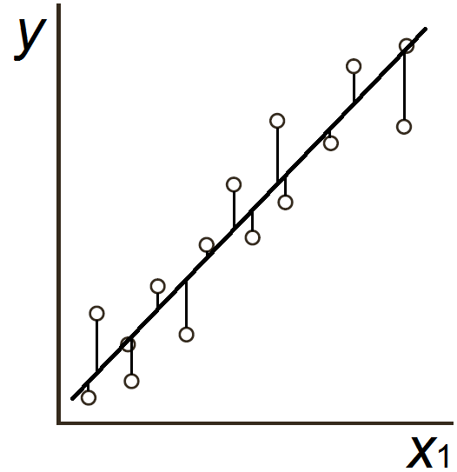
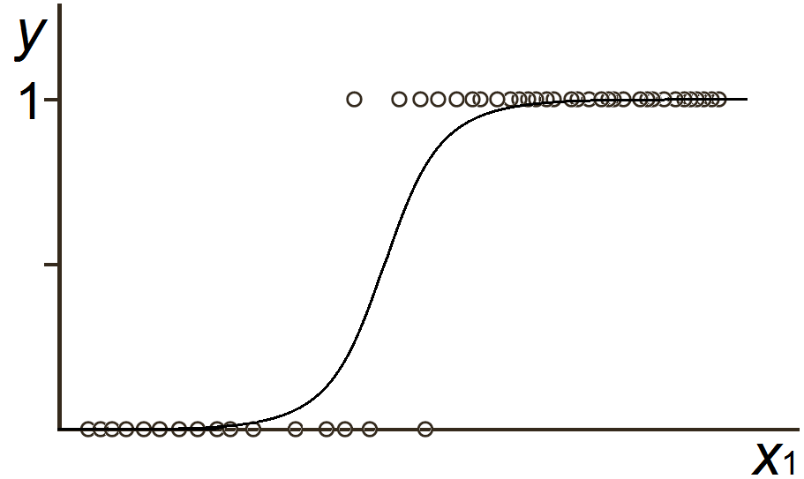
Regression / Linear & Logistic Models
Linear Model
Logistic Model
Notes:
линеен модел?: f(x) или f(q)
Примери за лин. по пар – монография 57 (69)

Slide 42
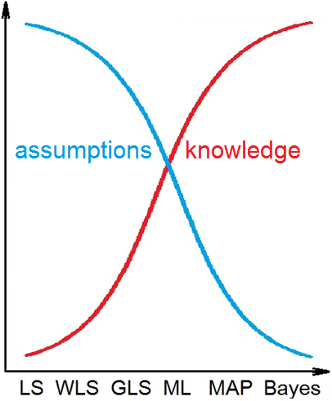
Regression / Estimators
System Knowledge & Assumptions
Bayes Method
known: p(θ|y), p(θ), los(θ, θ')
Maximum A-Posteriori (MAP)
known: p(θ|y), p(θ)
assumed: los(θ, θ') = const
Maximum Likelihood (ML)
known: p(θ|y)
assumed: p(θ) = const
Generalized Least Squares (GLS...)
known: Ǝ cov(e_{k1}, e_{k2})
assumed: e ~ N(0, Σ_{e})
Weighted Least Squares (WLS)
known: Σ_{e} → diag /W – weight matrix/
assumed: cov(e_{k1}, e_{k2}) = 0
Least Squares (LS)
assumed: w_{kk} = const

Slide 43
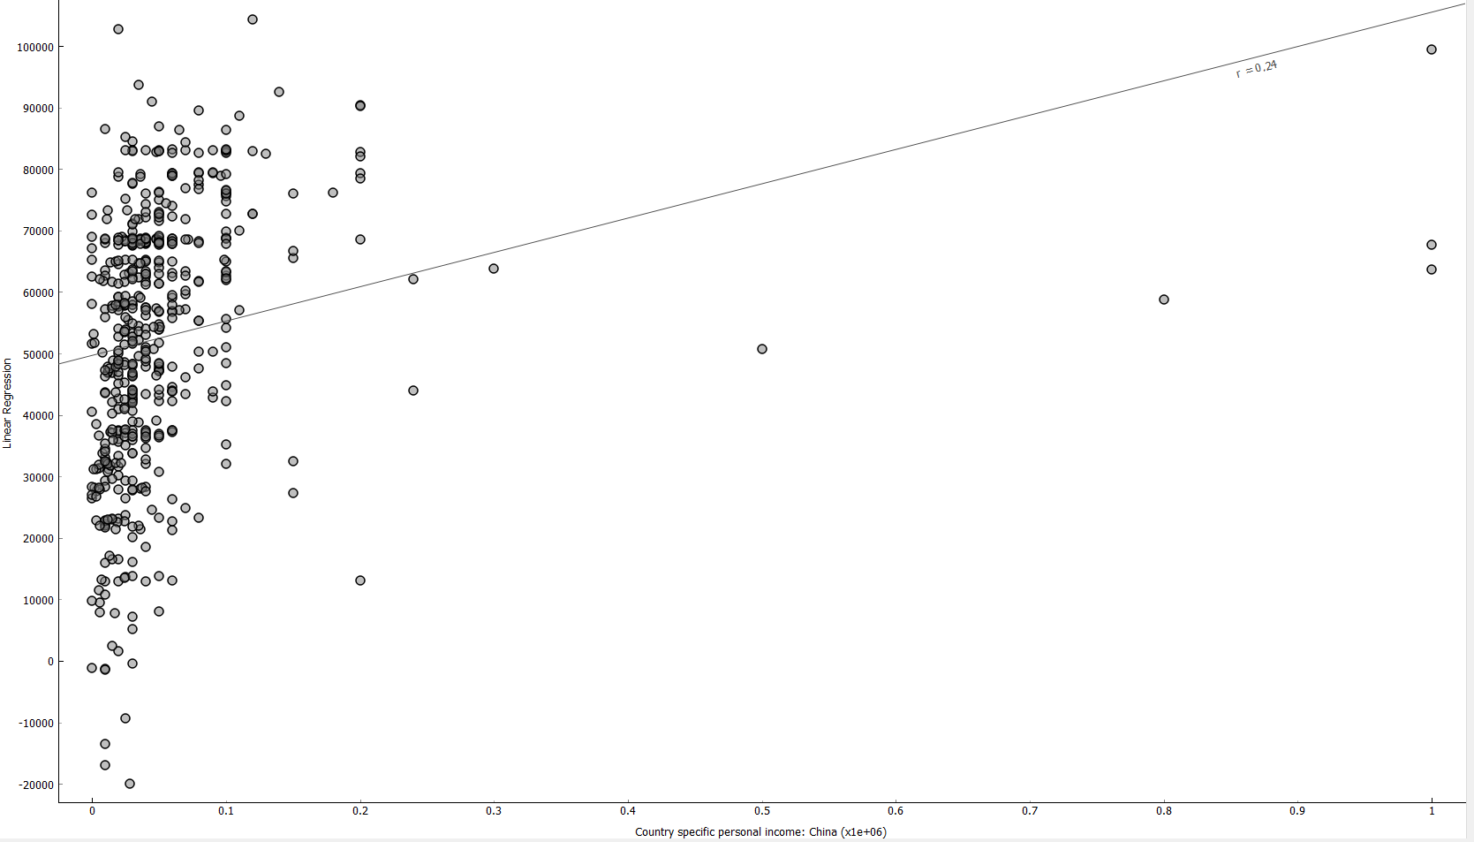
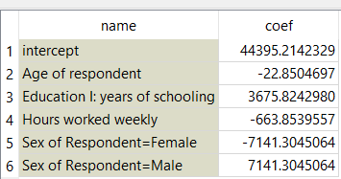
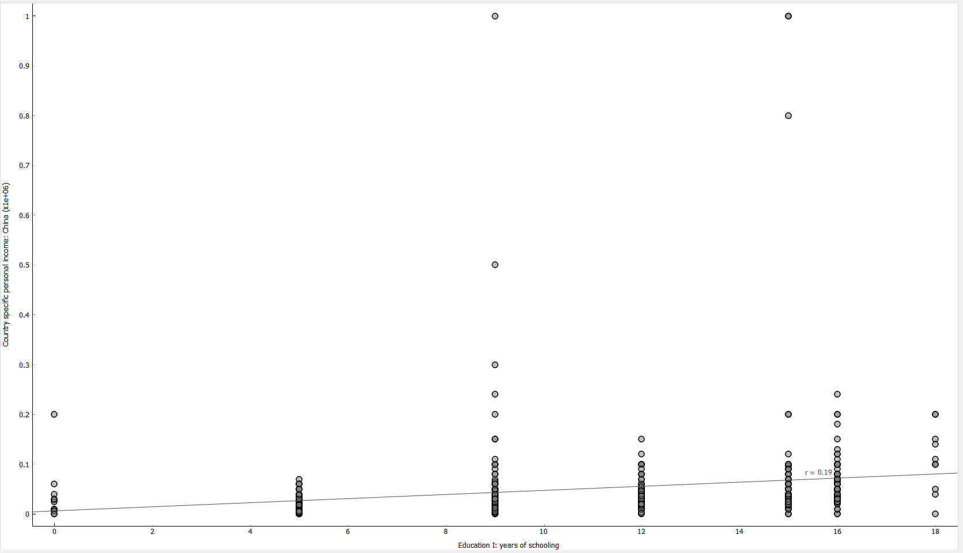
Relations Analysis, Classification / Ex: Regression & Correlation
Data: International social survey program (ISSP), 2015, China (http://zacat.gesis.org/webview/)
Software: Orange (https://orange.biolab.si/)

Slide 44
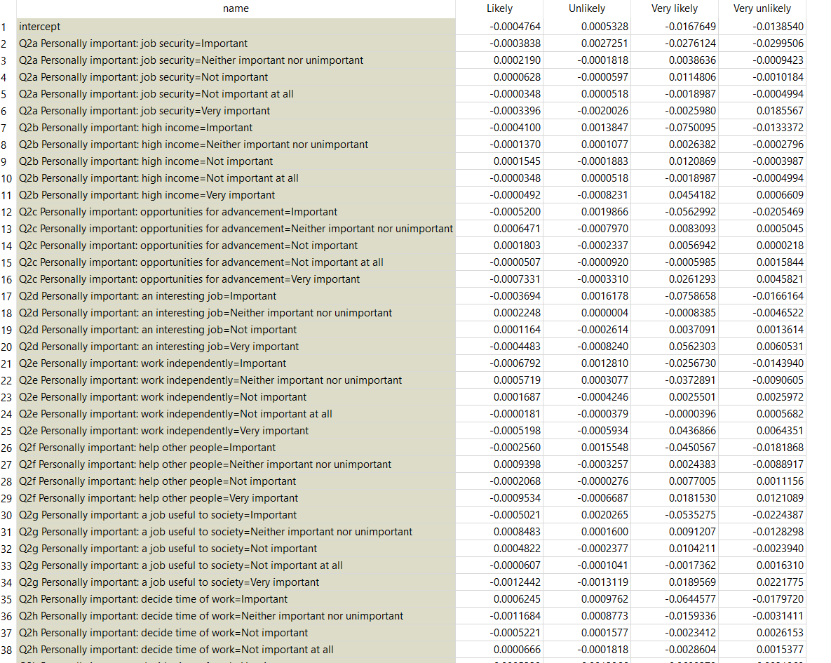
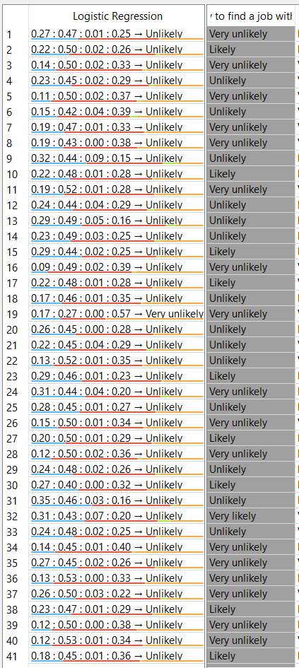
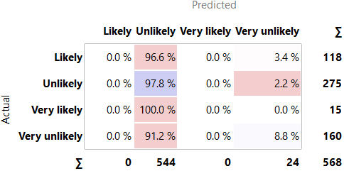
Relations Analysis, Classification / Ex: Logistic Regression
Data: International social survey program (ISSP), 2015, China (http://zacat.gesis.org/webview/)
Software: Orange (https://orange.biolab.si/)

Slide 45
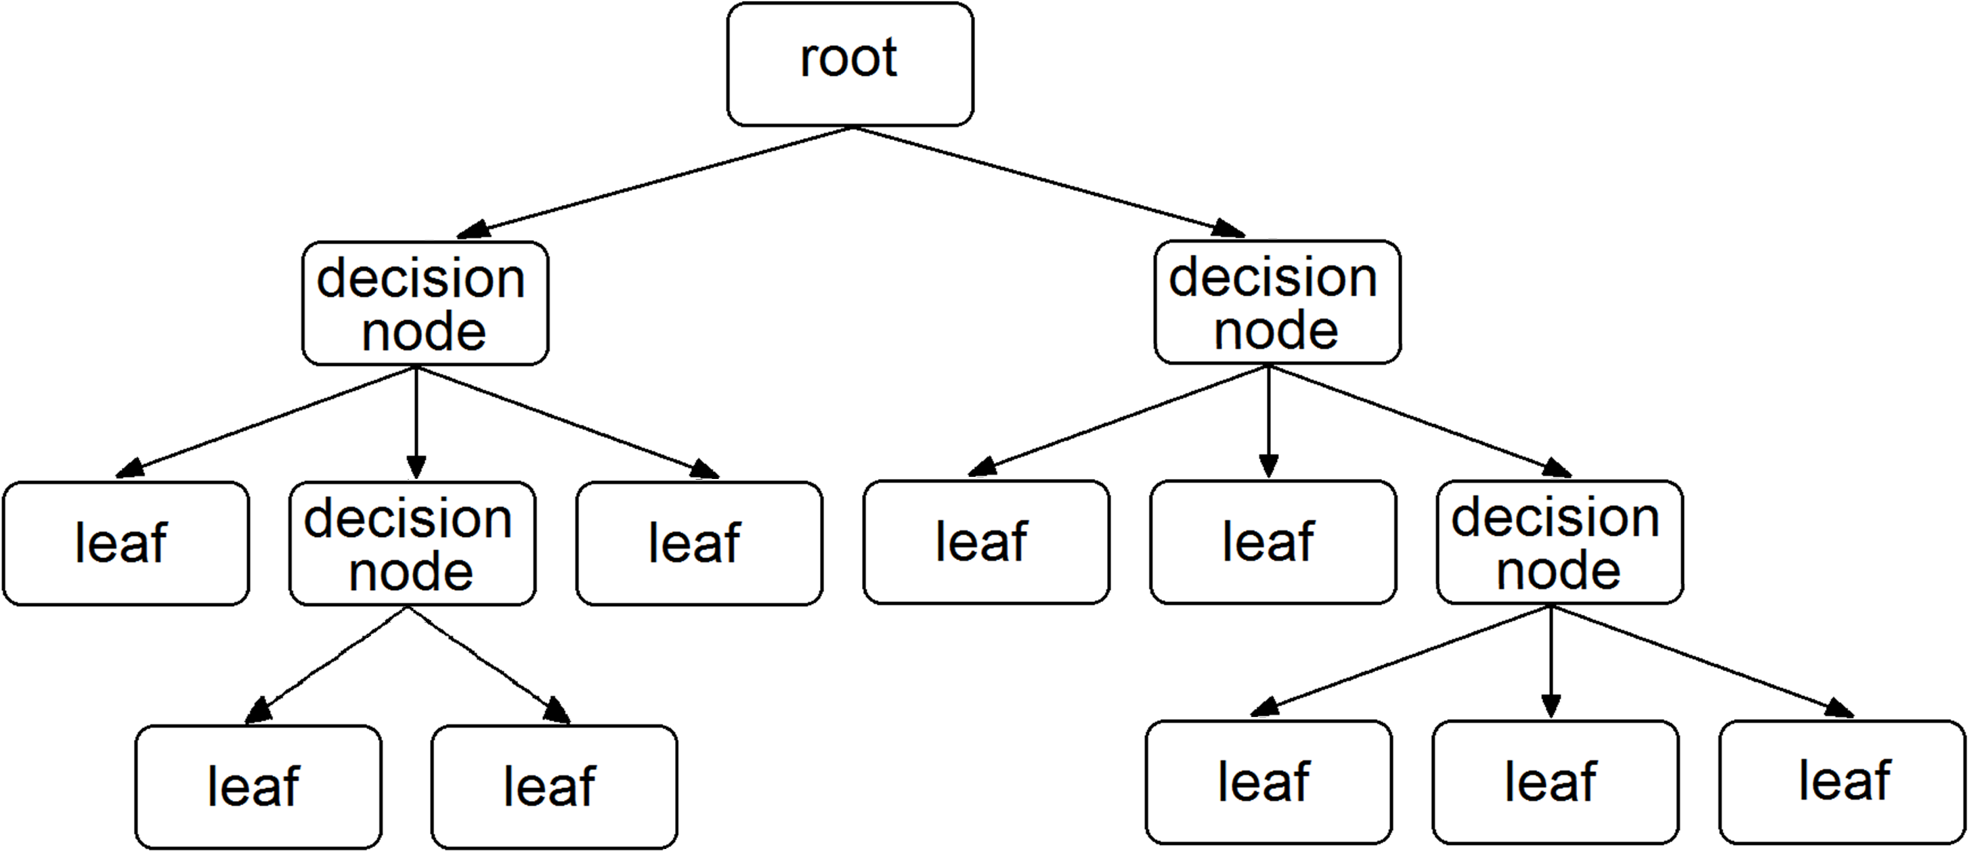
Decision Tree
DT Development
Initialization
Stage 1: Growing
Stage 2: Pruning

Slide 46
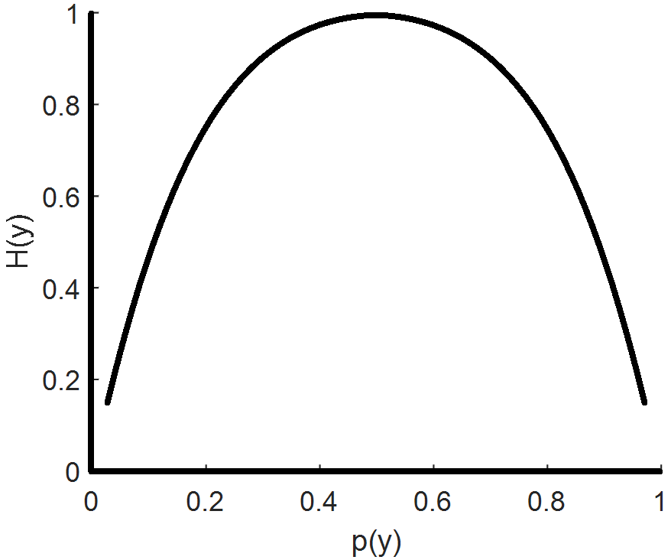
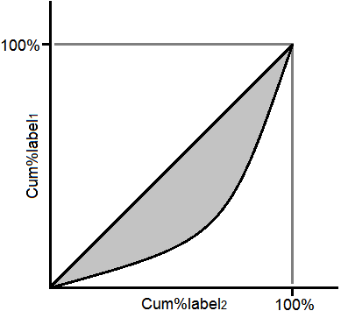
Decision Tree
DT Criteria
Information Gain
/H(y) – Entropy/
Gini
ChiSq
F-ratio
Twoing

Slide 47
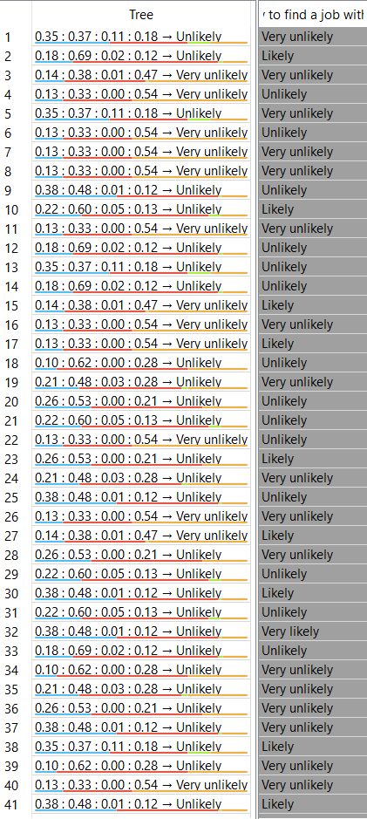
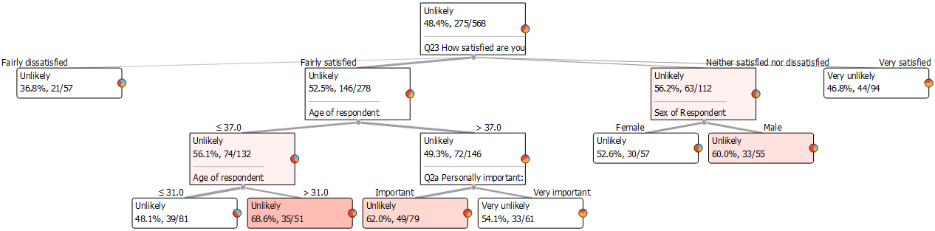
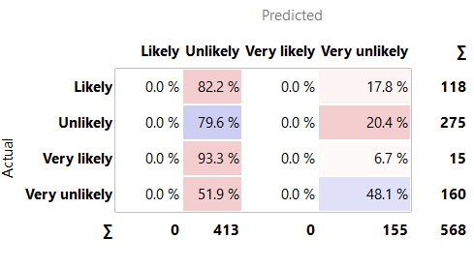
Relations Analysis, Classification / Ex 1: Classification Trees
Data: International social survey program (ISSP), 2015, China (http://zacat.gesis.org/webview/)
Software: Orange (https://orange.biolab.si/)

Slide 48
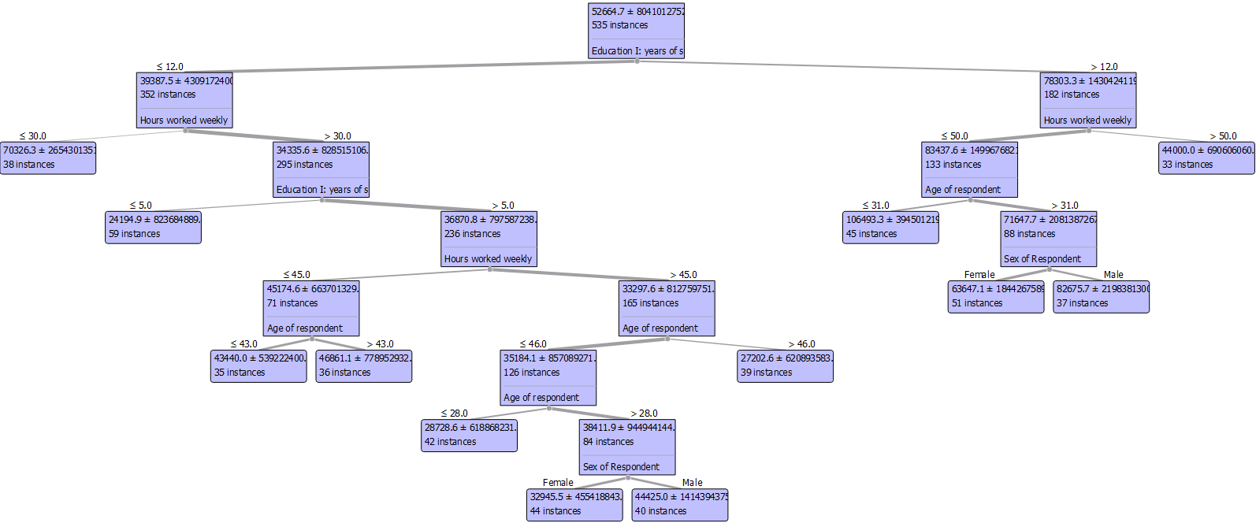
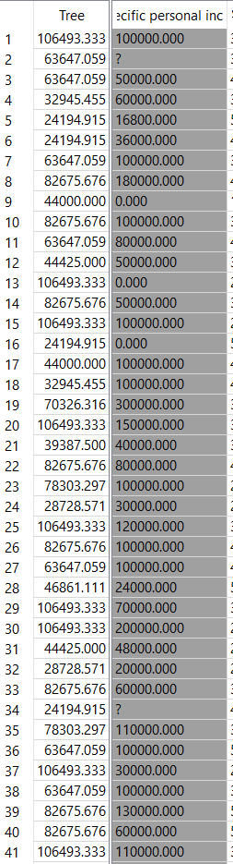
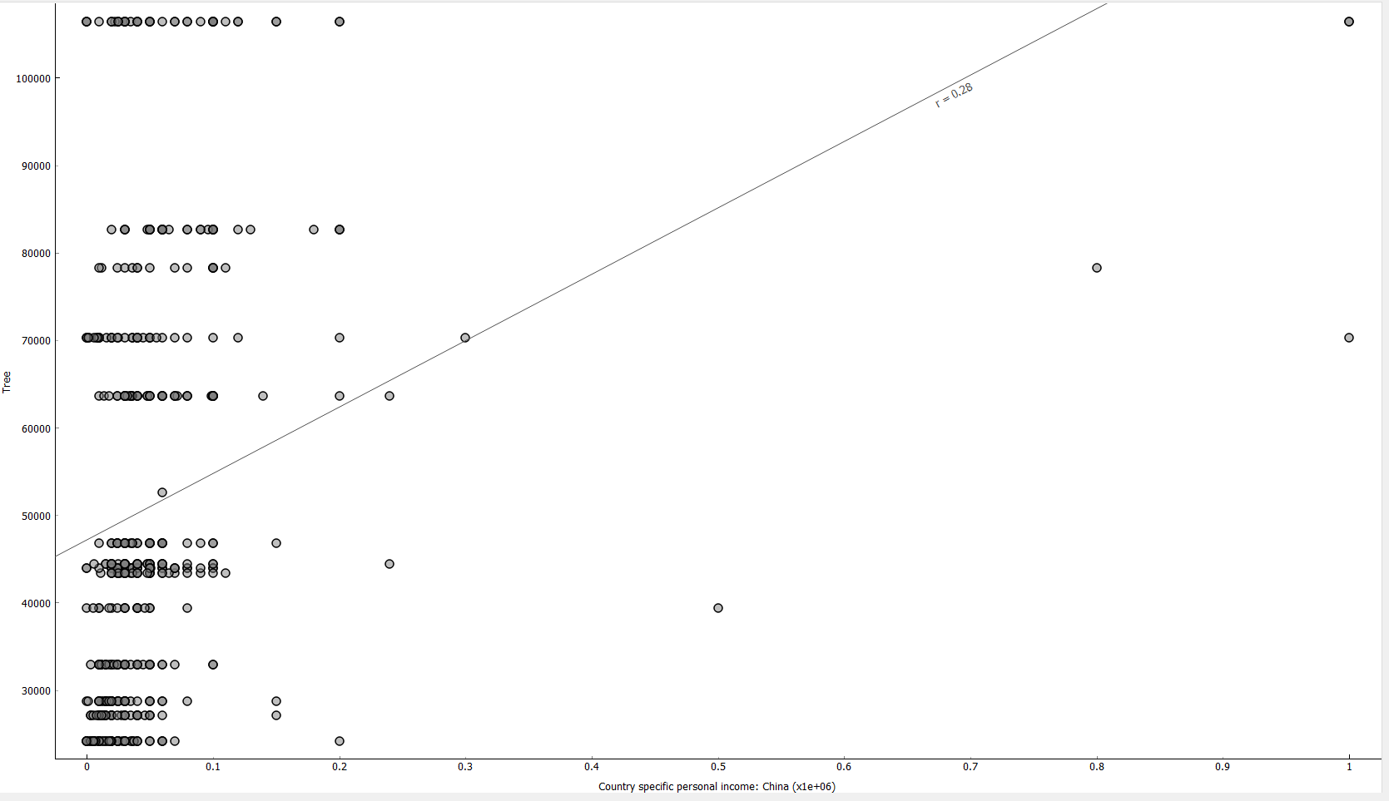
Relations Analysis, Classification / Ex 2: Classification Trees
Data: International social survey program (ISSP), 2015, China (http://zacat.gesis.org/webview/)
Software: Orange (https://orange.biolab.si/)

Slide 49

Research Tasks & Data Structure
And now… let’s see how all these methods work in practice...

Slide 50
THANKS
Contacts:
Kaloyan Haralampiev, Ph.D.
k_haralampiev@phls.uni-sofia.bg
http://kaloyan-haralampiev.info/
Assoc. Prof. of Sofia University “St. Kliment Ohridski”
https://www.uni-sofia.bg/
Alexander Efremov, Ph.D., Eng.
aefremov@gmail.com
https://bg.linkedin.com/in/aefremov
Assoc. Prof. at Technical University of Sofia http://anp.tu-sofia.bg/aefremov/index.htm
Co-founder & Chief Scientist at A4E https://www.a4everyone.com

