Slide 1
Time series analysis
Angel Marchev, Jr.
Kaloyan Haralampiev

Slide 2
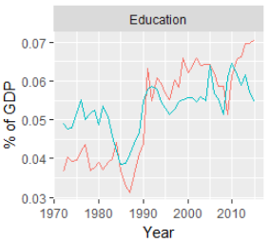
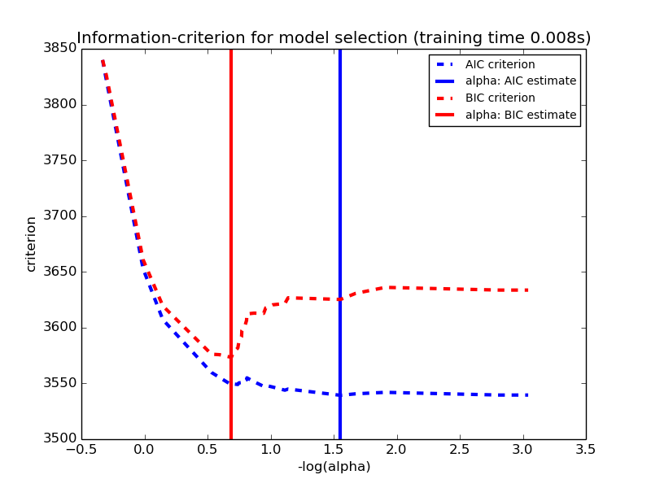
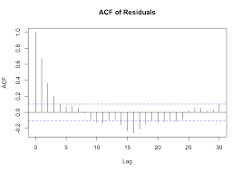
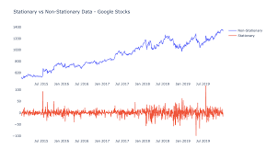
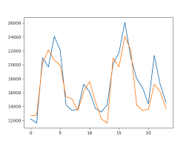
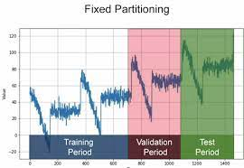
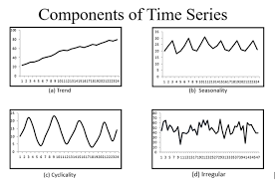
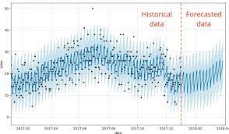
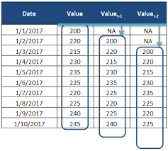
Key topics
Comparability
Stationarity
Components
Autocorrelation
Models
Feature engineering
Optimization
Validation
Forecast

Slide 3
Comparability
Basic
Additional
By territory
By time
By methodology
By prices
By coverage
By measurement units

Slide 4
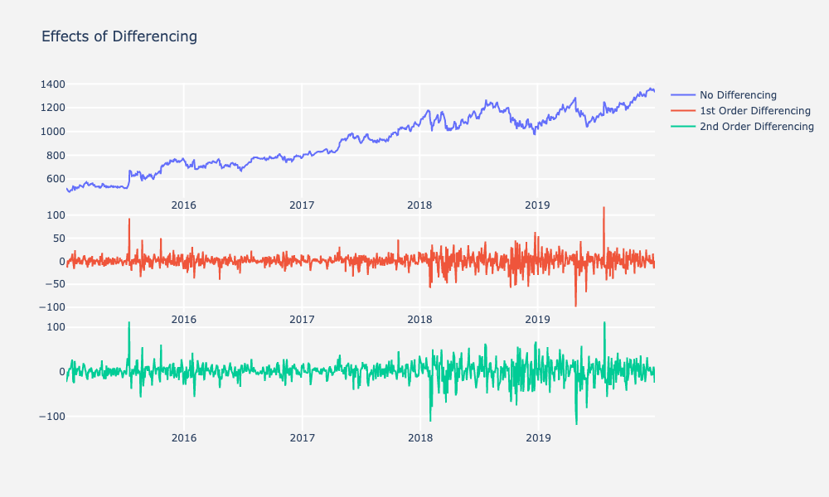
Stationarity
Constant distribution
i.e.
Constant mean
Constant variance
etc…

Slide 5
Components of dynamics
Trend
Cycle
Seasonality
Residuals

Slide 6
Trend

Slide 7
Cycle

Slide 8
Seasonality

Slide 9

Autocorrelation
Autocorrelation function (ACF)
$$R_{y_{t},y_{t−i}}$$
Partial autocorrelation function (PACF)
$$R_{y_{t},y_{t−i}|y_{t−j}}, j<i$$

Slide 10
Main models
Regression
Autoregression
Mixed models of regression and autoregression

Slide 11

Regression models
$${\hat{y}}_{t}=f(t)$$
$${\hat{y}}_{t}=f(t,x)$$

Slide 12

Autoregression models
$${\hat{y}}_{t}=f\left(y_{t−i}\right)$$
$${\hat{y}}_{t}=f\left(y_{t−i}, x_{t−j}\right)$$

Slide 13

Mixed models of regression and autoregression
$${\hat{y}}_{t}=f({t,y}_{t−i}, x_{t−j})$$

Slide 14
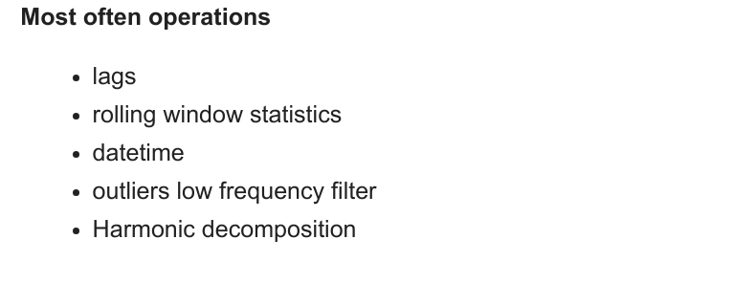
Feature engineering

Slide 15
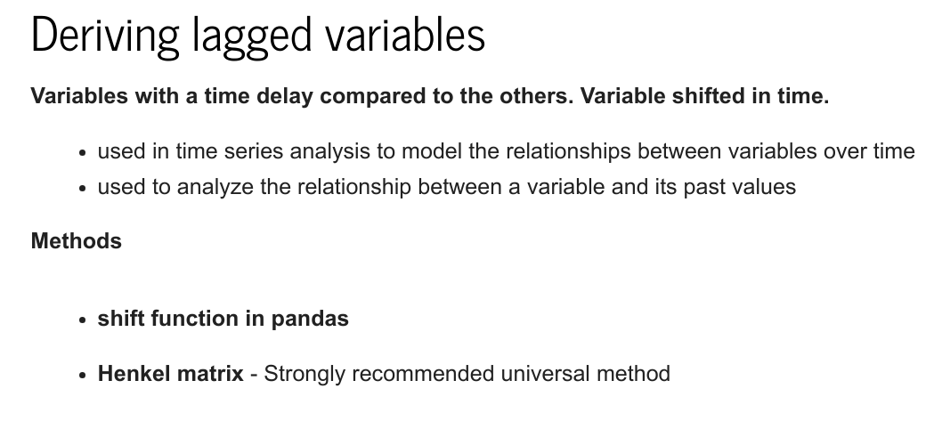

Slide 16
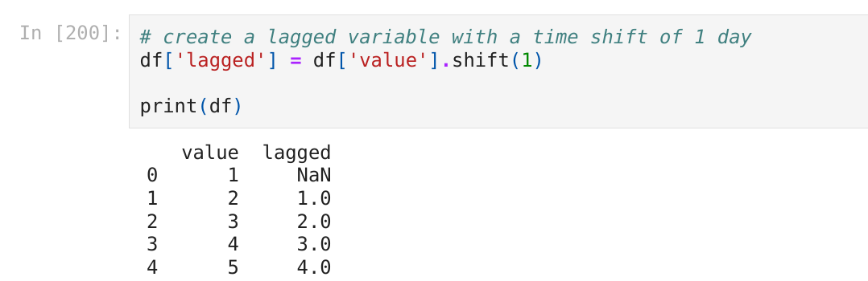
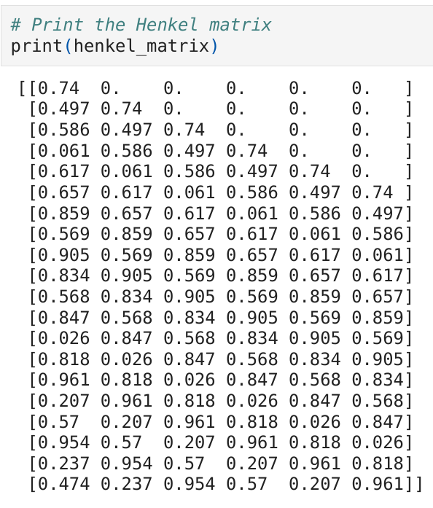
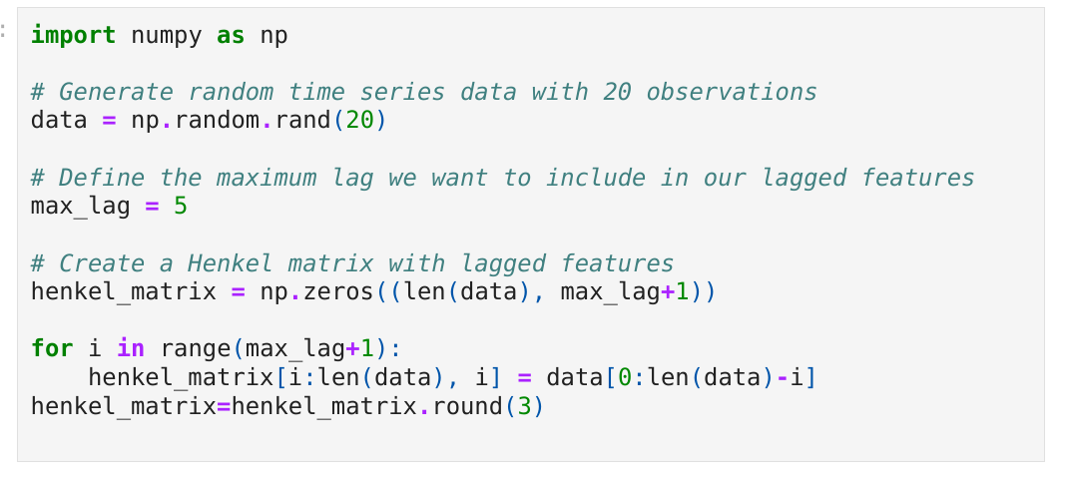

Slide 17
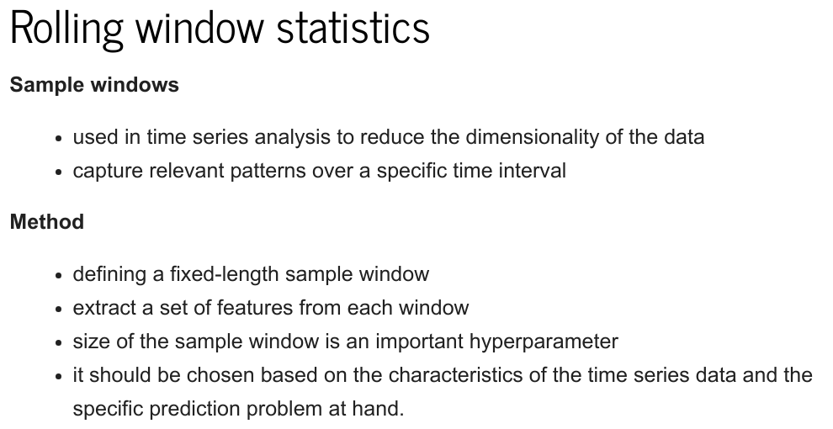

Slide 18
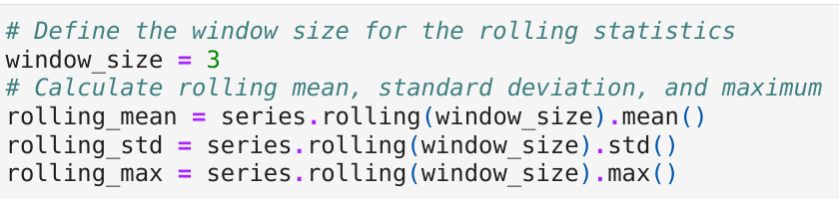
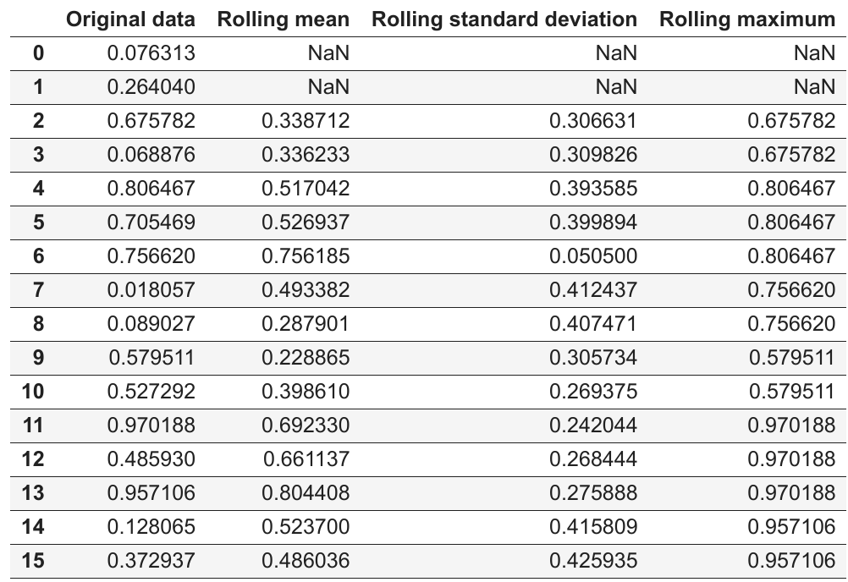

Slide 19
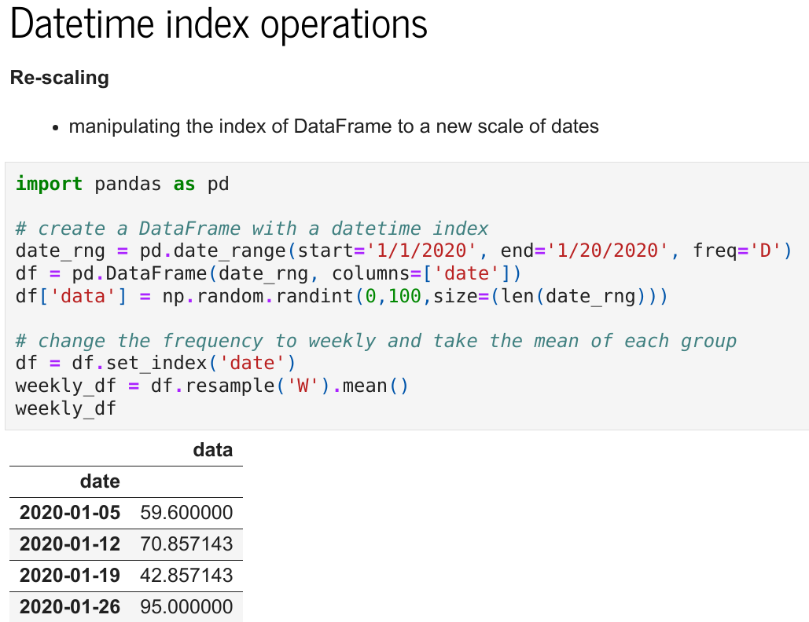

Slide 20
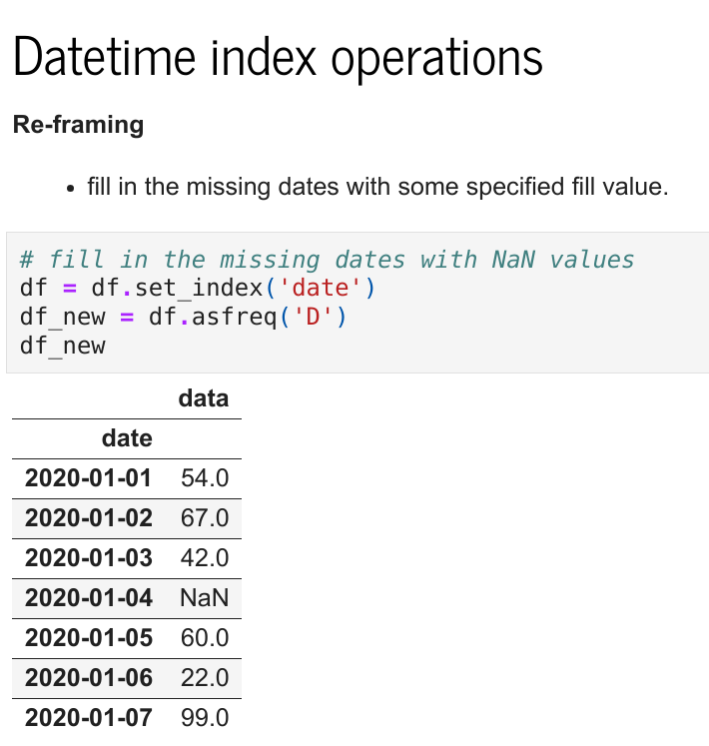

Slide 21
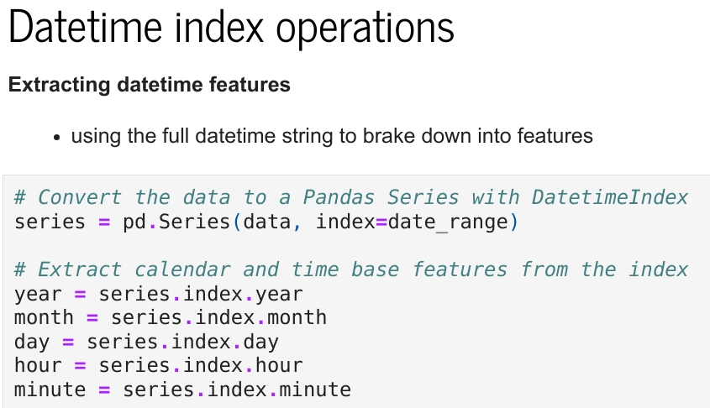
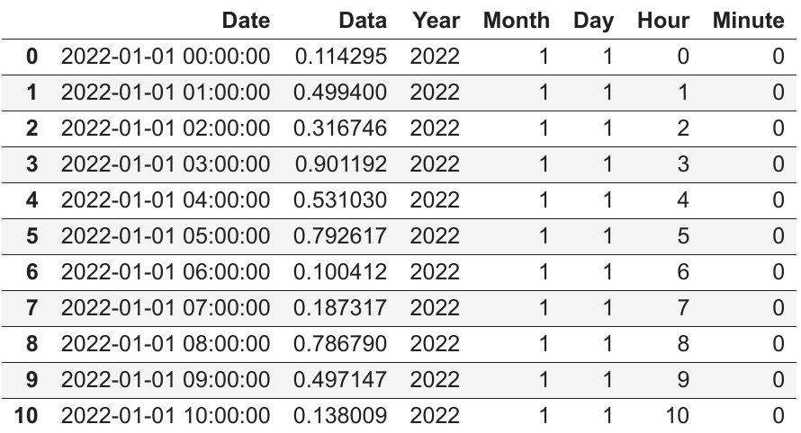

Slide 22
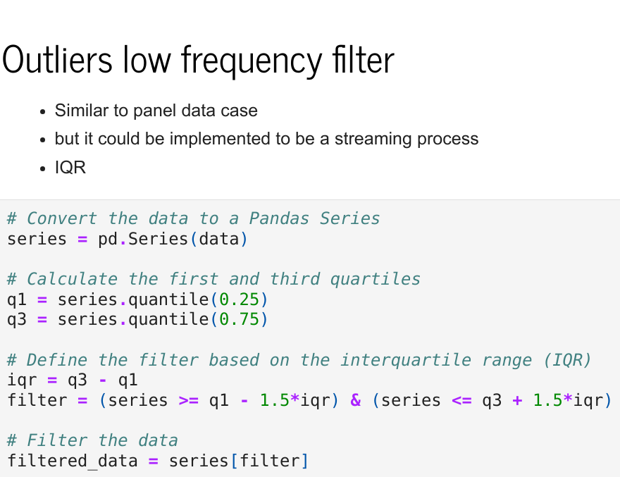
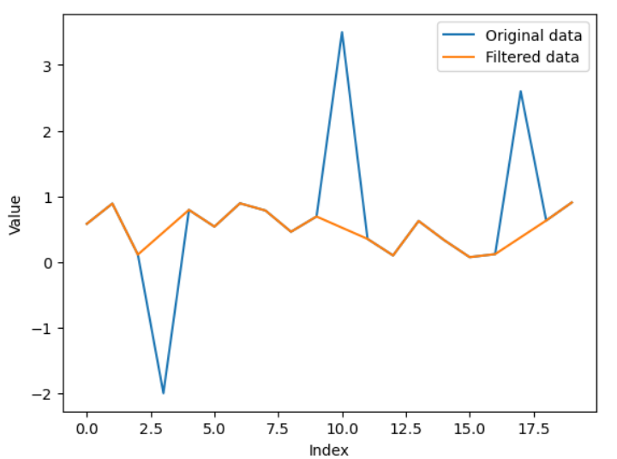

Slide 23
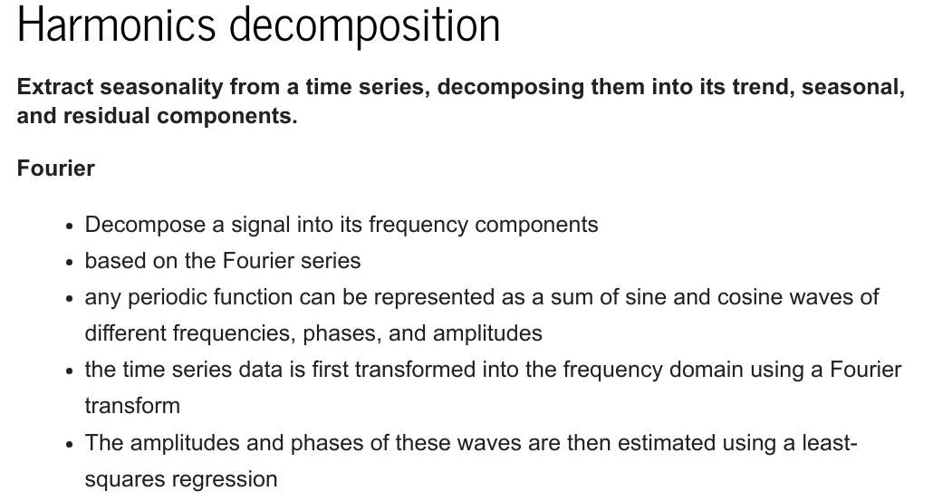

Slide 24
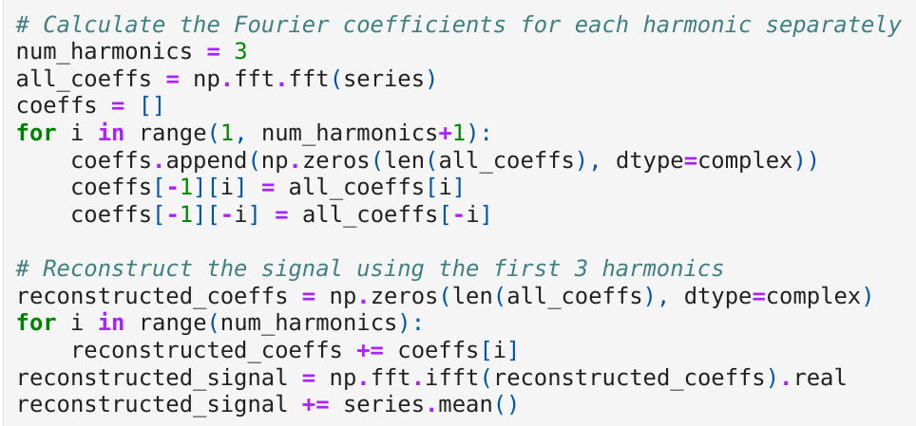
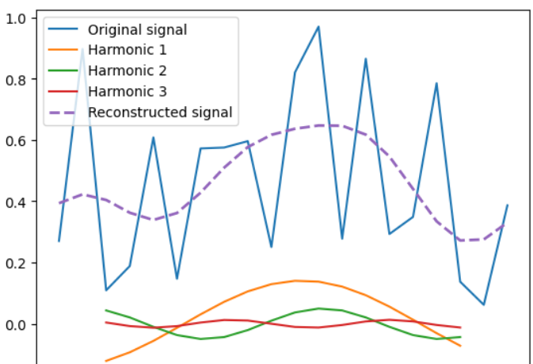

Slide 25
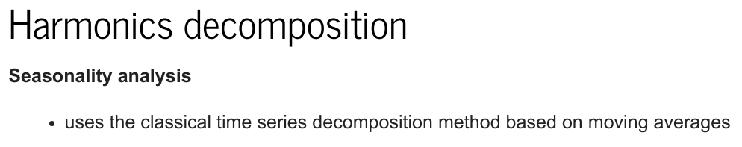
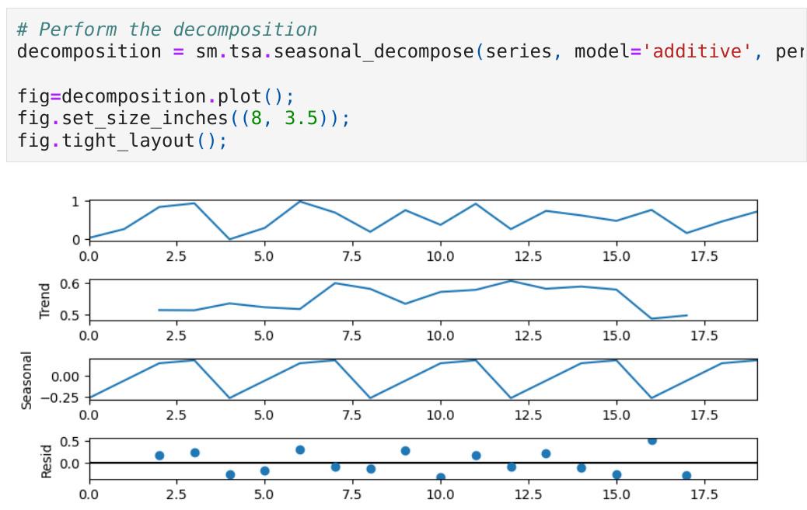

Slide 26
Approaches for estimation of coefficients
Analytical
Ordinary least squares (OLS)
Maximum likelihood (ML)
Bayesian
Iterative…
but…
All of these are in fact optimization

Slide 27
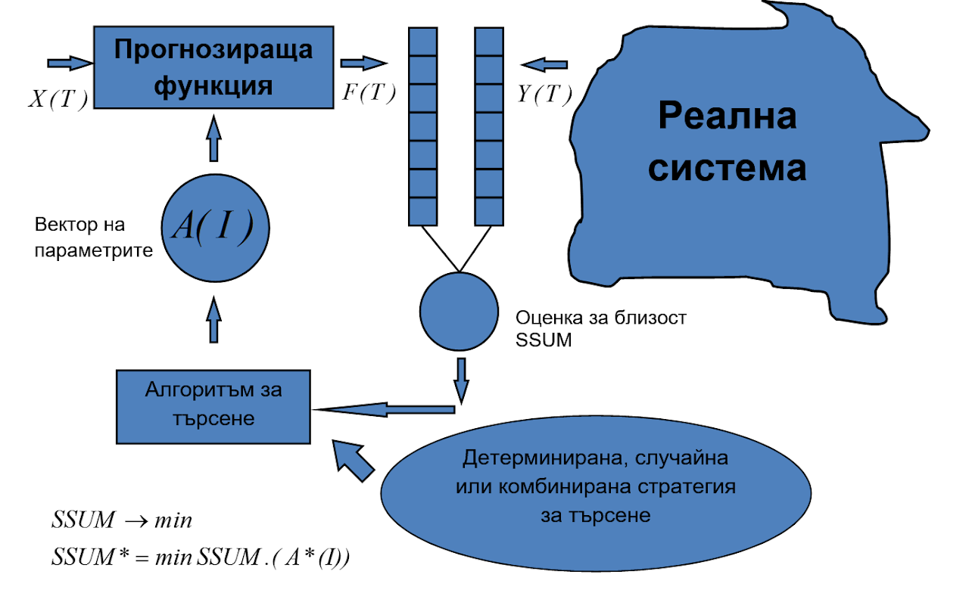
Optimization

Slide 28
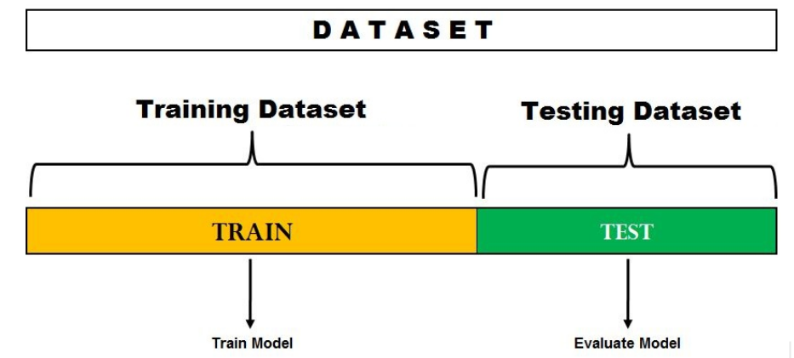
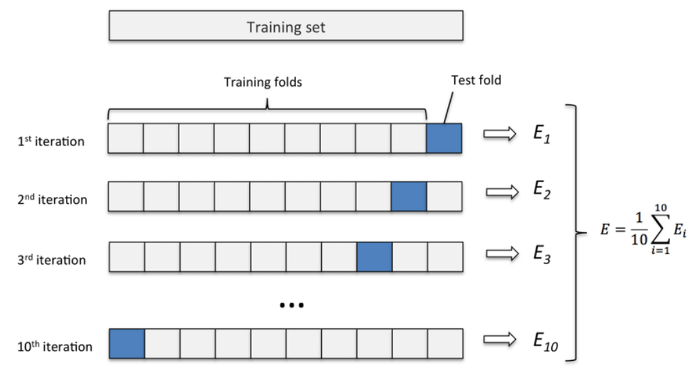
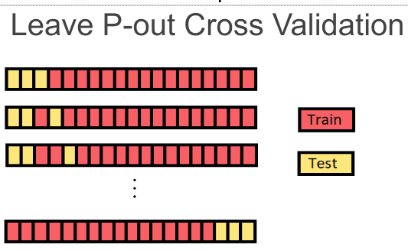
Validation
Split sample validation
Training set
Test set
Validation subset/method

Slide 29
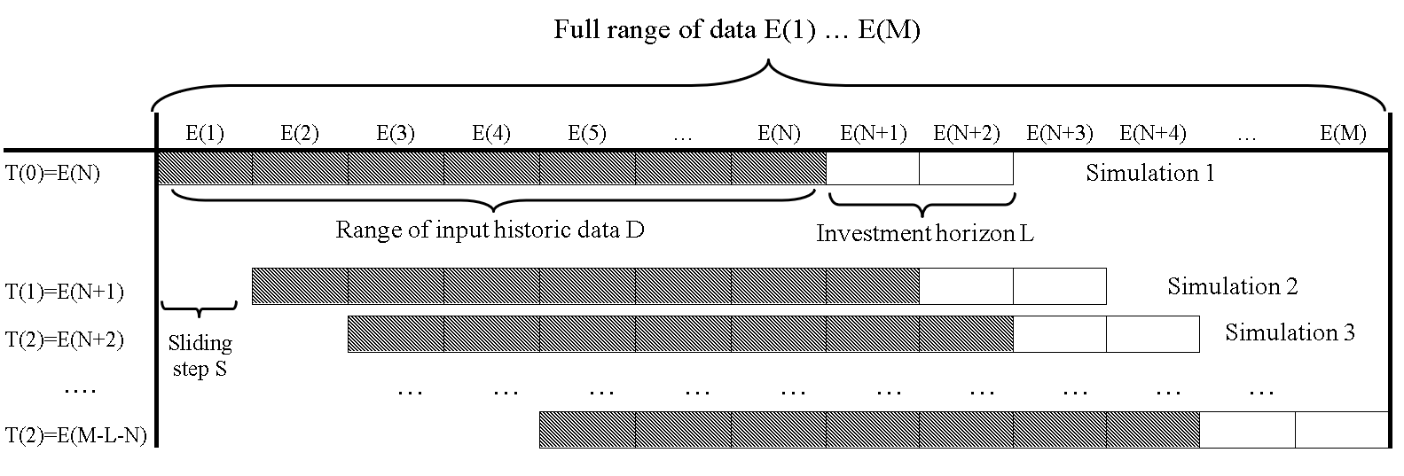
Validation
Validation with moving window

Slide 30
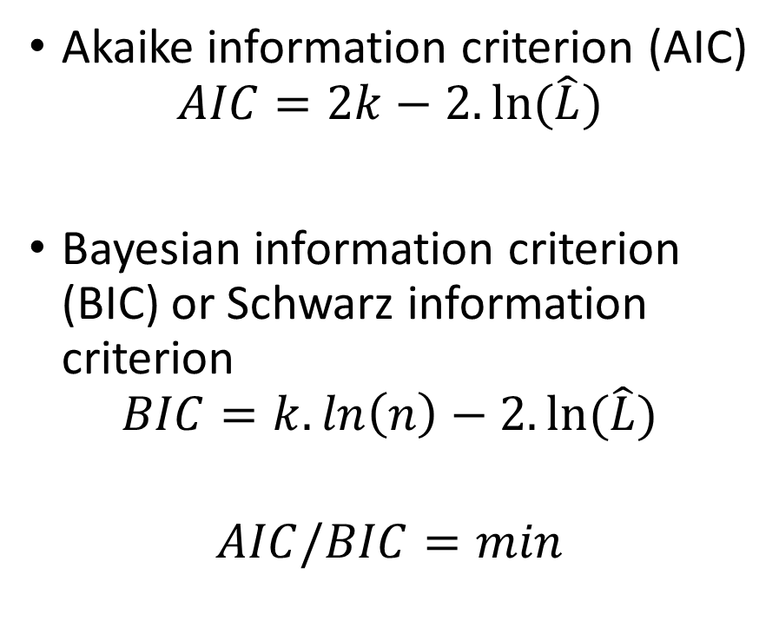
Overfitting
Akaike information criterion (AIC)
$$AIC=2k−2.ln⁡(\hat{L})$$
Bayesian information criterion (BIC) or Schwarz information criterion
$$BIC=k.ln\left(n\right)−2.ln⁡(\hat{L})$$
$$AIC/BIC=min$$

Slide 31
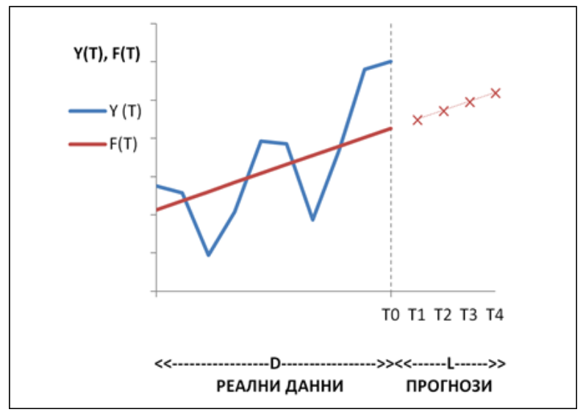
Forecasts
Extrapolation/interpolation
Analytical forecasts
Target forecasts

Slide 32
Forecast horizon
Short term, medium term, long term
Depending of time series length

Slide 33
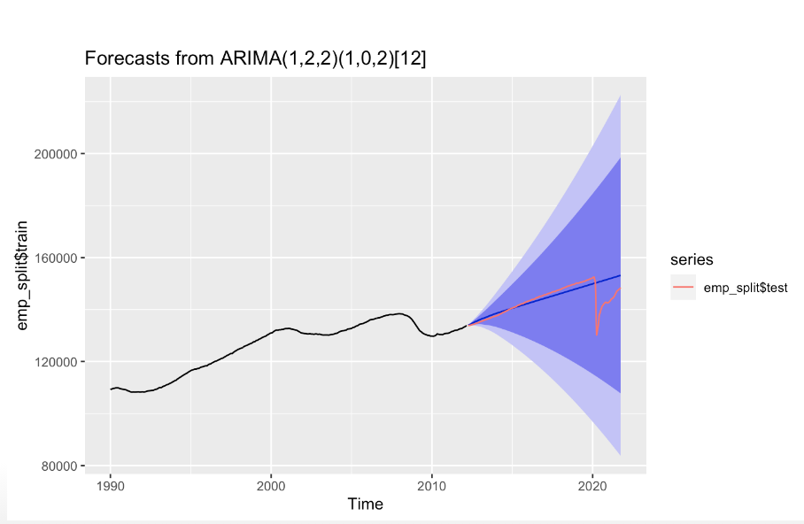
Confidence interval of forecast

Slide 34
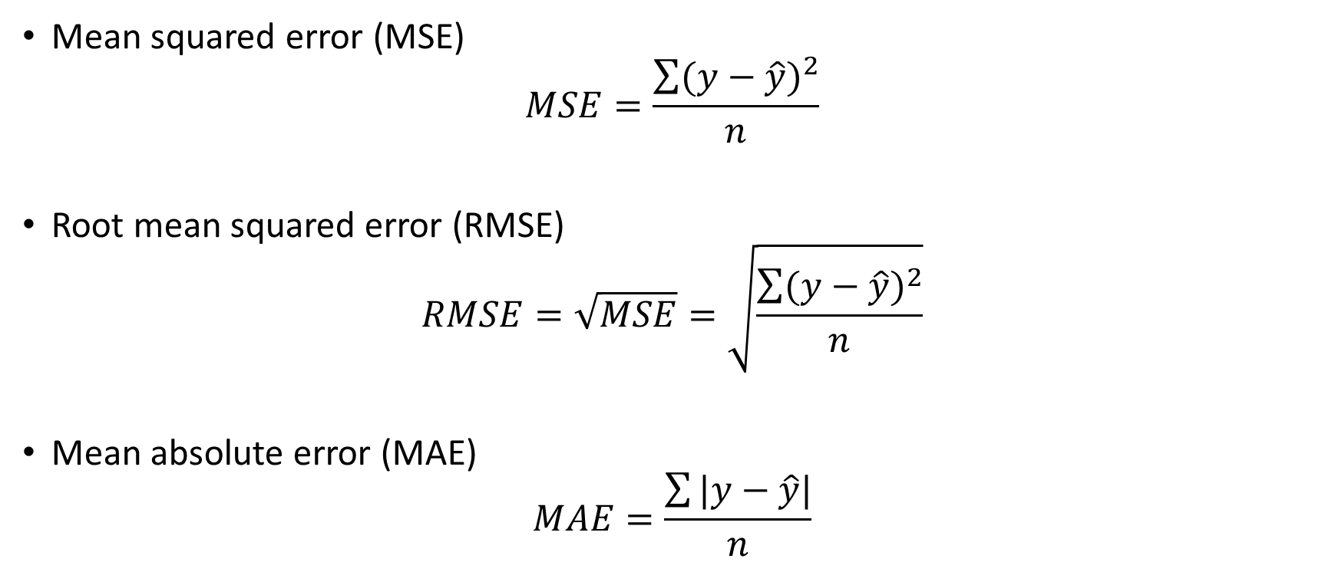
Evaluation of forecast
Mean squared error (MSE)
$$MSE=\frac{\sum{{(y−\hat{y})}^{2}}}{n}$$
Root mean squared error (RMSE)
$$RMSE=\sqrt{MSE}=\sqrt{\frac{\sum{{(y−\hat{y})}^{2}}}{n}}$$
Mean absolute error (MAE)
$$MAE=\frac{\sum{|y−\hat{y}|}}{n}$$

Slide 35
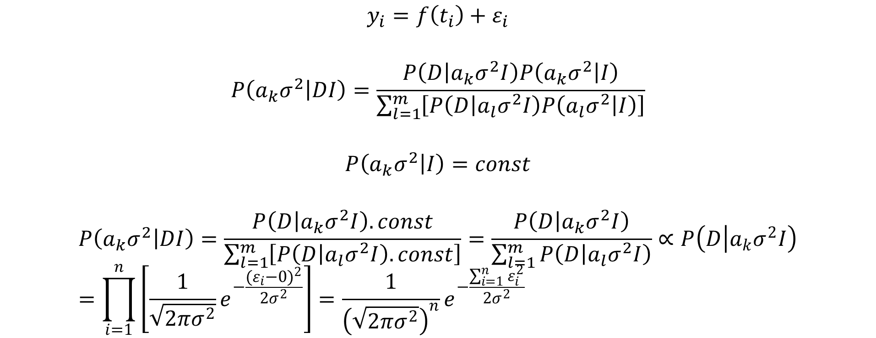
Bayesian estimation of model coefficients
$$y_{i}=f\left(t_{i}\right)+ε_{i}$$
$$P\left(a_{k}σ^{2} | DI\right)=\frac{P\left(D | a_{k}σ^{2}I\right)P\left(a_{k}σ^{2} | I\right)}{\sum_{l=1}^{m}{\left[P\left(D | a_{l}σ^{2}I\right)P\left(a_{l}σ^{2} | I\right)\right]}}$$
$$P\left(a_{k}σ^{2} | I\right)=const$$
$$P\left(a_{k}σ^{2} | DI\right)=\frac{P\left(D | a_{k}σ^{2}I\right).const}{\sum_{l=1}^{m}{\left[P\left(D | a_{l}σ^{2}I\right).const\right]}}=\frac{P\left(D | a_{k}σ^{2}I\right)}{\sum_{l=1}^{m}{P\left(D | a_{l}σ^{2}I\right)}}∝P\left(D | a_{k}σ^{2}I\right)=\prod_{i=1}^{n}{\left[\frac{1}{\sqrt{2πσ^{2}}}e^{−\frac{{(ε_{i}−0)}^{2}}{2σ^{2}}}\right]}=\frac{1}{{\left(\sqrt{2πσ^{2}}\right)}^{n}}e^{−\frac{\sum_{i=1}^{n}{ε_{i}^{2}}}{2σ^{2}}}$$

Slide 36

Bayesian estimation of model coefficients
$$P\left(a_{k}σ^{2} | DI\right)=max→P\left(D | a_{k}σ^{2}I\right)=max$$
$$\left|\begin{aligned}\frac{dP\left(D | a_{k}σ^{2}I\right)}{da_{k}}=0 \\ \frac{dP\left(D | a_{k}σ^{2}I\right)}{dσ^{2}}=0\end{aligned}\right.$$
$$\left|\begin{aligned}\sum_{i=1}^{n}{\left[y_{i}\frac{df\left(t_{i}\right)}{da_{k}}\right]}=\sum_{i=1}^{n}{\left[f\left(t_{i}\right)\frac{df\left(t_{i}\right)}{da_{k}}\right]} \\ σ^{2}=\frac{\sum_{i=1}^{n}{ε_{i}^{2}}}{n}\end{aligned}\right.$$

Slide 37
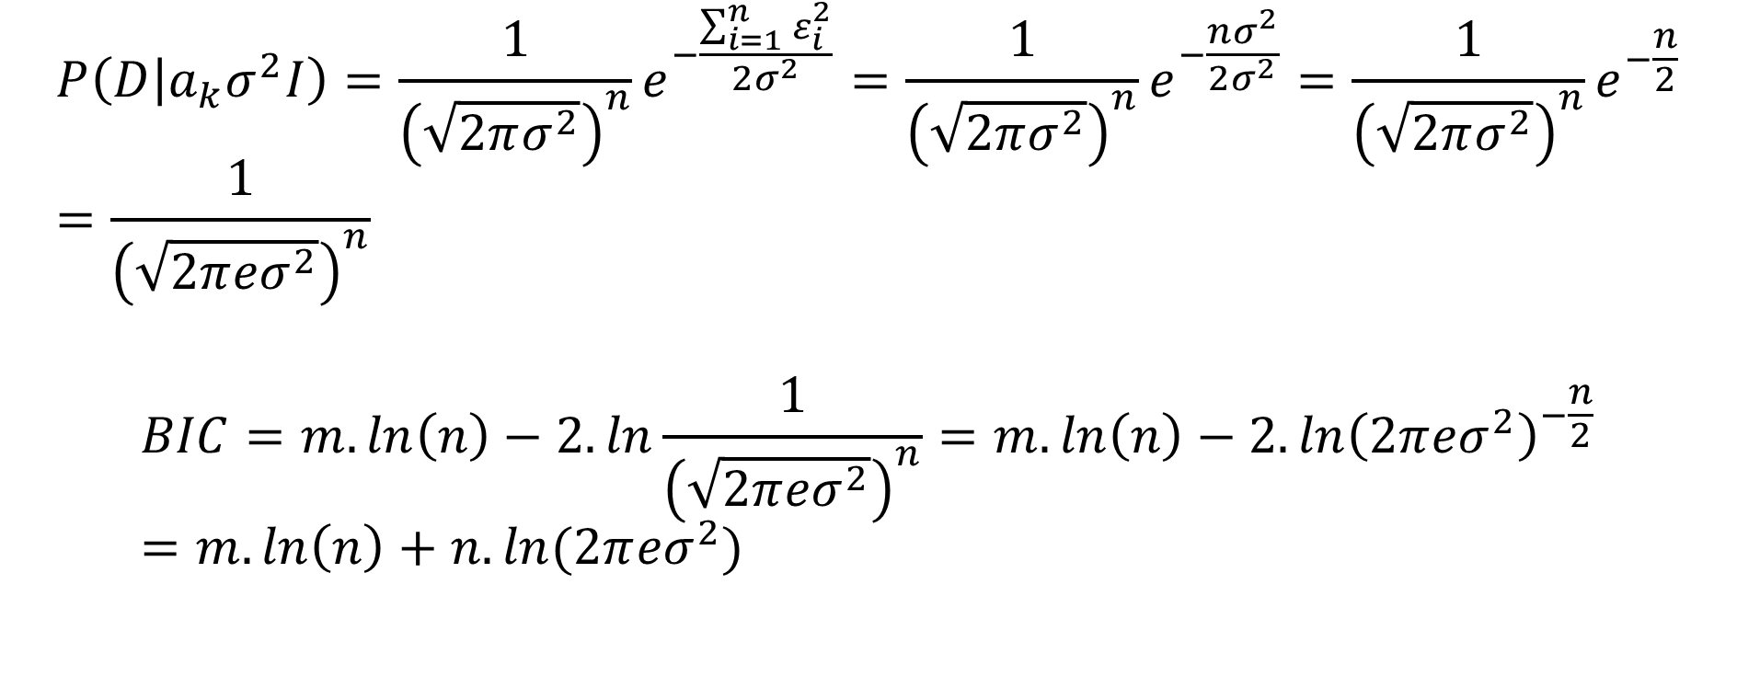
Bayesian estimation of model coefficients
$$P\left(D | a_{k}σ^{2}I\right)=\frac{1}{{\left(\sqrt{2πσ^{2}}\right)}^{n}}e^{−\frac{\sum_{i=1}^{n}{ε_{i}^{2}}}{2σ^{2}}}=\frac{1}{{\left(\sqrt{2πσ^{2}}\right)}^{n}}e^{−\frac{nσ^{2}}{2σ^{2}}}=\frac{1}{{\left(\sqrt{2πσ^{2}}\right)}^{n}}e^{−\frac{n}{2}}=\frac{1}{{\left(\sqrt{2π{eσ}^{2}}\right)}^{n}}$$
$$BIC=m.\ln\left(n\right)−2.ln\frac{1}{{\left(\sqrt{2π{eσ}^{2}}\right)}^{n}}=m.\ln\left(n\right)−2.ln{\left(2π{eσ}^{2}\right)}^{−\frac{n}{2}}=m.\ln\left(n\right)+n.ln(2π{eσ}^{2})$$

Slide 38
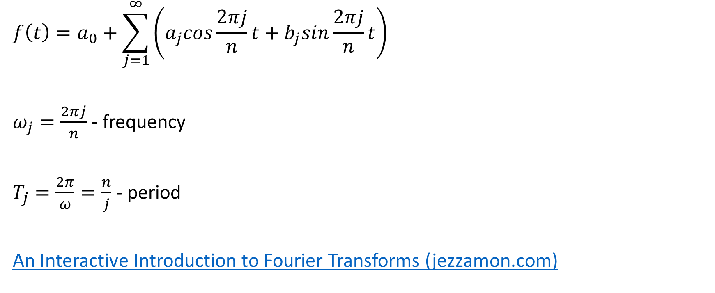
Periodogram analysis
$$f\left(t\right)=a_{0}+\sum_{j=1}^{∞}{\left(a_{j}cos\frac{2πj}{n}t+b_{j}sin\frac{2πj}{n}t\right)}$$
$ω_{j}=\frac{2πj}{n}$ - frequency
$T_{j}=\frac{2π}{ω}=\frac{n}{j}$ - period
An Interactive Introduction to Fourier Transforms (jezzamon.com)

Slide 39
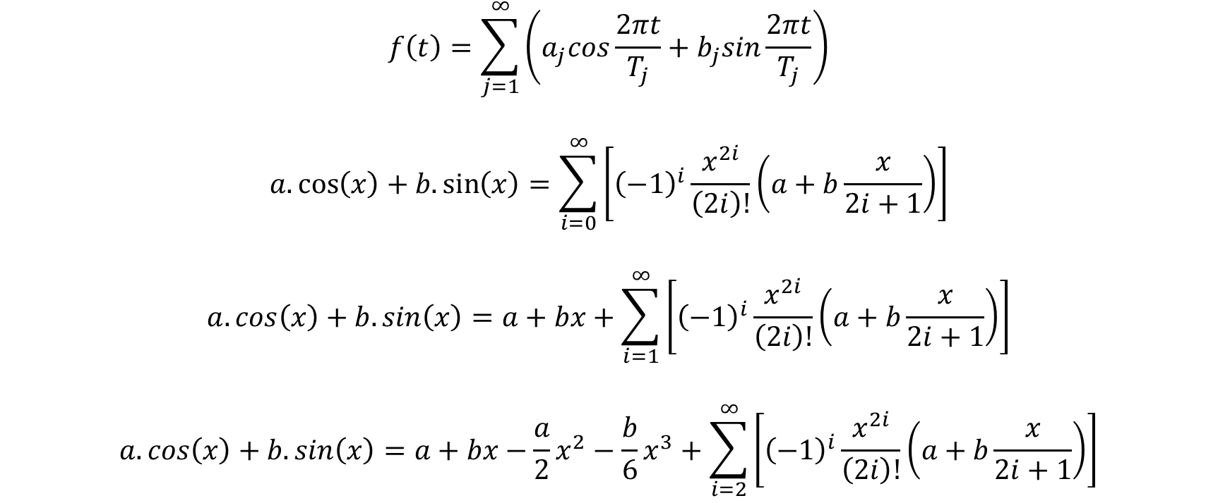
Bayesian periodogram analysis
$$f\left(t\right)=\sum_{j=1}^{∞}{\left(a_{j}cos\frac{2πt}{T_{j}}+b_{j}sin\frac{2πt}{T_{j}}\right)}$$
$$a.\cos\left(x\right)+b.\sin\left(x\right)=\sum_{i=0}^{∞}{\left[{\left(−1\right)}^{i}\frac{x^{2i}}{\left(2i\right)!}\left(a+b\frac{x}{2i+1}\right)\right]}$$
$$a.\cos\left(x\right)+b.\sin\left(x\right)=a+bx+\sum_{i=1}^{∞}{\left[{\left(−1\right)}^{i}\frac{x^{2i}}{\left(2i\right)!}\left(a+b\frac{x}{2i+1}\right)\right]}$$
$$a.\cos\left(x\right)+b.\sin\left(x\right)=a+bx−\frac{a}{2}x^{2}−\frac{b}{6}x^{3}+\sum_{i=2}^{∞}{\left[{\left(−1\right)}^{i}\frac{x^{2i}}{\left(2i\right)!}\left(a+b\frac{x}{2i+1}\right)\right]}$$

Slide 40
Approximation of linear function

Slide 41
Approximation of quadratic function

Slide 42
Approximation of cubic function

Slide 43
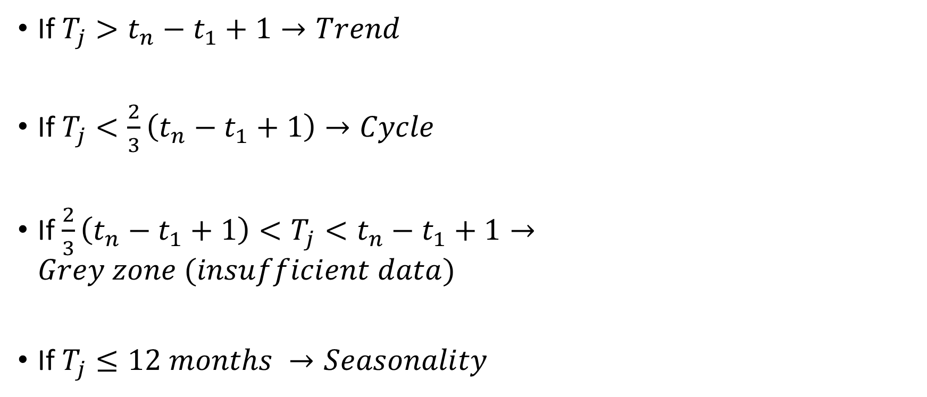
Components of dynamics
If $T_{j}>t_{n}−t_{1}+1→Trend$
If $T_{j}<\frac{2}{3}\left(t_{n}−t_{1}+1\right)→Cycle$
If$\frac{2}{3}\left(t_{n}−t_{1}+1\right)<T_{j}<t_{n}−t_{1}+1→Grey zone (insufficient data)$
If $T_{j}≤12 months →Seasonality$

Slide 44
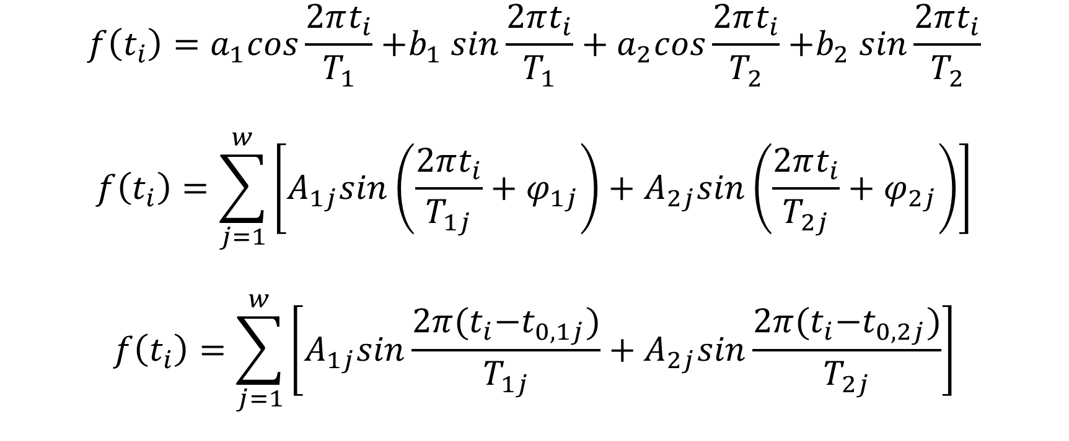
Bayesian periodogram analysis
$$f\left(t_{i}\right)=a_{1}cos\frac{2πt_{i}}{T_{1}}{+b}_{1}sin\frac{2πt_{i}}{T_{1}}+a_{2}cos\frac{2πt_{i}}{T_{2}}{+b}_{2}sin\frac{2πt_{i}}{T_{2}}$$
$$f\left(t_{i}\right)=\sum_{j=1}^{w}{\left[A_{1j}sin\left(\frac{2πt_{i}}{T_{1j}}+φ_{1j}\right)+A_{2j}sin\left(\frac{2πt_{i}}{T_{2j}}+φ_{2j}\right)\right]}$$
$$f\left(t_{i}\right)=\sum_{j=1}^{w}{\left[A_{1j}sin\frac{2π{(t}_{i}−t_{0,1j})}{T_{1j}}+A_{2j}sin\frac{2π{(t}_{i}−t_{0,2j})}{T_{2j}}\right]}$$

Slide 45

Confidence intervals of forecast
$$P\left({\hat{f}}_{i} | f_{i}I\right)=\frac{C_{{\hat{f}}_{1}}^{f_{1}}C_{{\hat{f}}_{2}}^{f_{2}}…C_{{\hat{f}}_{m}}^{f_{m}}}{C_{N+m−1}^{N−n}}$$
$$N=n+1$$
$${\hat{f}}_{k}=f_{k}+1$$
$${\hat{f}}_{i}=f_{i};i≠k$$
$$P\left({\hat{f}}_{i} | f_{i}I\right)=\frac{C_{f_{1}}^{f_{1}}C_{f_{2}}^{f_{2}}…C_{f_{k}+1}^{f_{k}}{…C}_{f_{m}}^{f_{m}}}{C_{n+1+m−1}^{n+1−n}}=\frac{C_{f_{k}+1}^{f_{k}}}{C_{n+m}^{1}}=\frac{f_{k}+1}{n+m}$$

Slide 46

Confidence intervals of forecast
$$\frac{f_{2}+1}{n+3}=P$$
$$f_{2}=P\left(n+3\right)−1$$
$$\frac{f_{1,3}+1}{n+3}=\frac{1−P}{2}$$
$$f_{1,3}=\frac{1−P}{2}\left(n+3\right)−1$$

Slide 47

Confidence intervals of forecast
$$ε_{{[f}_{1}]}≤ε_{LL}≤ε_{{[f}_{1}]+1}$$
$$ε_{LL}=ε_{{[f}_{1}]}+\left(ε_{{[f}_{1}]+1}−ε_{{[f}_{1}]}\right)\left({f_{1}−[f}_{1}]\right)$$
$$y_{n+i,LL}=f\left(t_{n+i}\right)+ε_{LL}$$
$$ε_{n−{[f}_{3}]}≤ε_{UL}≤ε_{n−{[f}_{3}]+1}$$
$$ε_{UL}=ε_{n−{[f}_{3}]+1}−\left(ε_{n−{[f}_{3}]+1}−ε_{n−{[f}_{3}]}\right)\left({f_{3}−[f}_{3}]\right)$$
$$y_{n+i,UL}=f\left(t_{n+i}\right)+ε_{UL}$$

Slide 48
References
Атанасов, А. 2018. Статистически методи за анализ на динамични редове. София: Издателски комплекс – УНСС
Величкова, Н. 1981. Статистически методи за изучаване и прогнозиране развитието на социално-икономическите явления. София: „Наука и изкуство“
Харалампиев, К. Бейсовски подход за оценка на хармонични колебания с променлива амплитуда. Научна конференция с международно участие „Авангардни научни инструменти в управлението”, Равда, 2014
Bretthorst, G., 1988. Bayesian Spectrum Analysis and Parameter Estimation. Berlin, Heidelberg: Springer-Verlag
Schwarz, G. 1978. Estimating the Dimension of a Model. The Annals of Statistics, Vol. 6, No. 2, 461-464
Stone, M. 1977. An Asymptotic Equivalence of Choice of Model by Cross-Validation and Akaike’s Criterion. Journal of the Royal Statistical Society. Series B (Methodological) , 1977, Vol. 39, No. 1 (1977), pp. 44-47
Stone, M. 1979. Comments on Model Selection Criteria of Akaike and Schwarz. Journal of the Royal Statistical Society. Series B (Methodological) , 1979, Vol. 41, No. 2 (1979), pp. 276-278

