Slide 1
Bayesian periodogram analysis

Slide 2
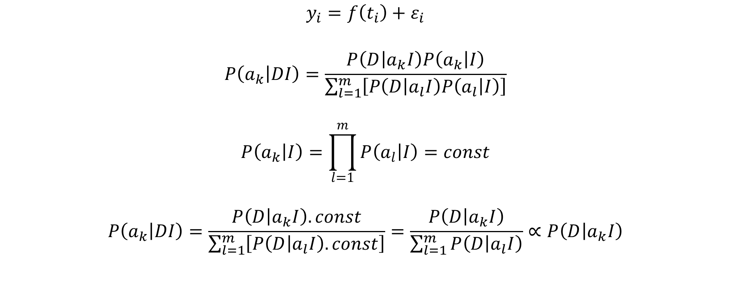
Bayesian estimation of model coefficients

Slide 3
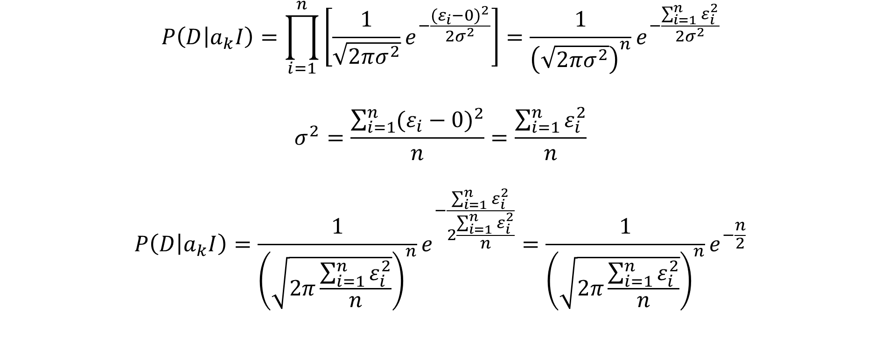
Bayesian estimation of model coefficients

Slide 4
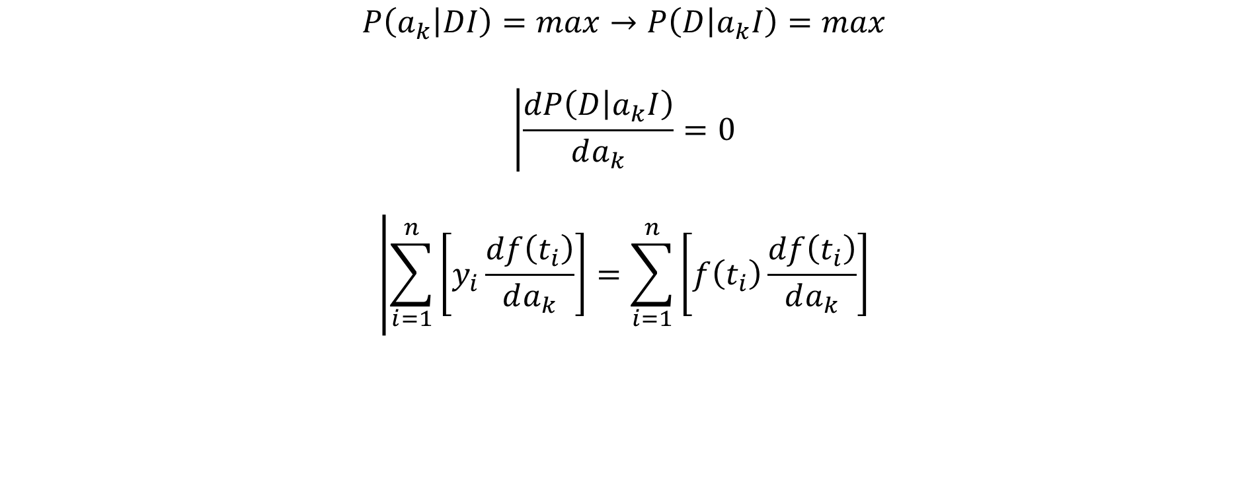
Bayesian estimation of model coefficients

Slide 5
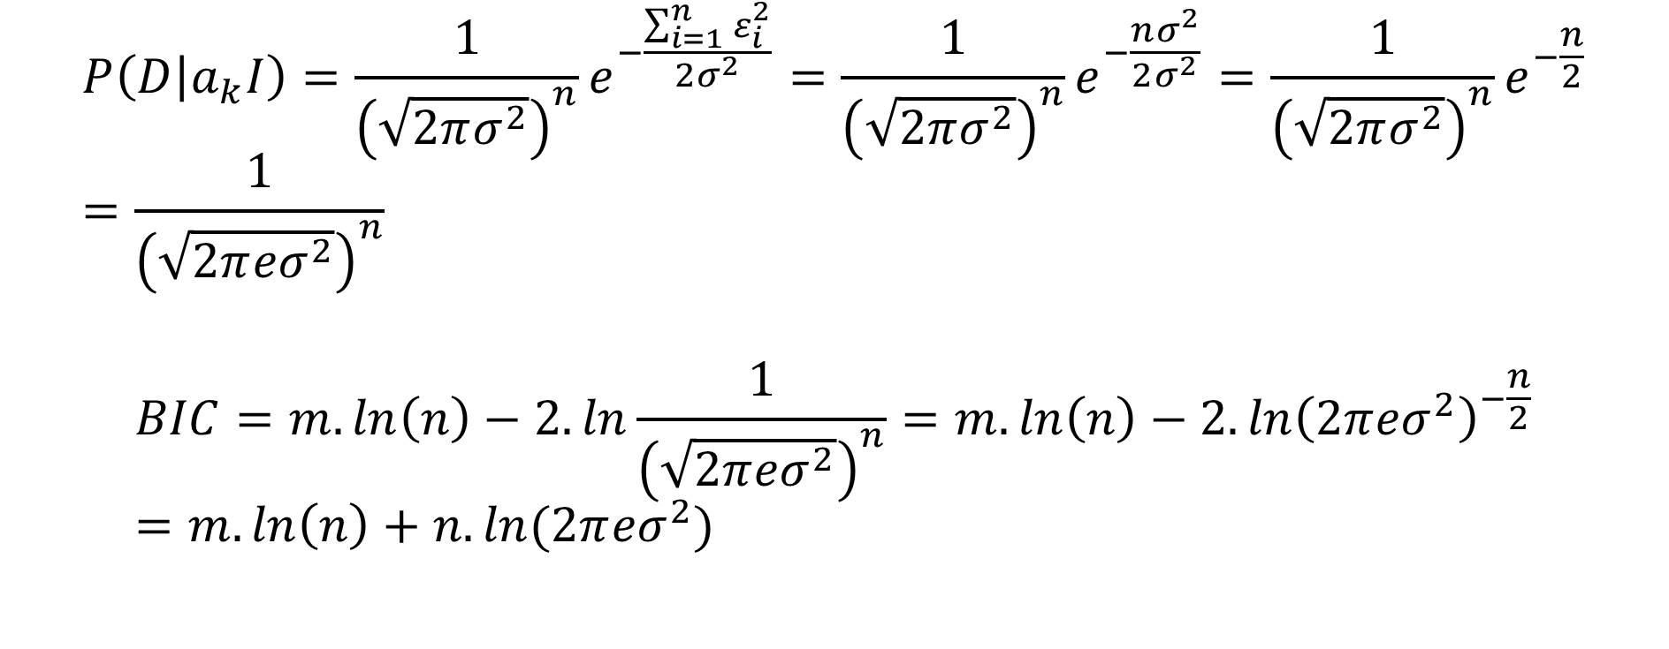
Bayesian estimation of model coefficients

Slide 6
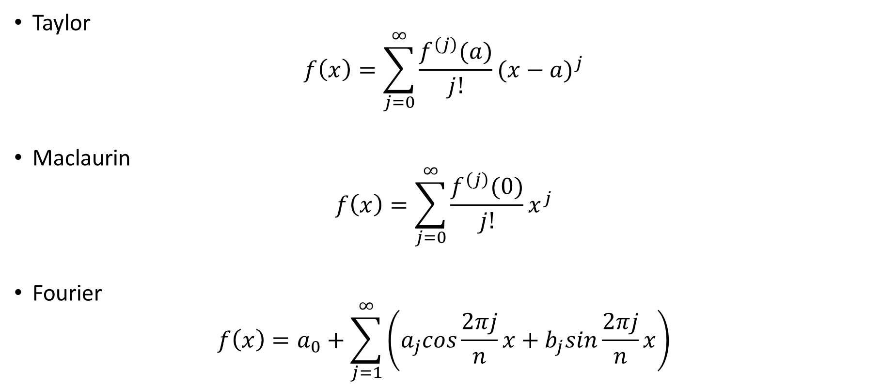
Series

Slide 7
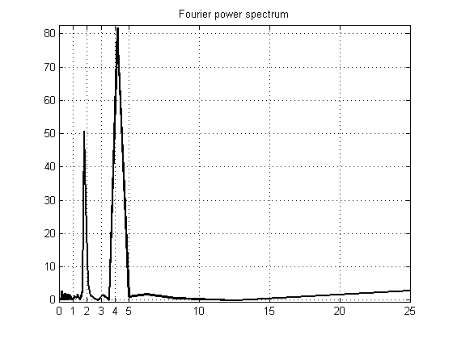
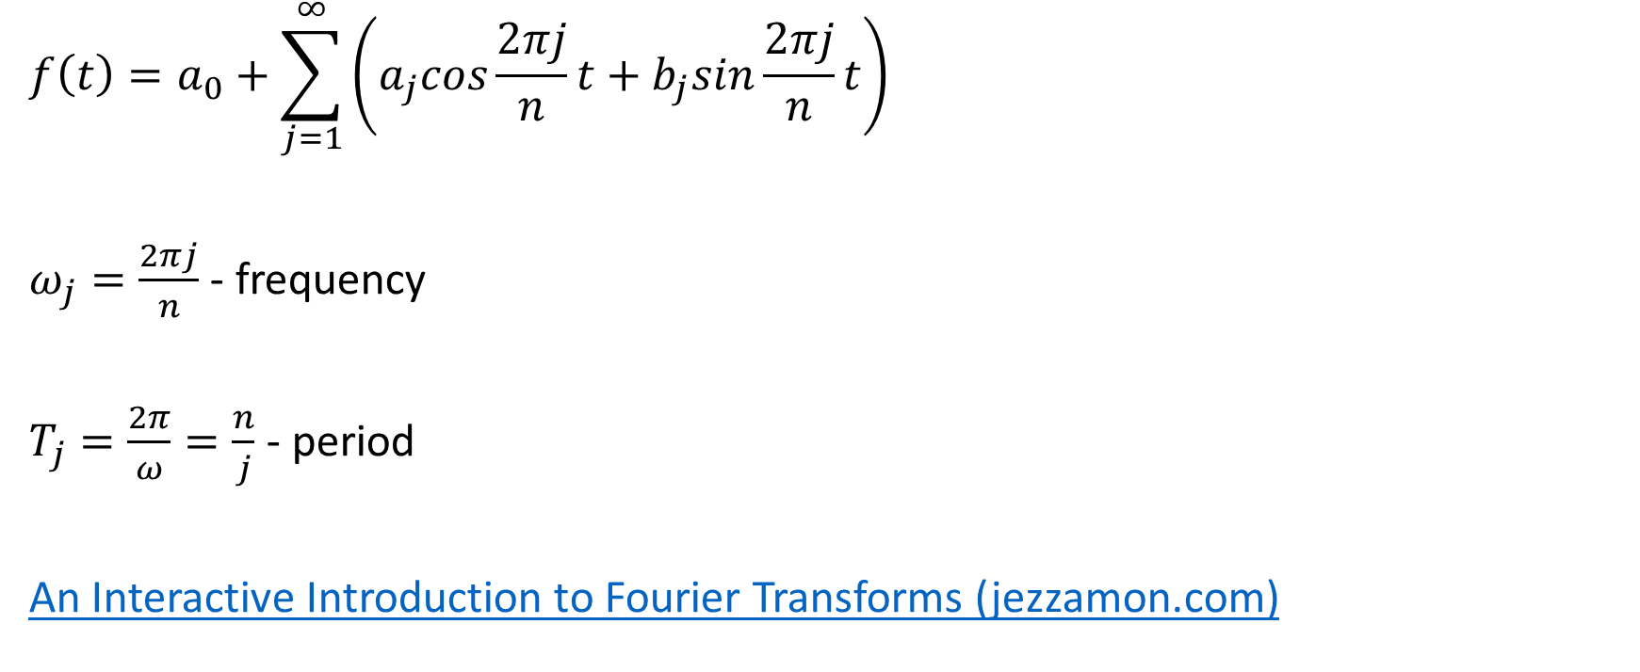
Periodogram analysis

Slide 8
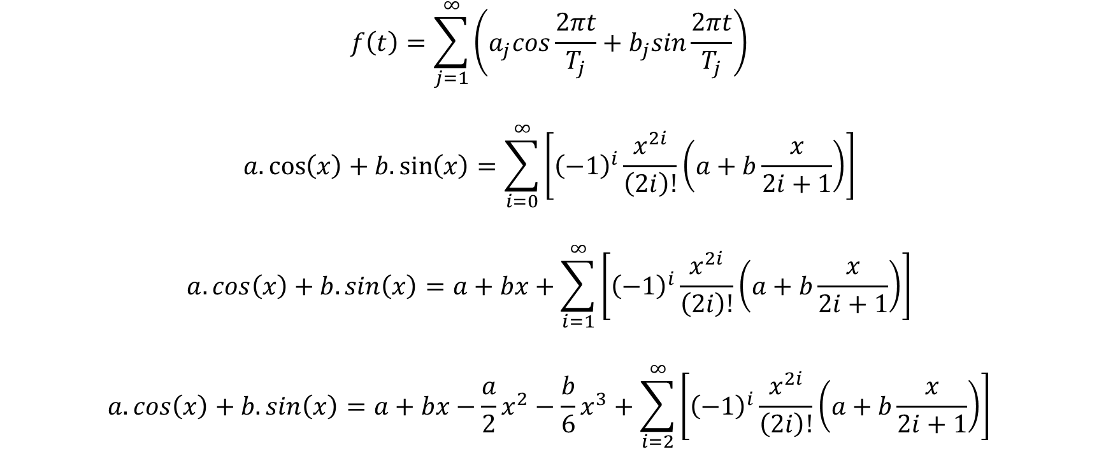
Bayesian periodogram analysis

Slide 9
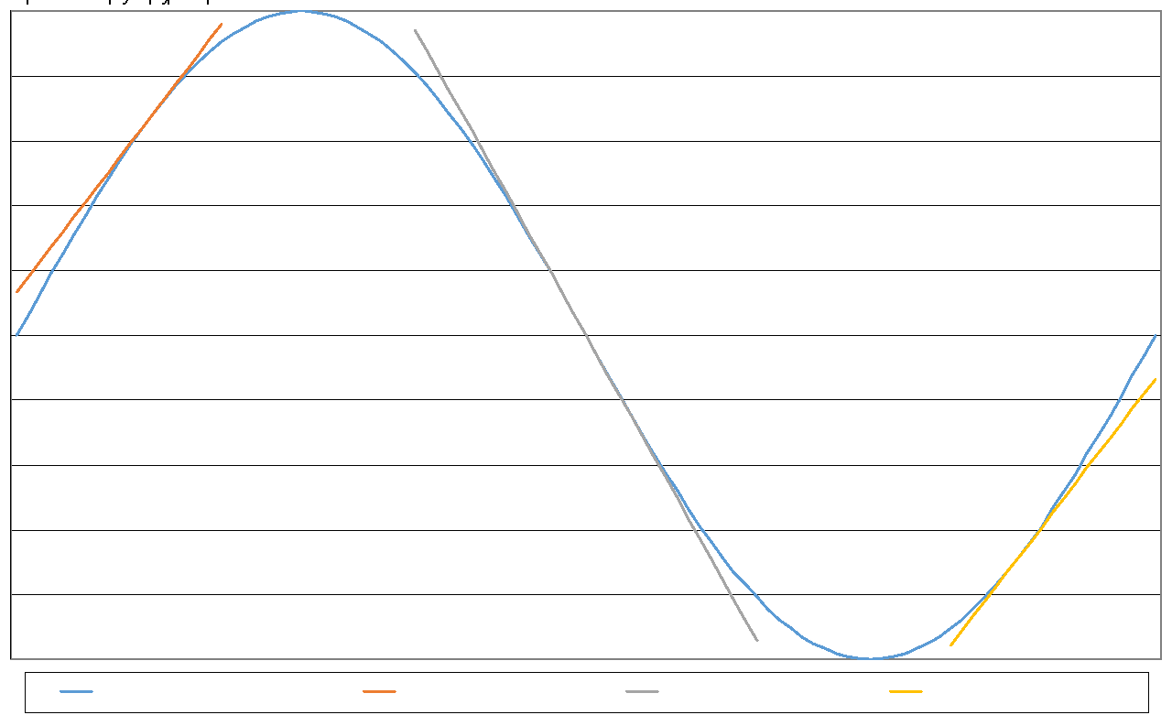
Approximation of linear function

Slide 10
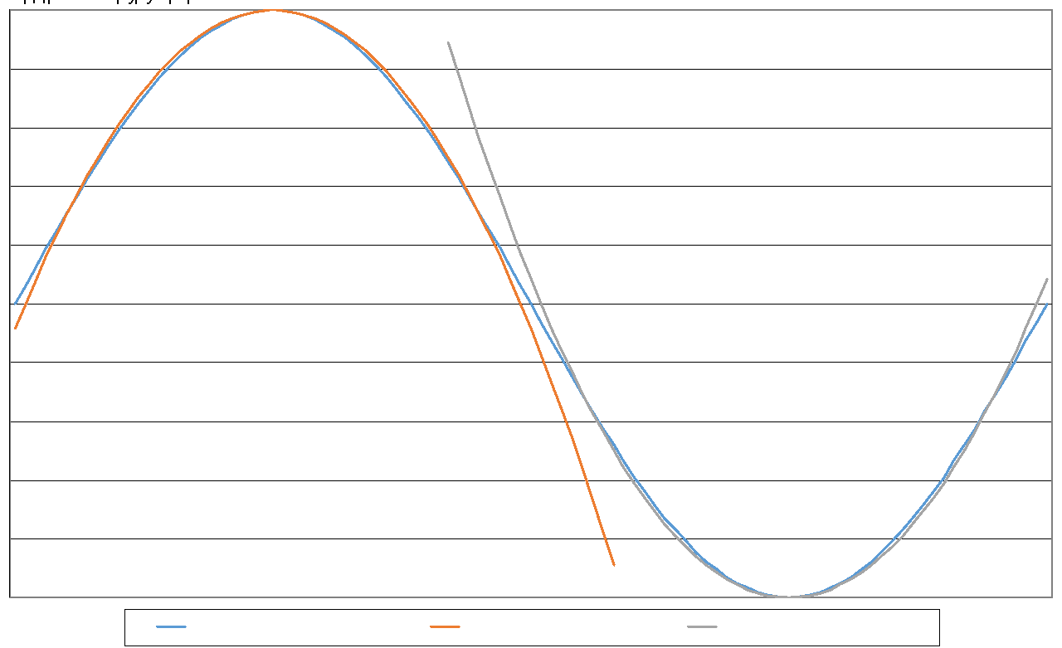
Approximation of quadratic function

Slide 11
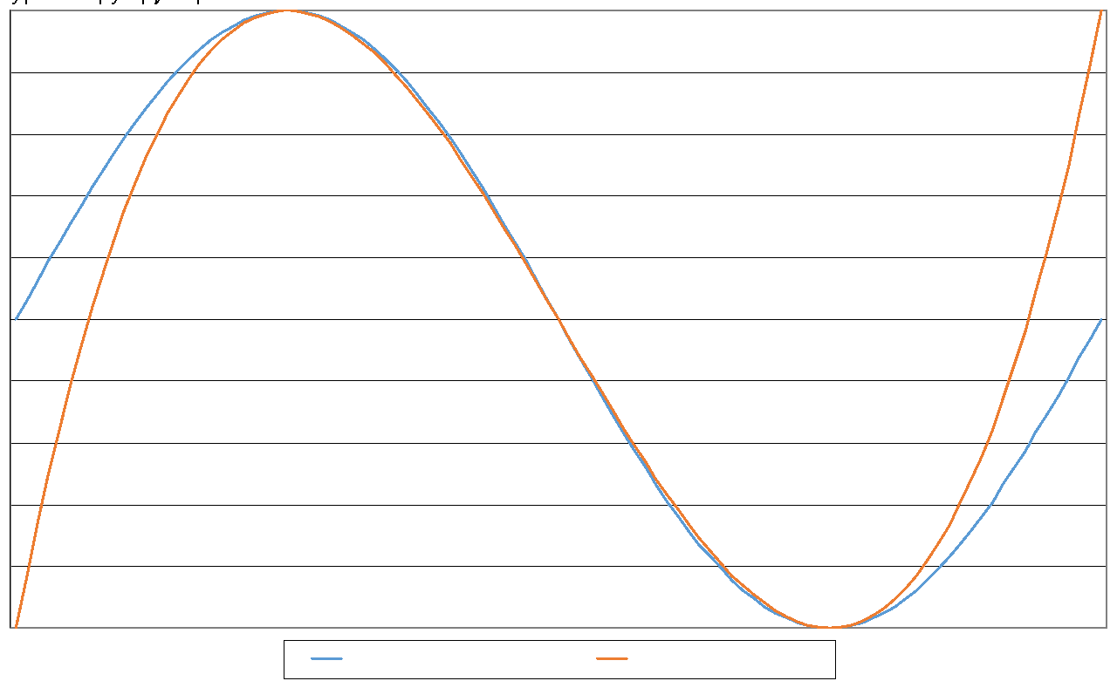
Approximation of cubic function

Slide 12
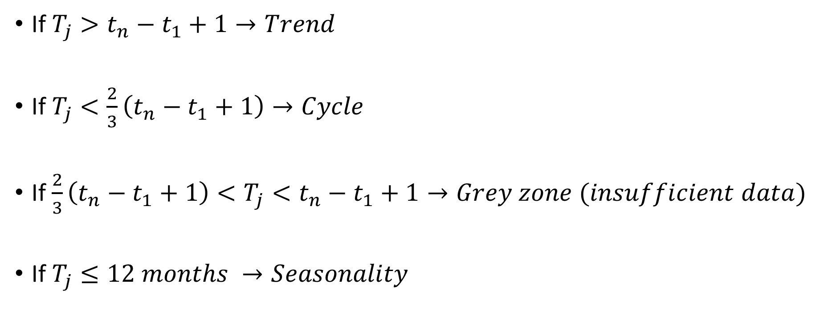
Components of dynamics

Slide 13
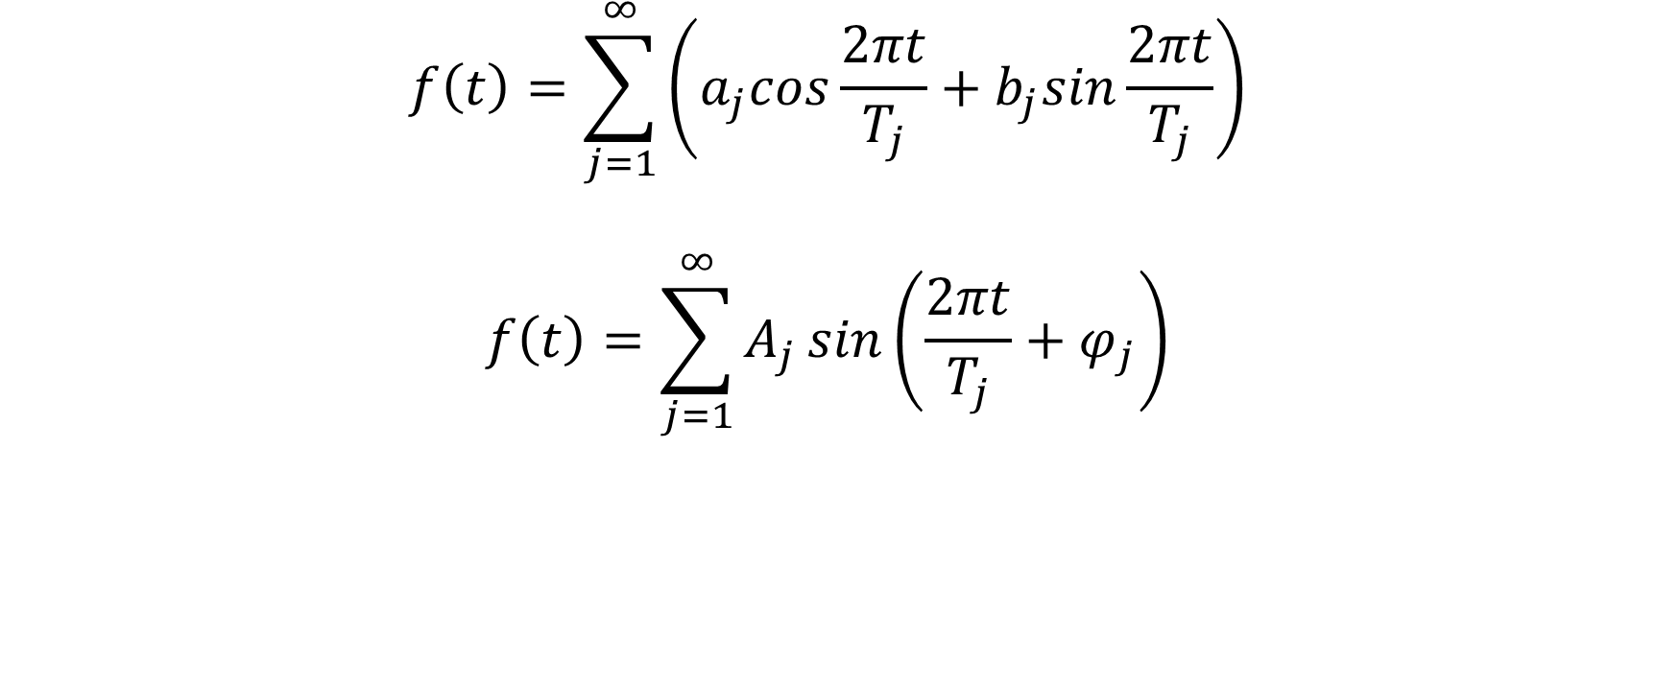
Bayesian periodogram analysis

Slide 14
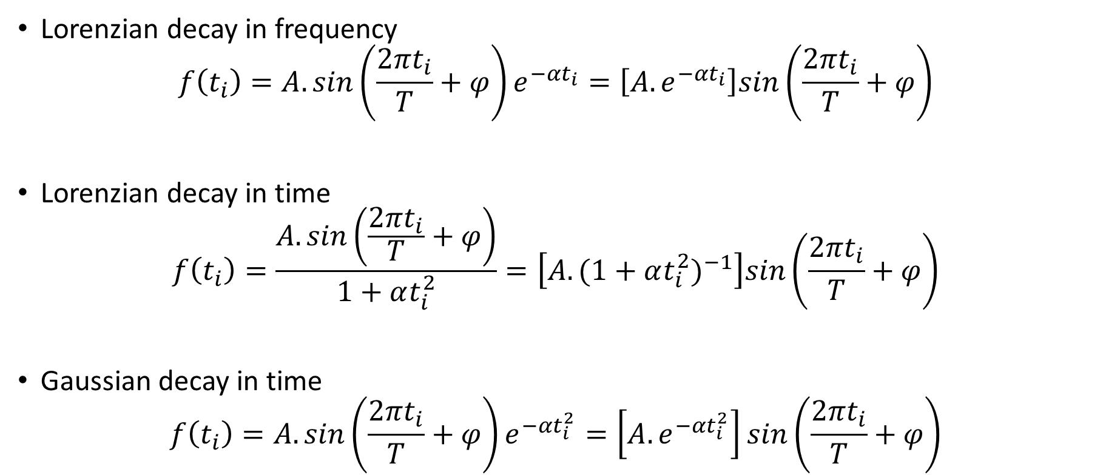
Decays

Slide 15
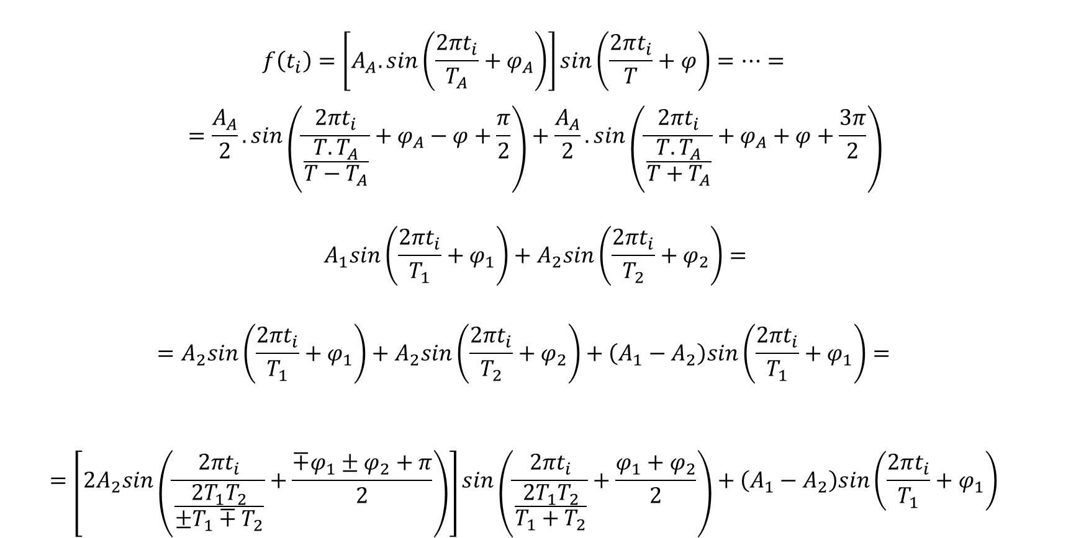
Decays

Slide 16
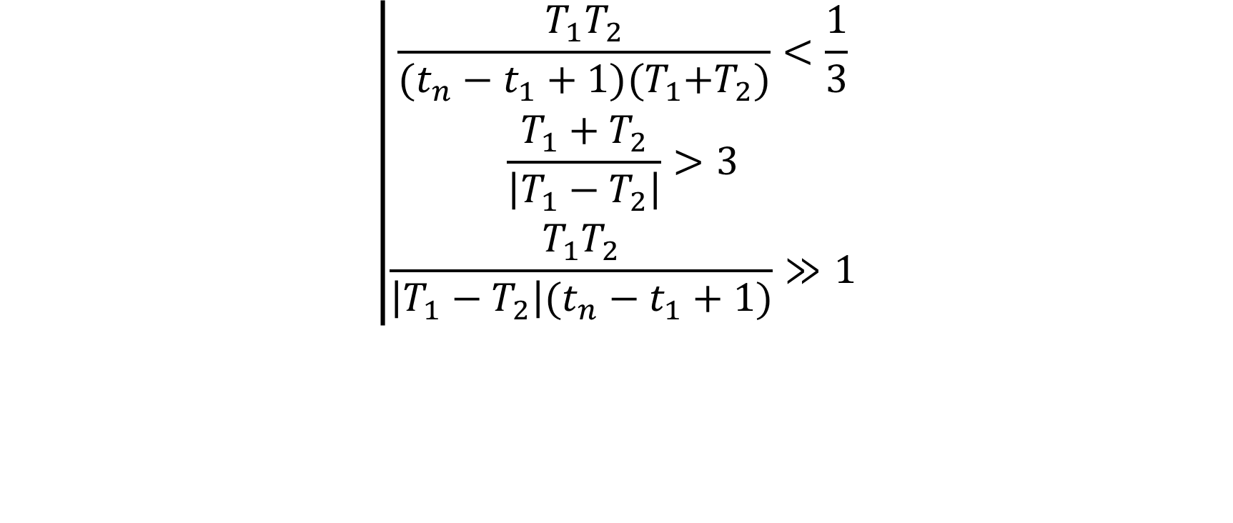
Decays

Slide 17
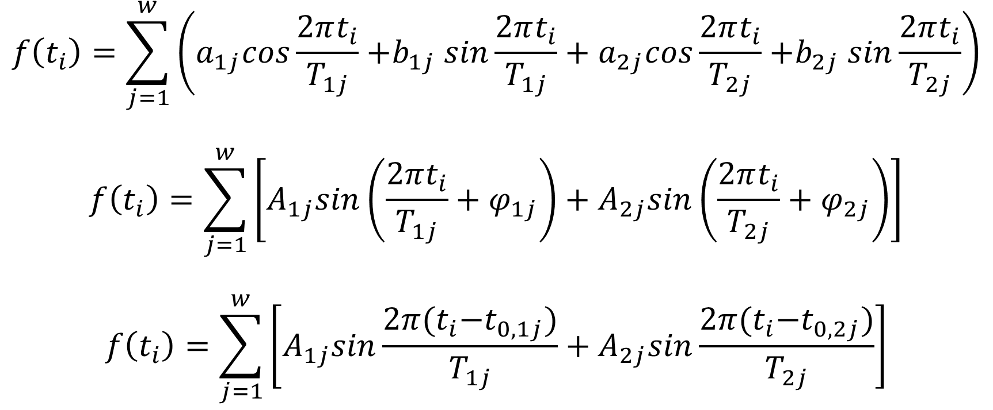
Bayesian periodogram analysis

Slide 18
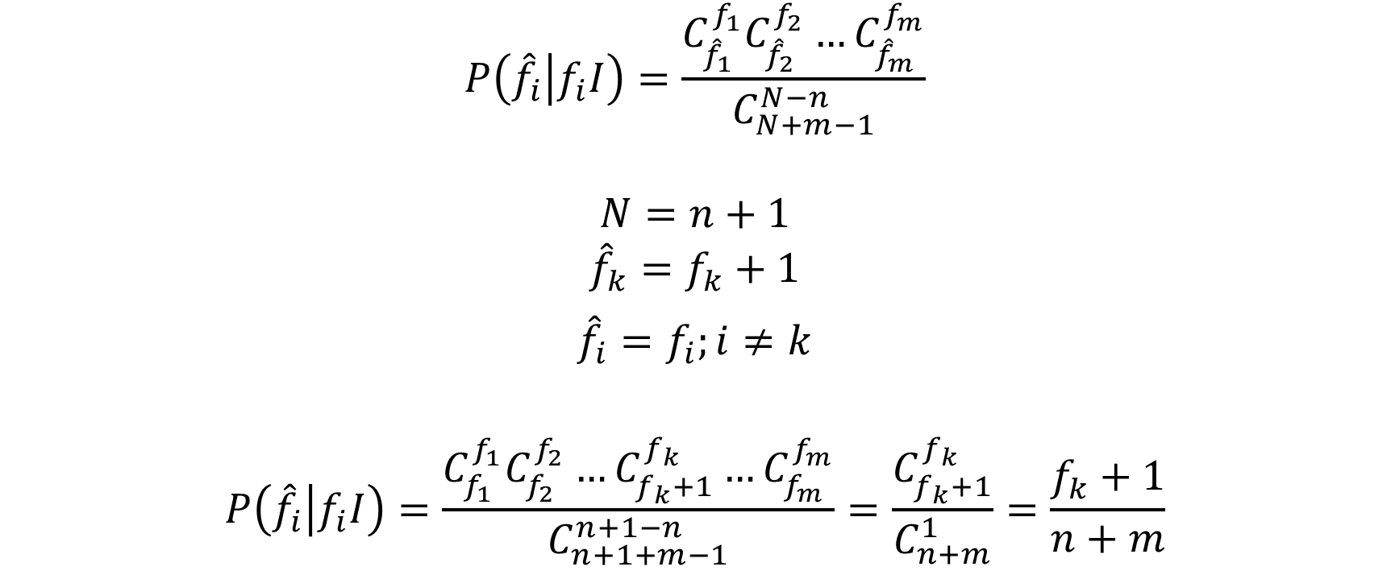
Confidence intervals of forecast

Slide 19
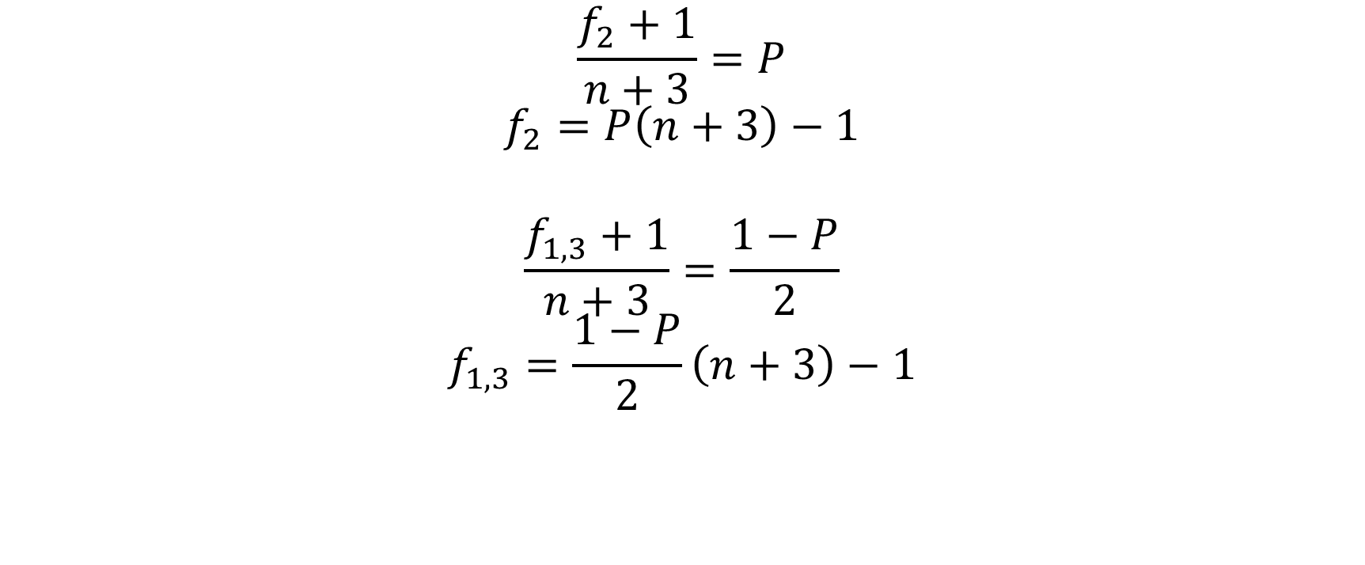
Confidence intervals of forecast

Slide 20
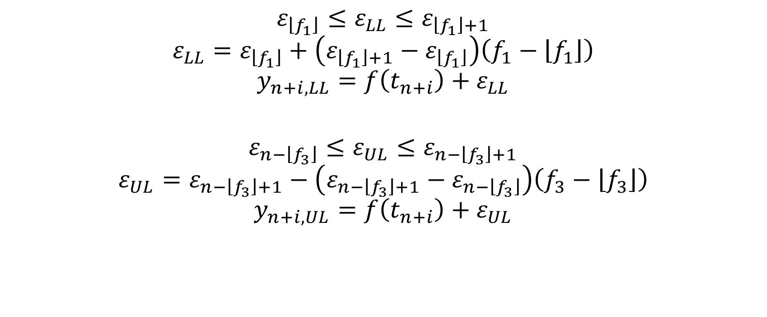
Confidence intervals of forecast

Slide 21
References
Атанасов, А. 2018. Статистически методи за анализ на динамични редове. София: Издателски комплекс – УНСС
Величкова, Н. 1981. Статистически методи за изучаване и прогнозиране развитието на социално-икономическите явления. София: „Наука и изкуство“
Харалампиев, К. Бейсовски подход за оценка на хармонични колебания с променлива амплитуда. Научна конференция с международно участие „Авангардни научни инструменти в управлението”, Равда, 2014
Bretthorst, G., 1988. Bayesian Spectrum Analysis and Parameter Estimation. Berlin, Heidelberg: Springer-Verlag
Schwarz, G. 1978. Estimating the Dimension of a Model. The Annals of Statistics, Vol. 6, No. 2, 461-464
Stone, M. 1977. An Asymptotic Equivalence of Choice of Model by Cross-Validation and Akaike’s Criterion. Journal of the Royal Statistical Society. Series B (Methodological) , 1977, Vol. 39, No. 1 (1977), pp. 44-47
Stone, M. 1979. Comments on Model Selection Criteria of Akaike and Schwarz. Journal of the Royal Statistical Society. Series B (Methodological) , 1979, Vol. 41, No. 2 (1979), pp. 276-278

