Slide 1
Predicting NBA salaries

Slide 2
Teams signing players
Based on market
See what similar players have been paid
Sources: NBA.com and Basketball-Reference.com

Slide 3
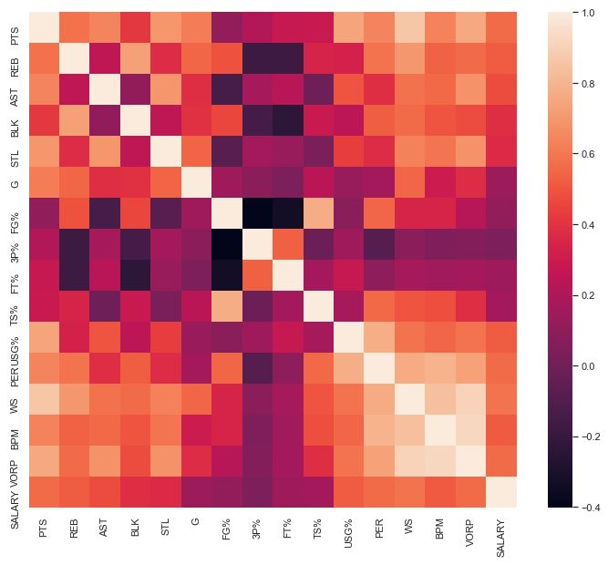
EDA

Slide 4
Dummy (mean) Regressor
R^2 (train) = 0
R^2 (test) = -0.001144622163
A R^2 (train) = -0.1595744681
A R^2 (test) = -0.4704311638
MAE (train) = 7067479.768
MAE (test) = 6951335.557
RMSE (train) = 8290153.791
RMSE (test) = 8507852.202

Slide 5
Linear Regression (unscaled)
R^2 (train) = 0.6214726672
R^2 (test) = 0.3892925341
A R^2 (train) = 0.5610693694
A R^2 (test) = 0.1030234095
MAE (train) = 3993532.992
MAE (test) = 4959487.834
RMSE (train) = 5100481.887
RMSE (test) = 6644895.294

Slide 6
Linear Regression (scaled)
R^2 (train) = 0.6214726672
R^2 (test) = 0.3892925341
A R^2 (train) = 0.5610693694
A R^2 (test) = 0.1030234095
MAE (train) = 3993532.992
MAE (test) = 4959487.834
RMSE (train) = 5100481.887
RMSE (test) = 6644895.294

Slide 7
Ridge Regression (scaled)
(mean R^2 = 0.4327860265)
R^2 (train) = 0.5856605149
R^2 (test) = 0.4230847569
A R^2 (train) = 0.3422731583
A R^2 (test) = 0.1526557367
MAE (train) = 4209099.691
MAE (test) = 4715319.277
RMSE (train) = 5336306.281
RMSE (test) = 6458438.588

Slide 8
Lasso Regression (scaled)
(mean R^2 = 0.3745317665)
R^2 (train) = 0.6214726262
R^2 (test) = 0.3893765573
A R^2 (train) = 0.2747230059
A R^2 (test) = 0.1031468186
MAE (train) = 3993490.105
MAE (test) = 4958987.241
RMSE (train) = 5100482.162
RMSE (test) = 6644438.164

Slide 9
ElasticNet Regression (scaled)
(mean R^2 = 0.4327837711)
R^2 (train) = 0.5784262474
R^2 (test) = 0.4226972406
A R^2 (train) = 0.342270543
A R^2 (test) = 0.1520865722
MAE (train) = 4255236.742
MAE (test) = 4710168.547
RMSE (train) = 5382690.005
RMSE (test) = 6460607.303

Slide 10
DecisionTreeRegressor (scaled)
(mean R^2 = 0.3628601174)
R^2 (train) = 0.4798729114
R^2 (test) = 0.1060998076
A R^2 (train) = 0.2611888595
A R^2 (test) = -0.3129159076
MAE (train) = 4591332.135
MAE (test) = 5796544.278
RMSE (train) = 5978845.4
RMSE (test) = 8039259.411

Slide 11
RandomForestRegressor (scaled)
(mean R^2 = 0.4407261668)
R^2 (train) = 0.9055482711
R^2 (test) = 0.461732025
A R^2 (train) = 0.3514803424
A R^2 (test) = 0.2094189117
MAE (train) = 2008312.709
MAE (test) = 4598098.391
RMSE (train) = 2547812.965
RMSE (test) = 6238365.243

Slide 12
GradientBoostingRegressor (scaled)
(mean R^2 = 0.4395221139)
R^2 (train) = 0.8855335992
R^2 (test) = 0.4143208777
A R^2 (train) = 0.3500841534
A R^2 (test) = 0.1397837892
MAE (train) = 1054246.233
MAE (test) = 5030078.541
RMSE (train) = 2804798.077
RMSE (test) = 6507308.537

Slide 13
AdaBoostRegressor (scaled)
(mean R^2 = 0.4576899585)
R^2 (train) = 0.7856629242
R^2 (test) = 0.3119801129
A R^2 (train) = 0.3711511221
A R^2 (test) = -0.01052920916
MAE (train) = 3257417.705
MAE (test) = 5425524.857
RMSE (train) = 3838055.389
RMSE (test) = 7052969.782

Slide 14
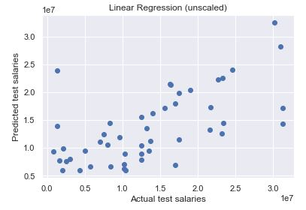
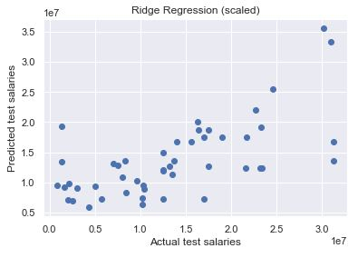
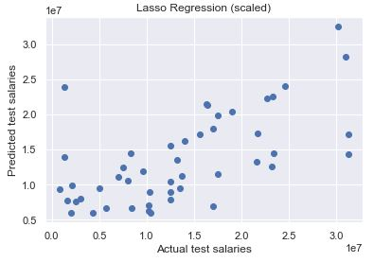
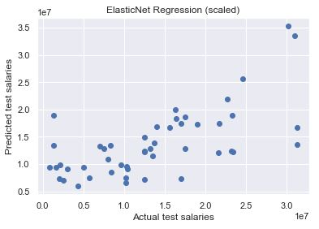
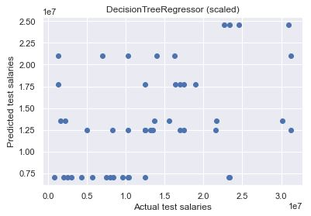
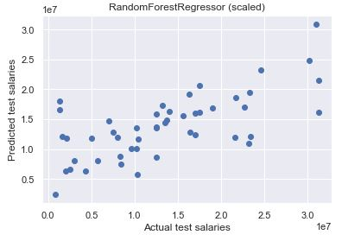

Slide 15
ElasticNet regression(scaled)
(mean R^2 = 0.3255089928)
R^2 (train) = 0.5455805423
R^2 (test) = 0.4821033177
A R^2 (train) = 0.2178774491
A R^2 (test) = 0.2393392479
MAE (train) = 3644945.945
MAE (test) = 3290803.783
RMSE (train) = 4477399.322
RMSE (test) = 4227838.632

Slide 16
Ridge Regression (scaled)
(mean R^2 = 0.3255239243)
R^2 (train) = 0.5530187069
R^2 (test) = 0.4829340165
A R^2 (train) = 0.2178947633
A R^2 (test) = 0.2405593368
MAE (train) = 3609410.286
MAE (test) = 3275991.795
RMSE (train) = 4440603.976
RMSE (test) = 4224446.576

Slide 17
RandomForestRegressor (scaled)
(mean R^2 = 0.2183300533)
R^2 (train) = 0.9154689561
R^2 (test) = 0.4711292819
A R^2 (train) = 0.09359548732
A R^2 (test) = 0.2232211329
MAE (train) = 1474121.486
MAE (test) = 3419278.908
RMSE (train) = 1931103.21
RMSE (test) = 4272396.981

Slide 18
Recommendations
Analyze how much they are overpaying for a player
Analyze how much other teams are overpaying for their players and determine if their “mistake” signing is worth trading for.
Gauge the trajectory a player is taking based on how much a team has overpaid them over the past few years.

