Slide 1


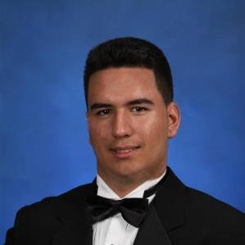


ScreenTime
Ana Jelacic
Tana Konda
Marcial Abrahantes
Nikhil Thota
Charlie Qualmann
COO
CMO
CTO
CEO
CFO

Slide 2

Value Proposition
ScreenTime is an online platform that fills the gap for personal one-on-one interaction between online personalities and their subscribers

Slide 3
Problem
Increasing amount of information shared around the globe
2. Digitalization is decreasing personalization
3. Many different social media but, no unified platform that enables personalized one-one interactions
Market gap for for having a go-to product/platform that will prioritize live one-on-one interaction and enable users to receive advice from an expert in their field of interest

Slide 4
Unique Proposed Solution
A video-sharing platform with a predetermined time limit, combining features from apps such as Quora and Skype into one place
FORM
Allow people to modularize their time into discrete chunks, so they can sell such featured content to other people through a user-friendly and easily manageable platform
FUNCTION
Increased understanding of creator’s fanbase, while simultaneously building their brand and potentially bringing in extra money earned during the process
BENEFIT

Slide 5
Product Features
User Experience
Easy search, scheduling, payment, high quality video call
User Profile, History & Notes feature, Request and Gift sessions
Creator Experience
Set up rate & availability, Report & Contact features
Sharing feature for popular social media platforms

Slide 6











Market Demographics
Customer Segments
Female : Male
Gamers, YouTubers
10-15 min
SOP
Global
18-35
$5-$50
Creator Platforms
Gamers, Tutorial-ists, Educators, Artists
Social Media Personalities, Bloggers
45%

Slide 7


$210 M
Market Size
+

Slide 8
Rollout
Content Creator Acquisition
Reach out to content creators from the blogosphere, Youtube, Patreon, and other social media influencers. Offer starting bonuses to the first creators.
User Acquisition
Rate per minute decreases for longer sessions, incentivizing a larger sale
Distribution
Web portal (mobile responsive)
Customer support team
B2B partnerships
Retention
Referral coupon codes for bringing a friend to the platform Recommended Sessions Email: a list of sessions pertinent to a user’s profile interests and past interactions

Slide 9





Competitive Analysis
Creator Profiles | YES | Yes | Yes
Funding Opportunities | Unlimited | Unlimited | One-time
Direct Supporter Engagement | Yes | NO | NO
Payment Processing Fees | 4% | 5% | 5%
Extra Features | Video Conferencing, Scheduling | N/A | N/A

Slide 10
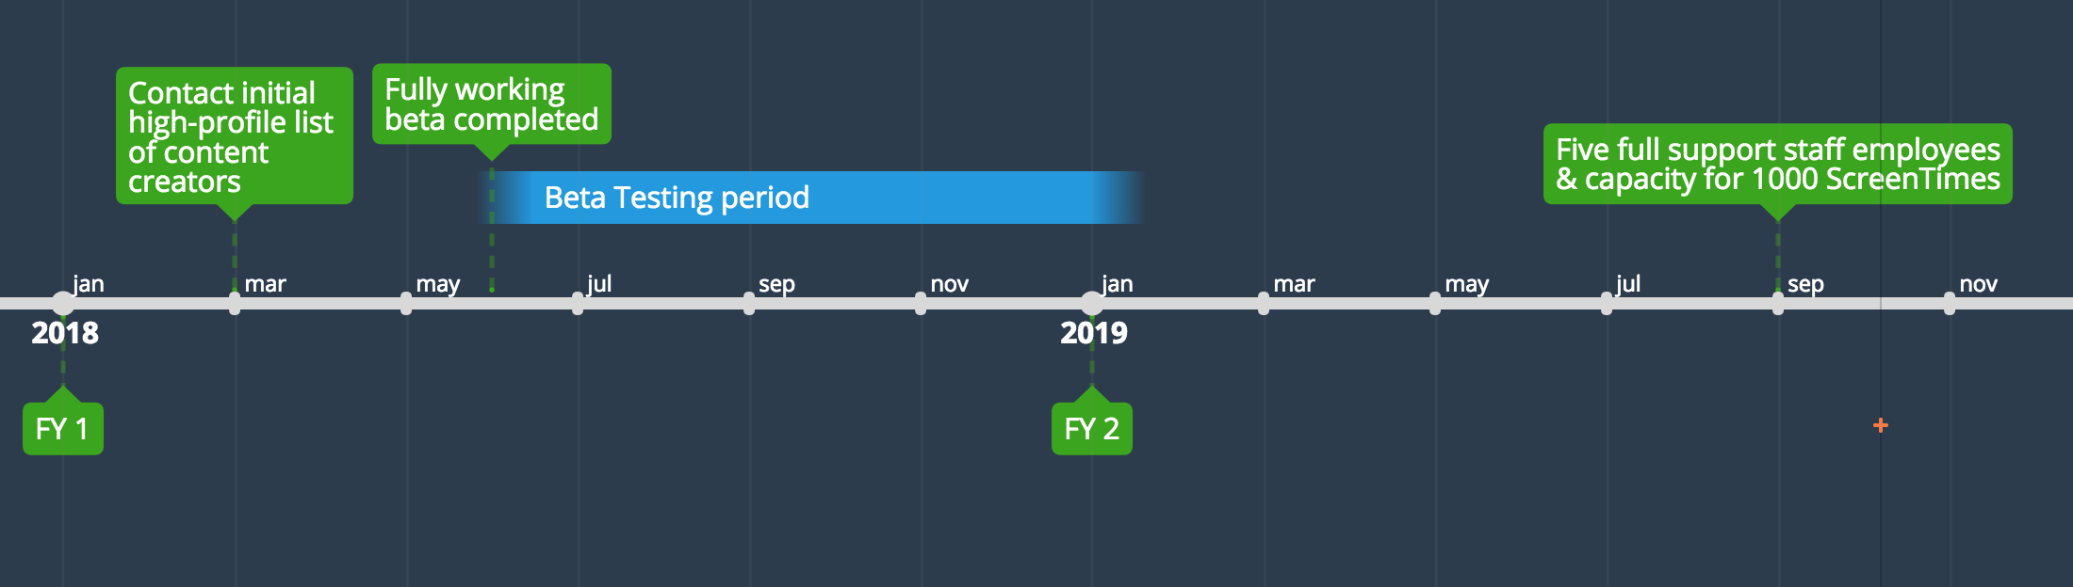
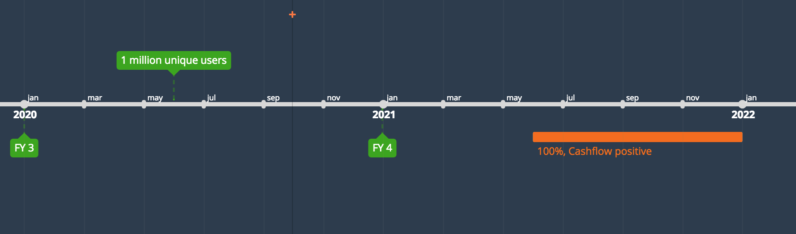
Key Milestones

Slide 11
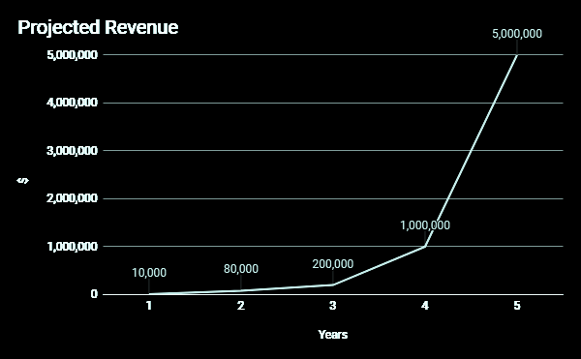
Revenue
Revenue Models
Portion of User Payment to Content Creator
Paid Image/Video Advertisements on screen while waiting for session to begin

Slide 12



Thank you!
Let’s ScreenTime

