Slide 1
DAT205
Dr Simon Lock

Slide 2
There comes a time…
When everyone has to work in a team
When you need to keep track of project evolution
When you have to share your work with others
When you need to have version control
When you are going to have to use git

Slide 3
Now is that time

Slide 4
Simon
Will
Code
Code
Code
Code
Code
Code

Slide 5
GitHub
Code
Code
Code
Simon
Will
Code
Code
Code
Code
Code
Code

Slide 6
GitHub
Code
Code
Code
Simon
Will
Code
Code
Code
Code
Code
Code

Slide 7
GitHub
Code
Code
Marking
Time !
Code
You
Simon
Code
Code
Code
Code
Code
Code

Slide 8
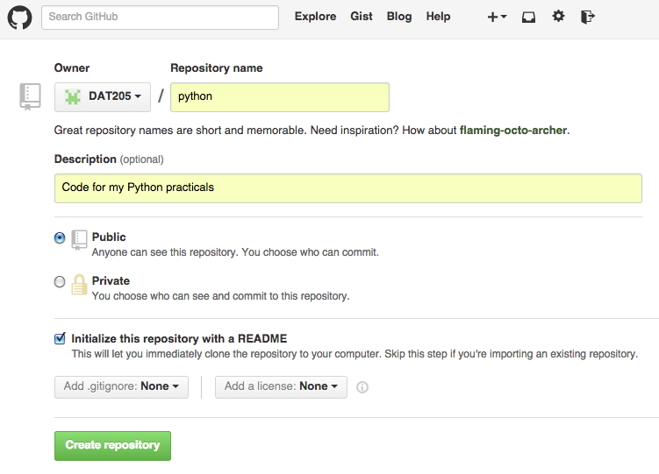

Slide 9
GitHub
Code
Code
Code
Index
Revision
Simon
Will
Code
Code
Code
Code
Code
Code
Index
Index
Revision
Revision
git clone https://github.com/python.git

Slide 10
GitHub
Code
Code
Code
Index
Revision
Simon
Will
myfile.py
Code
Code
Code
Code
Code
Code
Index
Index
Revision
Revision
git add myfile.py

Slide 11
GitHub
Code
Code
Code
Index
Revision
Simon
Will
Code
Code
Code
Code
Code
Code
Index
Index
Revision
Revision
git commit -a -m "Useful Comment"

Slide 12
GitHub
Code
Code
Code
Index
Revision
Simon
Will
Code
Code
Code
Code
Code
Code
Index
Index
Revision
Revision
git push

Slide 13
GitHub
Code
Code
Code
Index
Revision
Simon
Will
Code
Code
Code
Code
Code
Code
Index
Index
Revision
Revision
git pull

Slide 14
To Finish
This isn't the whole story
There is a lot more to version control than this
A big area is merging and conflict management
That is for another day (and another lecturer ;o)

Slide 15
Finally
We have shown you enough to get you started
Get a github account - use it to backup your code
I will clone your repos when it's time to do marking
When we do cover the trickier stuff…
At least the concept of git will be familiar

