Slide 1
Neural Fuzzy Adaptation (NFA)
Hugh Aitchison
Manager of Technical Services
Notes:
Today I’ll be presenting one of our translation technologies, Neural Fuzzy Adaptation

Slide 2







SYSTRAN Languages … always growing…
150+
WESTERN EUROPE
EASTERN EUROPE
MIDDLE EAST
& AFRICA
ASIA
NORTH AMERICA
LANGUAGE PAIRS
Danish
Dutch
English
Finnish
French
German
Greek
Icelandic
Italian
Norwegian
Portuguese
Spanish
Swedish
Welsh
Albanian
Bulgarian
Croatian
Czech
Estonian
Hungarian
Latvian
Lithuanian
Polish
Romanian
Russian
Serbian
Slovak
Slovenian
Ukrainian
Arabic
Dari
Farsi (Persian)
Hebrew
Pashto
Somali
Tajik
Turkish
Urdu
Chinese (Simplified)
Chinese (Traditional)
Hindi
Indonesian
Japanese
Korean
Malay
Punjabi
Tagalog
Tamil
Thai
Vietnamese
US English
FR Canada
SOUTH AMERICA
Brazilian Portuguese
Latin Am. Spanish
Notes:
But first I’ll give a brief overview of who and what we are as a company.
We specialize in machine translation technology, with over 150 language pairs in our catalogue and growing.
Some of the languages that we currently offer
A point to keep in mind is that translation quality is constantly being improved through the training of new models with improved data, data filtering, training parameters, and addition of synthetic/augmented data

Slide 3

SYSTRAN Technologies and Products
State of the art Neural Technology
SYSTRAN is the co-founder of OpenNMT
Most widely used open-source NMT framework:
More than 3000 contributing (researchers / industry users)
More than 600 papers published worldwide
Optimized proprietary translation pipeline based on OpenNMT
Fastest CPU inference; Performance optimizations for highly available and less expensive CPU hardware
100’s of language specific operations for on-the-fly normalization of text stream before OpenNMT decoding
Support for advanced linguistic features: formal/informal, domains, terminology, placeholders, etc.
Scalable deployment in SYSTRAN Pure neural server
REST-API
Advanced Expert Features:
File/Image/Speech Translation
Integration with OCR
Post-editing environment
Feedback management
Development of models based on language expert community
SYSTRAN Marketplace trainers expand model catalog
Notes:
We are the co-founders of OpenNMT, the most widely used open-source NMT framework, with more than 3000 contributors, and over 600 published papers
Some of our differentiating features include
Fastest CPU inference achieved through performance optimizations for highly available and less expensive CPU hardware
100’s of language specific operations for on-the-fly normalization of text stream before OpenNMT decoding
Support for advanced linguistic features: formal/informal, domains, terminology, placeholder etc…
Able to deploy on-prem behind your firewall, with a highly available and scalable architecture
Our solution supports a full featured REST translation API that can be used in any programming language or application that supports REST queries
Along with advanced expert features such as:
File/Image/Speech Translation
Integration with OCR
Post-editing environment
Feedback management
And finally the ability to leverage existing translation expertise by empowering the language expert community to train new models in our proprietary SYSTRAN Marketplace

Slide 4


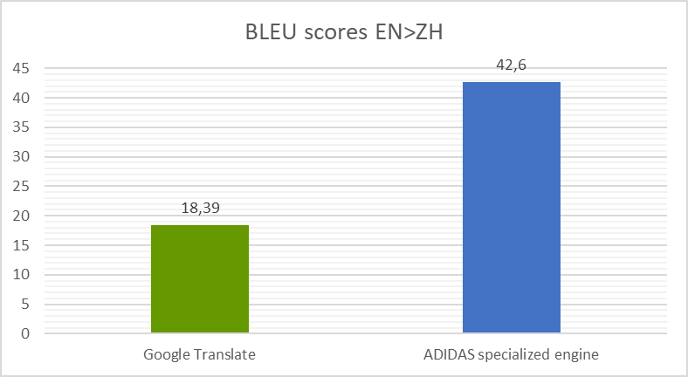
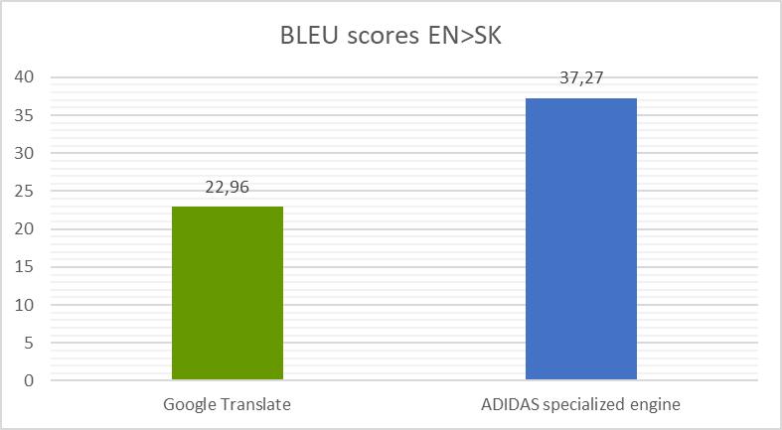
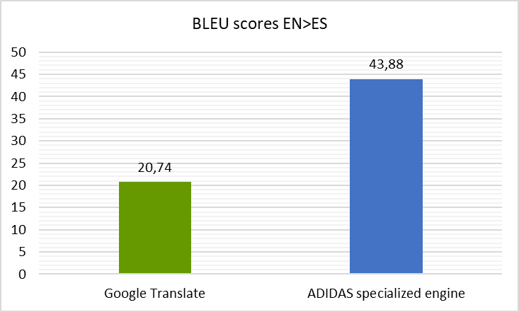
Specialization: highest quality translations for your content
User Dictionaries & Translation memories
Linguistic Translation Profiles
Feedback loop for continuous improvement
Specialization of the neural MT engine using your own data
💡 As the pioneer in Machine Translation, we introduce new features on a regular basis.
For example, in 2020 we introduced the ability to train multi-domain engines.
This significantly improves the translation quality for low resource domains and allows you to address various business cases with the same neural engine.
SYSTRAN Generic Neural engine
provided by SYSTRAN
Specialized
MT engine
Customer / In-domain Data
Notes:
We offer the ability to improve translation of existing models through the use of user generated customization resources such as User Dictionaries, Translation Memories, Normalization Dictionaries, Translation Choices, Style Sheets, and Entity Rules
We also have the ability to train specialized, custom domain translation models, trained with customer provided In-Domain data which we see contributes to a significant increase in translation quality

Slide 5
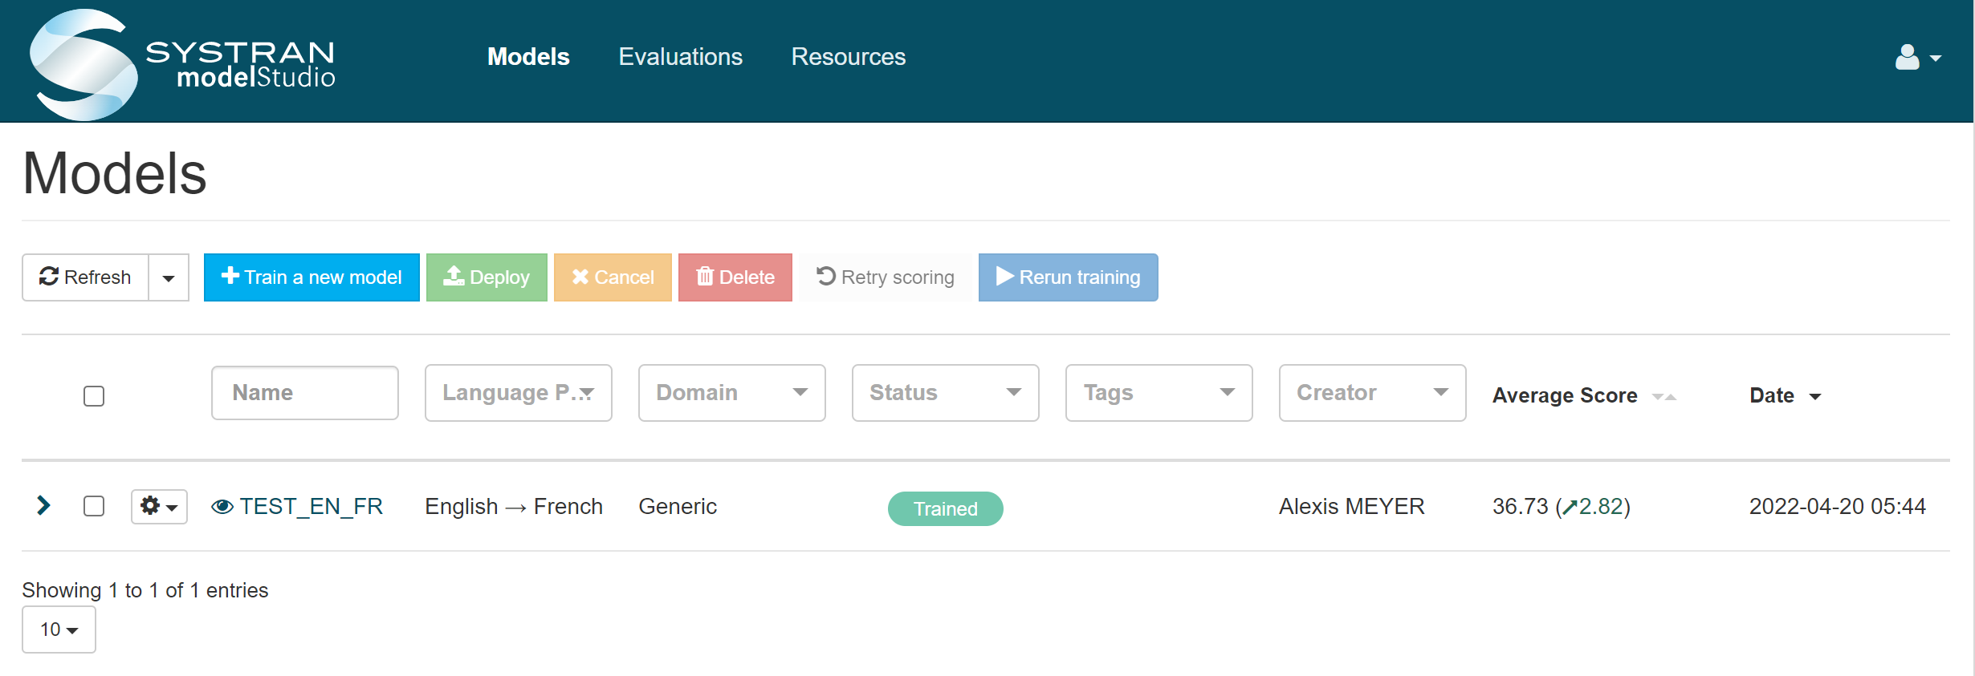
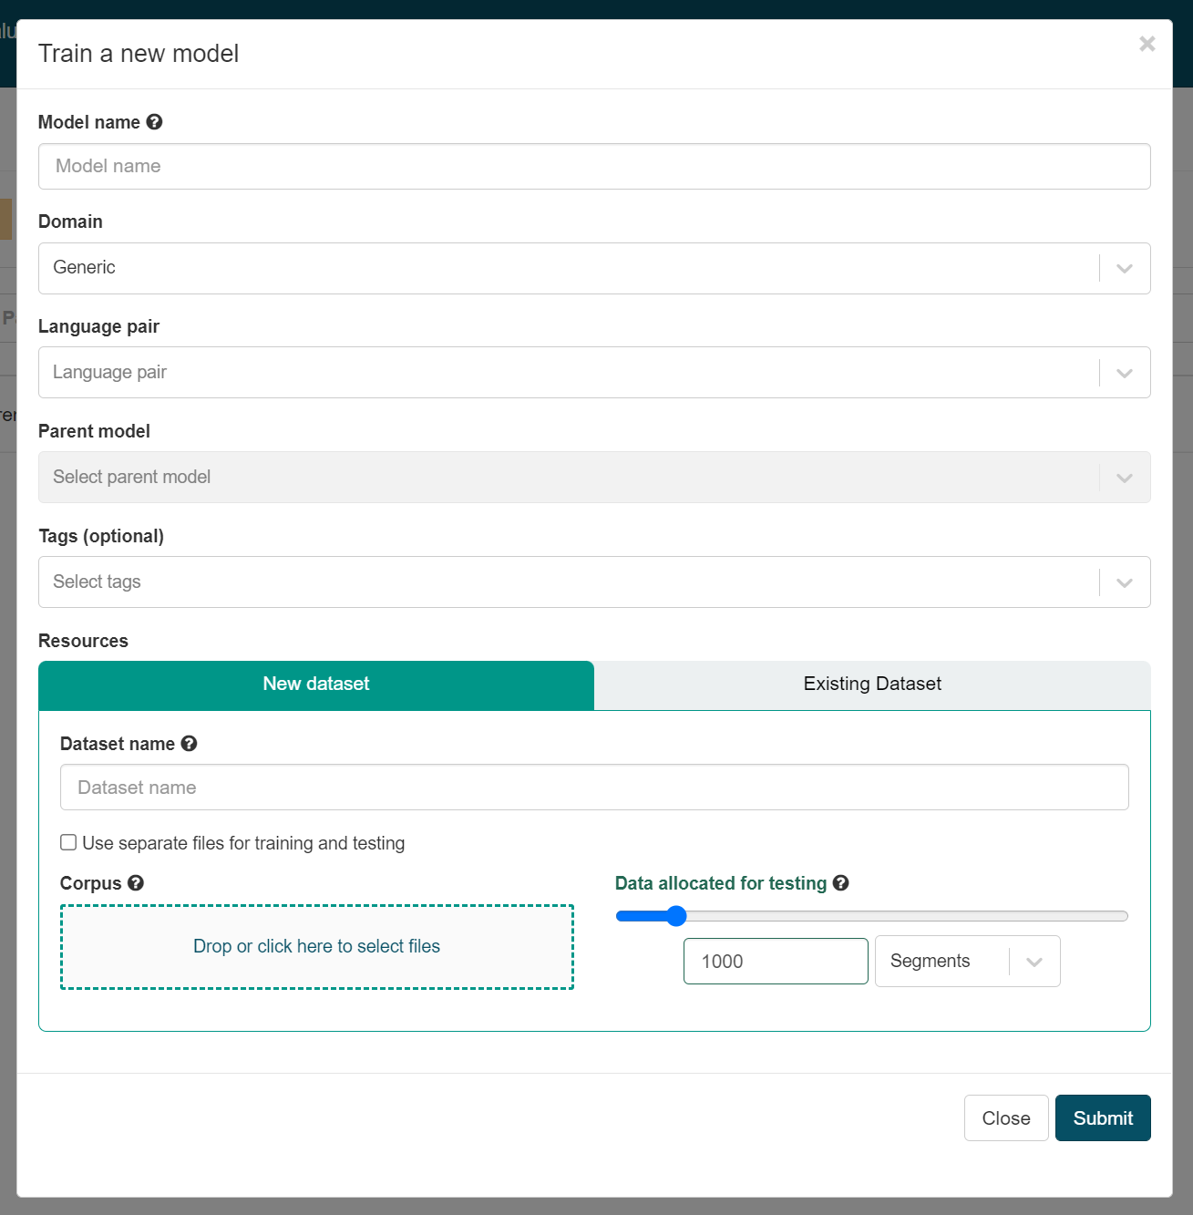
Model Studio
Model Studio Documentation:
https://docs.systran.net/modelStudio/en/login.html
Notes:
Traditionally, these specialized modles have been trained by our in-house Linguistic development team as Professional Services, however we are actively rolling out our new product, Model Studio with an intuitive interface that will allow translation novices train, test, and deploy new models to their own SYSTRAN SPNS translation server

Slide 6
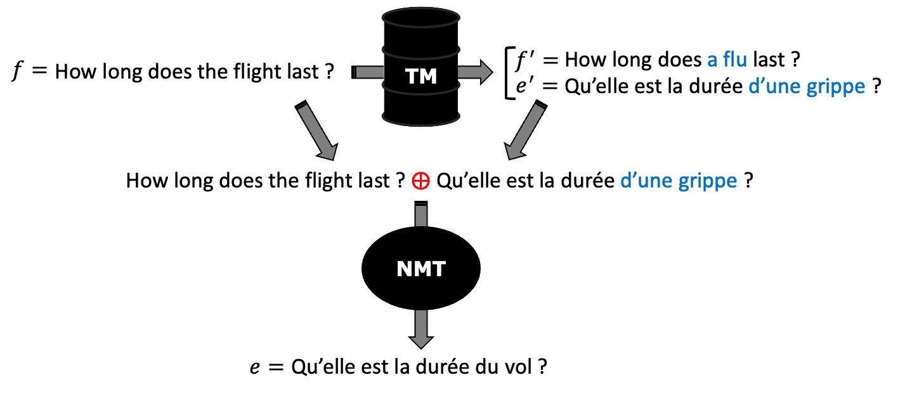
NFA Workflow - Overview
Notes:
Now getting into the NFA workflow…
The remainder of this presentation is based on a white paper on NFA prepared by our SYSTRAN researchers
The NMT model has been taught to translate the input sentence (f) which appears in the input stream just before the similar translation (e’), the Direct Sum (token ⨁) is used to indicate the separation between both sentences. It is worth notice that the similar translation (e’) cannot be used as a translation of f, as it needs to be “repaired” since it translates f’ (not f). Examples following this template are given to the network that learns to repair similar translations. As outlined in the example, the most important challenge of the model consists in identifying the words in the similar translation e’ (d’une grippe) that do not translate the input sentence f and to replace them to obtain the correct translation.

Slide 7
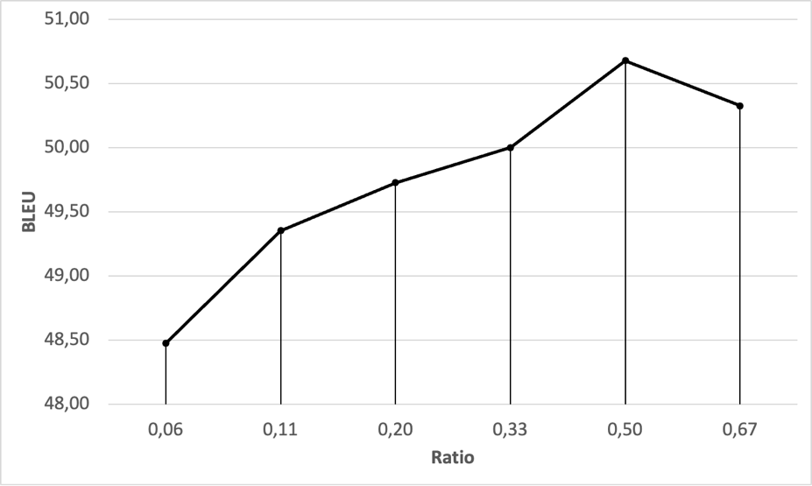
How many augmented examples must be used in training?
Notes:
As we have pointed out, we want to improve our model by giving it the ability to use similar translations, but at the same time, it must retain its performance when similar translations are not available in inference. To this end, we prepare training sets with varying ratios of augmented/regular examples. This graph shows the average BLEU score measured on our four test sets by varying the ratio of augmented examples in the training sets.

Slide 8
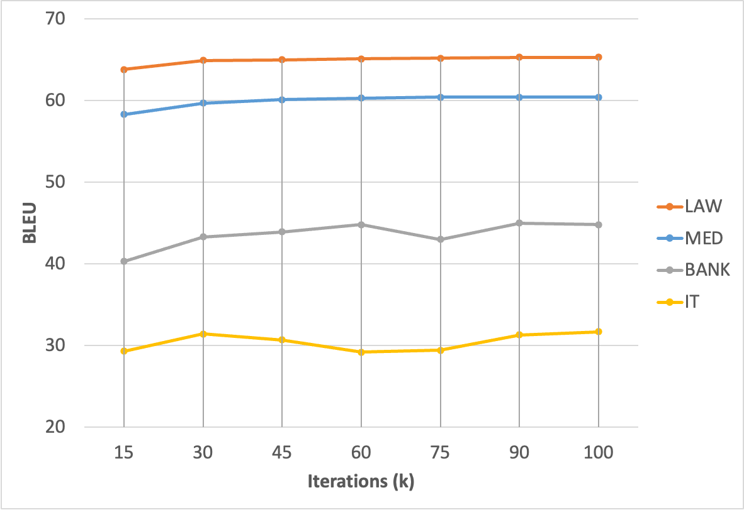
How many training iterations are needed to effectively teach a regular model to use similar translations?
Notes:
We experiment with the best performing ratio obtained in the lines above (0.5) and evaluate performance (BLEU) over our test sets every 15,000 iterations. Note that as average, every iteration is built from around 500 training examples. Results show that best performances are obtained after training around 100,000 iterations. This is after training with around 50 million sentence pairs (half of which were augmented with similar translations). Note that in most cases, an acceptable performance is reached after 50,000 iterations.

Slide 9
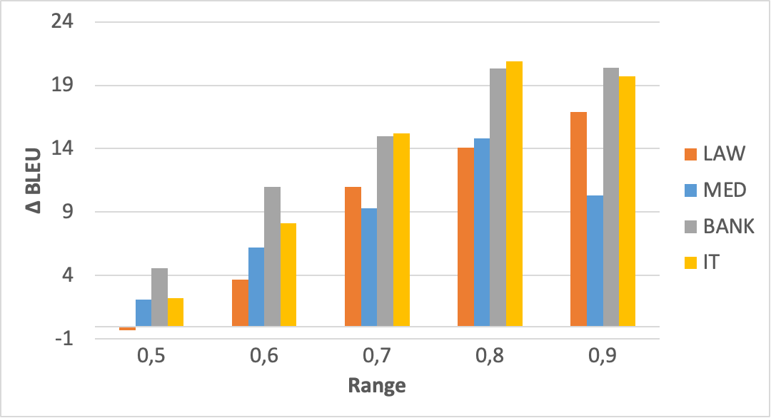
How “similar” must similar sentences be?
Notes:
The experiments so far show that similar sentences are useful and can drastically boost MT performance. We now want to understand the effect of the similarity level of sentences retrieved from our translation memories. With that aim we split similar translations (e’) into several ranges considering the distance between their source translation (f’) and the input sentence (f). We build 5 similarity ranges [0.5, 0.6), [0.6, 0.7), [0.7, 0.8), [0.8, 0.9), [0.9, 1.0) and measure the gain in BLEU score obtained by each set: As expected, the higher the similarity the higher the performance boost. A limited gain is observed for translations using similar sentences in the range [0.5, 0.6) where even a negative impact is reported in the LAW test set.

Slide 10
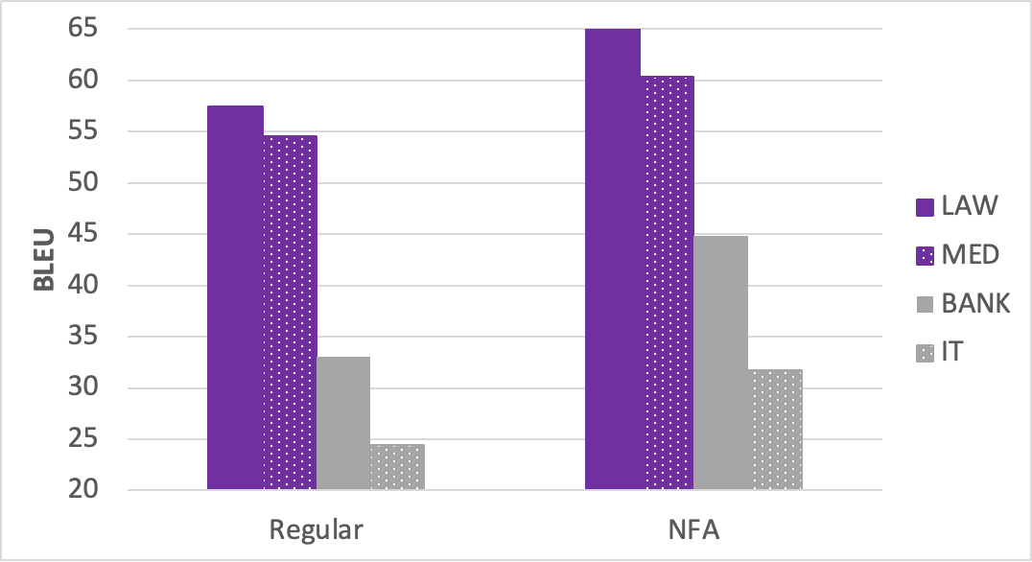
Translating with out-domain translation memories
Notes:
In both cases the boost in performance is clear, showing the suitability of the NFA method to improve MT performance using TMs. However, the instabilities observed in this table for out-domain test sets suggest the difficulties found by the model to consider the similar translations injected in the source stream as these are never (or rarely) seen in training.

Slide 11
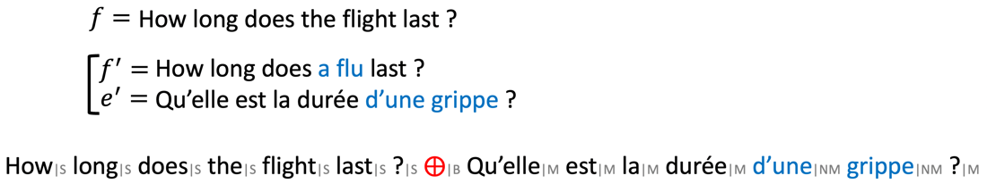
Qualitative Analysis
Input sentence augmented with a fuzzy match and match/non-match information.
Notes:
Predictions of matched/non-matched words are performed using the edit distance between f and f’ and word alignments between f’ and e’.
The study focuses on a specific translation domain, namely the European institutions. The MT models were built using TMs of the European Commission’s translation service (DGT-TM), which consists of texts and their translations written for mostly legal purposes, such as contracts, reports, regulations, directives, policies and plans within the Commission. The study considers translations from English into Dutch. A subset of the same data is whith held for use in evaluation.

Slide 12
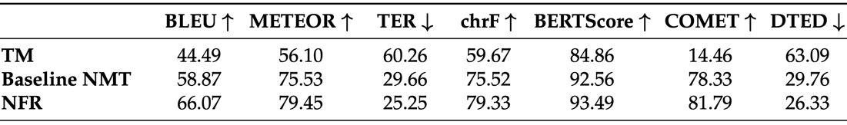
Automated quality assessment
Automatic measure evaluation.
Notes:
We use a very complete set of evaluation metrics, ranging from BLEU (accounting for lexical overlap) to BERTScore and COMET (distributed sentence representations judging semantic similarity). All metrics employed, as can be seen in this table, estimate the quality of the NFA translations to be clearly higher than the one produced by the baseline NMT system.

Slide 13
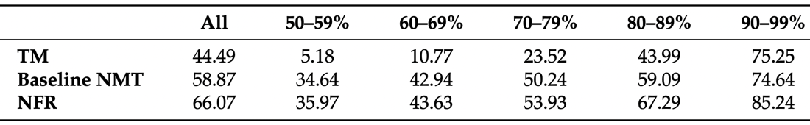
Automated quality assessment
BLEU scores for the TM, baseline NMT and NFA system in different FM ranges.
Notes:
To allow a more detailed analysis, the BLEU scores per FM range are displayed in this table. These scores confirm previous findings. With the increase in FM scores, (a) the estimated translation quality increases for both systems and (b) the difference between the baseline NMT and NFA systems becomes larger.
This table also shows that, in the highest FM range (90–99%), FMs retrieved achieved a higher BLEU score when used as the final output than the baseline NMT system (75.25 vs. 74.64). On the other hand, the scores obtained by the NFA system are much higher (85.24). This observation illustrates why a baseline NMT system is often used as a back-off to a TM in CAT workflows and why NFA, as a single system, could be a better alternative to this traditional TM–MT combination approach; even in the highest FM range, the NFA system outperformed the TM output by a large margin, at least in terms of BLEU scores (85.24 vs. 75.25).

Slide 14
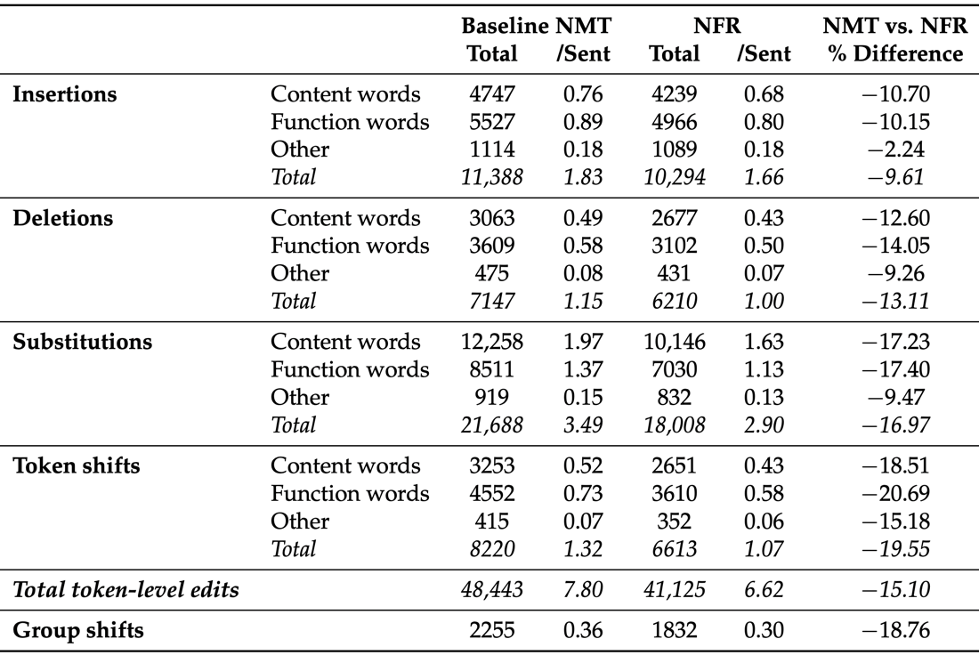

TER: Edit operations
Notes:
The paper analyzes the number and types of TER edit operations needed to transform MT outputs into the corresponding reference translations. This table indicates the number of different types of edit operations for the test set and for both MT systems. For the purpose of this analysis, a distinction is made between edits involving content words, function words and other words.

Slide 15
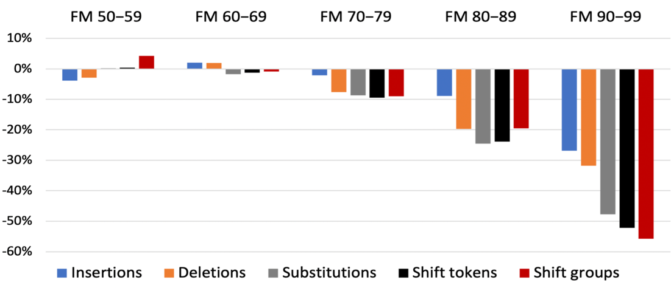
NFA produced translations that required fewer edit operations overall
Percentage of difference in total number of edits, per edit type, and different FM ranges between NFA and baseline NMT output.
Notes:
An overview of the frequency of edit operations per match range is provided in this table. In this graph, only edit types are distinguished and plot the percentage difference between the baseline NMT and NFA systems.
For source sentences that were augmented with FMs with a similarity score of up to 70%, there was minor difference between the NFA and the baseline systems. In fact, compared to the NFA system, the baseline system required fewer substitutions and shifts in the FM range 50–59% and fewer insertions and deletions in the range 60–69%. With FM similarity scores of 70% and higher, NFA requires fewer edits for all edit types. The reduction in required edits increased dramatically for higher FM ranges, reaching a difference of between −26.88% (for insertions) and −55.77% (for shift groups) in the FM range 90–99%.

Slide 16
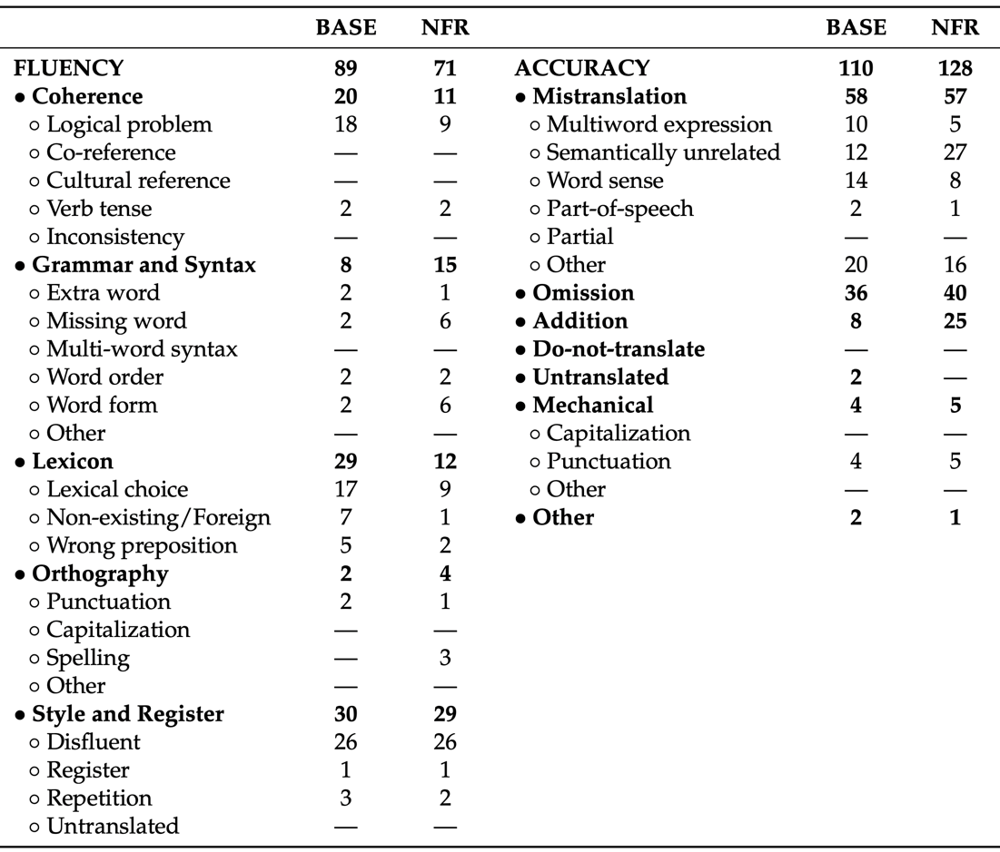
Fine-Grained Error Analysis
Number of errors per category of the SCATE error taxonomy, for the baseline NMT and NFA systems.
Notes:
We also compare the types and number of errors that were made by the NFA and the baseline NMT systems, classified according to the SCATE (6) error taxonomy. Overall, the annotators identified the same number of errors (199) for both translation systems. Likewise, the number of sentences that contained at least one error was highly similar for both systems (120 for baseline NMT and 123 for NFA). However, the errors in the NFA output spanned more tokens (442 compared to 395, or 7.9% and 7.0%, respectively). It is worth noting that, overall, around 60% of the sentences in the test set did not contain any errors, according to the annotations. Figure 11 shows which types of errors were made by both MT systems according to the SCATE error taxonomy

Slide 17
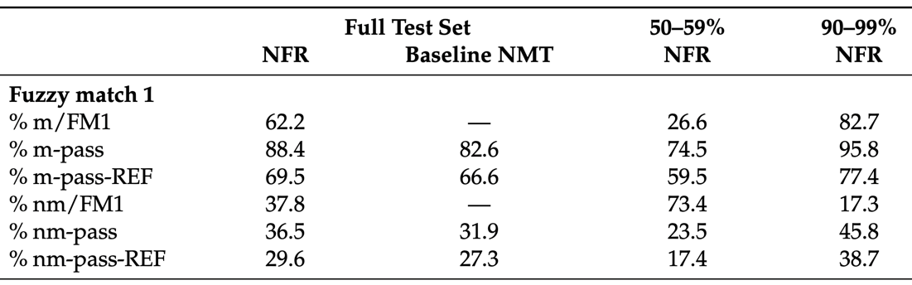
Impact of data augmentation
Analysis of match (m) and no-match (nm) words in FMs and whether they appeared in the MT output (pass) as well as in the reference translation (REF).
Notes:
Out work also found that the tokens in the fuzzy translations appeared more often in the NFA output than in baseline NMT translations. This was the case for both tokens that were aligned to tokens in the input sentence (matched) and those that were not (non-matched). In both cases, we observed that more of these tokens were also present in the reference translations.
Another question targeted the impact FMs had on the MT output. This tableshows the percentage of matched tokens per selected FM (% m/FM1) and how many of these tokens appear in the MT output relative to the total number of matched tokens (% m-pass). We report these values for the full test set for both the baseline NMT and the NFA systems, even though the FM tokens, of course, did not actually appear in the baseline input. The table also shows what percentage of match/no-match tokens that appeared in the MT output, also formed part of the reference translation (%m-pass-REF). In addition to providing the values for the full test set, we provide them for the lowest (50–59%) and the highest (90–99%) match ranges for the NFA system.
On average, FM contained 62.2% tokens that were aligned with the source sentence (matched). For the highest FM range, this percentage reached 82.7%; for the lowest, it was only 26.6%. In the full test set, 88.4% of the matching tokens were transferred to the NFA output. Of all the matching tokens that appeared in the NFA output, 69.5% could also be found in the reference translation. Another interesting observation is that fewer matching tokens passed to the NFA output in the lowest FM range (74.5%), especially when compared to the highest range (95.8%).
Looking at how no-match tokens were used by both systems, on average, a higher ratio of such tokens appeared in the NFA translations (36.5%) than the baseline NMT output (31.9%). It is worth noting that a higher proportion of no-match tokens in NFA translations also formed part of the reference translation (29.6%) than is the case for the baseline translations (27.3%). On the other hand, the majority of no-match tokens that appeared in the NFA and baseline outputs (70.4% and 72.7%, respectively) did not appear in the reference translations. The NFA system also seemed to carry a higher percentage of no-match tokens to its output in higher FM ranges (45.8% in 90–99% vs. 23.5% in 50–59%) and more of these tokens appeared in the reference translations in the higher match range.

Slide 18
NFA > NMT > TM
Improving translation quality with Neural Fuzzy Adaptation
Results showed that all automated metrics, which compared the MT output to a reference translation, showed higher scores for the NFA system than for an NMT baseline and confirmed the significant improvements it achieved.
A detailed TER analysis showed that the strengths of the NFA system are to produce translations with more similar lexical choices and word order than the reference translations.
Notes:
Results showed that all automated metrics, which compared the MT output to a reference translation, showed higher scores for the NFA system than for an NMT baseline and confirmed the significant improvements it achieved. A detailed TER analysis showed that the strengths of the NFA system are to produce translations with more similar lexical choices and word order than the reference translations.
References
Neural Fuzzy Repair: Integrating Fuzzy Matches into Neural Machine Translation. Bulté, Bram and Tezcan, Arda. Proceedings of the 57th Annual Meeting of the Association for Computational Linguistics. 2019, Jul. Florence, Italy.
Boosting Neural Machine Translation with Similar Translations. Xu, Jitao, Crego, Josep and Senellart, Jean. Proceedings of the 58th Annual Meeting of the Association for Computational Linguistics. 2020, Jul. Online.
Priming Neural Machine Translation. Pham, MinhQuang, Xu, Jitao, Crego, Josep, Yvon, François and Senellart, Jean. Proceedings of the Fifth Conference on Machine Translation. 2020, Nov. Online.
Towards a Better Integration of Fuzzy Matches in Neural Machine Translation through Data Augmentation. Tezcan, A., Bulté, B., Vanroy, B. Informatics 2021, 8, 7.
Evaluating the Impact of Integrating Similar Translations into Neural Machine Translation. Tezcan, Arda, Bulté, Bram. Information 2022, 13, 19. https://doi.org/10.3390/info13010019
SCATE taxonomy and corpus of machine translation errors. Tezcan, A.; Hoste, V.; Macken, L. Trends E-tools Resour. Transl. Interpret. 2017, 32, 219–244.

Slide 19
References
Improving translation quality with Neural Fuzzy Adaptation
References
Neural Fuzzy Repair: Integrating Fuzzy Matches into Neural Machine Translation. Bulté, Bram and Tezcan, Arda. Proceedings of the 57th Annual Meeting of the Association for Computational Linguistics. 2019, Jul. Florence, Italy.
Boosting Neural Machine Translation with Similar Translations. Xu, Jitao, Crego, Josep and Senellart, Jean. Proceedings of the 58th Annual Meeting of the Association for Computational Linguistics. 2020, Jul. Online.
Priming Neural Machine Translation. Pham, MinhQuang, Xu, Jitao, Crego, Josep, Yvon, François and Senellart, Jean. Proceedings of the Fifth Conference on Machine Translation. 2020, Nov. Online.
Towards a Better Integration of Fuzzy Matches in Neural Machine Translation through Data Augmentation. Tezcan, A., Bulté, B., Vanroy, B. Informatics 2021, 8, 7.
Evaluating the Impact of Integrating Similar Translations into Neural Machine Translation. Tezcan, Arda, Bulté, Bram. Information 2022, 13, 19. https://doi.org/10.3390/info13010019
SCATE taxonomy and corpus of machine translation errors. Tezcan, A.; Hoste, V.; Macken, L. Trends E-tools Resour. Transl. Interpret. 2017, 32, 219–244.
Notes:
Results showed that all automated metrics, which compared the MT output to a reference translation, showed higher scores for the NFA system than for an NMT baseline and confirmed the significant improvements it achieved. A detailed TER analysis showed that the strengths of the NFA system are to produce translations with more similar lexical choices and word order than the reference translations.
References
Neural Fuzzy Repair: Integrating Fuzzy Matches into Neural Machine Translation. Bulté, Bram and Tezcan, Arda. Proceedings of the 57th Annual Meeting of the Association for Computational Linguistics. 2019, Jul. Florence, Italy.
Boosting Neural Machine Translation with Similar Translations. Xu, Jitao, Crego, Josep and Senellart, Jean. Proceedings of the 58th Annual Meeting of the Association for Computational Linguistics. 2020, Jul. Online.
Priming Neural Machine Translation. Pham, MinhQuang, Xu, Jitao, Crego, Josep, Yvon, François and Senellart, Jean. Proceedings of the Fifth Conference on Machine Translation. 2020, Nov. Online.
Towards a Better Integration of Fuzzy Matches in Neural Machine Translation through Data Augmentation. Tezcan, A., Bulté, B., Vanroy, B. Informatics 2021, 8, 7.
Evaluating the Impact of Integrating Similar Translations into Neural Machine Translation. Tezcan, Arda, Bulté, Bram. Information 2022, 13, 19. https://doi.org/10.3390/info13010019
SCATE taxonomy and corpus of machine translation errors. Tezcan, A.; Hoste, V.; Macken, L. Trends E-tools Resour. Transl. Interpret. 2017, 32, 219–244.

