Slide 1
My Portfolio Projects

Slide 2
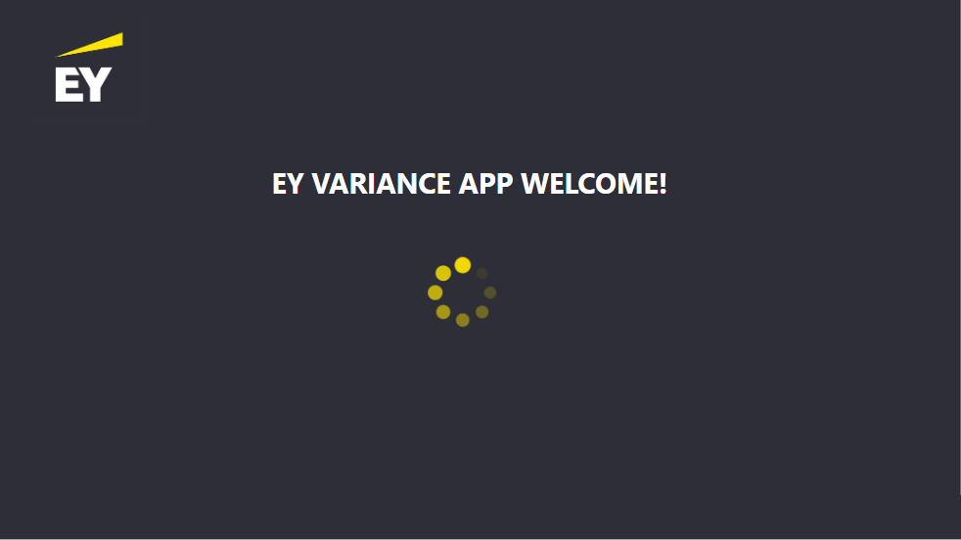
Variance App + Mercury Dashboard

Slide 3
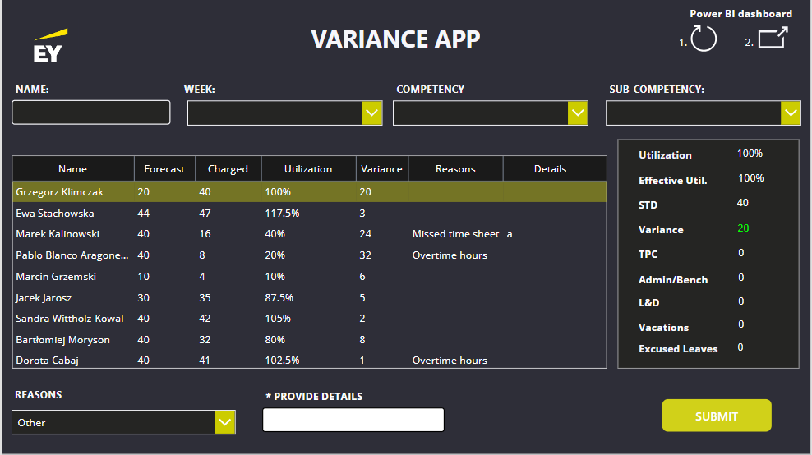

Slide 4
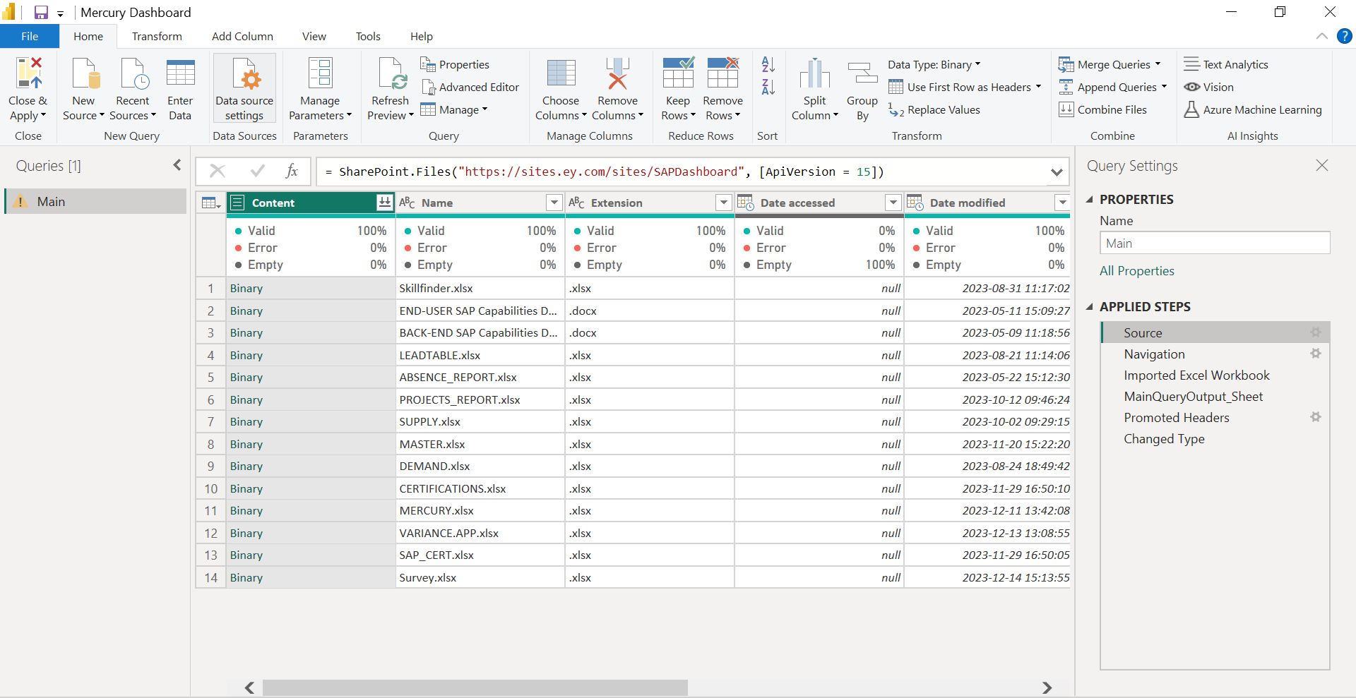

Slide 5
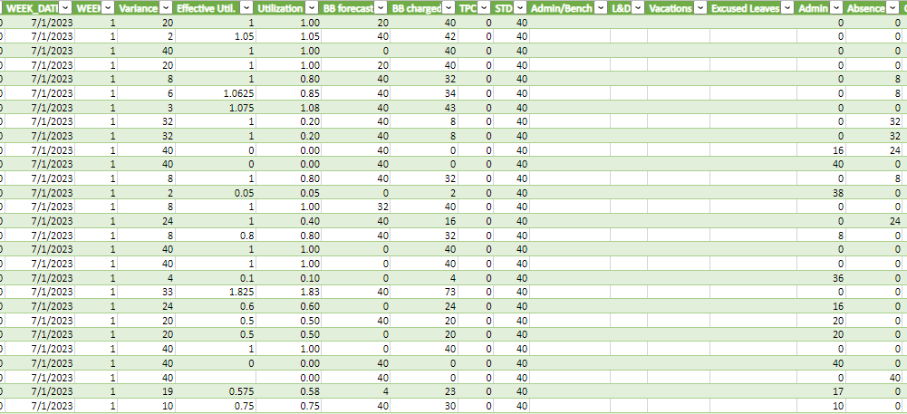

Slide 6
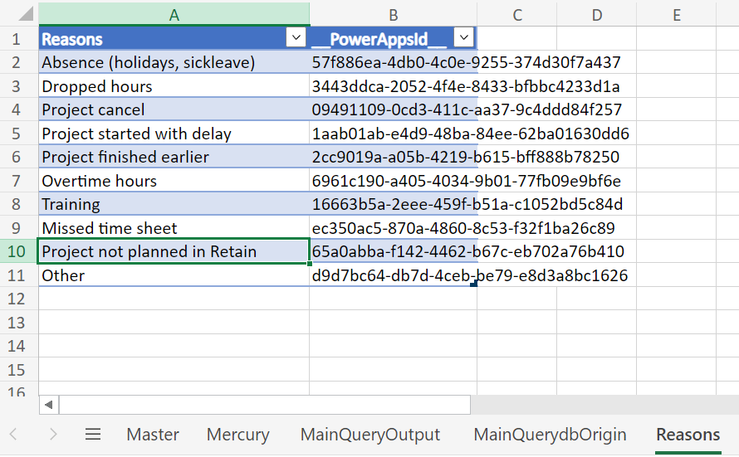

Slide 7
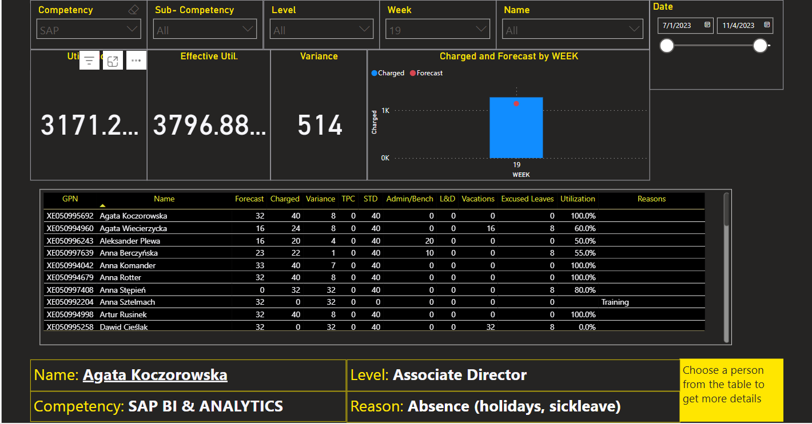
Doe John
Business Intelligence

Slide 8
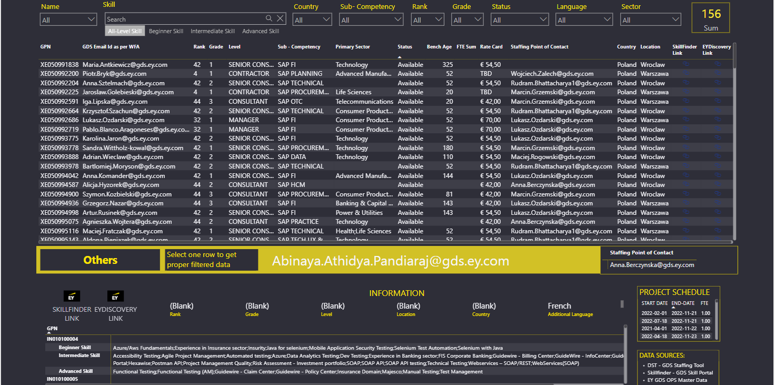
Employee’s Capabilities Dashboard

Slide 9
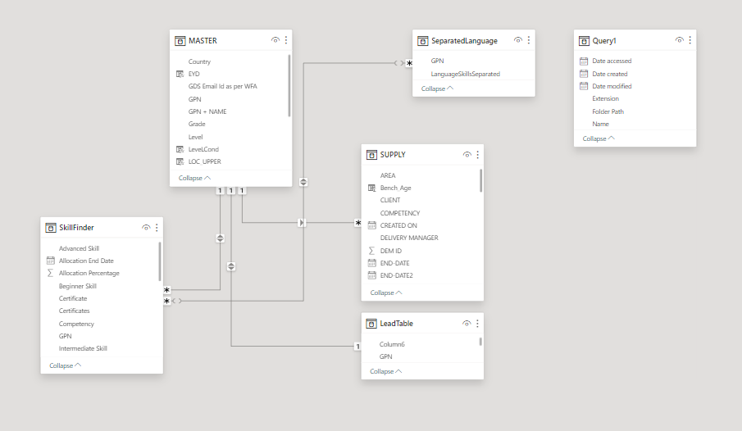

Slide 10
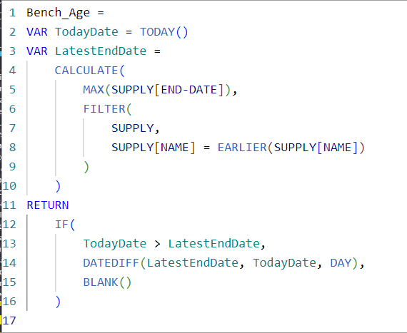
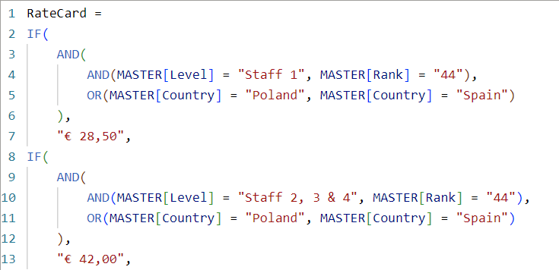
We didn’t know SWITCH back in a day ☺

Slide 11
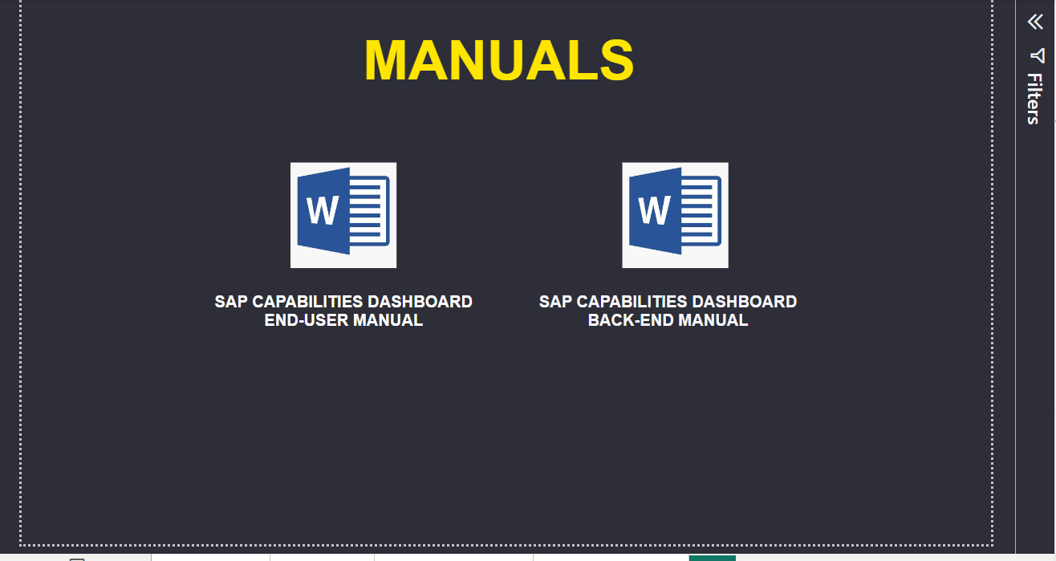

Slide 12
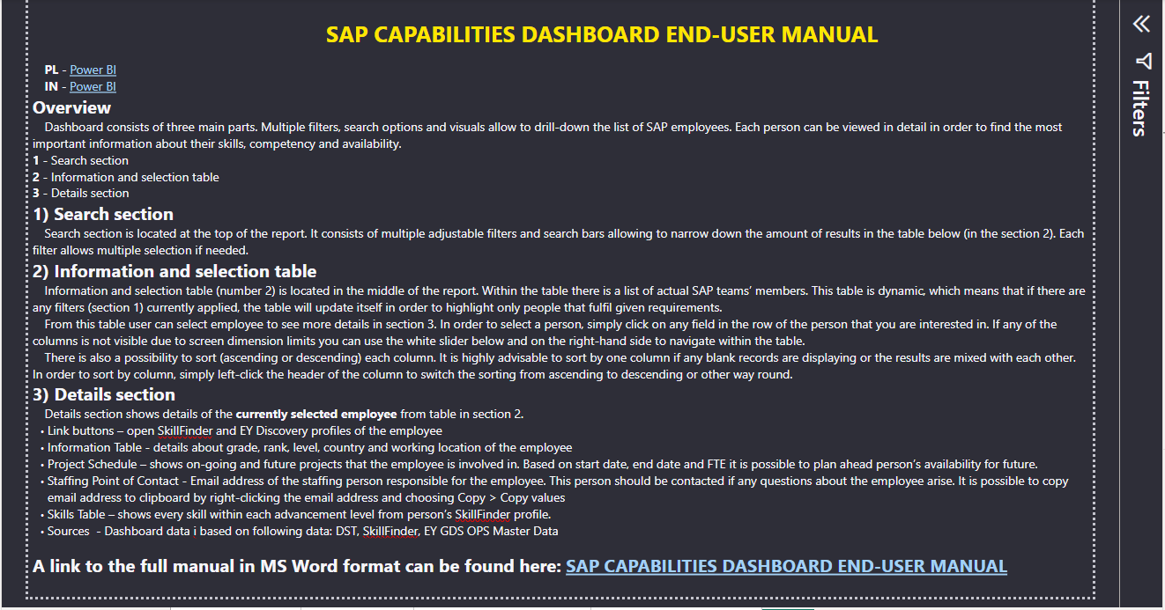

Slide 13
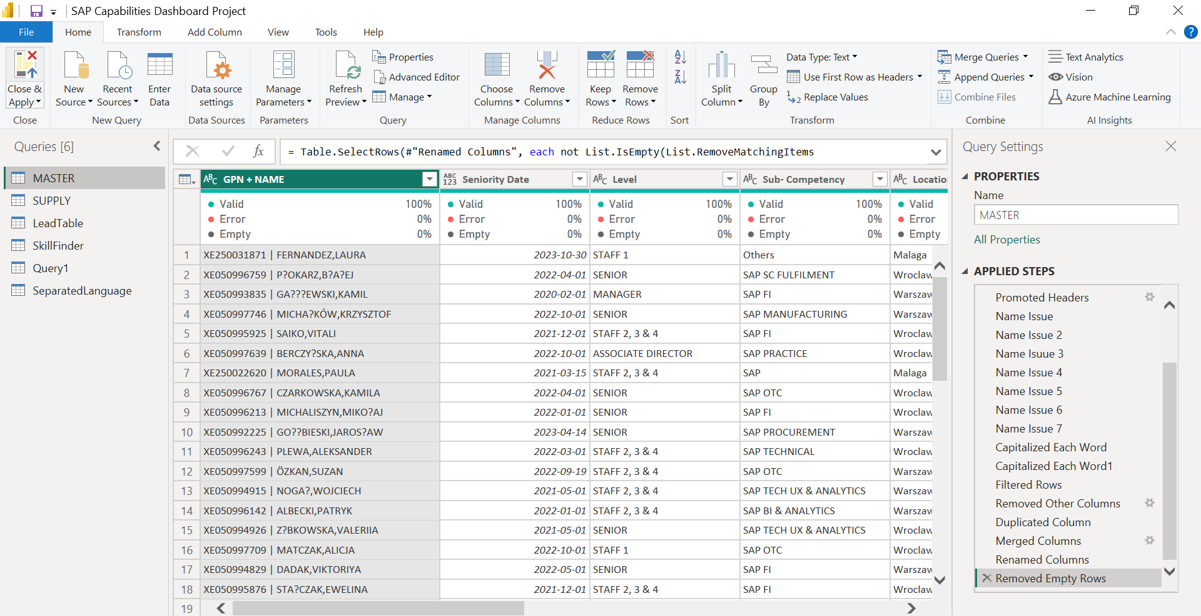

Slide 14
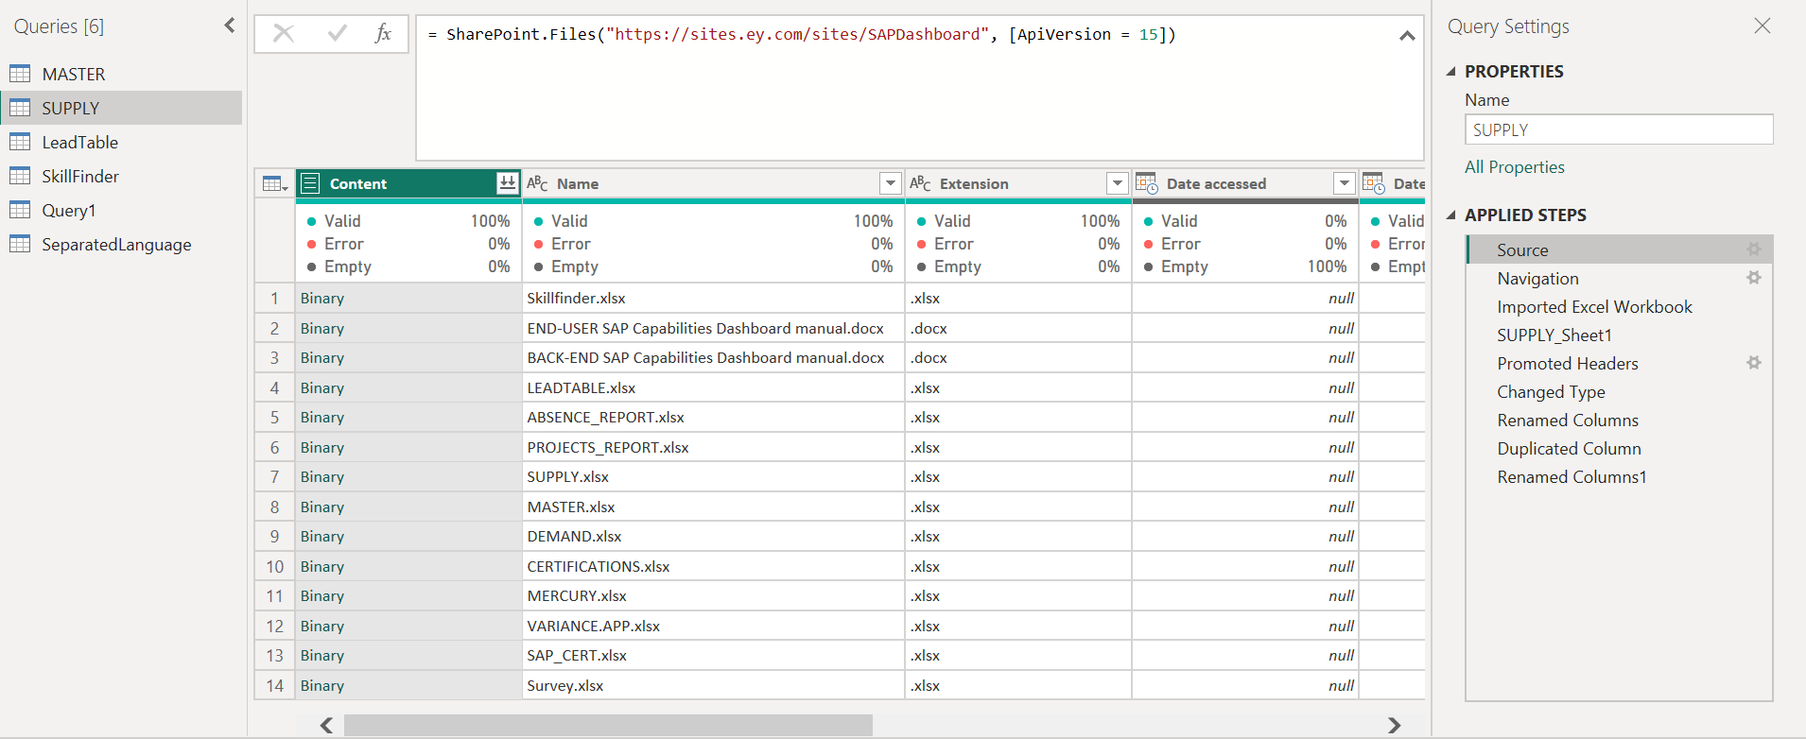

Slide 15
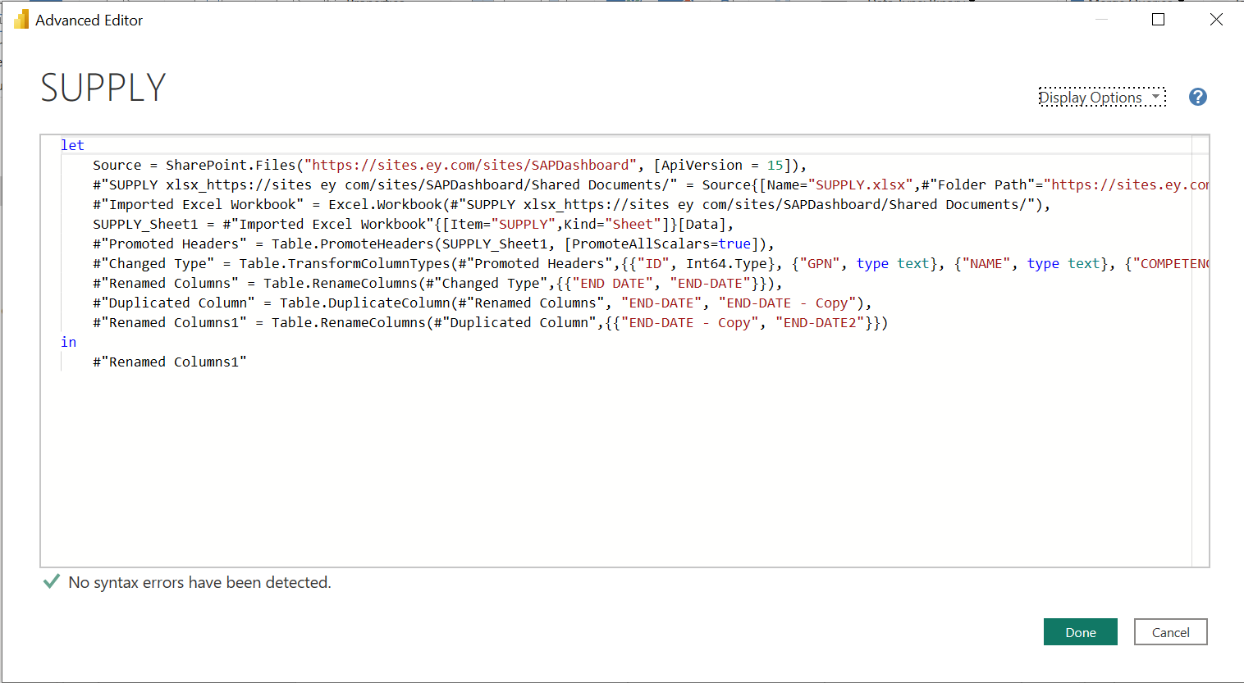

Slide 16
EUROPEAN UTILIZATION PROJECT

Slide 17
SAP Practice Europe - Supply Capabilities dashboard
Master Data records available in the dashboard
PURPOSE - enable professionals to track and identify skilled resources using more than one dimension in order to reduce search time and the manual effort
NOTE - Resource Managers at Regional/Country Level should be always contacted to validate availability and provide additional updated info needed (e.g. language, availability to travel, etc.
Supply data sources, visualization and appliance
SAP Specific skills
SAP Primary skill (Domain) | RETAIN (Sub group4) | Tracked
SAP Sub-skill (more than one) | Excel file | It will be tracked with one or more sub-skills per individual
Non-SAP specific skills
Seniority | RETAIN | rank, not related to a particular SAP skill
Project availability | RETAIN | Tracked
Languages | SuccessFactors - Employee profile | Quality of info challenged
Industry Experience (sector and service provided) | SuccessFactors- Employee profile | Quality of info challenged
Availability to travel | SuccessFactors (manual input) | Optional – dynamic
1
Data Sources
Retain
Excel
SuccessFactors
Data aggregation
Data visualization
2
SAP Practice Europe Supply Capacity Dashboard
SAP Practic Talent ooversight, monitoring, forecasting and reporting
3
MyDemand EMEIA tool
Demand intake | users workflow | resource allocation | reporting

Slide 18
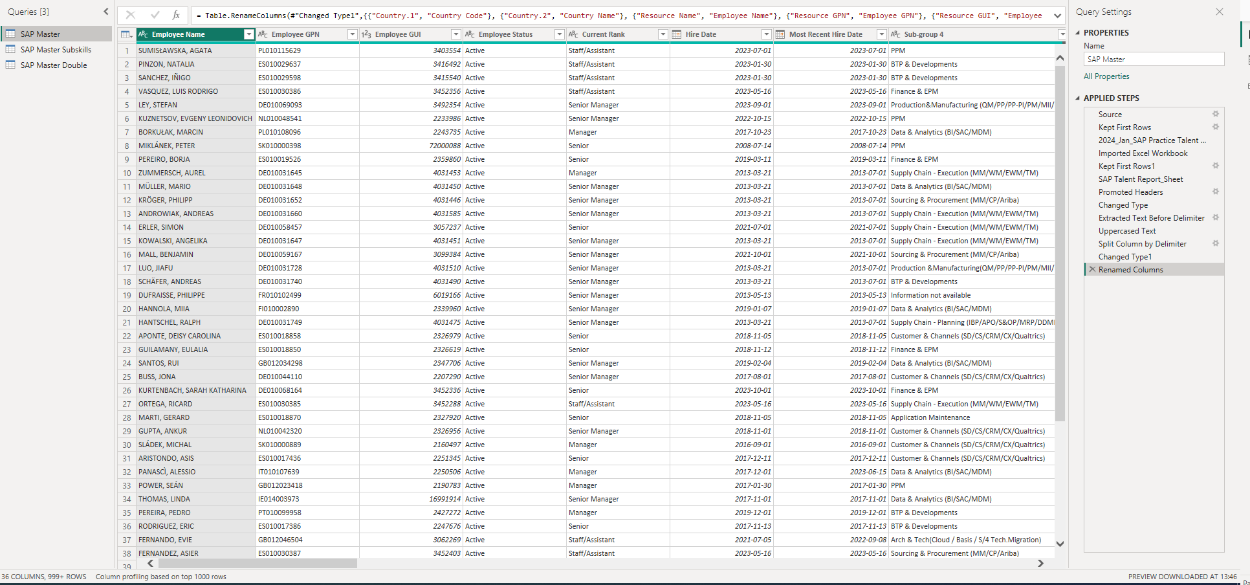

Slide 19
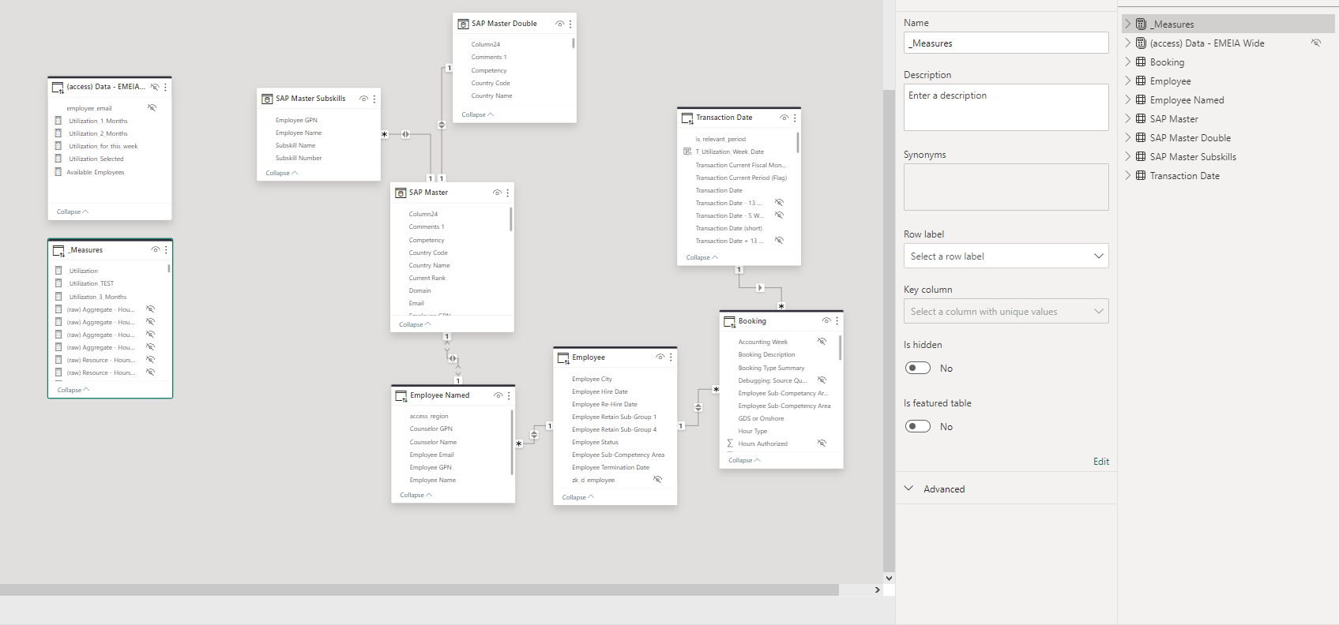

Slide 20
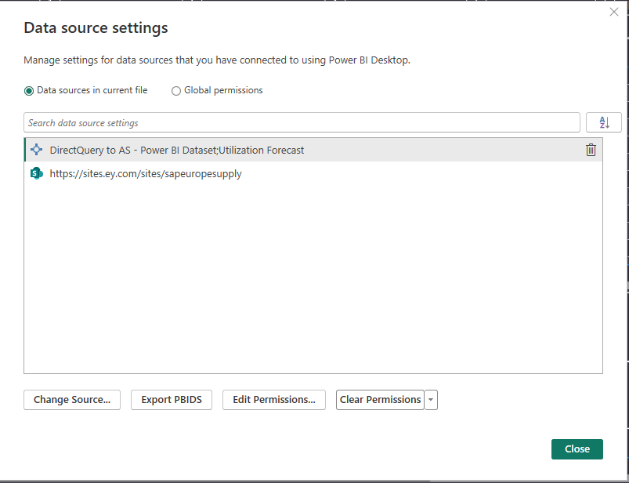

Slide 21
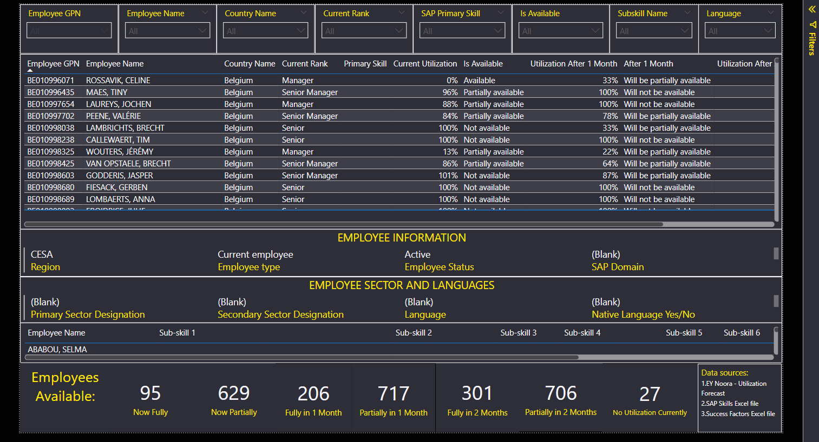

Slide 22
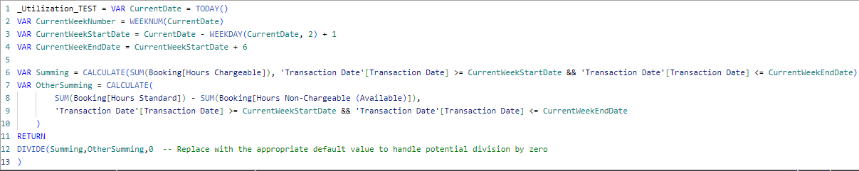
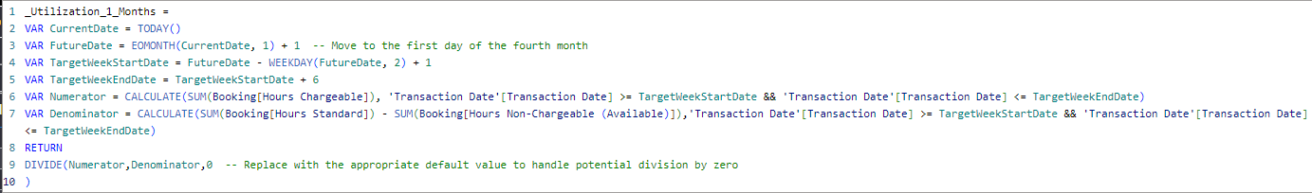
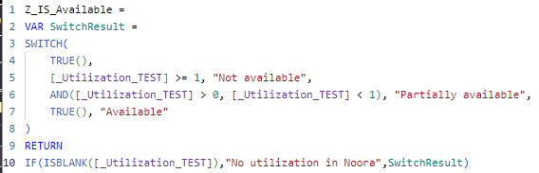
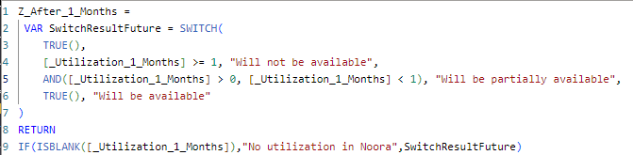

Slide 23
Further actions
In order to make this dashboard accessible for any user, I had to somehow bypass a requirement for providing credentials.
This was caused by the fact that my model was a composite (both Sharepoint Excel and live connection to external source).
In such case, live connection requires any user to be granted with access to the source, even for the dashboard using only part of its data.
To bypass this, I have exported the data from source dashboard into a new one, in order to create the same calculations and visuals.
In this scenario, dashboard is accessible to any user with view permissions and data security is maintained.

Slide 24
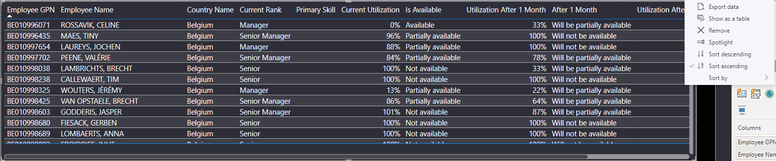
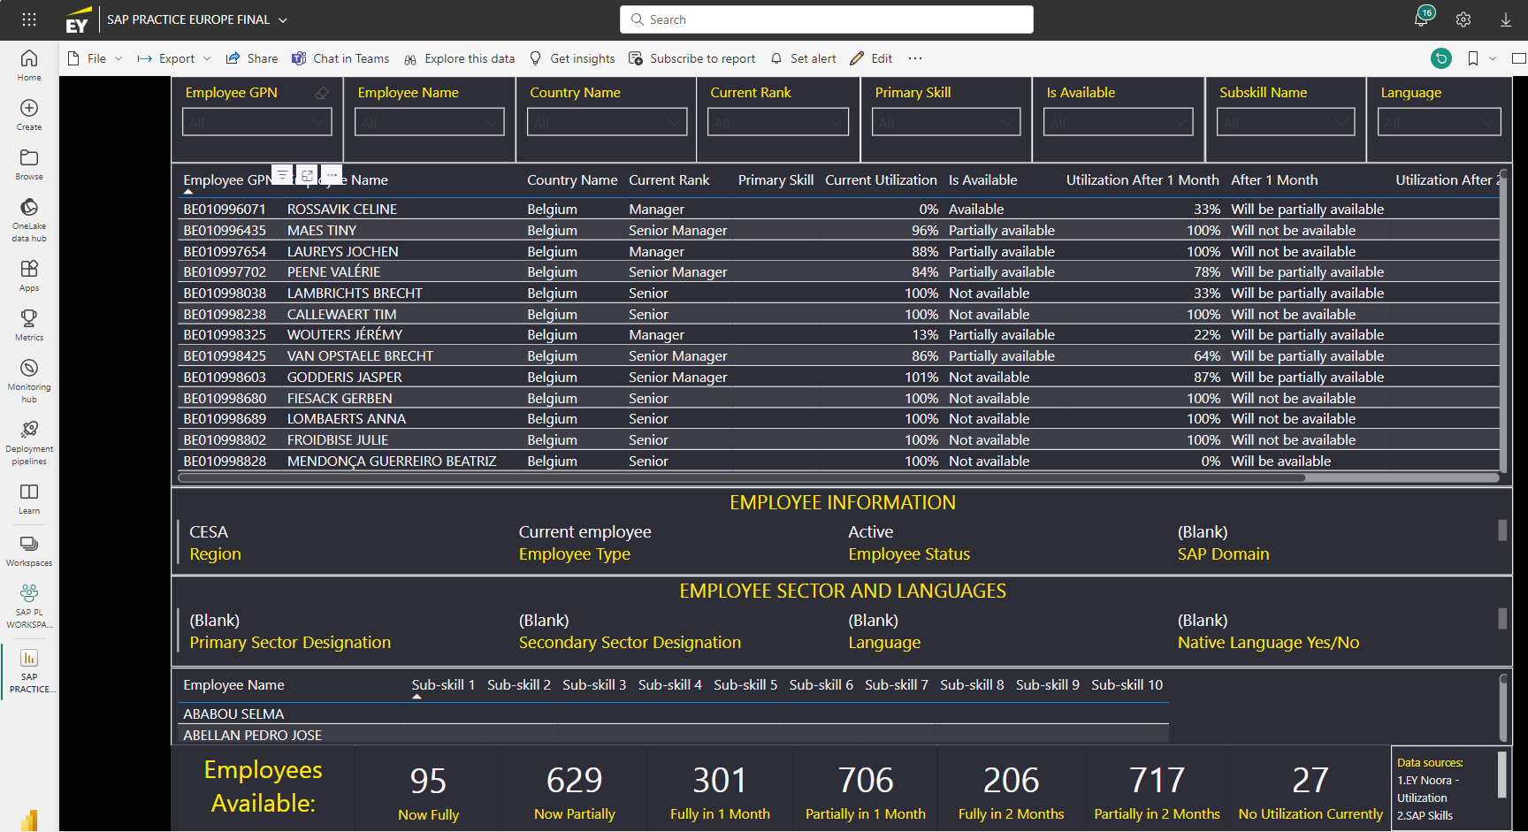

Slide 25
Thank you!

