Slide 1
Hybrid classifier using Rough Sets and Fuzzy Logic
Supervisor: dr inż. A. Żołnierek
Marcin Majak
Wroclaw University of Technology

Slide 2
Agenda
Introduction
Rough Sets
Fuzzy logic
Tasks
Simulations
Conclusions

Slide 3
Rough Sets
Invented in 1992 by polish scientist
Used in:
  Sequential classification tasks
  Medical diagnosis
Can deal with vaque and
Requires granulation step and construction of IF-THEN rules

Slide 4
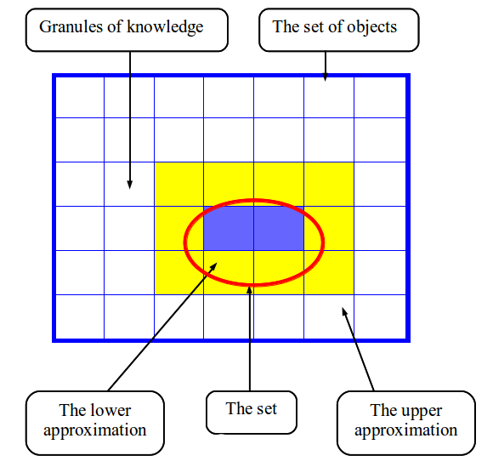
Rough Sets
Key features of Rough Sets:
  indiscernibility relation
  crips sets described by lower and upper approximations
  boundary region

Slide 5
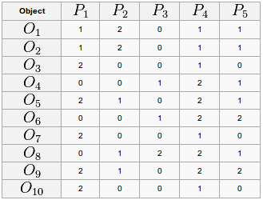
Rough Sets-example
Using P1, P2, P3, P4, P5:
  {O1, O2}
  {O3, O7, O10}
  {O4}
  {O5}
  {O6}
  {O8}
  {O9}

Slide 6
Definition of a Rough Set
Lower approximation:
PX ={O1, O2} u { O4}
Upper approximation
PX = {O1, O2} u {O4} u {O3, O7, O10}
X represents concept
X = {O1, O2, O3, O4}
P = {P1, P2, P3, P4, P5}

Slide 7
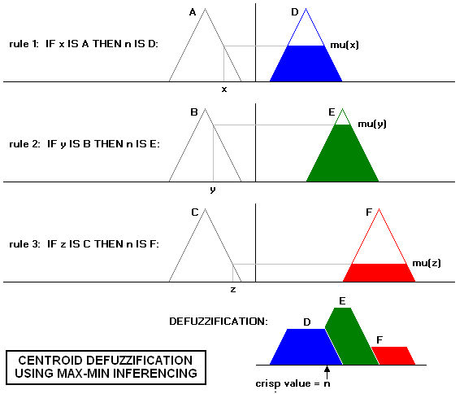
Fuzzy logic
Describe membership of element in a set
  membership function in the real unit interval [0,1]
  Crips set: an element either belongs or does not belong to the set
  Fuzzy set: an element either belongs (1), does not belong (0) or partially belong (0-1) to the set

Slide 8
Aspects of master thesis
Engineer aspect:
  preparation of simulation tool for experimental investigations
    done using python
Research aspect:
  researche about different types of fusion for fuzzy and rough set classifier
  algorithm proposal
  Test on the real input data

Slide 9
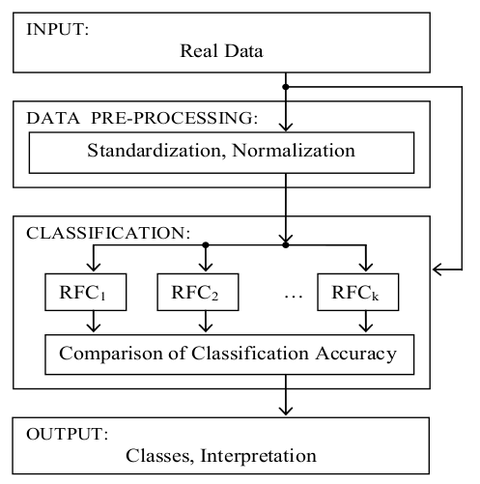
Proposal of algorithm

Slide 10
Algorithm description

Slide 11
Input datasets
Well known testing datasets from UCI repository:
  Iris dataset
  Wine dataset
  Glass datasets
  Breast cancer Wisconsin
  Diabetest dataset (pima)

Slide 12
Experiment design
Each test was repeated 20 times
10-fold Cross Validation used for obtaining learning and testing data
Indicators:
  Classification accuracy
  stability

Slide 13
Results

Slide 14
Summary

Slide 15
Literature
Kuncheva L., Wiley J. ’Combining pattern classifiers’, 2004 New Jersey
Grzymala-Busse, J., ’A system for learning from examples based on rough sets’. In: R. Slowinski (Ed.), Intelligent decision support: handbook of applications and advances of the rough sets theory Dordrecht, Kluver Academic Publishers, 1992,
Pawlak, Z.:’Rough sets, decision algorithm and Bayes’ theorem’ European Journal of Operational Research, 136, 2002,
Zolnierek A.: ’Simulation investigations of rough sets method in sequential pattern recognition task’. Proceeding of International
Conference ASIS’2007, Ostrava, Czech Republic 2007, pp. 86-91 Qinghua H,Yu D.: ’Hybrid Attribute Reduction for Classification
Based on a fuzzy rough set technique’, SIAM Conference, 2009 Qinghua H., Shuang A., Xiao Y.: ’Robust fuzzy rough classifiers’, Elsevier, 2011
Wei-Zhi W., Zhang W.: ’Generalized fuzzy rough sets’, Information Sciences, Elsevier, 2009

