Slide 1
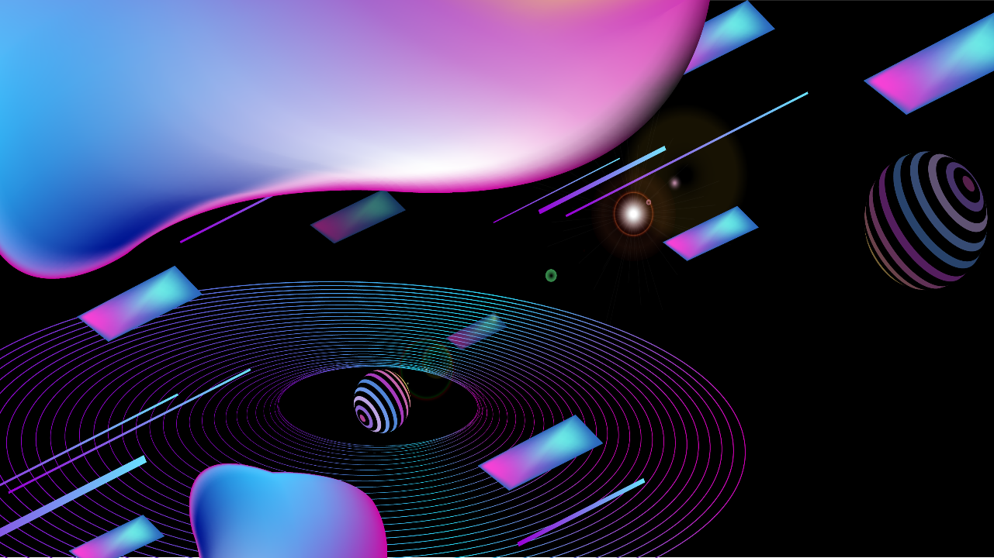
Chat Application Using MERN Stack

Slide 2
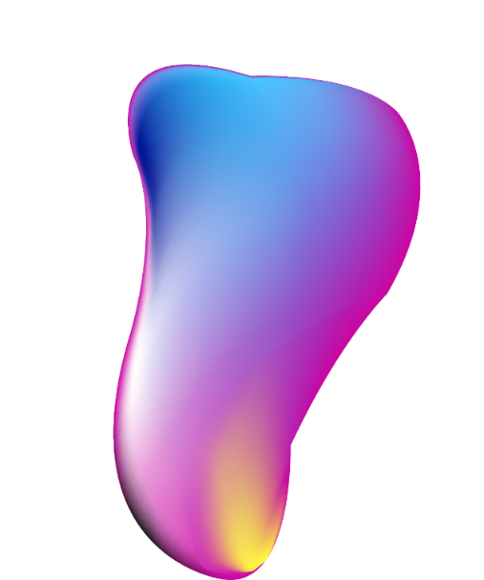


01
02
03
Project Overview
MERN Stack Architecture
Dockerization of the Application
04
05
06
Kubernetes Deployment
Application Deployment Demo
Future Enhancements and Conclusion

Slide 3



Project Overview
01.

Slide 4


Introduction to the Project
Technologies Used: MERN
The project leverages the MERN stack, composed of MongoDB for database management, Express.js for server-side application logic, React.js for interactive UIs, and Node.js for running JavaScript server-side. This combination ensures seamless interactions and efficient data management.
Key Features of the Application
Key features include user authentication, real-time messaging with WebSockets, media sharing capabilities, and a responsive design for optimal experience on various devices. The app also supports group chats and user-friendly notifications.
Purpose of the Chat App
The chat app was designed to facilitate real-time communication among users through a user-friendly interface, enabling text, image, and file sharing. It aims to enhance collaboration and connectivity in personal and professional contexts.

Slide 5
Development Process
Challenges Faced During Development
Key challenges included managing real-time data synchronization between users and ensuring robust user authentication. Additionally, addressing compatibility issues across different browsers required significant attention.
Solutions Implemented
Overview of Development Steps
To tackle synchronization, WebSocket connections were implemented for real-time updates. For authentication, JWT (JSON Web Tokens) were used to secure user sessions. This improved security and user experience considerably.
Development began with requirement gathering, followed by setting up the development environment. This was followed by iterative development cycles including coding, testing, and deployment using version control to manage changes effectively.

Slide 6
MERN Stack Architecture
02.

Slide 7
Understanding MERN Stack
MongoDB for Database
React.js for Frontend
MongoDB serves as a NoSQL database, allowing the storage of data in flexible, JSON-like documents. This model supports easy scaling and high availability, making it suitable for the app's growing data needs.
React.js offers a modular and component-based architecture, facilitating dynamic rendering of UI elements. This enhances user interactivity with state management features, improving overall user experience.
Express.js for Backend
Node.js for Server
Express.js is utilized to handle server-side logic and routing. It simplifies API development and allows for efficient handling of incoming requests and responses through middleware functions.
Node.js enables JavaScript execution on the server side, allowing for a unified language throughout the stack. Its event-driven architecture makes it capable of handling concurrent connections efficiently.

Slide 8

Application Architecture
Application Structure
Data Flow in the App
Component Breakdown
The application structure follows a typical MVC pattern, separating concerns into models, views, and controllers. This organization helps in maintaining code clarity and facilitates team collaboration.
Data flows in a loop where user inputs from the frontend are sent to the backend via API calls. The backend processes requests and interacts with MongoDB, returning responses back to the frontend for display.
Major components include User Authentication, Message Sending, Chat User Interface, and Notification System. Each component handles specific functionalities, promoting reusability and better code management.

Slide 9
Dockerization of the Application
03.

Slide 10
Creating Docker Image
Building the Image
Building the Docker image involves executing the Docker build command, which compiles all specified layers within the Dockerfile. This streamlined process enhances portability and consistency across development and production environments.
Dockerfile Explanation
The Dockerfile outlines the instructions for building the application image, detailing the base image, dependencies, and configuration for the container environment, ensuring consistent application behavior.

Slide 11

Benefits of Docker
Isolation of Services
Each service can run in its isolated container, preventing conflicts and allowing independent management. This isolation applies to different versions of services, making it easier to update without impacting the overall system.
Consistency Across Environments
Docker ensures that the application runs consistently regardless of the environment, eliminating "it works on my machine" issues by encapsulating the app and its dependencies within containers.
Easy Deployment
With Docker, the deployment process becomes straightforward: simply run the container and the application is launched, significantly reducing downtime and improving deployment speed.

Slide 12
Kubernetes Deployment
04.

Slide 13
Setting Up Kubernetes
Key Benefits of Kubernetes
Kubernetes provides scalability, self-healing capabilities, and load balancing. These features enhance application uptime and reliability, making it ideal for managing multiple containers across clusters.
Introduction to Kubernetes
Kubernetes is an open-source platform designed for the orchestration of containerized applications. It automates deployment, scaling, and management of application containers, offering robust infrastructure for cloud-native applications.

Slide 14
Deployment Configuration
Services Configuration for Frontend and Backend
Services are configured to expose the frontend and backend components, allowing communication between the two. Specific configurations include type of service, ports mapping, and environment variables for proper integration.
Deployment YAML Files
Deployment YAML files are used to define the desired state of the application. They describe services, routes, and deployments, allowing Kubernetes to manage the application lifecycle as requested.

Slide 15
Application Deployment Demo
05.

Slide 16
Live Demo of Chat App
Demonstration of Features
The demo will display real-time messaging, file sharing, and notifications. User interactions will be highlighted, illustrating how quickly users can communicate and share information.
Accessing the Application
The application can be accessed via its designated URL, where users can sign up, sign in, and explore the chat features, showcasing the seamless integration of all components.

Slide 17
Performance Analysis
01.
02.
Response Times
Load Handling
The performance analysis focuses on measuring response times for various operations, demonstrating the application’s efficiency in handling user inputs and server responses effectively.
Load testing results will be presented, showcasing how well the application maintains performance under heavy traffic. This evaluation is crucial to ensure the application can scale as user demand grows.

Slide 18
Future Enhancements and Conclusion
06.

Slide 19
Potential Improvements
Feature Additions
Scalability Considerations
Future updates could include voice and video call functionalities, enhanced data encryption for security, and integrations with third-party services like calendar and task management tools.
Considerations for scalability include implementing horizontal scaling strategies and refining load balancers to ensure optimal performance as user numbers increase over time.

Slide 20
Conclusion
Final Thoughts on the Project
This project highlights the efficiency of modern web technologies and cloud-native architecture in building scalable applications, paving the way for future innovations and improvements in the chat application domain.
Summary of Accomplishments
The project successfully implemented a fully functional chat application using the MERN stack, showcasing real-time communication capabilities and robust architecture deployed in Docker and Kubernetes.

