Slide 1
Tetris
Team 8 2023.06.14
50231154 샤오치
20190660 장한
20223868 세비어
20222034 장육예

Slide 2
2. Demo
3. QA
1. Game Design
4. Job Assignment

Slide 3
1
Game Design

Slide 4
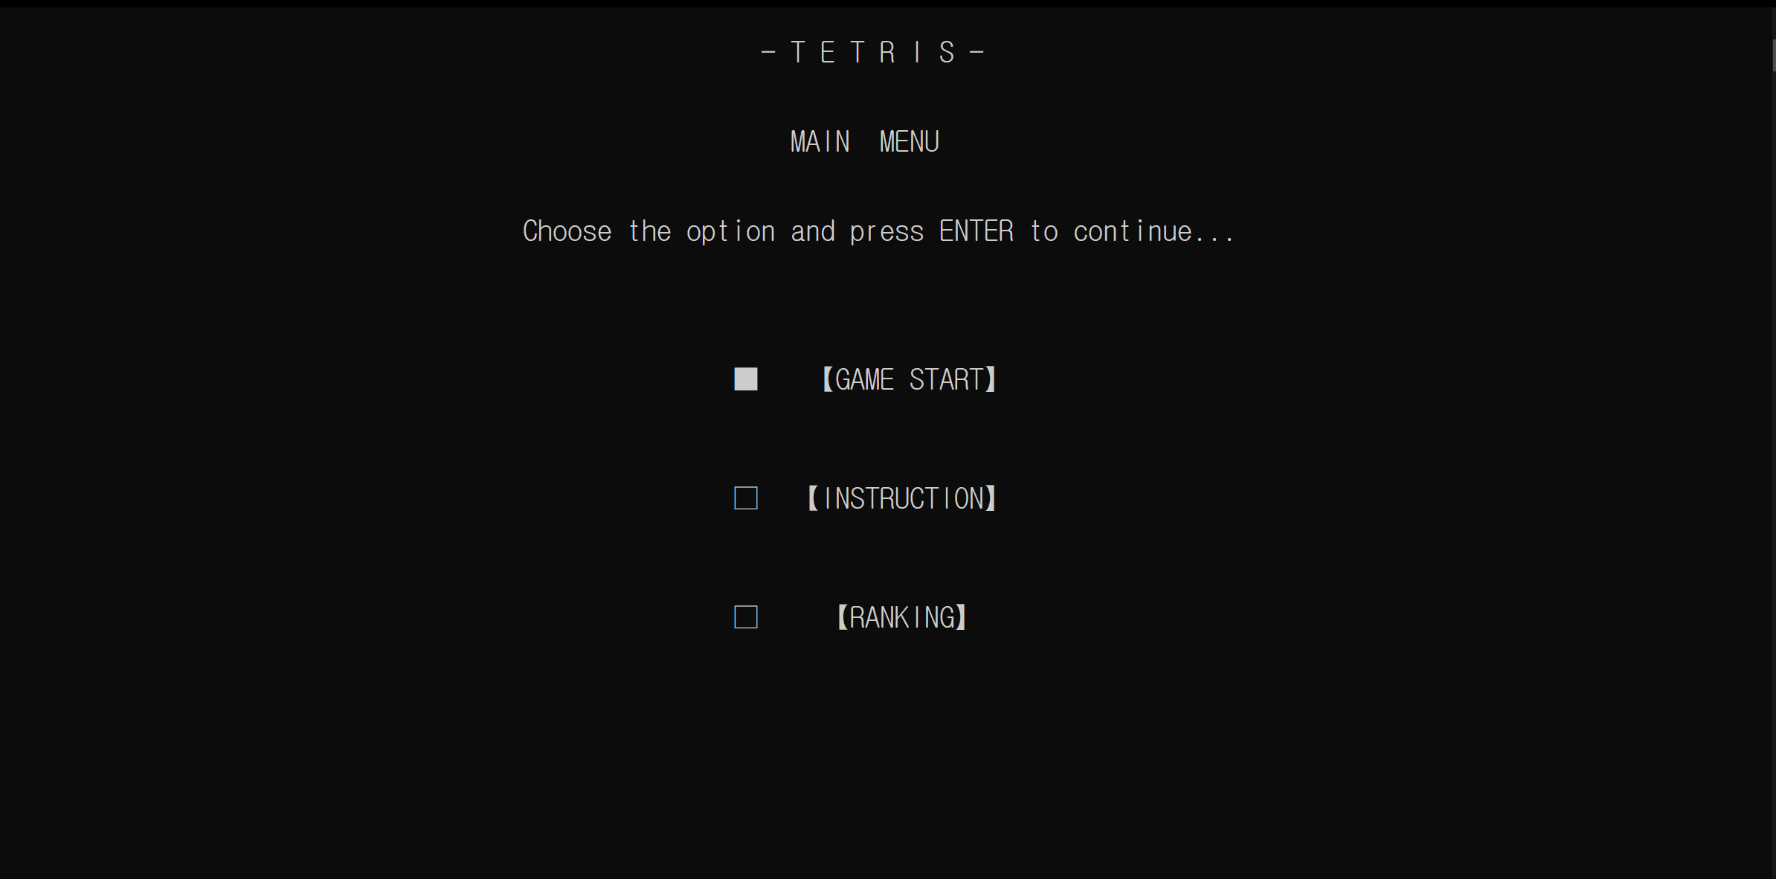
1
Game Design (Interface - Main Menu)
Notes:
Main menu主選單劃分為三個區域:
遊戲、操作說明、排名

Slide 5
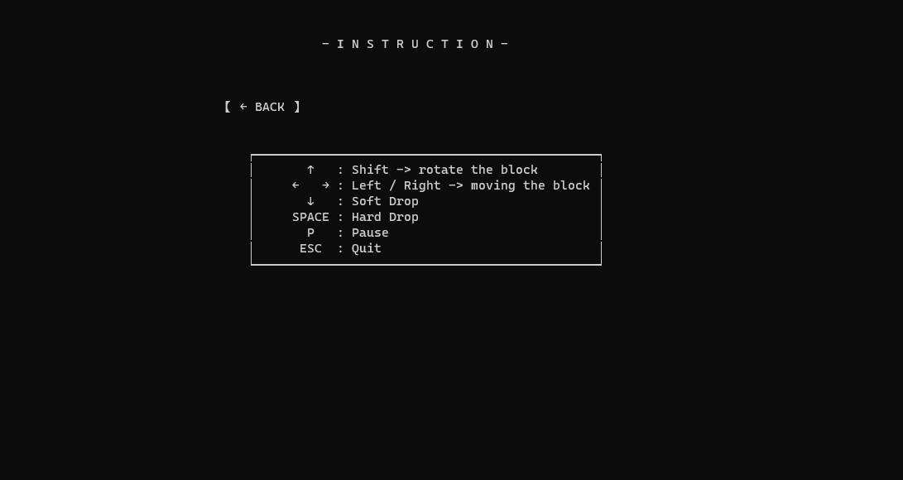
1
Game Design (Interface - Instruction)
Notes:
Instruction介面這邊會有基本的操作說明

Slide 6
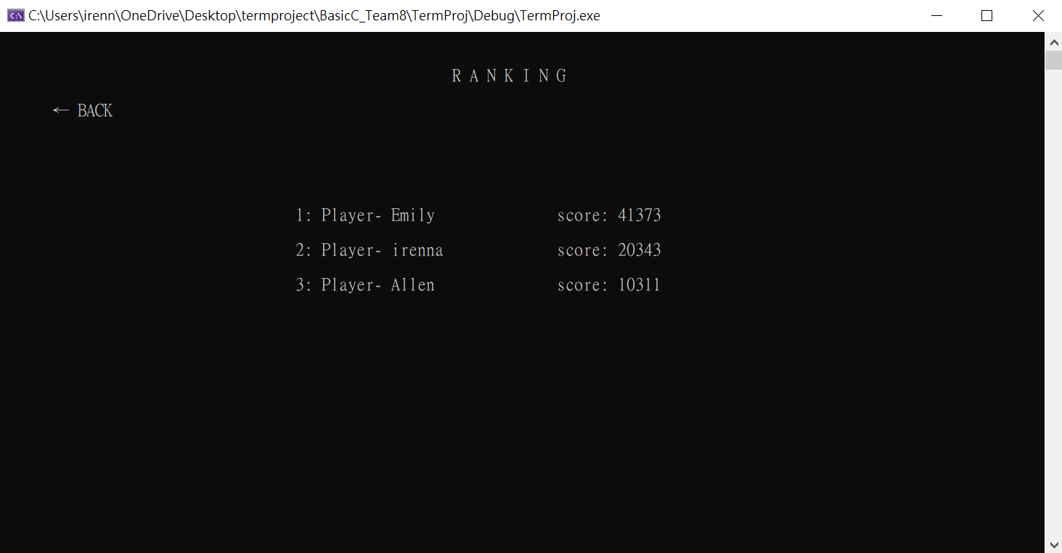
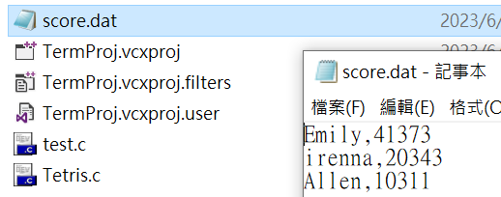
1
Game Design (Interface - Ranking)
Notes:
Ranking介面這邊可以看到Top 10的player name跟score

Slide 7
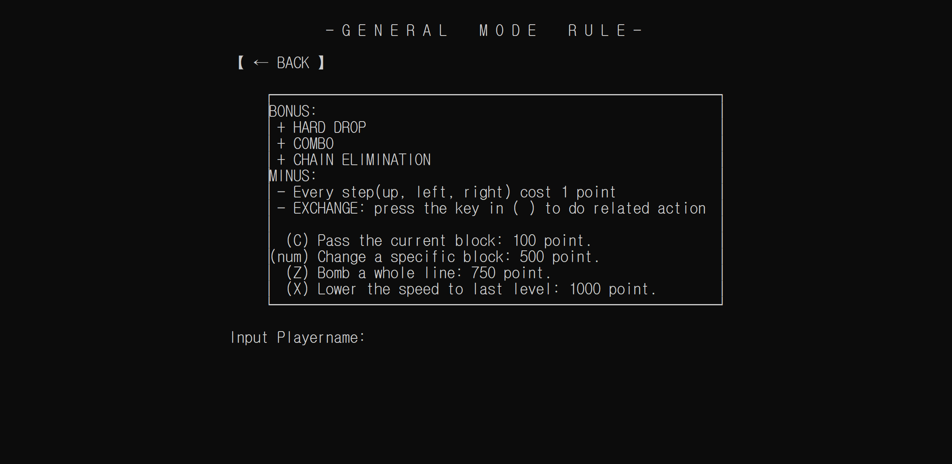
1
Game Design (Interface - Game Start)
Notes:
General mode的遊玩說明

Slide 8
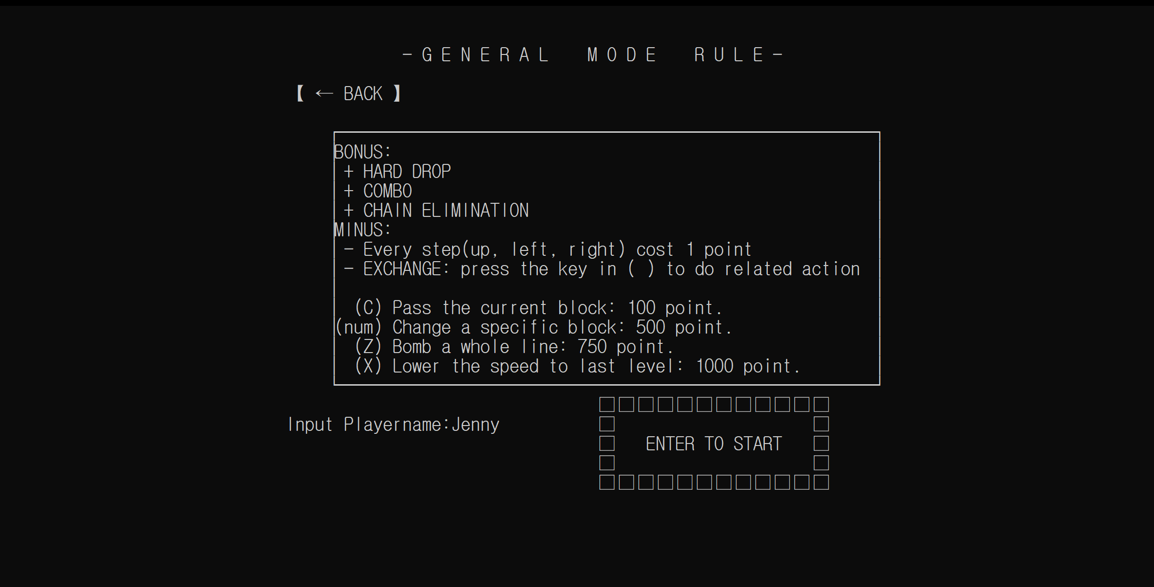
1
Game Design (Interface – General mode)
Notes:
輸入玩playername後按下enter。則會出現開始的框框。再次按下後即可開始遊玩。
這個模式的目的在於….

Slide 9
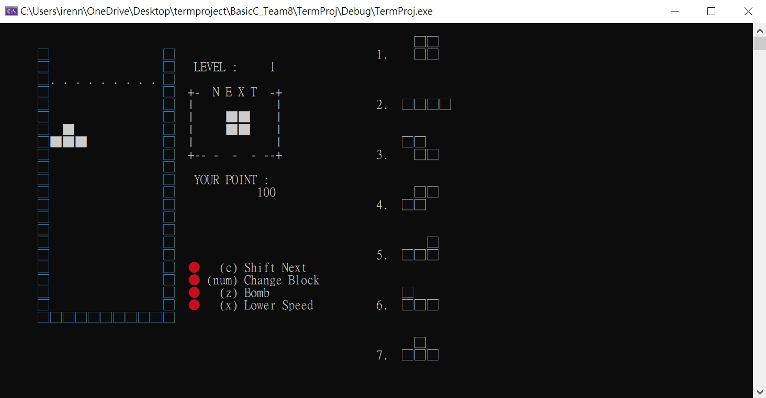
1
Game Design (Interface – General mode)
Notes:
介紹板面 說明紅色、黃色、綠色圖像

Slide 10
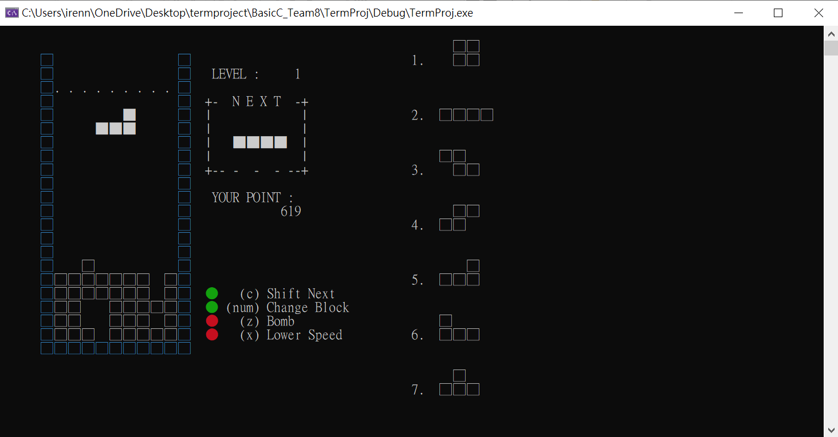
1
Game Design (Interface – General mode)
Notes:
介紹板面 說明紅色、黃色、綠色圖像

Slide 11
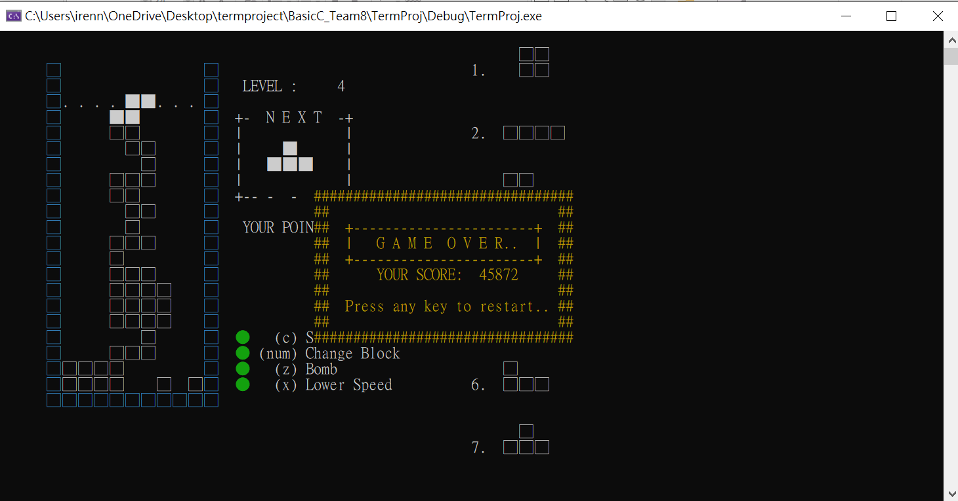
1
Game Design (Interface – General mode)
Notes:
死亡後會顯示當前分數

Slide 12
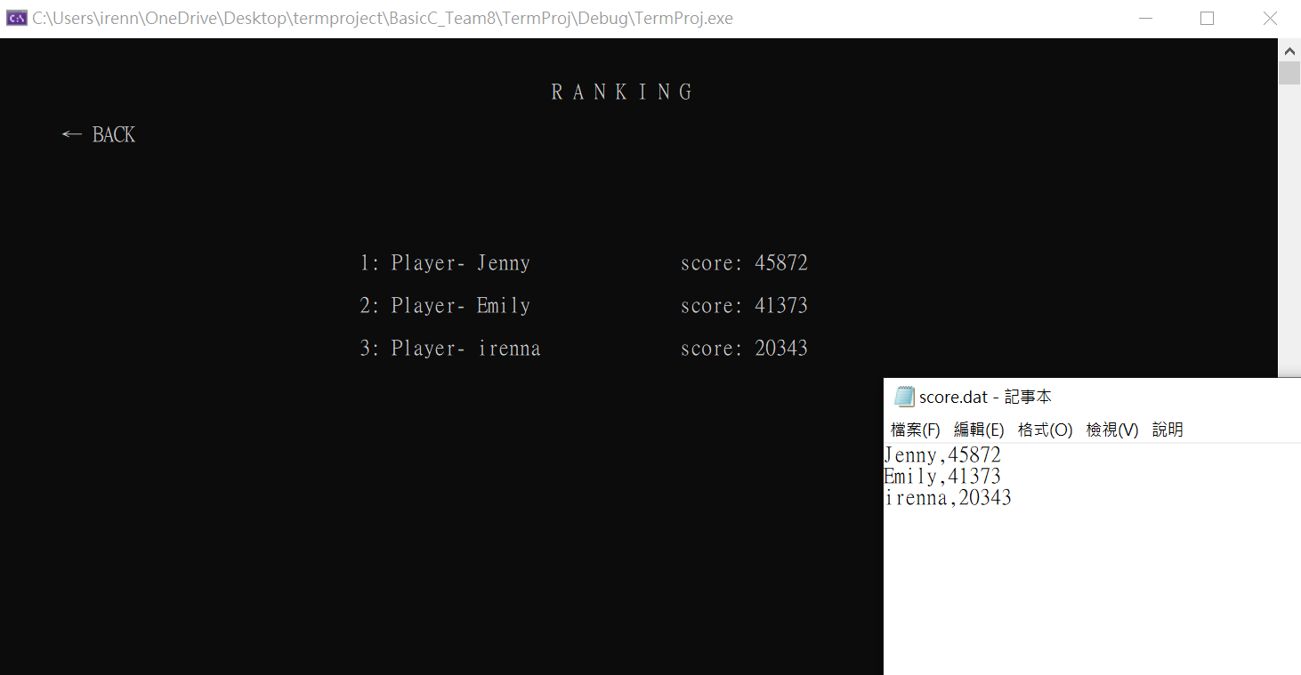
1
Game Design
Notes:
Update the score.dat with the new playername and score

Slide 13
2
Demo

Slide 14
3
QA

Slide 15
4
Job Assignments

Slide 16
4
Job Assignments
Game Design: 샤오치 루 50231154
Presentation: 세비어 20223868
PPT: 샤오치 루
Code-
Interface design: 샤오치 루
General Mode function: 장한 20190660
장육예 20222034
세비어

Slide 17
THANK
YOU

