Slide 1
RAG System project
by Cocilova Marco
GitHub reference: https://github.com/Marclova/Big_Data_RAG_Project.git

Slide 2
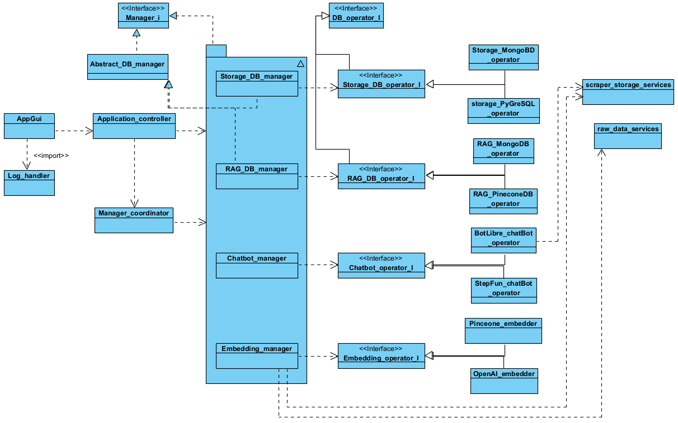
Project structure: dependencies

Slide 3
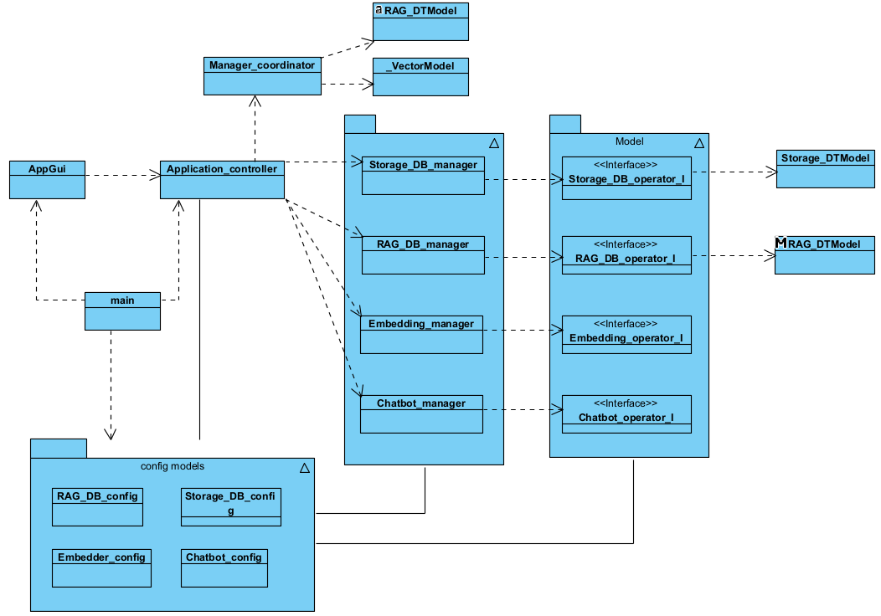
Project structure: initializations

Slide 4
RAGMongoDB: top_m vector retrieval
whole query
embeddings (JSON)
vectors
similarities
measurament
with
vector query
batch size
extract data
aggregate data into models
vector models
vector models (ordered)
vector models (ordered)
best top_m
insert into candidates list
sort by similarity
top_m = top_k * (1 + loge(batch_size)
produced candidates = top_m * (query_size/batch_size)

Slide 5
RAGMongoDB: intra-top_k filter
candidates list
top_k list (semi-ordered)
check if is closer than ‘min’
check if is not reduntìdant
min
unsorted
max
check if is closer than ‘max’
insert into the list as new ‘max’ or as unsorted element
eventual sort of the list
removal of ‘min’

Slide 6
Possible improvements
bug-fixes, adjustments and real-world-case error handling
complete GUI
distributive implementation
internal variables always manageable
intra-index top_k extension

Slide 7
Thank you
for
the attention

