Slide 1
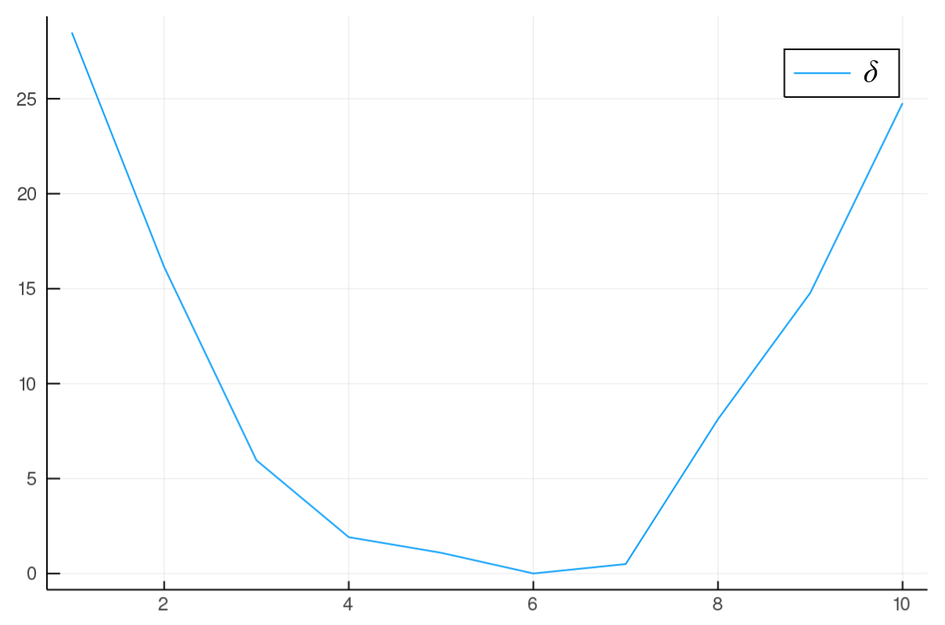
use case a)
use case b)
minimum ->
geometric mean
n
n

