Slide 1

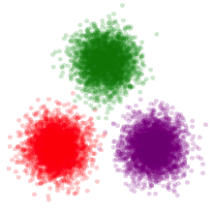
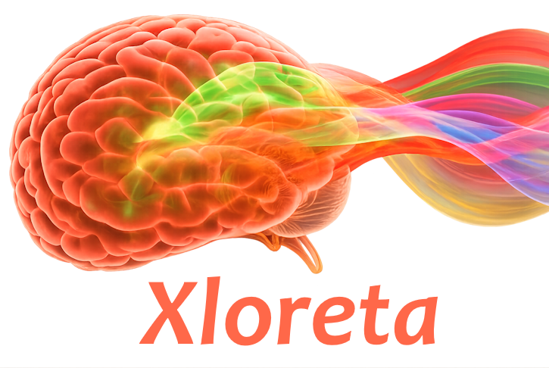
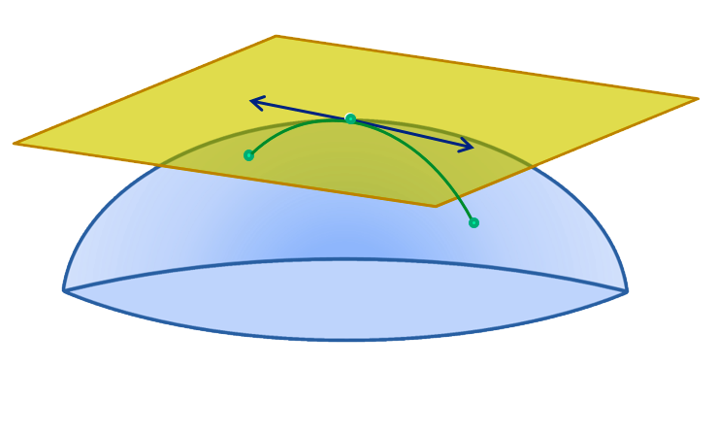
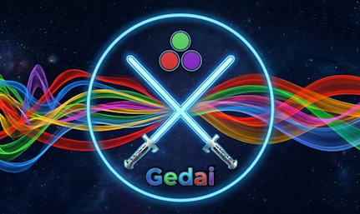
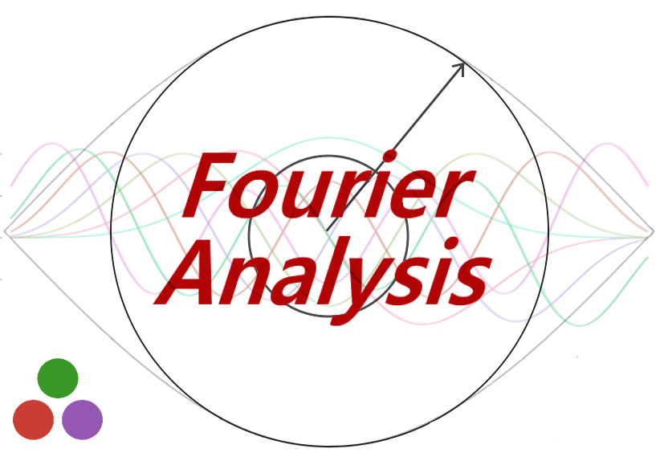
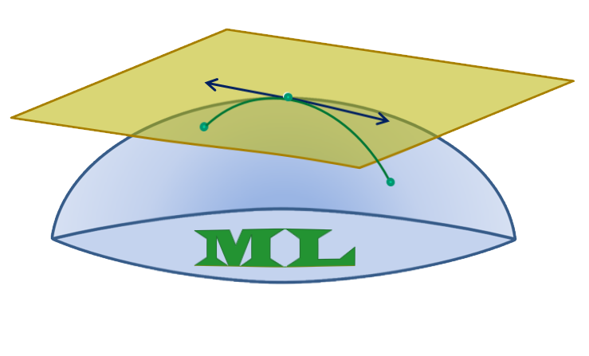

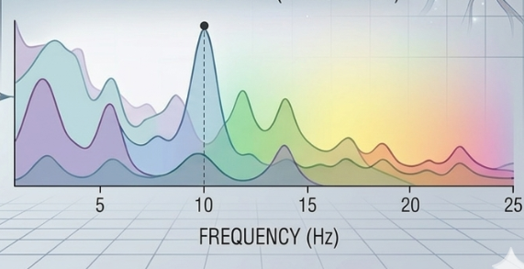
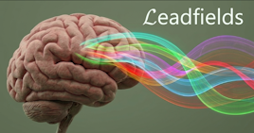
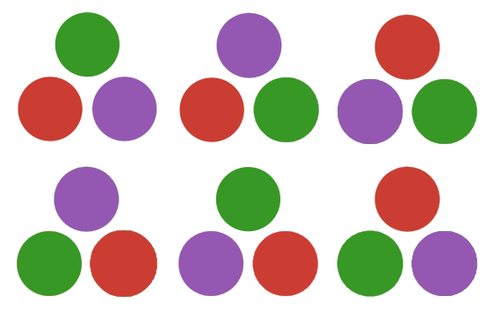

Eegle Integration
Powered by
PosDefManifold.jl
Inverse Solutions
Riemannian
geometry
Artifact Correction
LinearAlgebra.jl
FourierAnalysis.jl
PosDefManifoldML.jl
Linear Algebra, BLAS, LAPACK
Eegle
StatsBase.jl, Statistics.jl,
Distributions.jl
Riemannian
machine learning
Statistics, Probability distributions
and functions
Spectral analysis,
Time-frequency analysis,
Coherence, Connectivity
DSP.jl
Digital Signal Processing
PermutationTests.jl
Peak Frequency
Aperiodic Component
CovarianceEstimations.jl
Diagonalizations.jl
Covariance Estimations
Leadfield Matrices
Bonito.jl
Statistical testing
Spatial filters,
Blind Source Separation
Web GUIs

