Slide 1

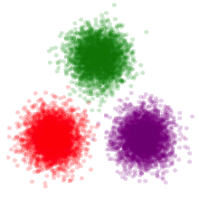
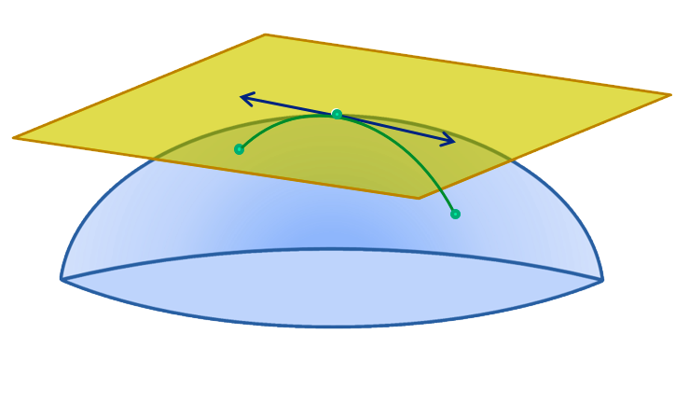
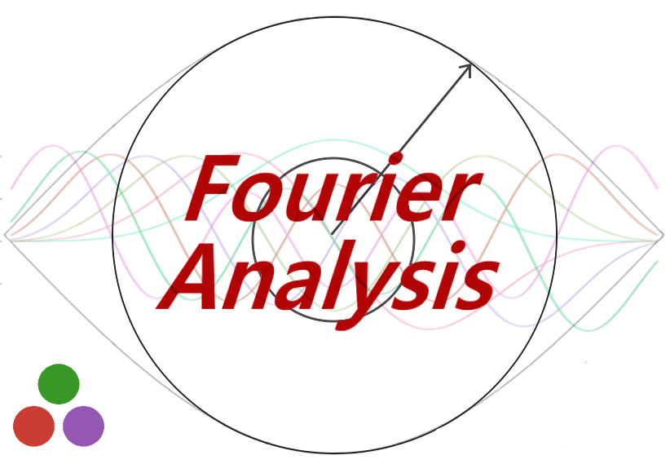
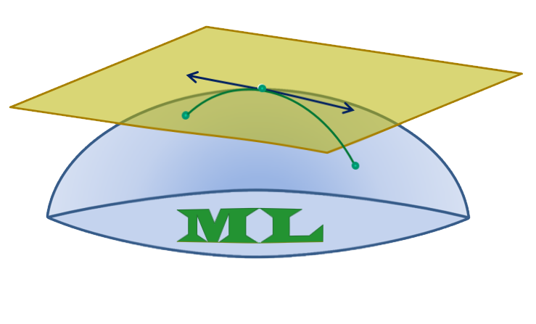

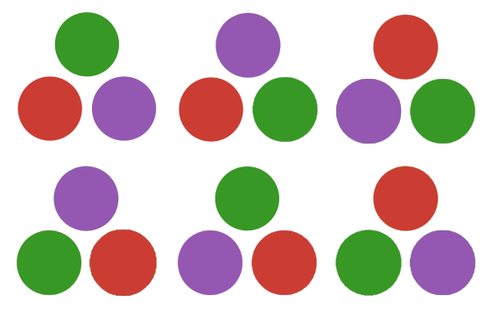

Eegle Integration
Powered by
PosDefManifold.jl
LinearAlgebra.jl
Riemannian
geometry
Linear Algebra, BLAS, LAPACK
FourierAnalysis.jl
PosDefManifoldML.jl
StatsBase.jl, Statistics.jl,
Distributions.jl
Eegle
Statistics,
Probability distributions and functions
Riemannian
machine learning
DSP.jl
Spectral analysis
Time-frequency analysis
Coherence
Connectivity
Digital Signal Processing
CovarianceEstimations.jl
Covariance Estimation
PermutationTests.jl
Diagonalizations.jl
Statistical testing
Spatial filters
Blind Source Separation

