Slide 1
Benchmarks
PermutationTests.jl
All tests performed on an old laptop running under Windows 10
equipped with a Intel(R) Core(TM) i7-8650U CPU @ 1.90GHz and 32Go of RAM

Slide 2
Univariate Tests
Benchmarks with group numerosity 9, 90, 900 and 9000 (N).
All tests are done with 10000 random permutations

Slide 3
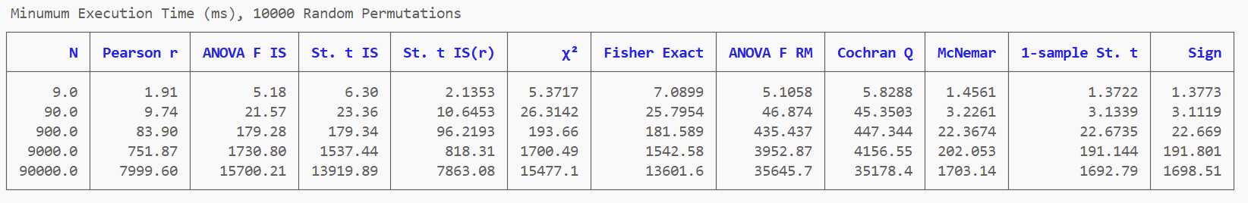
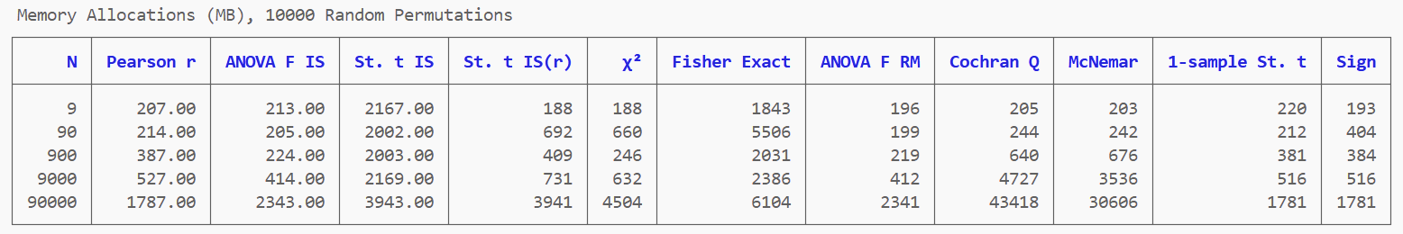
With 9000 observations all tests executes withn 4s, with the
Correlation/trend test, all t-tests, McNemar test and sign test executing within 1s.

Slide 4
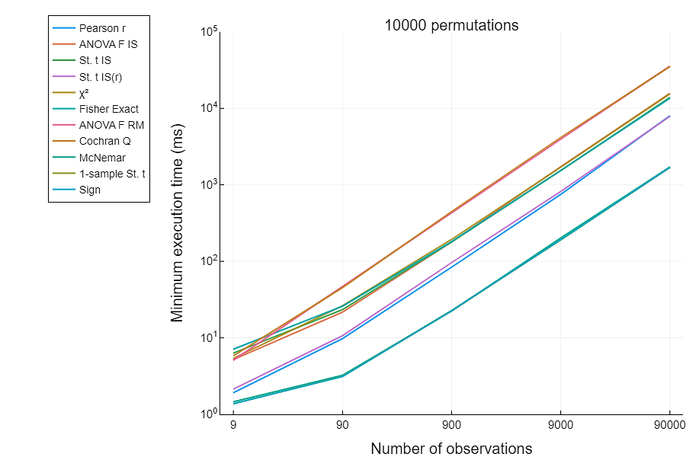
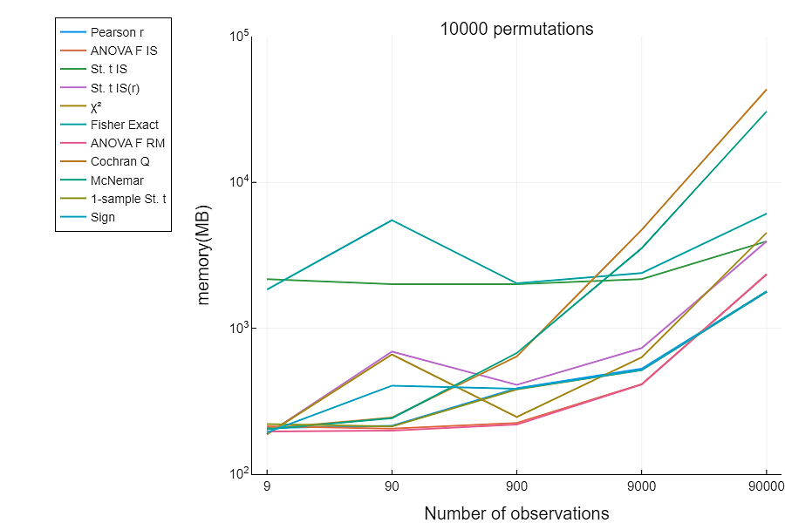
The execution time increases linearly with the number of observations (N)

Slide 5
Multiple Comparisons Tests
Benchmarks with group numerosity 12 and 10, 100, 1000 and 1000 hypotheses (M).
All tests are done with 10000 random permutations

Slide 6
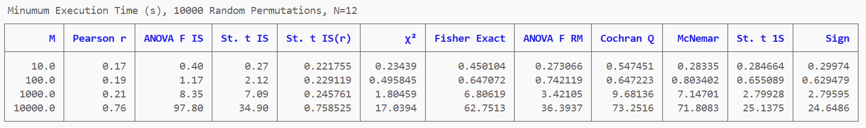
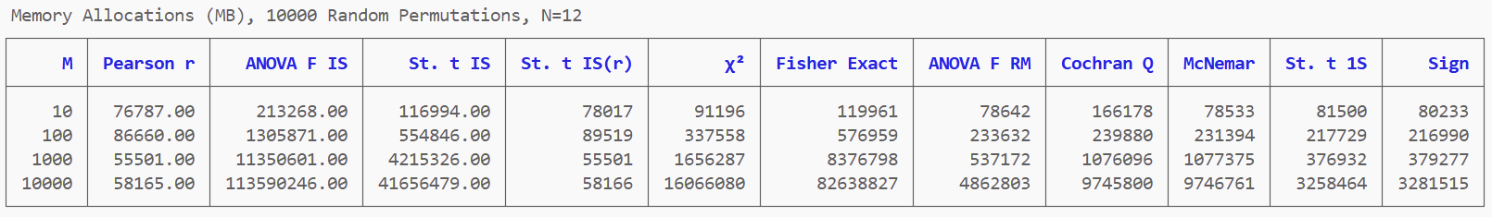

Slide 7
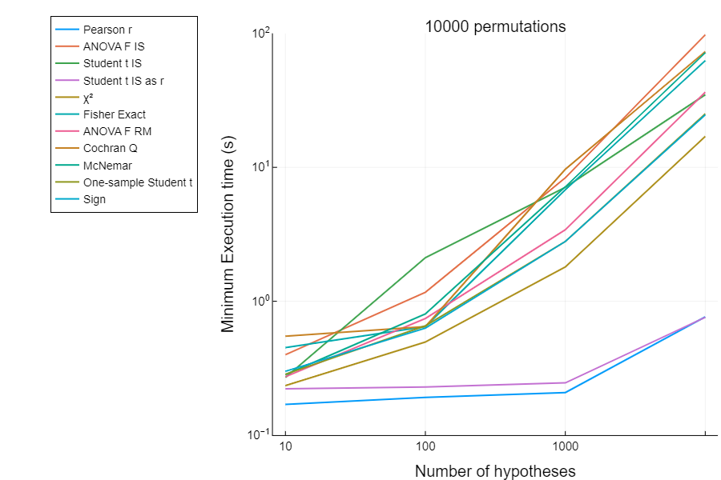
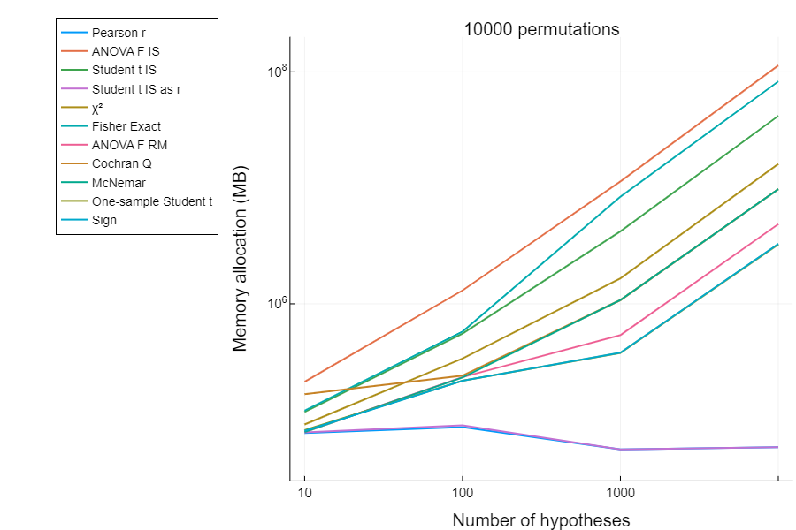
Correlations and t-tests for independent samples execute within one second

