Slide 1

Capstone: Find the best neighborhood in Berlin to open a Döner Kebab Restaurant

Slide 2
Introduction
More than 1000 Kebab Restaurants in Berlin
Berlin is Germanys Kebab capital city
High competitive intensity
→ This project is about providing potential operators of kebab restaurants in Berlin with a data-driven recommendation for the location of their new business

Slide 3
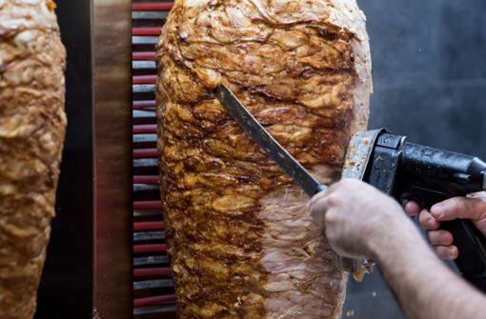
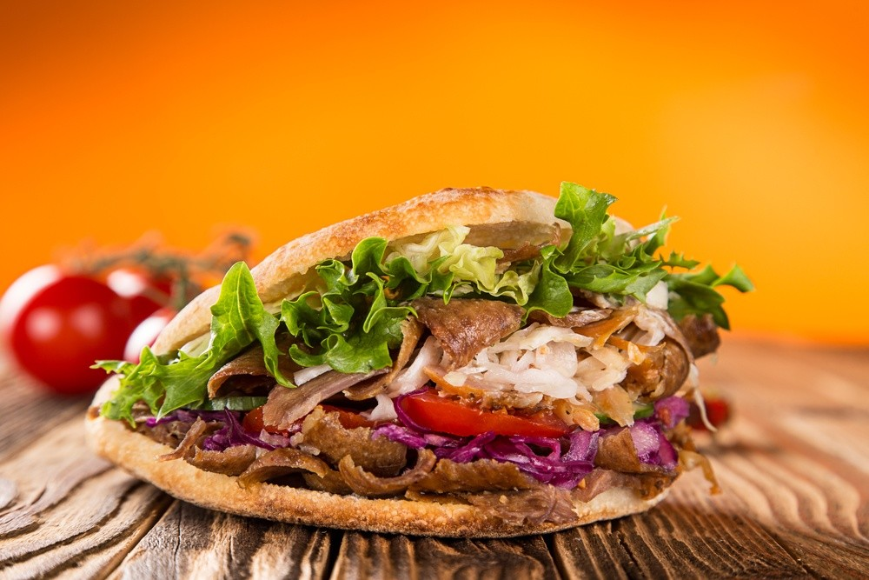
Döner Kebab
Doner kebab (Turkish; "(spinning) grilled meat"), or kebab for short, is one of the most famous dishes in Turkish cuisine. It is similar to the Greek gyros. It consists of slices of meat seasoned with marinade, which are placed in layers on a vertical rotating spit and grilled on the side. The outer, browned layers are then gradually cut off.
https://de.wikipedia.org/wiki/D%C3%B6ner_Kebab#Verbreitung_im_deutschsprachigen_Raum

Slide 4
Business Problem
For restaurateurs, the question of the right or best location always arises before opening a new establishment
Location determines the subsequent business success of the company.
Berlin is Germany's capital and has 3.645 million (2019) inhabitants living in its 12 boroughs
These boroughs are each further divided into different numbers of neighborhoods
Of these inhabitants, approximately 200,000 residents have a Turkish migrant background, which is why Döner kebab is particularly competitive in Berlin.
→ Therefore, it should be carefully selected, especially when we are dealing with such a large competition.

Slide 5
Business Problem
For restaurateurs, the question of the right or best location always arises before opening a new establishment
Location determines the subsequent business success of the company.
Berlin is Germany's capital and has 3.645 million (2019) inhabitants living in its 12 boroughs
These boroughs are each further divided into different numbers of neighborhoods
Of these inhabitants, approximately 200,000 residents have a Turkish migrant background, which is why Döner kebab is particularly competitive in Berlin.
→ Therefore, it should be carefully selected, especially when we are dealing with such a large competition.

Slide 6
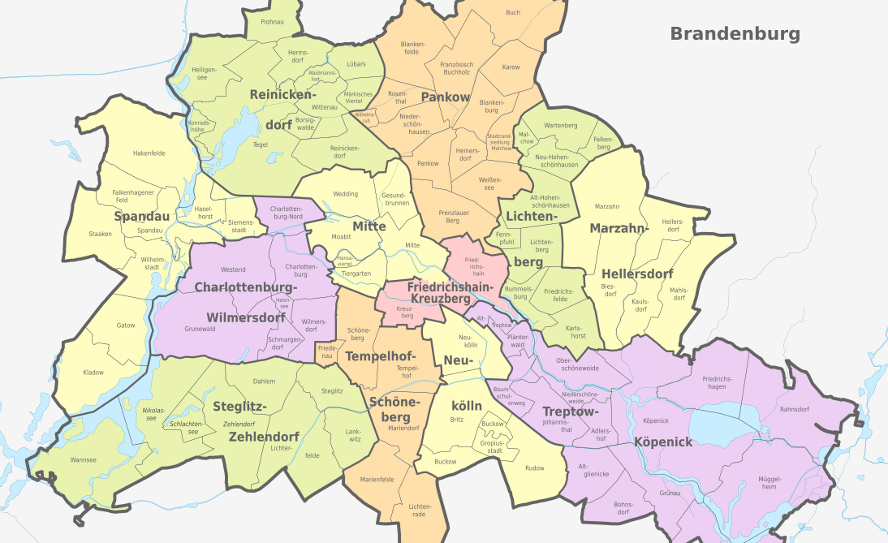
Business Problem

Slide 7
Target Audience:
The target group of this evaluation are entrepreneurs who want to open a kebab restaurant in one of the many neighborhoods in Berlin and for the decision would like to trust less on their gut feeling, but rather on the result of a data analysis.

Slide 8
Data
Data 1 : Berlin is Germany's capital and has 3.645 million (2019) inhabitants living in its 12 boroughs. These boroughs are each further divided into different numbers of neighborhoods. The required data was obtained with BeautifulSoup from one of the Wikipedia pages of Berlin. There they are available in one of the tables. In addition to the boroughs and the neighborhoods, information about the population density in the respective borough is also given there. These data are the basis for the further analysis → https://de.wikipedia.org/wiki/Verwaltungsgliederung_Berlins
Data 2 : Secondly, census data from the city of Berlin from 2019 was used. This data is available as a report and can be downloaded at the following address → https://download.statistik-berlin-brandenburg.de/d29b001f80353b17/289c7e11acc8/SB_A01-11-00_2019j01_BE.pdf
Data 3: Berlin geographical coordinates data of the neigborhoods will be loaded by Nominatim (geopy.geocoders) to convert an address into latitude and longitude values.
Data 4 : Berlin geographical coordinates data will be utilized as input for the Foursquare API, that will be leveraged to provision venues information for each neighborhood.We will use the Foursquare API to explore neighborhoods in Berlin. The below is image of the Foursquare API data.

Slide 9
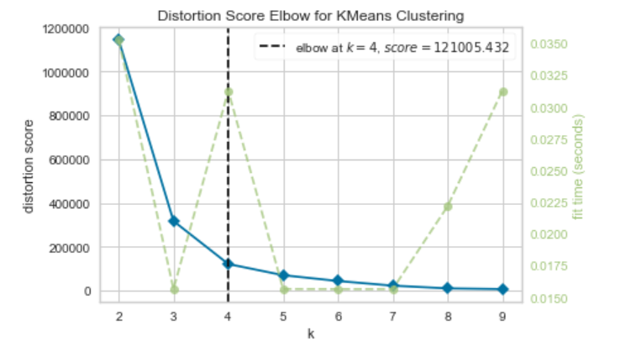
Methodology
Used Algorithm: Kmeans (ScikitLearn)
To use a reasonable number of clusters the elbow method was applied. For the neighborhoods in Berlin, this resulted in 4 clusters, taking into account the proportionate number of kebab restaurants, average income and population density.

Slide 10
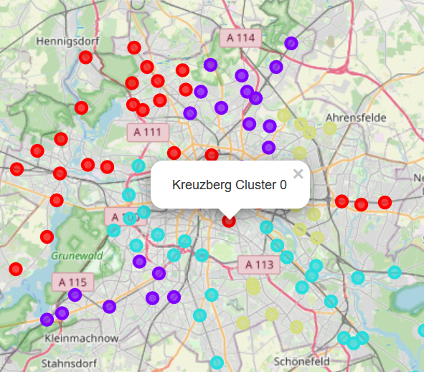
Results
Based on the currently available data, the Kreuzberg neighborhood is recommended for potential new kebab restaurants to open in Berlin
There, the location factors are the best, so that a successful opening can be recommended here.

Slide 11
Discussion
The calculated clusters were examined for their characteristic properties
For this purpose, the data were evaluated in tabular form and various visualizations were created

Slide 12
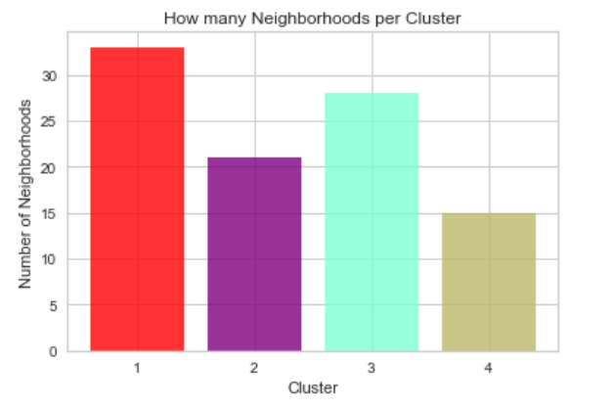
Discussion

Slide 13
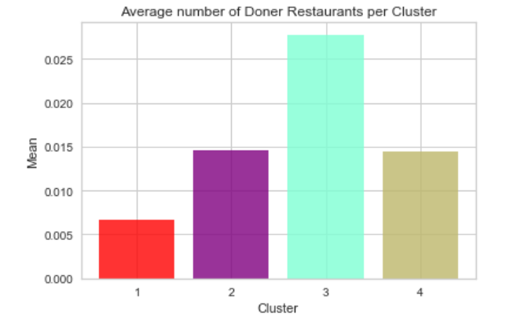
Discussion

Slide 14
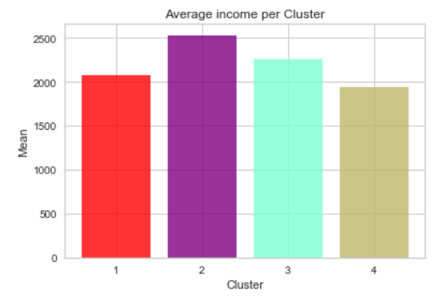
Discussion

Slide 15
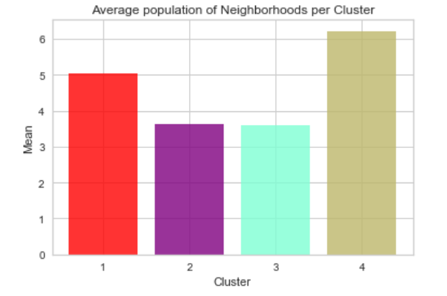
Discussion

Slide 16
Discussion
Cluster 3 has the most Döner Kebab restaurants and is excluded from further consideration due to the competitive situation in this cluster
Clusters 2 and 4 have about the same number of kebab restaurants and cluster 1 the least
Accordingly, cluster 1 is considered further
Cluster 1 has a medium average income, which fits well with kebab restaurants
In addition, the population density in cluster 1 is the highest, which speaks for a potentially good occupancy rate of a new kebab restaurant in one of these neighborhoods.
Now let's have a deeper look into the Neighborhoods in Cluster 1

Slide 17
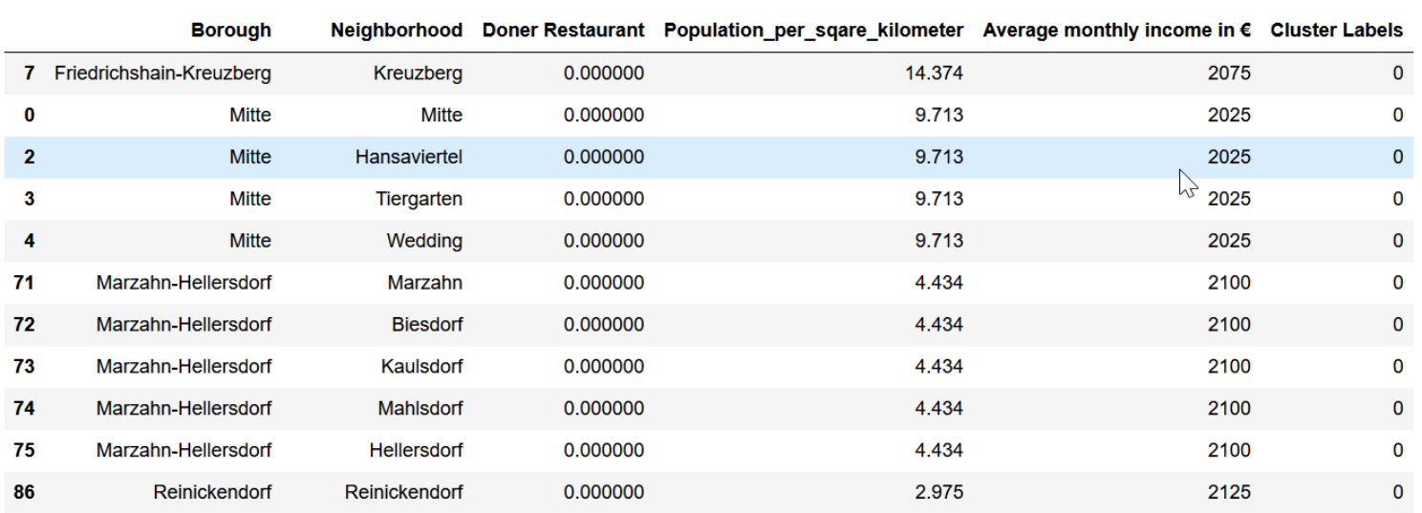
Discussion
Cluster 1 sorted by number of kebab restaurants, population density, and income to derive a recommendation for a suitable location:

Slide 18
Discussion
As we can see in the sorted list (sorted by number of kebab restaurants, population density and income), Kreuzberg should be a suitable choice for a new kebab restaurant.

Slide 19
Conclusion & further research
I feel confident with the recommendation of Berlin Kreuzberg I gave as it is backed up with demonstrated data analysis
There are certainly other data that can be considered in a more in-depth analysis
For example, data on the ethnic composition of the neighborhoods could be obtained
Likewise, data on tourist offerings and accommodations in the neighborhood would be interesting
These data are certainly related to the eating habits and preferences of people in a neighborhood.

