Slide 1

Science Based Target initiative Interactive dashboards
Marco Morás
Final Project
DAFT Aug-2024

Slide 2

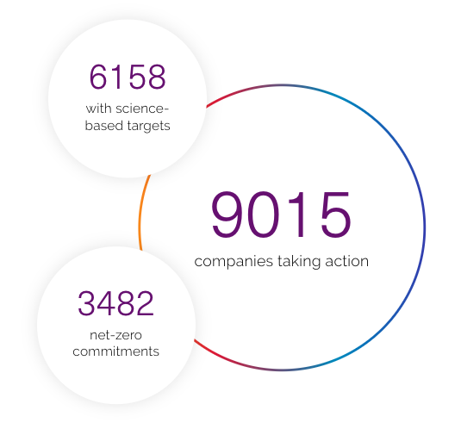
Science Based Targets initiative
What is it?
The Science Based Targets initiative (SBTi) is a corporate climate action organization that enables companies and financial institutions worldwide to play their part in combating the climate crisis.
The SBTi develops standards, tools and guidance which allow companies to set greenhouse gas (GHG) emissions reductions targets in line with what is needed to keep global heating below catastrophic levels and reach net-zero by 2050 at latest.
Why a dashboard?
There is a need for better presentation of the information submitted by companies. Current efforts are focused on data transparency and not on visualization and relations among data fields.

Slide 3
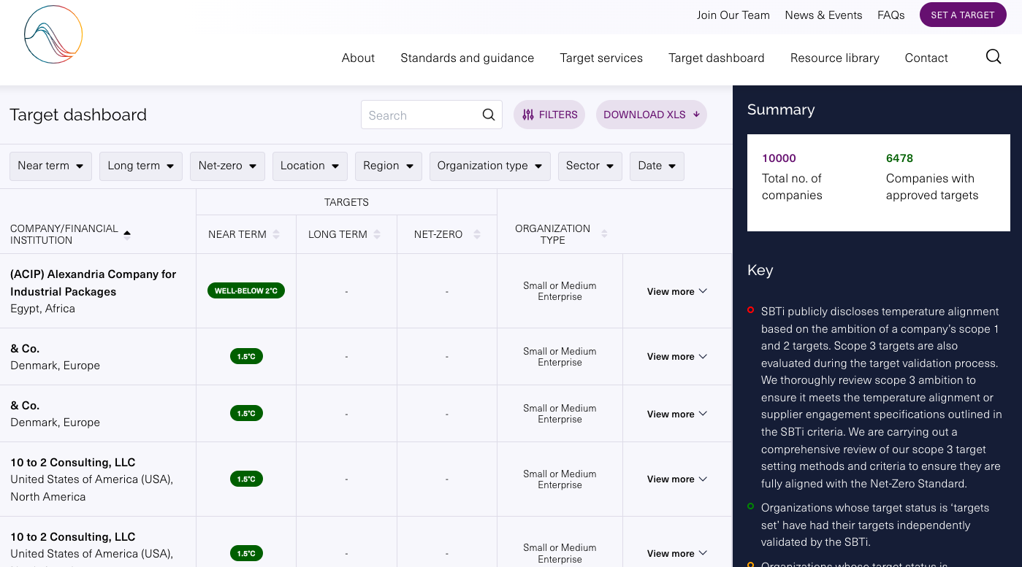

Legacy Dashboard

Slide 4
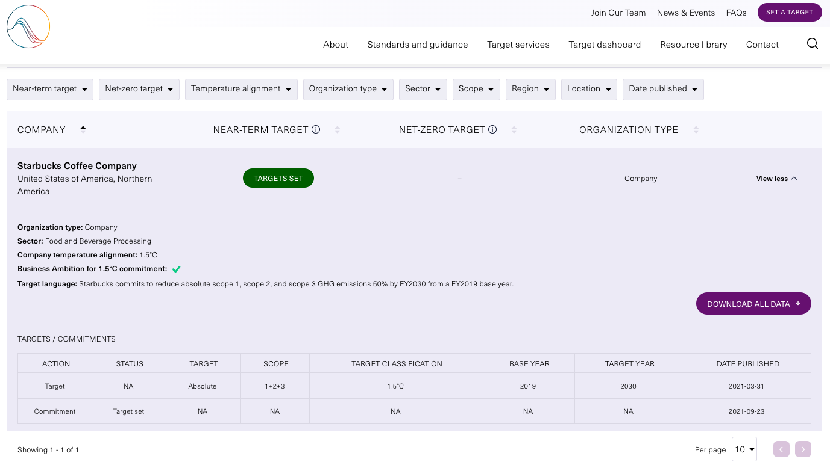
Target Dashboard (Beta)

Slide 5
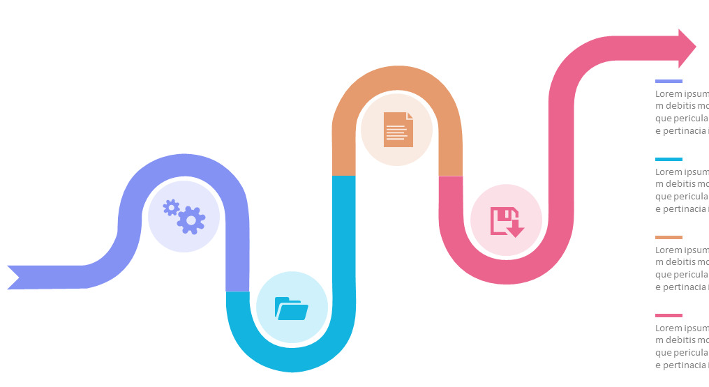
Interactive Dashboard development
Data processing
XLS Data download from SBTi website.
Data cleaning, data normalization and unit standardization.
Specific functions for easy replicability for weekly updates.
Tableau Dashboard Development
Three dashboards focusing on Regional, Sectoral, and Company perspectives.
Selection of KPIs.
Filtering and interactive functions.

Slide 6
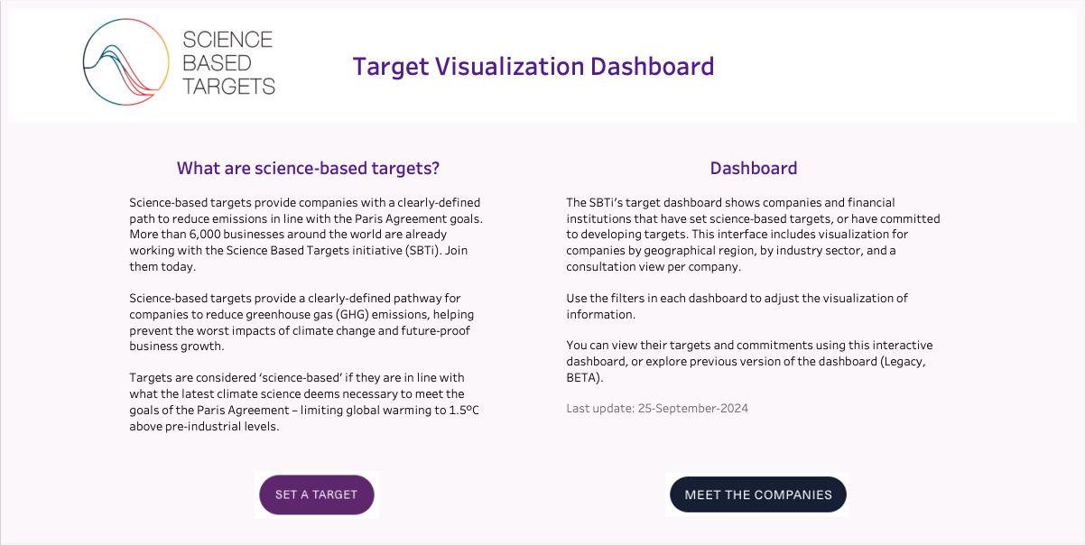
Interactive Dashboard
Tableau Dashboard

Slide 7



Recommendations
Data processing steps for: locations, dates, target values
Sector standardization of listed sectors (52) aligned with existing guidance documents (14)
In transition towards certification, define standard KPIs to be used in the Monitoring Reporting and Verification system

Slide 8
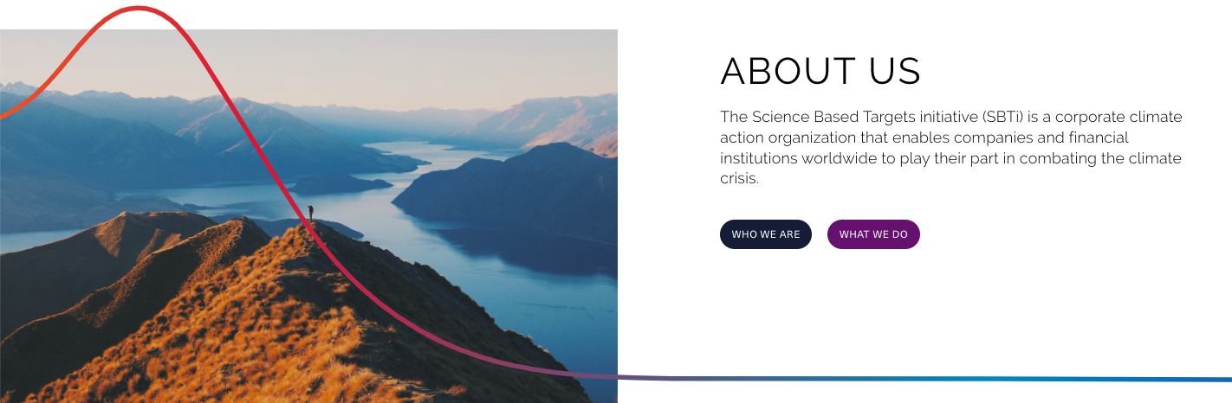
Thank you for your attention

