Slide 1

Distributed and Internet of Things Software Architectures
Digital Automation Engineering (D.M.270/04)
Curriculum: Digital Infrastructure
Hands-On Session
RESTful Pattern, HTTP
Prof. Marco Picone
A.A 2024/2025

Slide 2
Hands-On Session - HTTP
HTTP Quick Review
Demo Application Scenario
Device Categories
Data Modeling
Specifications
JSON Data Format
  Serialization/Deserialization
  Python & JSON

Slide 3
HTTP Review & Overview
The Hyper Text Transfer Protocol (HTTP) is a client-server network protocol
It is used and adopted by the World-Wide Web since 1990
It is base on Request - Response Paradigm
“Everything is an extendable convention”
You may create your own headers
You may create your own methods
You may not implement some methods
You may not implement header logic
Avoid Heterogeneity & Support Standard
=
RESTful HTTP as Reference

Slide 4
HTTP Request Message
GET /api/inventory/devices
HTTP/1.1
Accept:*/*
Accept-Language: en-gb
User-Agent: Mozilla/4.0 (compatible; MSIE 6.0)
Host: www.myiotplatform.com
Connection: Keep-Alive

Slide 5
HTTP Request Message (GET)
Resource Path
Version
Method
GET /api/inventory/devices HTTP/1.1
Accept:*/*
Accept-Language: en-gb
User-Agent: Mozilla/4.0 (compatible; MSIE 6.0)
Host: www.myiotplatform.com
Connection: Keep-Alive
….
Body (Empty in that case)

Slide 6
HTTP Response Message (GET)
HTTP/1.0 200 OK
Content-Type: application/json; charset=utf-8
Content-Length: 610
Server: Werkzeug/1.0.1 Python/3.8.5
Date: Fri, 02 Oct 2020 15:22:10 GMT
{
“location_info”: […]
}

Slide 7
HTTP Response Message (GET)
Status Line & Status Code
Headers
HTTP/1.0 200 OK
Content-Type: application/json; charset=utf-8
Content-Length: 610
Server: Werkzeug/1.0.1 Python/3.8.5
Date: Fri, 02 Oct 2020 15:22:10 GMT
{
“location_info”: […]
}
Double CRLF (Return Line)
Content Body

Slide 8
HTTP Request Message (POST)
POST /api/location/ HTTP/1.1
Content-Type: application/json
User-Agent: PostmanRuntime/7.26.5
Accept: */*
Postman-Token: c99042fd-ecb9-46fe-9c1e-c28d0d62b6c0
Host: 127.0.0.1:7070
Accept-Encoding: gzip, deflate, br
Connection: keep-alive
Content-Length: 199
{
"location_info":{
"latitude": 10.128712,
"longitude": 44.323231
},[…]
}

Slide 9
HTTP Request Message (POST)
Resource Path
Version
Method
POST /api/location/ HTTP/1.1
Content-Type: application/json
User-Agent: PostmanRuntime/7.26.5
Accept: */*
Postman-Token: c99042fd-ecb9-46fe-9c1e-c28d0d62b6c0
Host: 127.0.0.1:7070
Accept-Encoding: gzip, deflate, br
Connection: keep-alive
Content-Length: 199
{
"location_info":{
"latitude": 10.128712,
"longitude": 44.323231
},[…]
}
Body

Slide 10
HTTP Request Message (POST)
HTTP/1.1 201 CREATED
Date: Fri, 02 Oct 2020 15:22:10 GMT
Location: /api/location/00001abc
Content-Length: 0

Slide 11
HTTP Request Message (POST)
Status Line & Status Code
HTTP/1.1 201 CREATED
Date: Fri, 02 Oct 2020 15:22:10 GMT
Location: /api/location/00001abc
Content-Length: 0
Headers
….
Body (Empty in that case)

Slide 12
Level 2 - (HTTP) Verbs
Semantics is added to HTTP verbs when manipulating resources
Resources are still addressable using URIs
Each resource can be manipulated by using HTTP methods
Each method has a particular meaning and maps to a Create Read Update Delete (CRUD) operation:
  GET (safe and idempotent) is used to retrieve a resource with the given URI
  POST (not safe and not idempotent) is used to create a resource (a new URI is returned by the server)
  PUT (not safe and idempotent) is used to update a resource with the given URI
  DELETE (not safe and idempotent) is used to remove the resource with the given URI
Safe means that no side-effects occur on the resource (the resource remains the same)
Idempotent means that multiple requests have the same effect of a single request

Slide 13
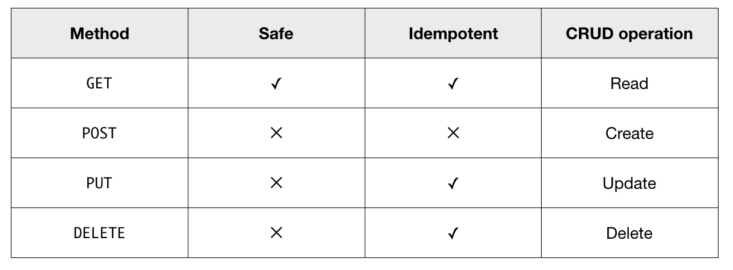
Level 2 - (HTTP) Verbs

Slide 14
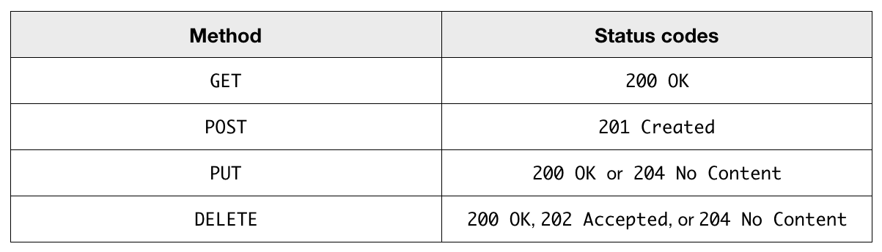
Level 2 - (HTTP) Verbs
Status (response) codes also have semantics: they have particular meaning
Each method has a specific set of status codes
4xx indicate client errors (e.g., 405 Method Not Allowed): the client should not repeat the request
5xx indicate server errors (e.g., 500 Internal Server Error): the client might repeat the request

Slide 15
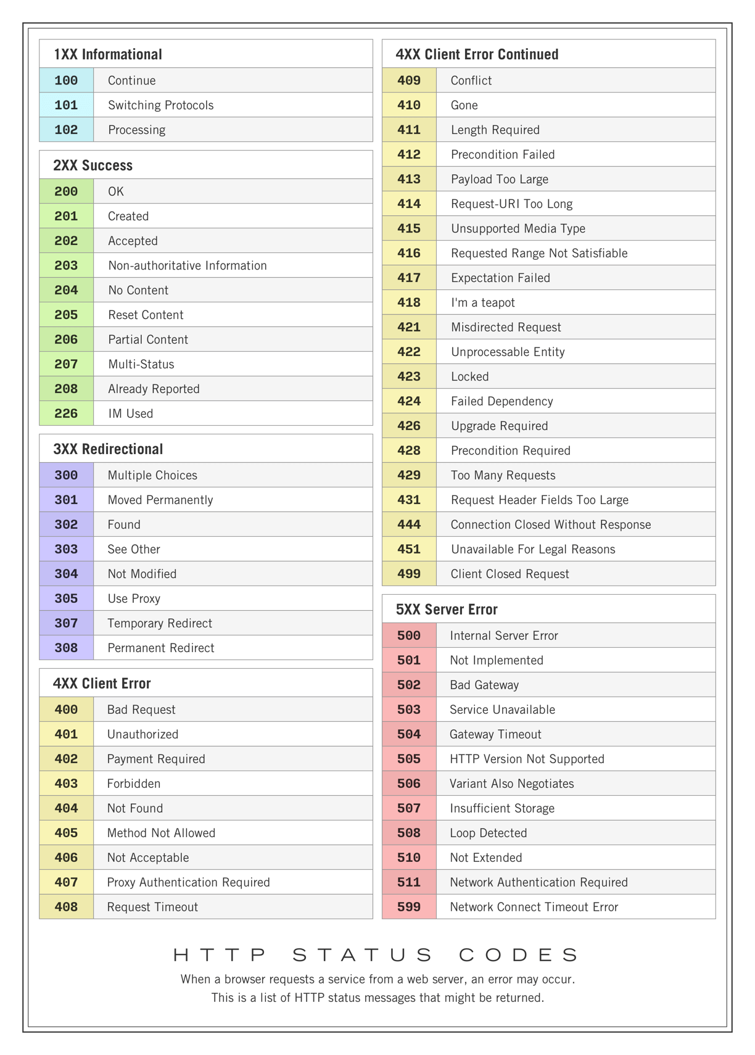
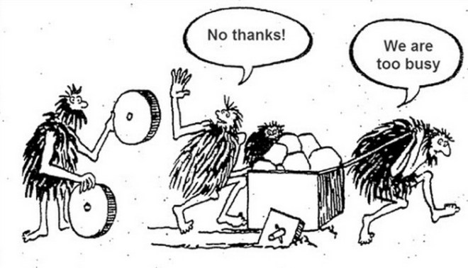
Level 2 - HTTP Status Codes

Slide 16
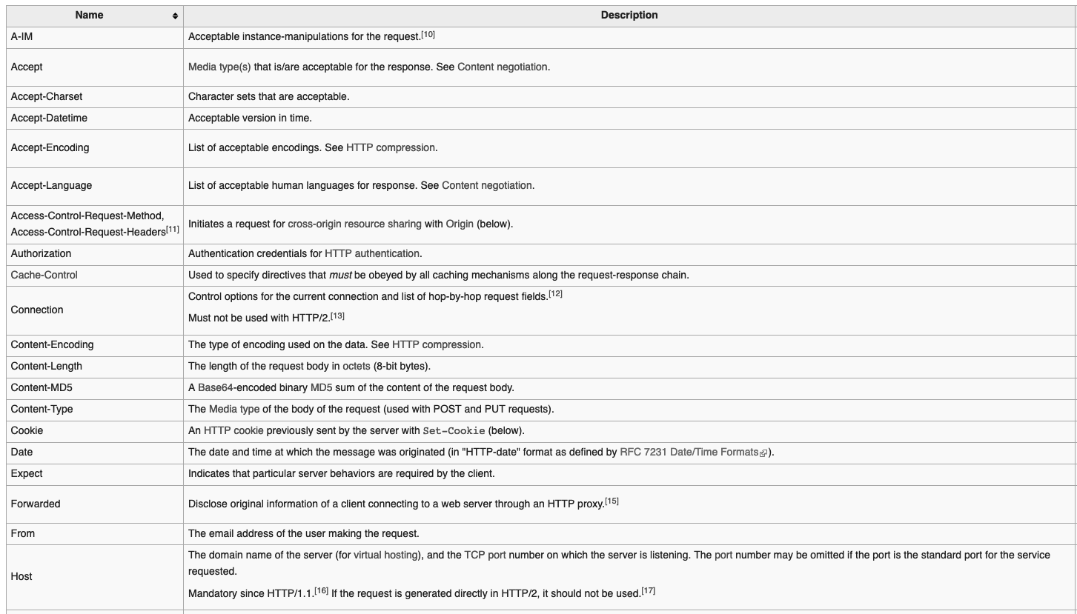
Level 2 - HTTP Request Headers (Some)
Source: https://en.wikipedia.org/wiki/List_of_HTTP_header_fields

Slide 17
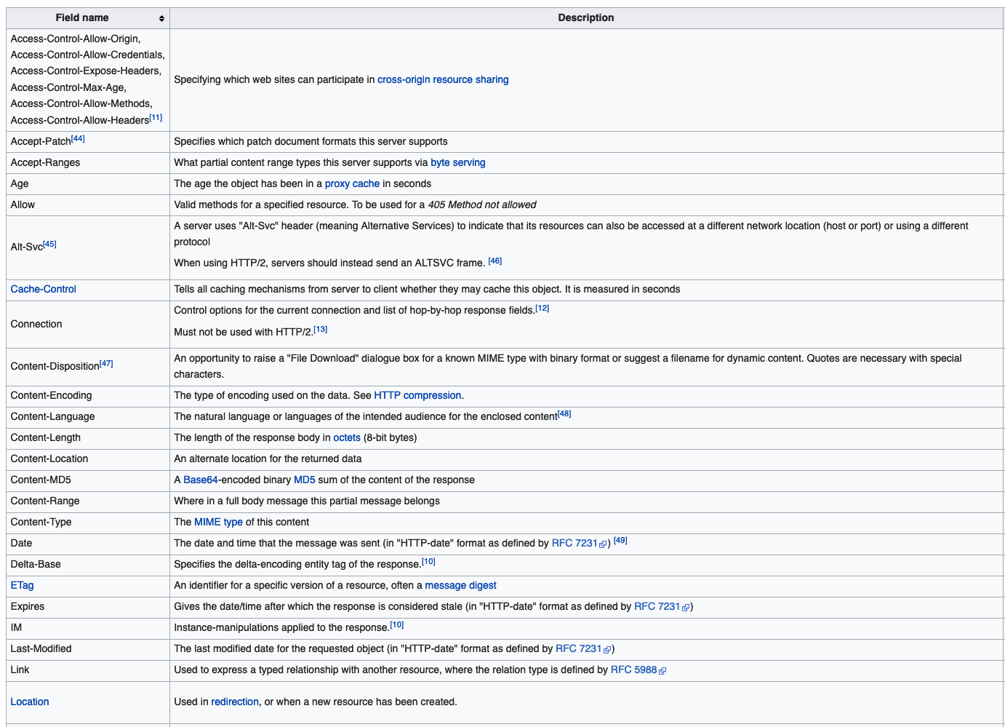
Level 2 - HTTP Response Headers (Some)
Source: https://en.wikipedia.org/wiki/List_of_HTTP_header_fields

Slide 18
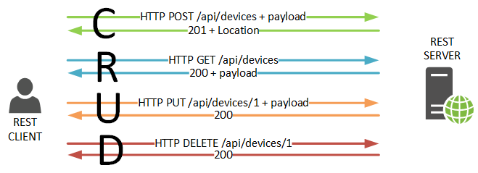
Level 2 - (HTTP) Verbs - POST
To create a resource:
  use POST
  target URI is that of a resource creator or the resource URI itself
  request body might contain the initial state
  response body might contains the state of the newly created resource
  [Mandatory] 201 Response Code + the URI of the new resource (to be used for subsequent operations) is returned in the Location header

Slide 19
Level 2 - (HTTP) Verbs - GET
To read a resource:
  use GET
  request body is left empty
  response body contains the state of the newly created resource

Slide 20
Level 2 - (HTTP) Verbs - PUT
To change a resource:
  use PUT
  URI is the one returned in the Location header after an initial POST
  request body might contain the new state
  response body contains the updated state

Slide 21
Level 2 - (HTTP) Verbs - DELETE
To read a resource:
  use DELETE
  request body is left empty
  response body might be empty or contain the state of the deleted resource

Slide 22
Level 2 - (HTTP) Verbs
HTTP is no longer used just as a transport for requests, but it is being used to describe what requests are intended for
HTTP verbs and status codes to coordinate interactions and manipulate resources
HTTP headers are also used to convey information (e.g., Location header to indicate the URI of a created resource)
Requests are self-descriptive; they can be read as:
  [READ, CREATE, UPDATE, DELETE] the resource identified by the URI
However, there is still some coupling between client and server applications: the client must know the URI of a resource and which methods can invoked
Some sort of documentation is needed (what can be done with a resource? where to go next?)

Slide 23

Demo Application Scenario
IoT Inventory
Location
Location
Location
Device(s)

Slide 24
Device Categories
Device
Mobile Device
(e.g., cat, electric scooter, etc …)
Sensor
(e.g., temperature, presence, parking, etc …)
Actuator
(e.g., switch, light, barrier/gate, etc …)

Slide 25
Data Modeling
Location
Device
Field
id
name
latitude
longitude
devices
Field
id
name
type
latitude
longitude
location id
manufacturer
software version

Slide 26
HTTP API
Base Path: /api/iot/inventory
/location
  GET: Returns the list of available locations
  POST: Handle the creation of a new Location
  /location/<id_location>
    GET: Returns the target location with the specified Id
    DELETE: Deletes the target location with the specified Id
    PUT: Update the target location with the specified id
  /location/<id_location>/device
    GET: Returns the list of devices for the target Location Id
    POST: Creates a new Device for the target Location Id
    /location/<id_location>/device/<id_device>
      GET: Returns the target device Id associated to the specified Location Id
      DELETE: Delete the target device Id associated to the specified Location Id
      PUT: Updates the target device Id associated to the specified Location Id

Slide 27

Data Models vs Data Transfer Objects (DTO)
HTTP
Client
Data Models: representations of the structure and attributes of the data entities within an application. They define how the data is organized, what properties it holds, and how different pieces of data relate to each other. Data models are used internally within the application to manage and manipulate data logically
Data Transfer Objects (DTOs): specialized objects used specifically for transferring data between different parts of a system, often in the context of remote communication like HTTP RESTful APIs. DTOs encapsulate a subset of the data from the data models and are designed to optimize the efficiency of data transmission, reducing the amount of unnecessary data sent over the network. They help improve performance and maintain a clear separation between the internal data structures and the data sent over APIs
A Resource typically has 1 Data Model and multiple DTOs according to the nature of modeled requests and responses
DTO 1
DTO 2
HTTP
RESTFul API
Data
Storage
(Data Models)

Slide 28
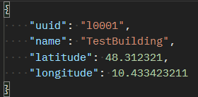
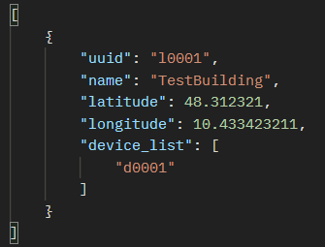
Data Models vs Data Transfer Objects (DTO)
DTO 1
(Without Devices field for creation)
Location
Data Model
Create New Location + Body
HTTP
RESTFul API
Field
id
name
latitude
longitude
devices
201 Created
Get Location 'l0001'
HTTP
Client
Data Storage
200 OK +
DTO 2
(Devices reported as list of id)

Slide 29
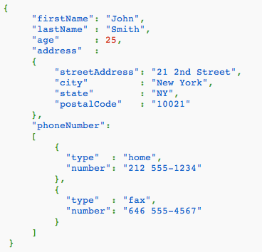
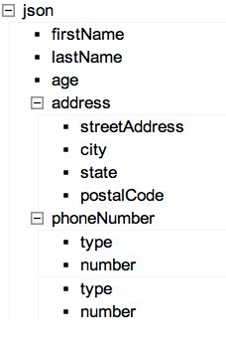
JSON
JSON, or JavaScript Object Notation, is a lightweight text-based open standard designed for human-readable data interchange. It is derived from the JavaScript scripting language for representing simple data structures and associative arrays, called objects. Despite its relationship to JavaScript, it is language-independent, with parsers available for most languages.

Slide 30
Serialization/Deserialization
Serialization and deserialization are concepts used in programming to convert data from one format to another for storage, transmission, or manipulation purposes
  Serialization: Serialization refers to the process of converting data objects or data structures from their in-memory representation into a format that can be easily stored, transmitted, or shared with other systems. The serialized data is typically in a standardized format like JSON (JavaScript Object Notation) or XML (eXtensible Markup Language) that can be easily understood by different programming languages and platforms. Serialization is commonly used for saving object states to disk, sending data over the network, or caching data.
  Deserialization: Deserialization is the reverse process of serialization. It involves converting the serialized data back into its original in-memory representation. The deserialization process reconstructs the data objects or data structures from the serialized format so that they can be used and manipulated within the program. This step is essential when receiving data from external sources, such as reading data from a file or receiving data over the network, as it allows the program to work with the data in its native form.
In summary, serialization and deserialization enable programmers to transform data between a format suitable for in-memory usage and a format suitable for storage, communication, or interaction with external systems.

Slide 31
JSON - Serialization/Deserialization
public class BookmarkDescriptor {
private String name = null;
private String url = null;
public BookmarkDescriptor()
{}
public BookmarkDescriptor(String name, String url)
{
this.name = name;
this.url = url;
}
}
Obj1 Instance
of
Bookmark Descriptor
JSON String
{
"name":"University",
  "url":"http://www.uni.it"
  }
Obj2 Instance
of
Bookmark Descriptor
name: “University”
url: “http://www.uni.it”
name: “University”
url: “http://www.uni.it”

Slide 32
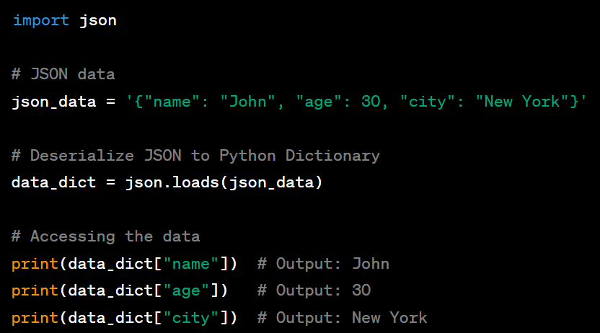
JSON - Python Serialization/Deserialization
In Python, JSON deserialization allows you to convert JSON-formatted data into native Python data structures, making it easy to work with JSON data in your Python programs.
The json module in Python provides functions for both:
  serializing (converting Python objects to JSON)
  deserializing (converting JSON data to Python objects).
Converting JSON to Python Dictionary

Slide 33
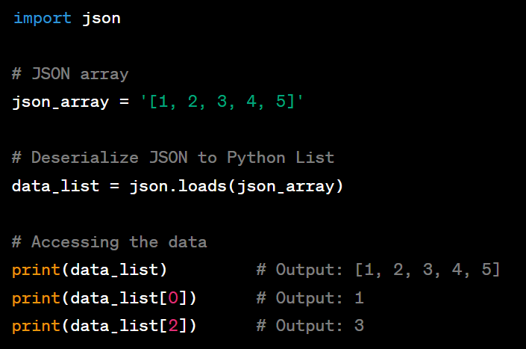
JSON - Python Serialization/Deserialization
Converting JSON to Python List

Slide 34
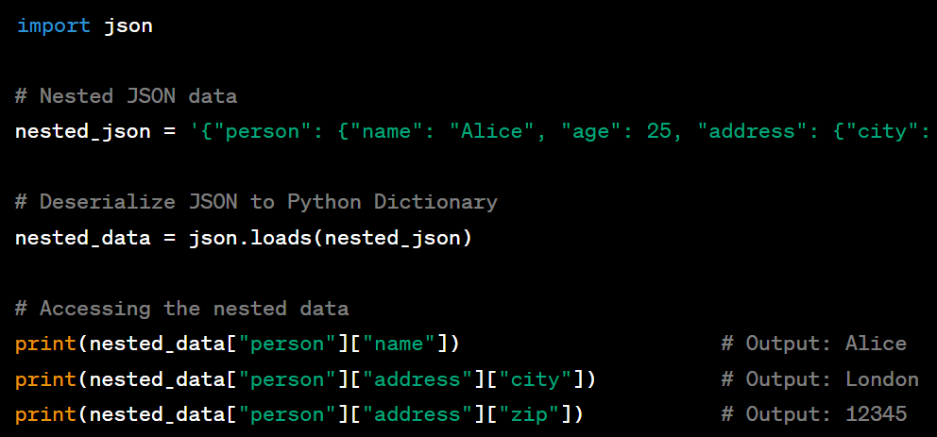
JSON - Python Serialization/Deserialization
Nested JSON Deserialization
nested_json = '{"person": {"name": "Alice", "age": 25, "address": {"city": "London", "zip": "12345"}}}'

Slide 35
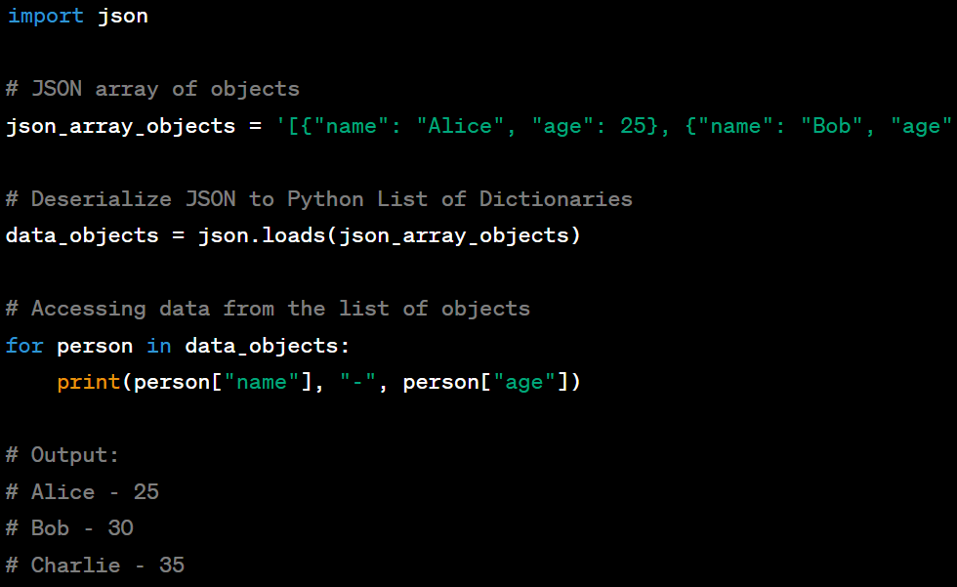
JSON - Python Serialization/Deserialization
Handling JSON Arrays
json_array_objects = '[{"name": "Alice", "age": 25}, {"name": "Bob", "age": 30}, {"name": "Charlie", "age": 35}]'

Slide 36
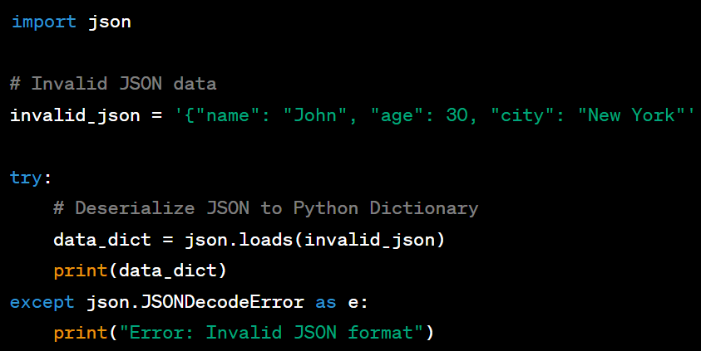
JSON - Python Serialization/Deserialization
Error Handling during Deserialization
Missing closing }
Exception
Management

Slide 37
Specifications
Create an HTTP RESTful API to model the application scenario described with the following characteristics:
  Identification and Modeling of REST Resources
  Possible CRUD actions on individual resources (GET, POST, PUT, DELETE)
  Handle Data Models and DTOs
  Correct response codes based on the resources, actions, and client requests
  Use JSON as the reference format for all communications
In the first version, model the resources without hierarchies and all at the same level
Test the developed API in the following ways:
  Postman: https://www.postman.com/product/rest-client/(Useful for testing purposes)
  Native Python Client -> We have to create it :)

Slide 38
Distributed and Internet of Things Software Architectures
Digital Automation Engineering (D.M.270/04)
Curriculum: Digital Infrastructure
Hands-On Session
RESTful Pattern, HTTP
Prof. Marco Picone
A.A 2024/2025

