Slide 1

2. Apache Iceberg
Data Lake
Marco Santoni

Slide 2
Agenda
Intro
Metadata
Key features and time-travel
Table maintenance
Row-level updates

Slide 3


Apache Iceberg
History
Cloud Vendors
Apache Iceberg is a table format created in 2017 by Netflix’s Ryan Blue and Daniel Weeks. It arose from the need to overcome challenges with performance, consistency, and many of the challenges previously stated with the Hive table format. In 2018, the project was made open source and was donated to the Apache Software Foundation.
and others…

Slide 4
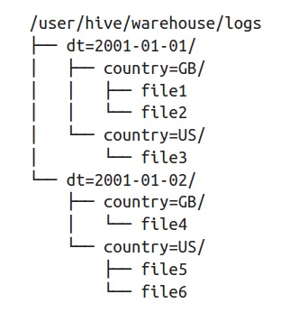
Why: flaws of Hive
Partitioning
The table should be able to give users the benefits of partitioning based on naturally intuitive queries and not depend on filtering extra partition columns derived from a column they are already filtering by (e.g., filtering by a month column when you’ve already filtered the timestamp it is derived from).
Performance
With Hive’s file/directory listing bottleneck, query planning would take excessively long to complete before actually executing the query. The table should provide metadata and avoid excessive file listing so that not only can query planning be a faster process, but also the resulting plans can be executed more quickly since they scan only the files necessary to satisfy the query.

Slide 5


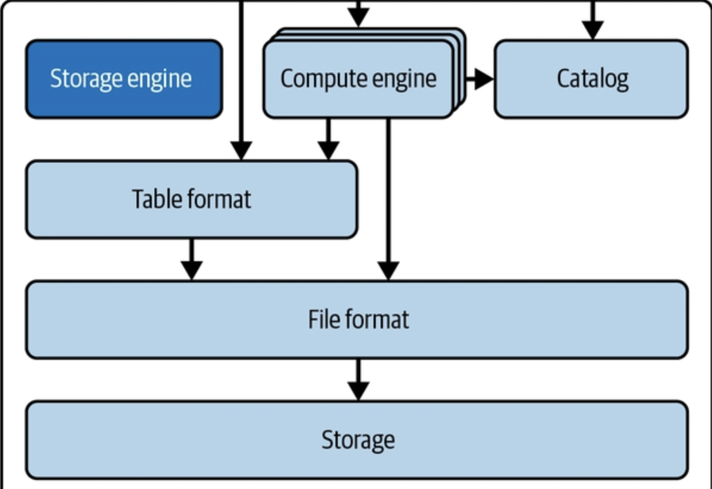


Hands-on 👩‍💻🧑‍💻
PyIceberg
We’ll setup a simple local lakehouse architecture for teaching purposes. This is not a realistic production architecture. We’ll PyIceberg as Python APIs to interact with Iceberg tables that are stored locally. The catalog will be stored in a local SQLite database.
Code: understand_metadata.ipynb
Local 💻

Slide 6
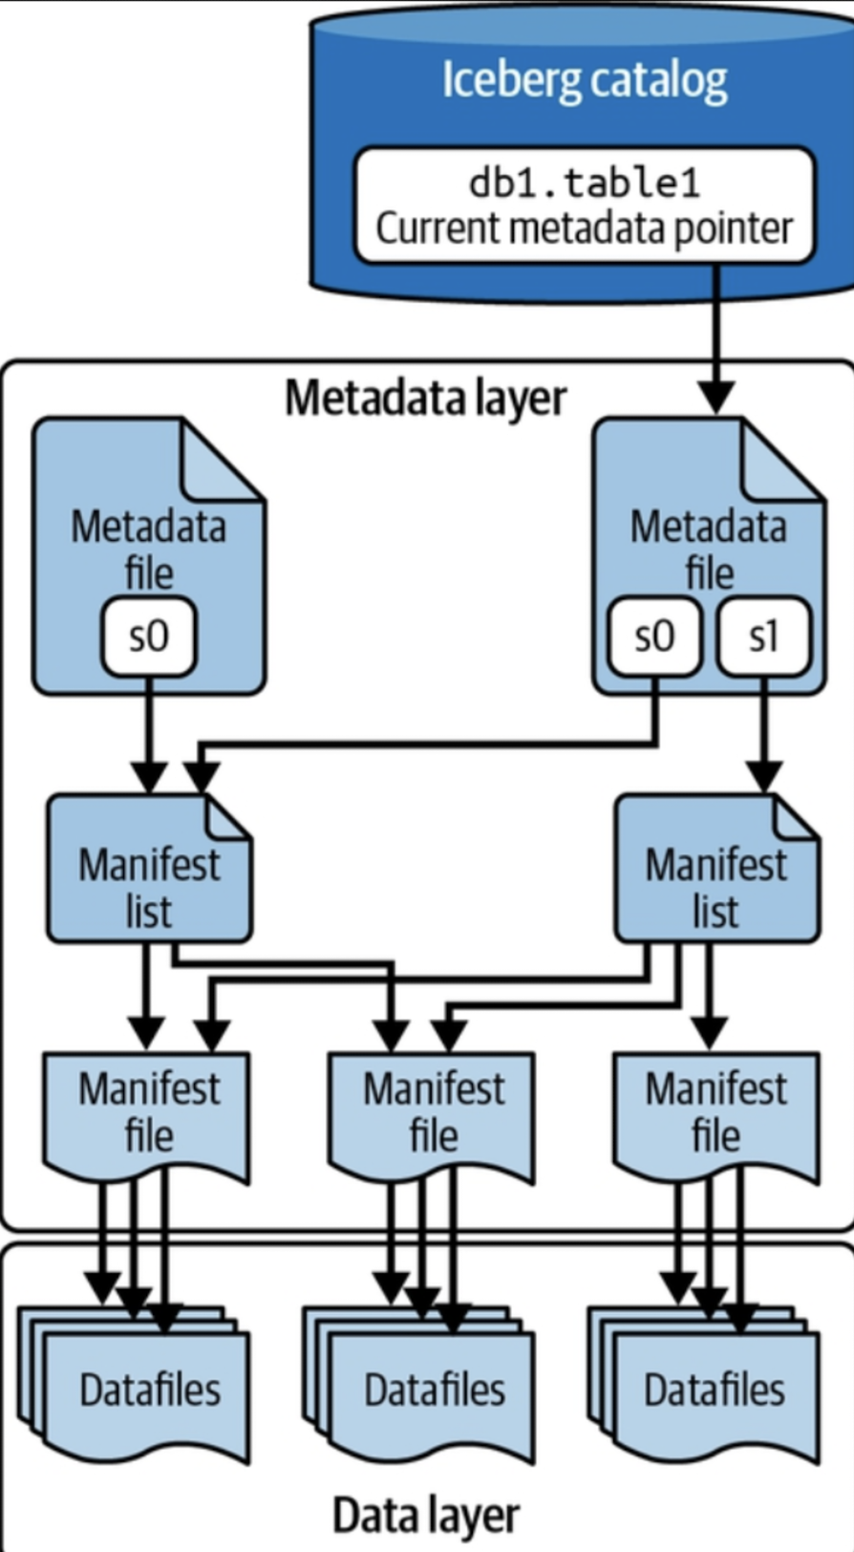
Apache Iceberg architecture
All about Metadata
Apache Iceberg tracks a table’s partitioning, sorting, schema over time, and so much more using a tree of metadata that an engine can use to plan queries at a fraction of the time it would take with legacy data lake patterns.
Apache Iceberg: The Definitive Guide (p. 54). O'Reilly Media

Slide 7
4 components of metadata
Catalog
Tracks the table location (similar to the Hive Metastore), but instead of containing a mapping of table name -> set of directories, it contains a mapping of table name -> location of the table’s most recent metadata file. Several tools, including a Hive Metastore, can be used as a catalog.
Metadata file
Files that define a table’s structure, including its schema, partitioning scheme, and a listing of snapshots.
Manifest list
Files that define a single snapshot of the table as a list of manifest files along with stats on those manifests that allow for creating more efficient execution plans.
Manifest file
A list of datafiles, containing each datafile's location/path and key metadata about those datafiles, which allows for creating more efficient execution plans.
Apache Iceberg: The Definitive Guide (p. 54). O'Reilly Media

Slide 8
Let's go back to our work👩‍💻🧑‍💻
PyIceberg
We’ll setup a simple local lakehouse architecture for teaching purposes. This is not a realistic production architecture. We’ll PyIceberg as Python APIs to interact with Iceberg tables that are stored locally. The catalog will be stored in a local SQLite database.
Code: understand_metadata.ipynb
Local

Slide 9
Agenda
Intro
Metadata
Key features and time-travel
Table maintenance
Row-level updates

Slide 10
Key features of Apache Iceberg
ACID Transactions
Partition evolution
Hidden partitioning
Time travel

Slide 11
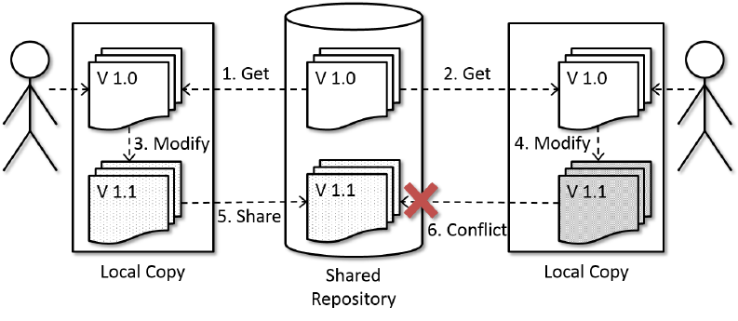
ACID transactions
Concurrency
Handled by catalog
Apache Iceberg uses optimistic concurrency control to enable ACID guarantees, even when you have transactions being handled by multiple readers and writers.
Concurrency guarantees are handled by the catalog, as it is typically a mechanism that has built-in ACID guarantees. This is what allows transactions on Iceberg tables to be atomic and provide correctness guarantees. If this didn’t exist, two different systems could have conflicting updates, resulting in data loss.
Optimistic concurrency assumes transactions won’t conflict and checks for conflicts only when necessary,
Glas,et al. (2014). Implications and Potential of Real-time Collaboration for the Design Process.

Slide 12
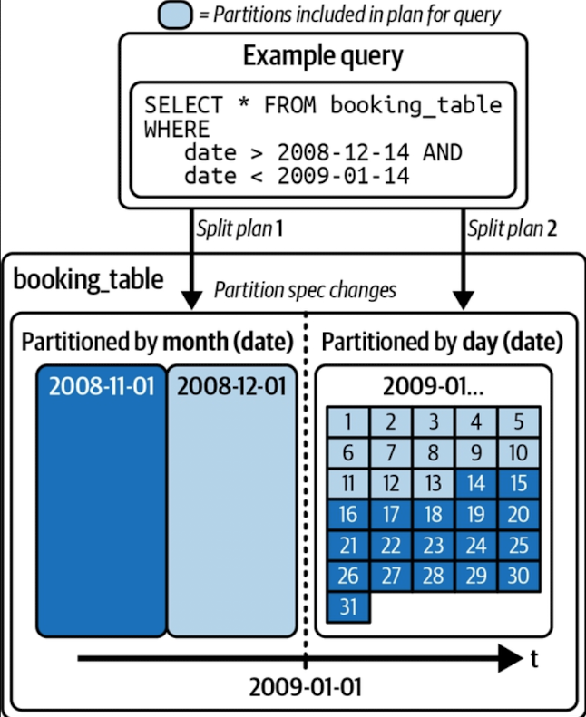
Partition evolution
With Apache Iceberg you can update how the table is partitioned at any time without the need to rewrite the table and all its data. Since partitioning has everything to do with the metadata, the operations needed to make this change to your table’s structure are quick and cheap.
The previously written data remains in month partitions while new data is written in day partitions, and in a query, the engine makes a plan for each partition based on the partition scheme applied to it.
Apache Iceberg: The Definitive Guide (p. 56). O'Reilly Media

Slide 13
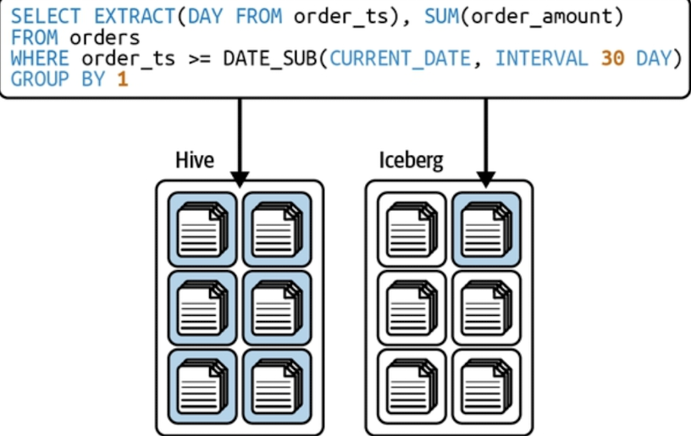
Hidden partitioning
Let’s assume the table is using day partitioning. The query depicted in the figure would result in a full table scan in Hive since another “day” column was probably created for partitioning, while in Iceberg the metadata would track the partitioning as “the transformed value of CURRENT_DATE” and therefore would use the partitioning when filtering by CURRENT_DATE (we will discuss this in more detail later in the book).
Apache Iceberg: The Definitive Guide (p. 58). O'Reilly Media

Slide 14
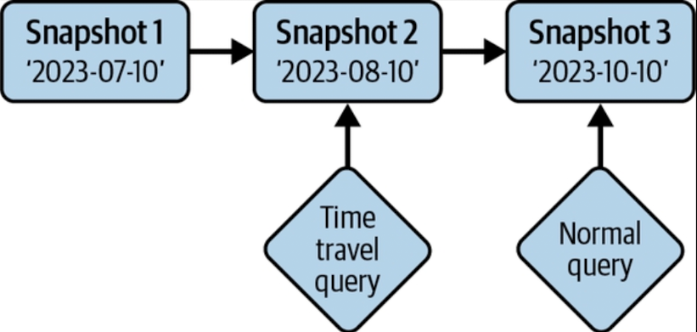
Time travel
Apache Iceberg provides immutable snapshots, so the information for the table’s historical state is accessible, allowing you to run queries on the state of the table at a given point in time in the past, or what’s commonly known as time travel. This can help you in situations such as doing end-of-quarter reporting without the need for duplicating the table’s data to a separate location or for reproducing the output of an ML model as of a certain point in time.
Version rollback. Not only does Iceberg’s snapshot isolation allow you to query the data as it is, but it also reverts the table’s current state to any of those previous snapshots. Therefore, undoing mistakes is as easy as rolling back

Slide 15
Hands-on time travel 👩‍💻🧑‍💻
We'll query the table back in time pointing at a former snapshot.
Code: iceberg_features.ipynb

Slide 16


Hands-on - More realistic setup 👩‍💻🧑‍💻
Iceberg-REST
We’ll setup a container with a simple local setup to try Iceberg. This includes Spark and a Postgres JDBC Catalog.
Code: README.md
Local
Reference: https://www.tabular.io/blog/docker-spark-and-iceberg-the-fastest-way-to-try-iceberg/
https://iceberg.apache.org/spark-quickstart/#docker-compose

Slide 17
About Metadata
Explore Metadata in Spark SQL
Iceberg table metadata is available through special tables called, unsurprisingly, metadata tables. Metadata tables are virtual tables that expose metadata in a tabular format.The most commonly used metadata tables show the levels in Iceberg’s metadata tree. These include:
snapshots – known versions of the table, with summary metadata
manifests – manifest files in the current snapshot; these track data and delete files
data_files – data files in the current snapshot
delete_files – delete files in the current snapshot; these store deleted keys or file offsets

Slide 18
Agenda
Intro
Metadata
Key features and time-travel
Table maintenance
Row-level updates

Slide 19
Table Maintenance
With the increase in the number of datafiles, the number of metadata files also increases. Additionally, streaming-based ingestion jobs can lead to a lot of small files being generated as data is written in smaller chunks as and when they arrive. It is therefore important to have a strategy as part of your organization’s regular maintenance process to remove these unnecessary metadata files or to compact smaller files into larger ones for better read performance.
rewrite_data_files
expire_snapshots
rewrite_manifests
🧹🧑‍🔧🔧
⚠️Not all available in PyIceberg

Slide 20
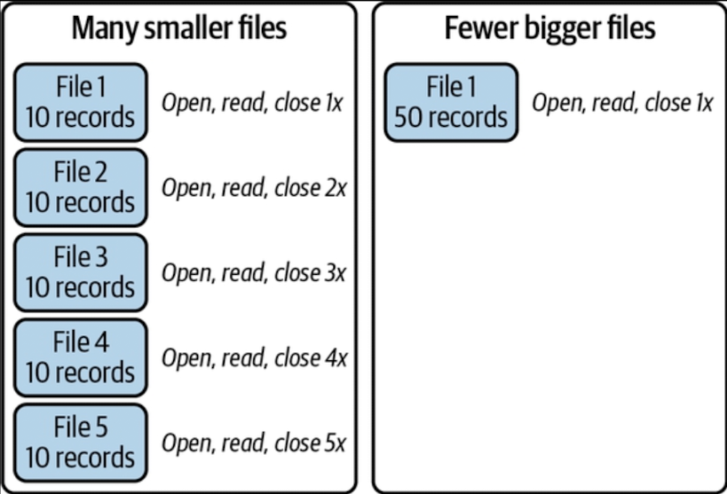
Compaction
When you are querying your Apache Iceberg tables, you need to open and scan each file and then close the file when you’re done. The more files you have to scan for a query, the greater the cost these file operations will put on your query. This problem is magnified in the world of streaming or “real-time” data, where data is ingested as it is created, generating lots of files with only a few records in each.
# Generic procedure
CALL catalog_name.system.rewrite_data_files(table, strategy, sort_order, options)
spark.sql("CALL glue.system.rewrite_data_files('test.employee')")
Apache Iceberg: The Definitive Guide (pp. 129-130). O'Reilly Media.

Slide 21
Expire Snapshots
Any modification to the data in Iceberg—be it an insert, update, delete, or upsert—generates a new snapshot. These snapshots are retained by Iceberg for supporting capabilities such as time travel. However, over a period of time you might end up with a lot of snapshots and not all of them might be necessary. The expire_snapshots procedure in Spark helps remove these older, unnecessary snapshots along with their datafiles.
# Generic procedure
CALL catalog_name.system.expire_snapshots(table, older_than, retain_last)
spark.sql("CALL glue.system.expire_snapshots('test.employees',
date_sub(current_date(), 90), 50)")

Slide 22
Rewrite manifests
Manifest files in Iceberg tables play a crucial role in optimizing scan planning as they keep statistical information about the datafiles. The rewrite_manifests procedure allows you to rewrite these manifests in parallel, thereby improving the speed and efficiency of data scans.
# Generic procedure
CALL catalog_name.system.rewrite_manifests(table)
spark.sql("CALL test.system.rewrite_manifests('test.employee')")

Slide 23
Hands-on - Table maintenance 👩‍💻🧑‍💻
Iceberg-REST
Code:
Iceberg - Table Maintenance Spark Procedures.ipynb
Local
Reference: https://www.tabular.io/blog/docker-spark-and-iceberg-the-fastest-way-to-try-iceberg/
https://iceberg.apache.org/spark-quickstart/#docker-compose

Slide 24
Agenda
Intro
Metadata
Key features and time-travel
Table maintenance
Row-level updates

Slide 25
Row-level updates
New record = new datafile
Update record = ?
Consider that
in data lakes datafiles are immutable (needed for snapshots)
consider updating 10 rows. What if they are in 10 different datafiles? Should we rewrite all of them?

Slide 26
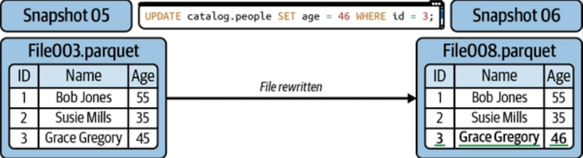
Row-level updates - Copy on Write
The default approach is referred to as copy-on-write (COW). In this approach, if even a single row in a datafile is updated or deleted, that datafile is rewritten, and the new file takes its place in the new snapshot.
Apache Iceberg: The Definitive Guide (p. 165). O'Reilly Media.

Slide 27
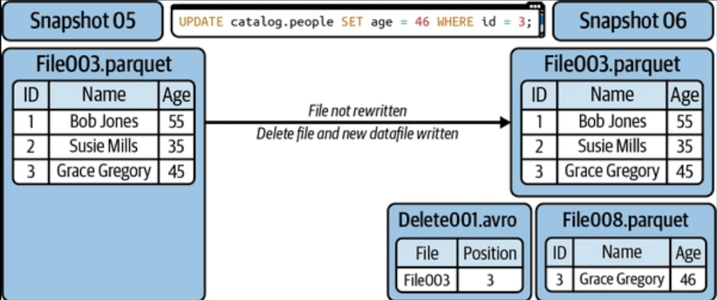
Row-level updates - Merge on Read
Instead of rewriting an entire datafile, you capture in a delete file the records to be updated in the existing file, with the delete file tracking which records should be ignored.
Apache Iceberg: The Definitive Guide (p. 166). O'Reilly Media.

Slide 28
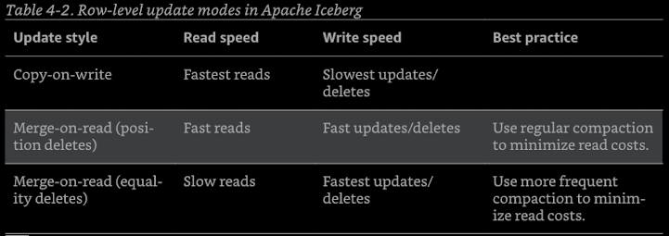
Row-level updates - COW vs MOR
Apache Iceberg: The Definitive Guide (pp. 164-165). O'Reilly Media.

Slide 29
Exam 18th December
40% exercise
60% quiz
You’ll be given 90 minutes to write a piece of code. The evaluation will be simple and defined as “completed” or “partially completed”. If “completed”, the score will be 40%, otherwise 20%.
The quiz is composed by 10 multiple-choice questions. Each question that is answered correctly gives +6% points on the final mark.

