Slide 1
Apache Spark per l’Analisi dei Dati
Introduzione al corso
Marco Santoni

Slide 2
Cosa impareremo
Core concepts behind Apache Spark
Spark APIs and DataFrames
Spark SQL
Structured Streaming
Machine Learning with Spark
Durata: 48h dal 2 ottobre 2023 al 16 novembre 2023

Slide 3
L’esame 😱
Prima prova: 26 ottobre(40%)
Prova finale: 16 novembre (60%)
Cosa
Esercizio di programmazione in PySpark
Domande a scelta multipla su concetti base teorici di Spark

Slide 4
Materiale
Slide and Notebook: Google Drive
2022-24.BD (download)
UFS17 - Big Data Analytics
Libro: Learning Spark, 2nd edition (PDF)

Slide 5

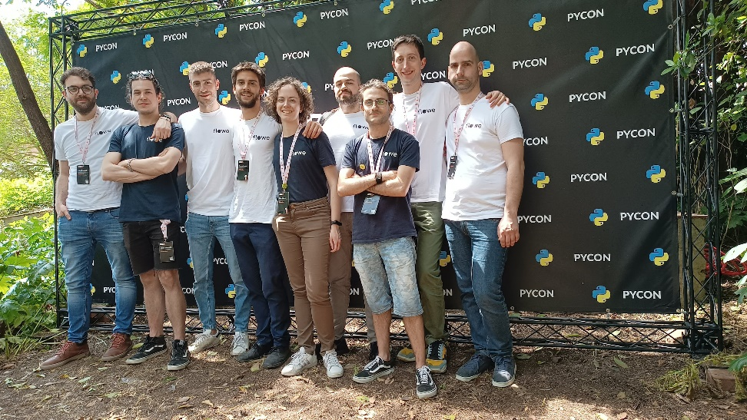








About me
Head of Data at
Organizer of Python Milano
Previously…
Host of Intervista Pythonista
intervista pythonista

Slide 6
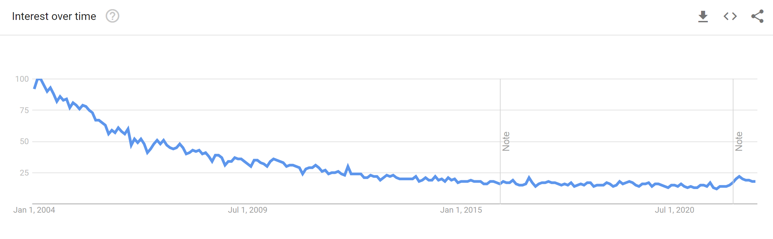
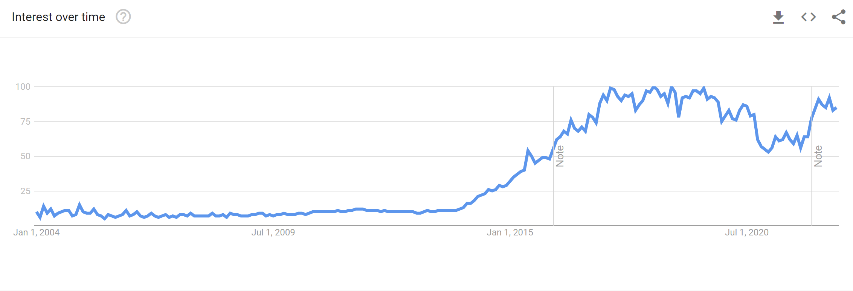
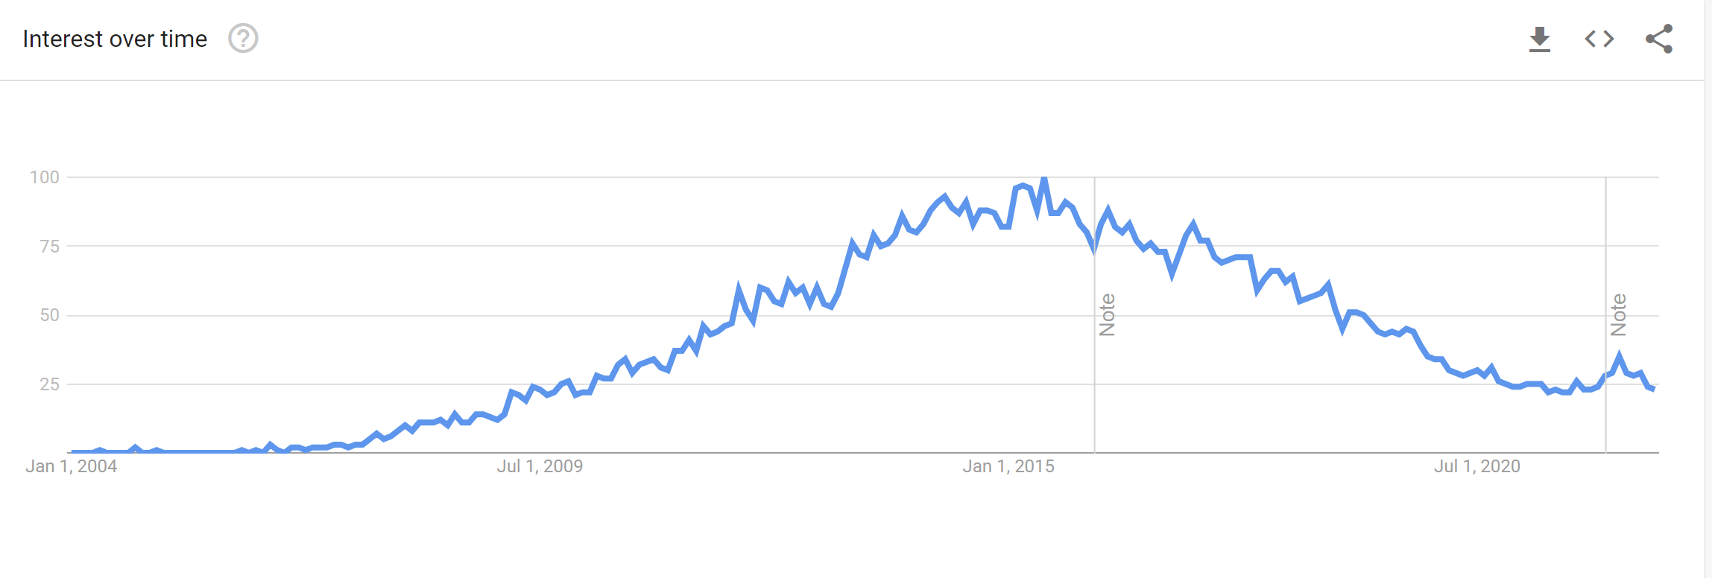
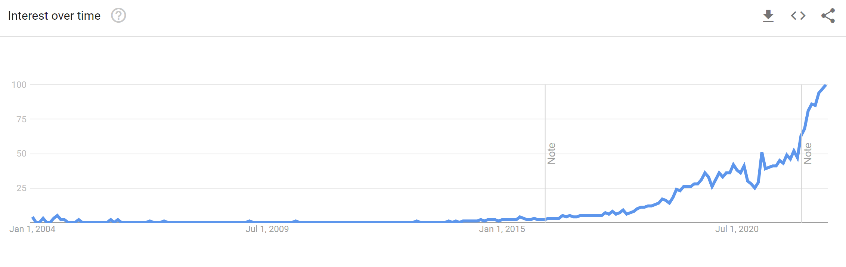
Why is this course relevant?
3V (2001)
SPARK (2009)
DWH (late 90s)
HADOOP (2005)
CLOUD
(BIG QUERY 2011, SNOWFLAKE 2012, DATABRICKS 2013)
Ref: Google Trends
Notes:
Cosa avete già studiato di questo?

Slide 7
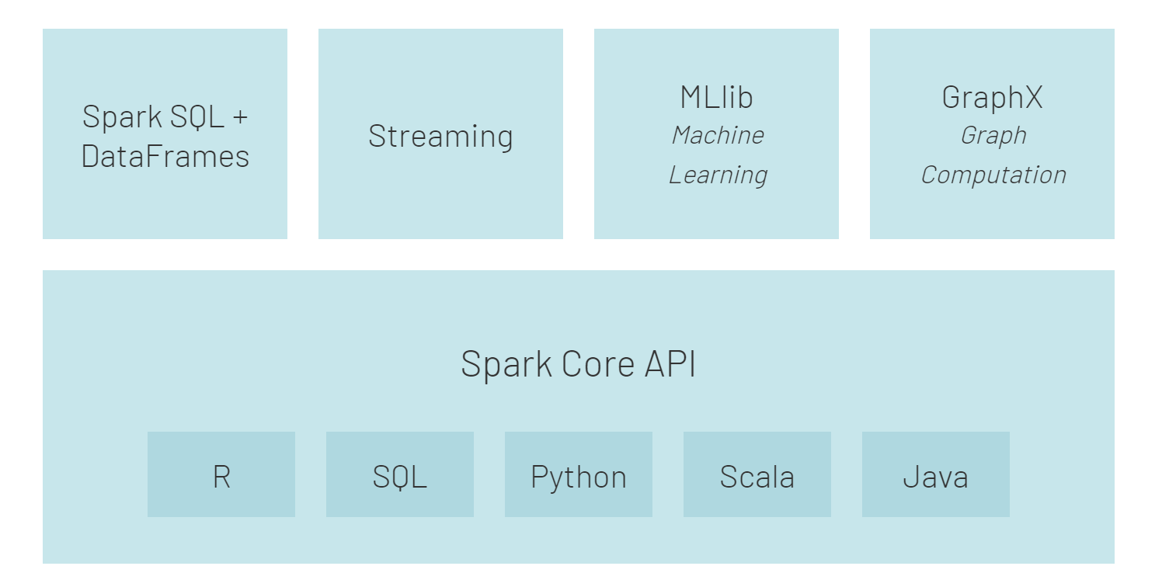
Why Spark?
Simplicity. Rich API for quick and easy interaction with data at scale.
Speed. Designed for speed outperforming Hadoop’s MapReduce
Support. Wide range of programming languages (eg Java, Python, Scala, R) and integration with storage solutions.
Ref: Gettting Started with Spark
Notes:
Simplicity: Spark’s capabilities are accessible via a set of rich APIs, all designed specifically for interacting quickly and easily with data at scale. These APIs are well-documented and structured in a way that makes it straightforward for data scientists and application developers to quickly put Spark to work.
Speed: Spark is designed for speed, operating both in memory and on disk. Using Spark, a team from Databricks tied for first place with a team from the University of California, San Diego, in the 2014 Daytona GraySort benchmarking challenge (https://spark.apache.org/news/spark-wins-daytona-gray-sort-100tb-benchmark.html). The challenge involves processing a static data set; the Databricks team was able to process 100 terabytes of data stored on solid-state drives in just 23 minutes, and the previous winner took 72 minutes by using Hadoop and a different cluster configuration. Spark can perform even better when supporting interactive queries of data stored in memory. In those situations, there are claims that Spark can be 100 times faster than Hadoop’s MapReduce.
Support: Spark supports a range of programming languages, including Java, Python, R, and Scala. Spark includes support for tight integration with a number of leading storage solutions in the Hadoop ecosystem and beyond, including HPE Ezmeral Data Fabric (file system, database, and event store), Apache Hadoop (HDFS), Apache HBase, and Apache Cassandra. Furthermore, the Apache Spark community is large, active, and international. A growing set of commercial providers, including Databricks, IBM, and all of the main Hadoop vendors, deliver comprehensive support for Spark-based solutions.

Slide 8

Why Databricks?
By creators of Apache Spark™
Easy to setup clusters
One platform for DE and DS
Image from imgflip

Slide 9
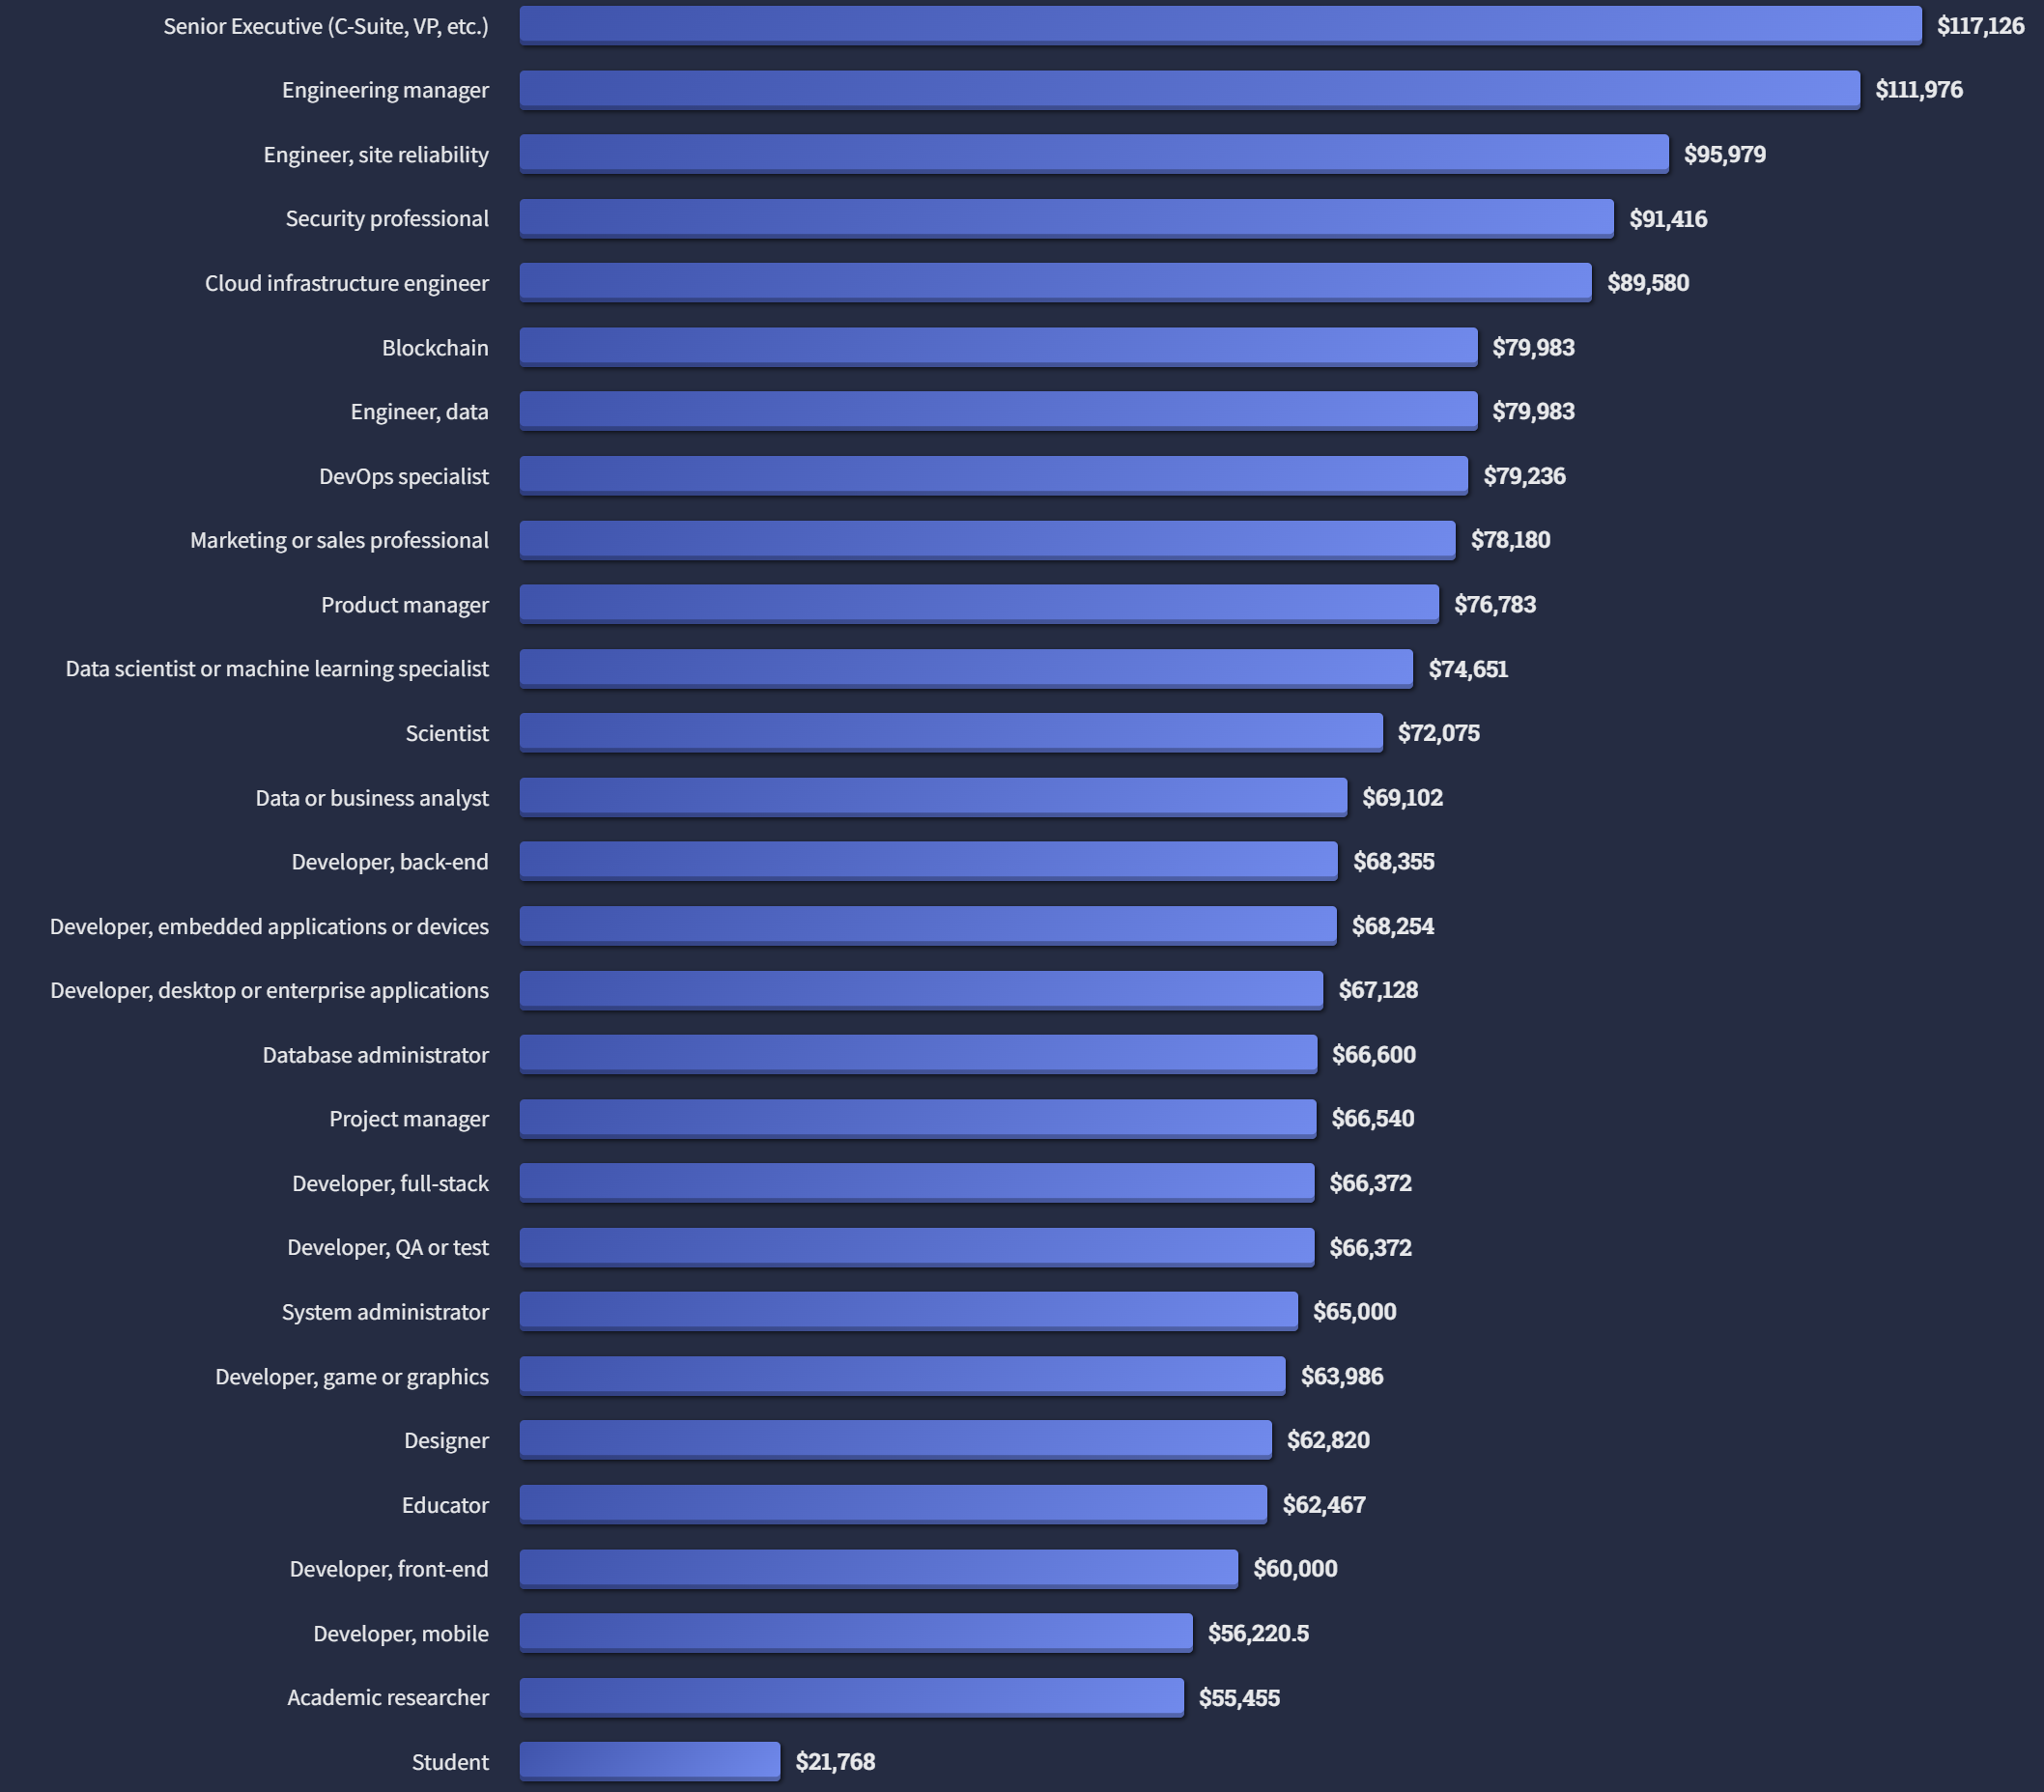
Why is this course relevant?
Is there anything you did not expect?
Ref: Salary by Developer Type, Stackoverflow Survey 2022
Notes:
Yes, data scientist is way lower

Slide 10
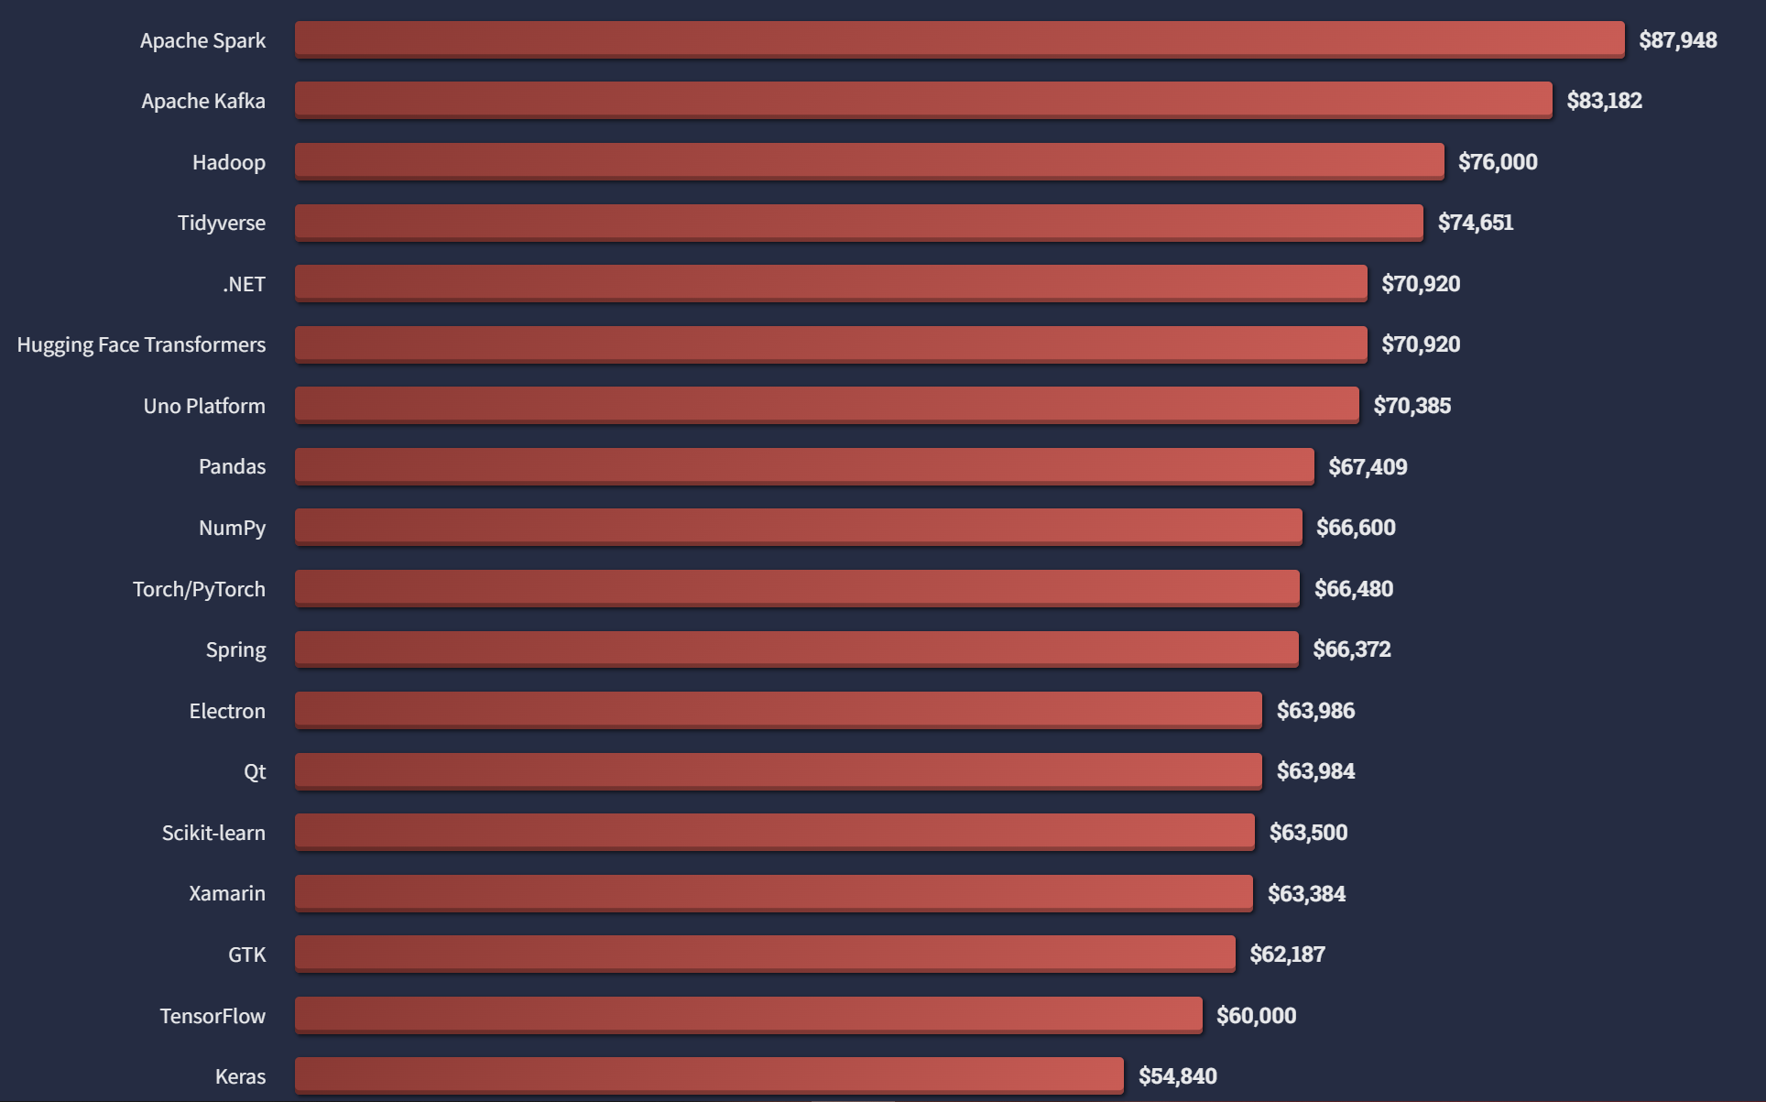
Why is this course relevant?
Ref: Top paying technologies, Stackoverflow Survey 2022

Slide 11

Image from matwrites

Slide 12

Setup Databricks Community
Guide: create a Community Edition account

Slide 13
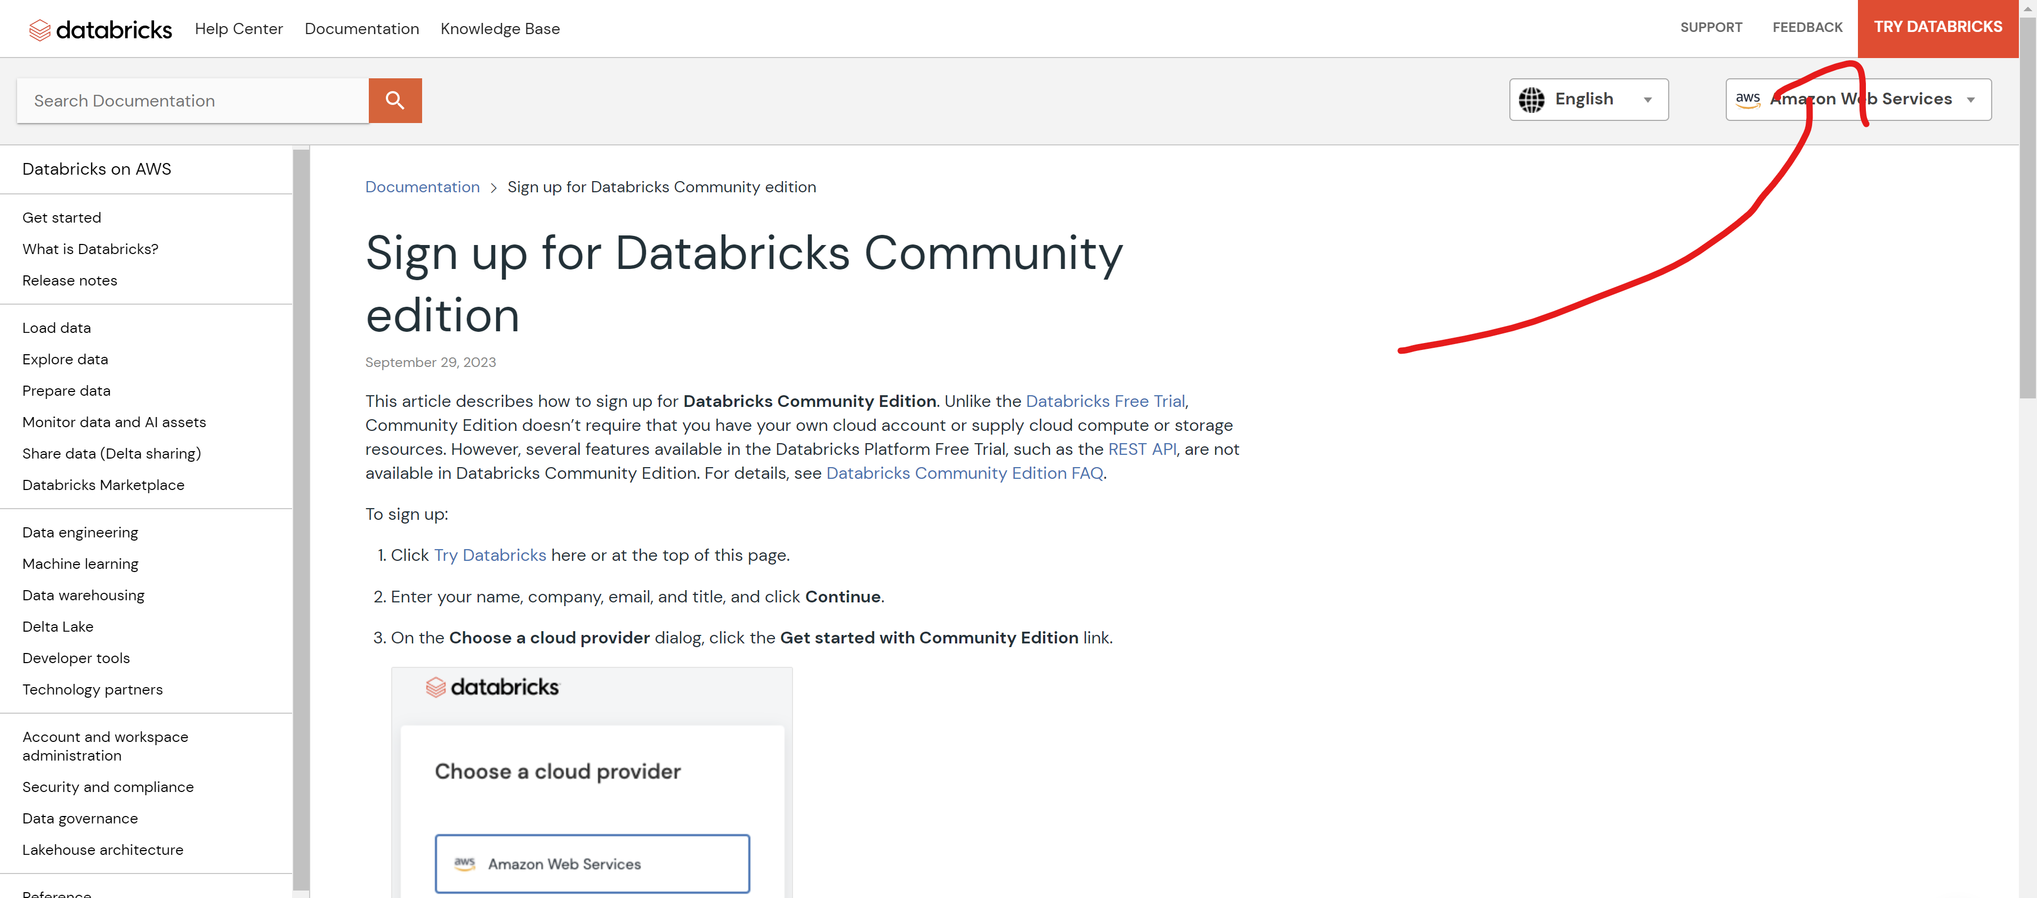
Setup Databricks Community
Guide: create a Community Edition account

Slide 14
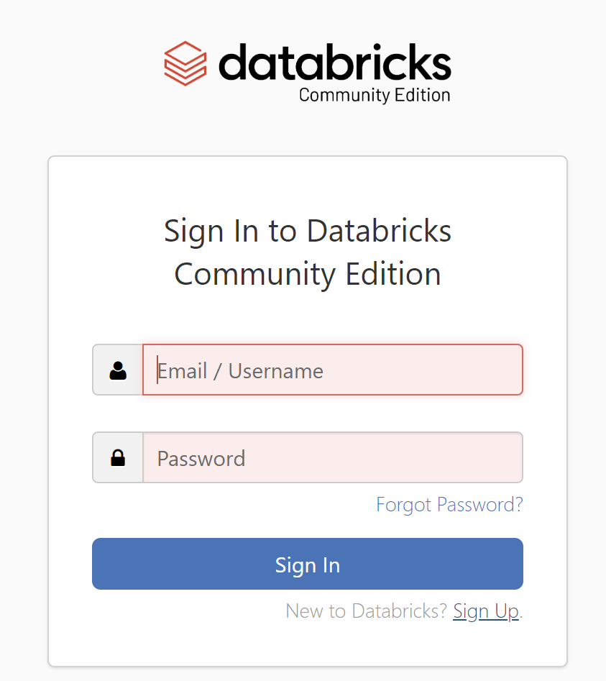
Setup Databricks Community

Slide 15
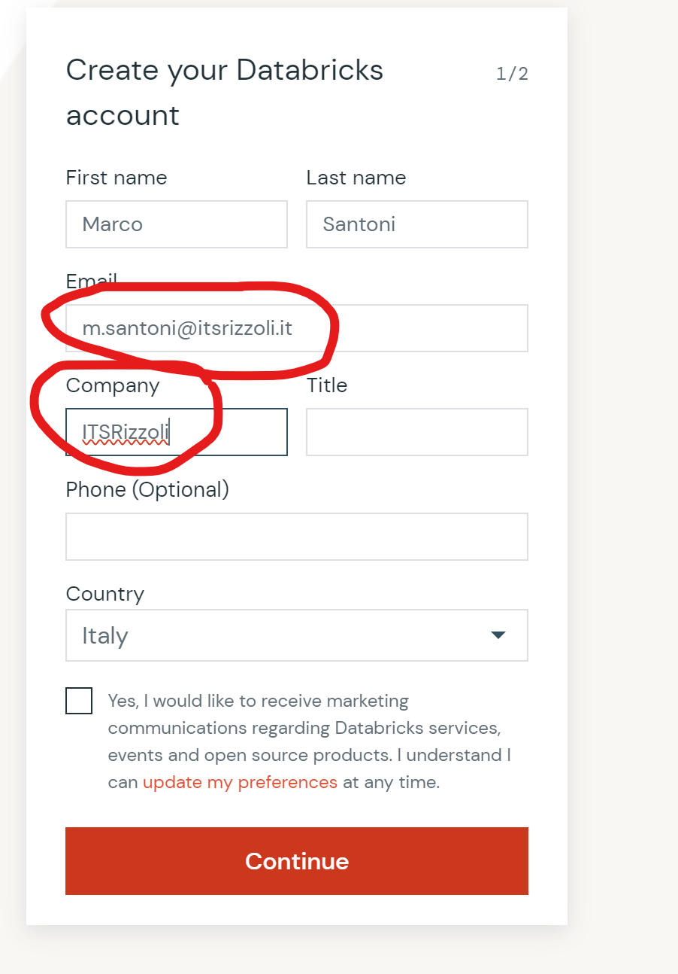
Setup Databricks Community

Slide 16

Setup Databricks Community
… and open your email

Slide 17
Our first coding session…
… an introduction to Databricks

