Slide 1
Apache Spark
Marco Santoni

Slide 2
We’ll look at
Application
SparkSession
Job
Stage
Task

Slide 3
How does Spark work?
Example as in video
Ref: Spark Architecture in 3 minutes

Slide 4
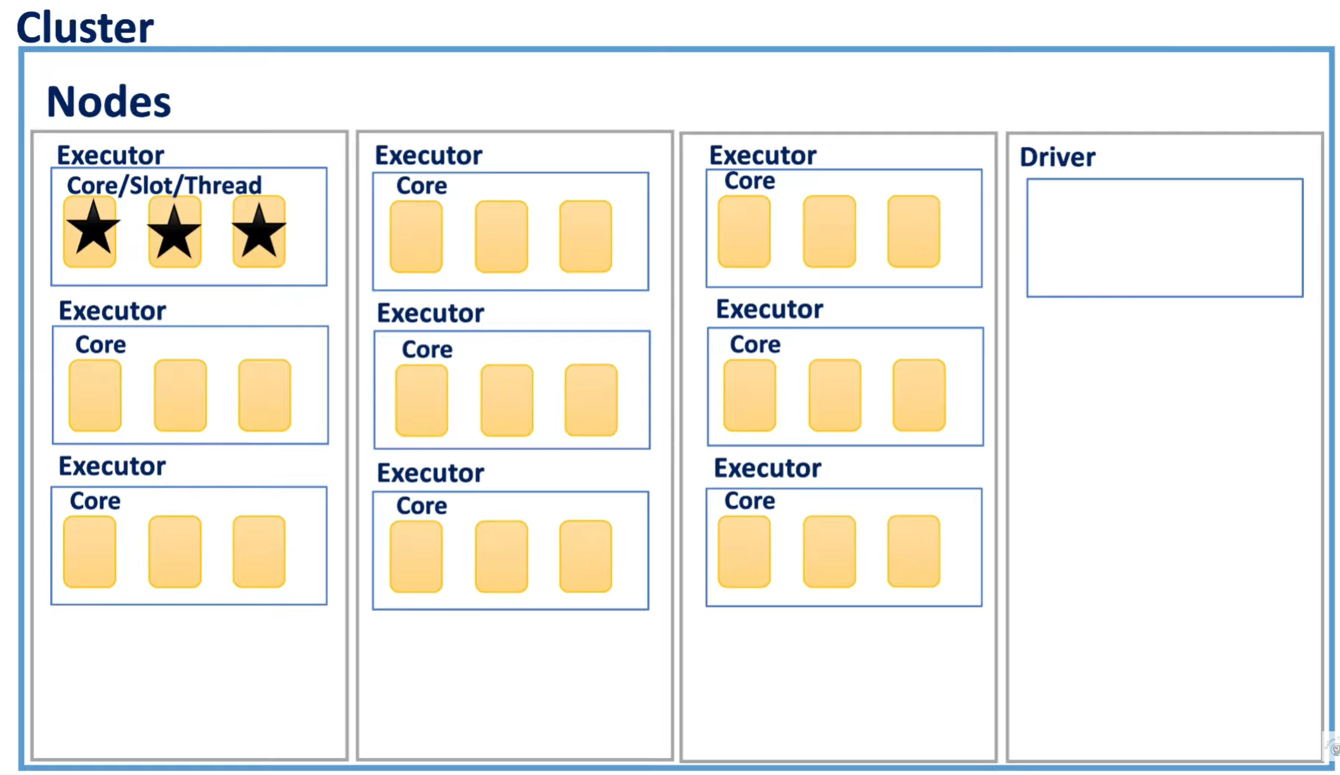
How does Spark work?
rifare
Ref: Spark Architecture in 3 minutes

Slide 5
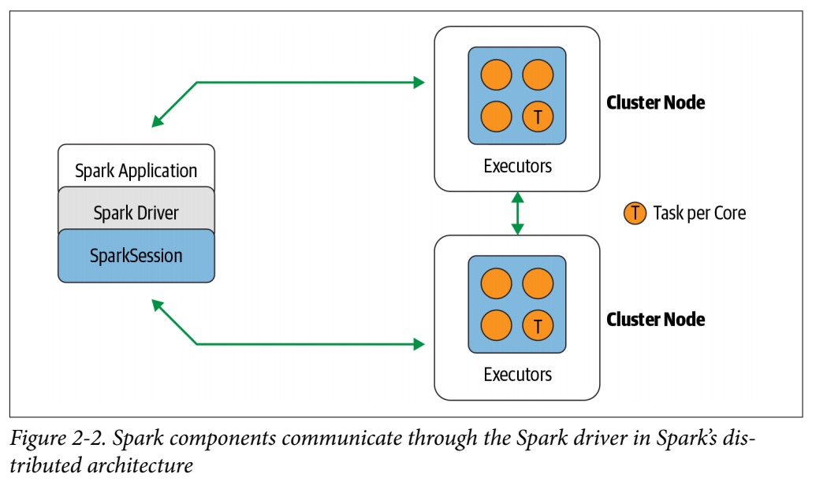
Application: program developed by the user built on Spark.
Application = Driver Program + Executors
Driver: process running the main() function of the Application and creating the SparkSession object.
Executor: process launched for an Application on a worker node, that runs tasks and keeps data in memory or disk storage across them. Each Application has its own Executors.
Image from: Learning Spark, Damji et al

Slide 6
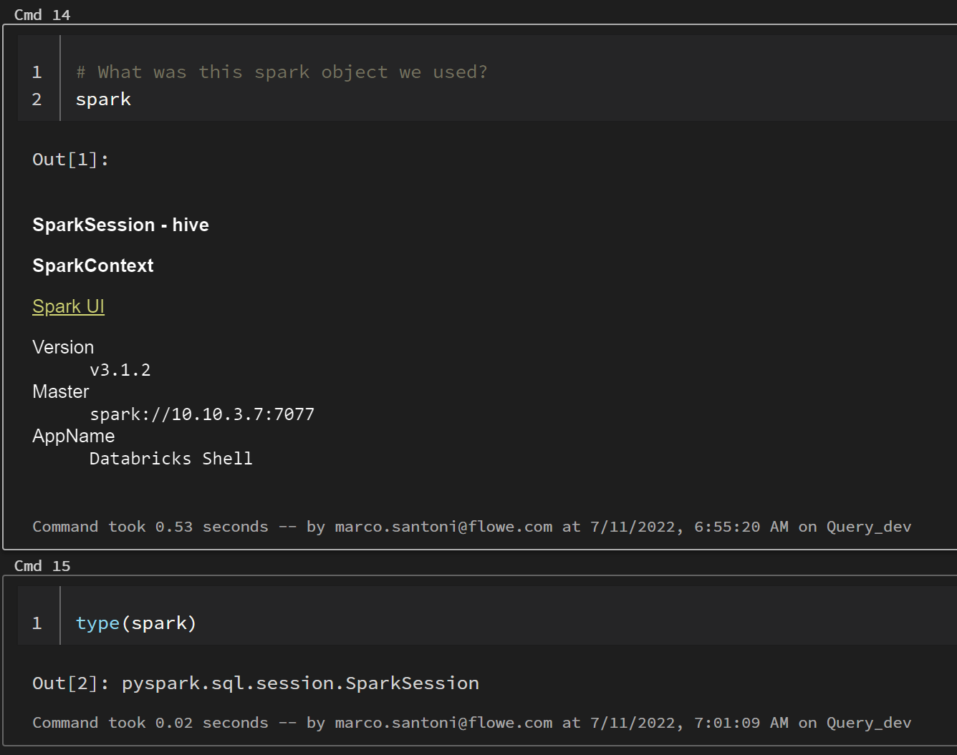
SparkSession
Single point of entry to interact with underlying Spark functionality
Allows programming Spark with DataFrame and Dataset APIs.
In the Databricks notebook, when you create a cluster, the SparkSession is created for you. In both cases it’s accessible through a variable called spark.
Ref: How to use SparkSession
Notes:
Most importantly, it curbs the number of concepts and constructs a developer has to juggle while interacting with Spark.
And through “spark” variable you can access all its public fields and methods.

Slide 7

Spark Driver
https://blog.knoldus.com/understanding-the-working-of-spark-driver-and-executor/
https://spark.apache.org/docs/latest/cluster-overview.html

Slide 8
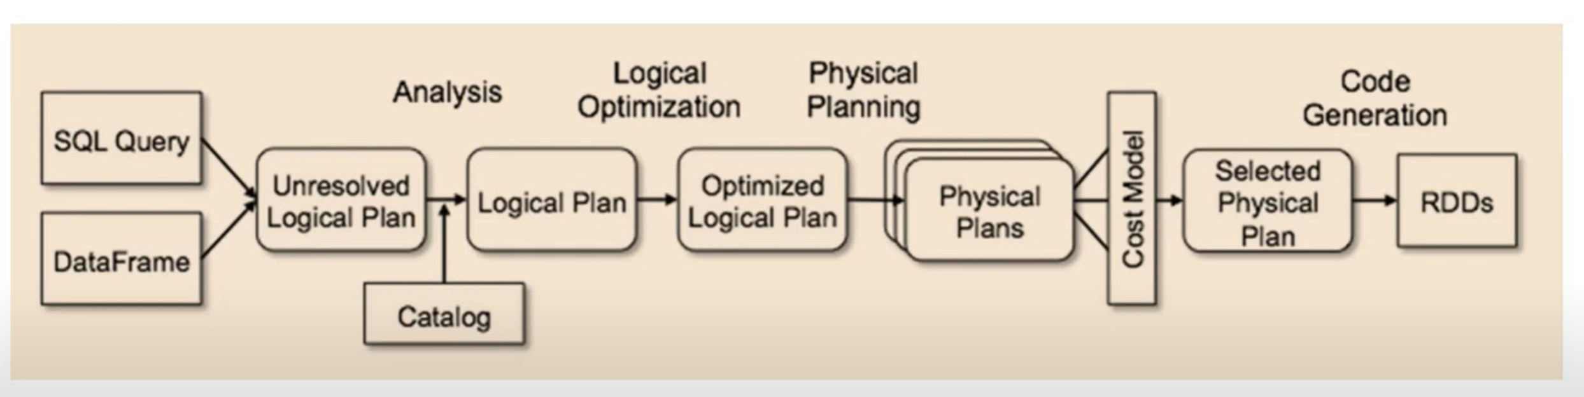
Dataframes behind the scene
Ref: Spark APIs

