Slide 1
Apache Spark
Marco Santoni

Slide 2
We’ll look at
Clusters, nodes, executors
Application, Driver, SparkSession, Job, Stage, Task

Slide 3
How does Spark work?
Example as in video
Ref: Spark Architecture in 3 minutes

Slide 4
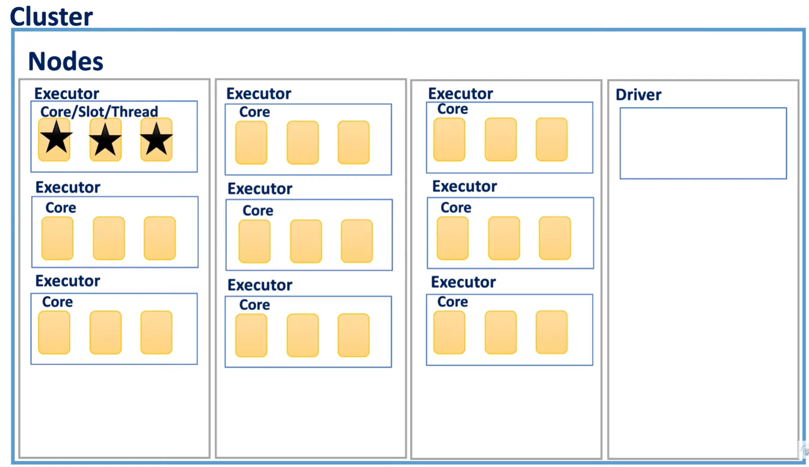
How does Spark work?
rifare
Ref: Spark Architecture in 3 minutes

Slide 5
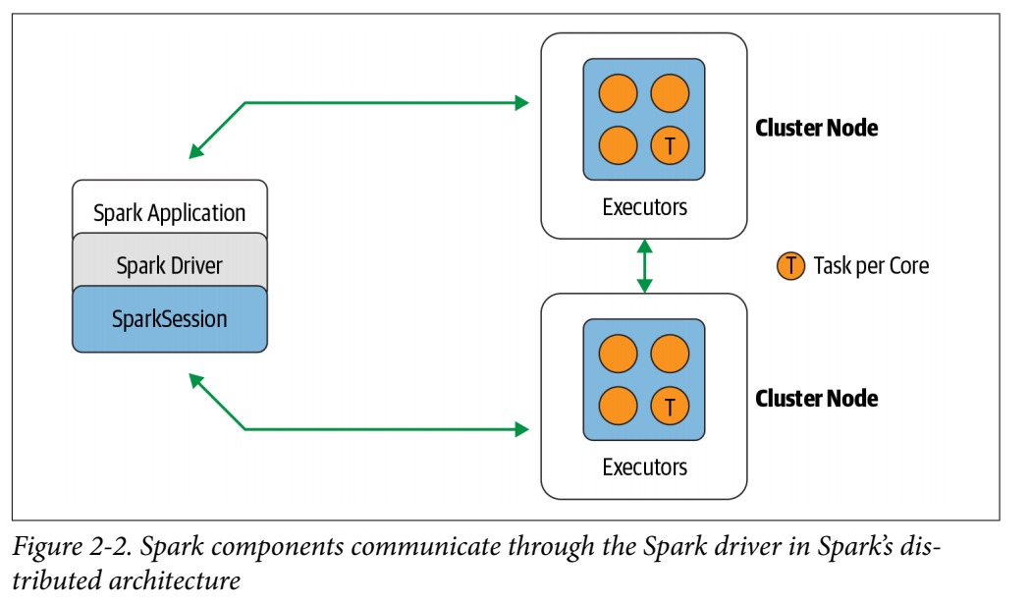
Application: program developed by the user built on Spark.
Application = Driver Program + Executors
Driver: process running the main() function of the Application and creating the SparkSession object.
Executor: process launched for an Application on a worker node, that runs tasks and keeps data in memory or disk storage across them. Each Application has its own Executors.
Image from: Learning Spark, Damji et al

Slide 6
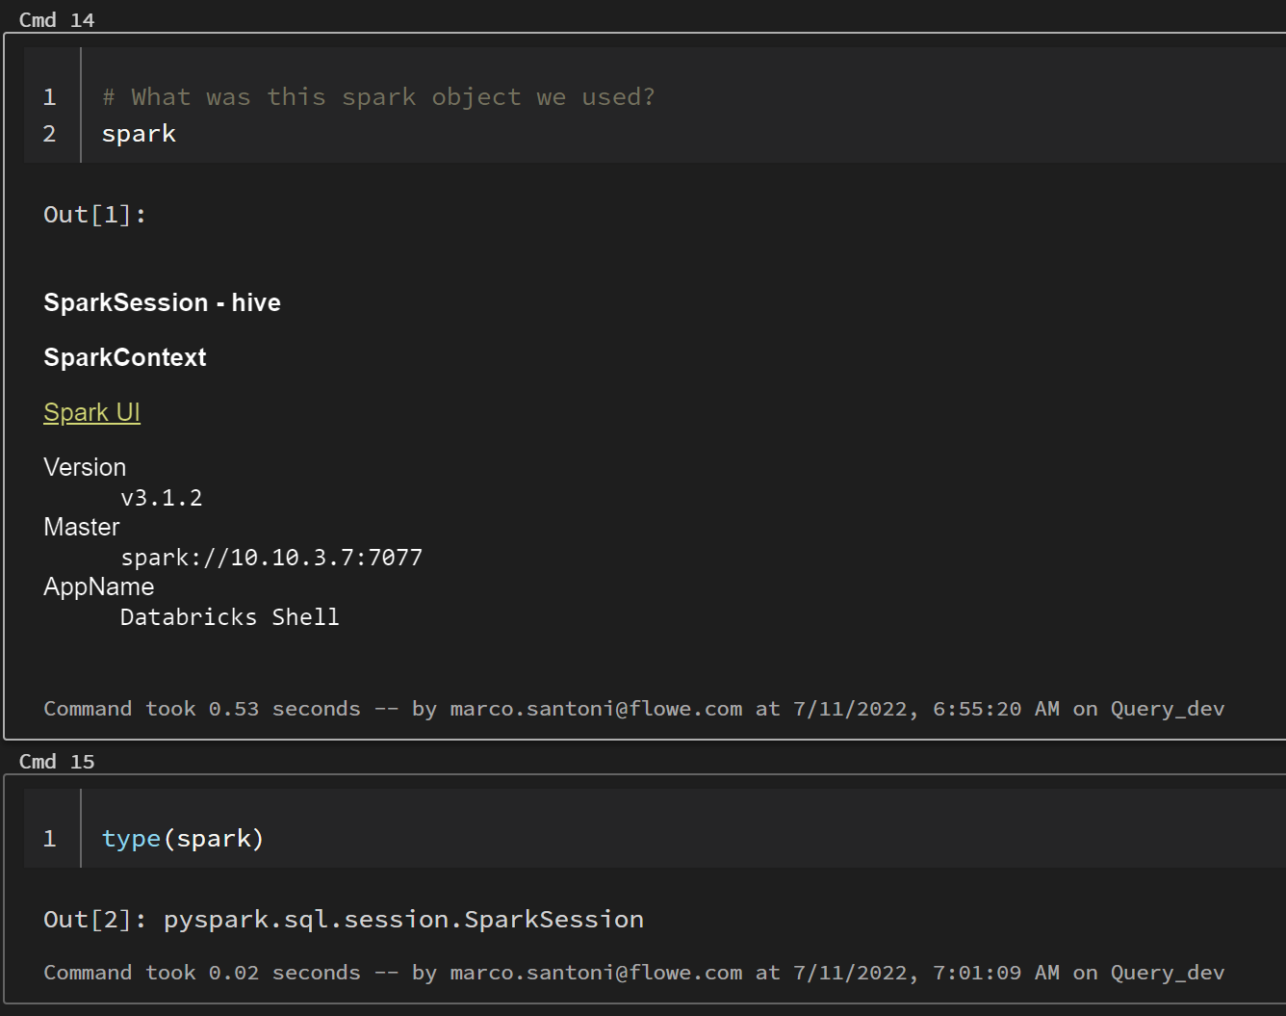
SparkSession
Single point of entry to interact with underlying Spark functionality
Allows programming Spark with DataFrame and Dataset APIs.
In the Databricks notebook, when you create a cluster, the SparkSession is created for you. In both cases it’s accessible through a variable called spark.
Ref: How to use SparkSession
Notes:
Most importantly, it curbs the number of concepts and constructs a developer has to juggle while interacting with Spark.
And through “spark” variable you can access all its public fields and methods.

Slide 7
Applications and Processes
rifare
Executor 2
Application 2
Each application gets its own executor processes
Why? Isolating applications from each other, on both the scheduling side (each driver schedules its own tasks) and executor side (tasks from different applications run in different JVMs)
Ref: Cluster Overview
Notes:
Each application gets its own executor processes, which stay up for the duration of the whole application and run tasks in multiple threads.
This has the benefit of isolating applications from each other, on both the scheduling side (each driver schedules its own tasks) and executor side (tasks from different applications run in different JVMs). However, it also means that data cannot be shared across different Spark applications (instances of SparkContext) without writing it to an external storage system.

Slide 8
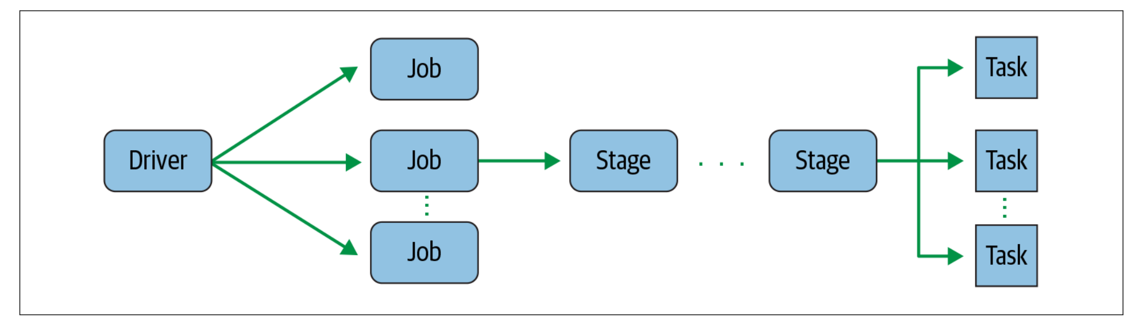
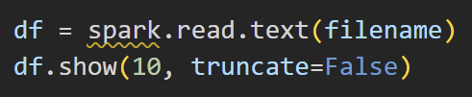
From Driver to Jobs
Driver converts your Spark application into one or more Spark jobs
Ref: Learning Spark, Damji et al

Slide 9
Jobs and Stages
Stages are created based on what operations can be performed serially or in parallel. Not all Spark operations can happen in a single stage, so they may be divided into multiple stages.
(Page 28).
Ref: Learning Spark, Damji et al

Slide 10
Stages and Tasks
Each stage is comprised of Spark tasks (a unit of execution), which are then federated across each Spark executor; each task maps to a single core and works on a single partition of data.
Ref: Learning Spark, Damji et al

Slide 11
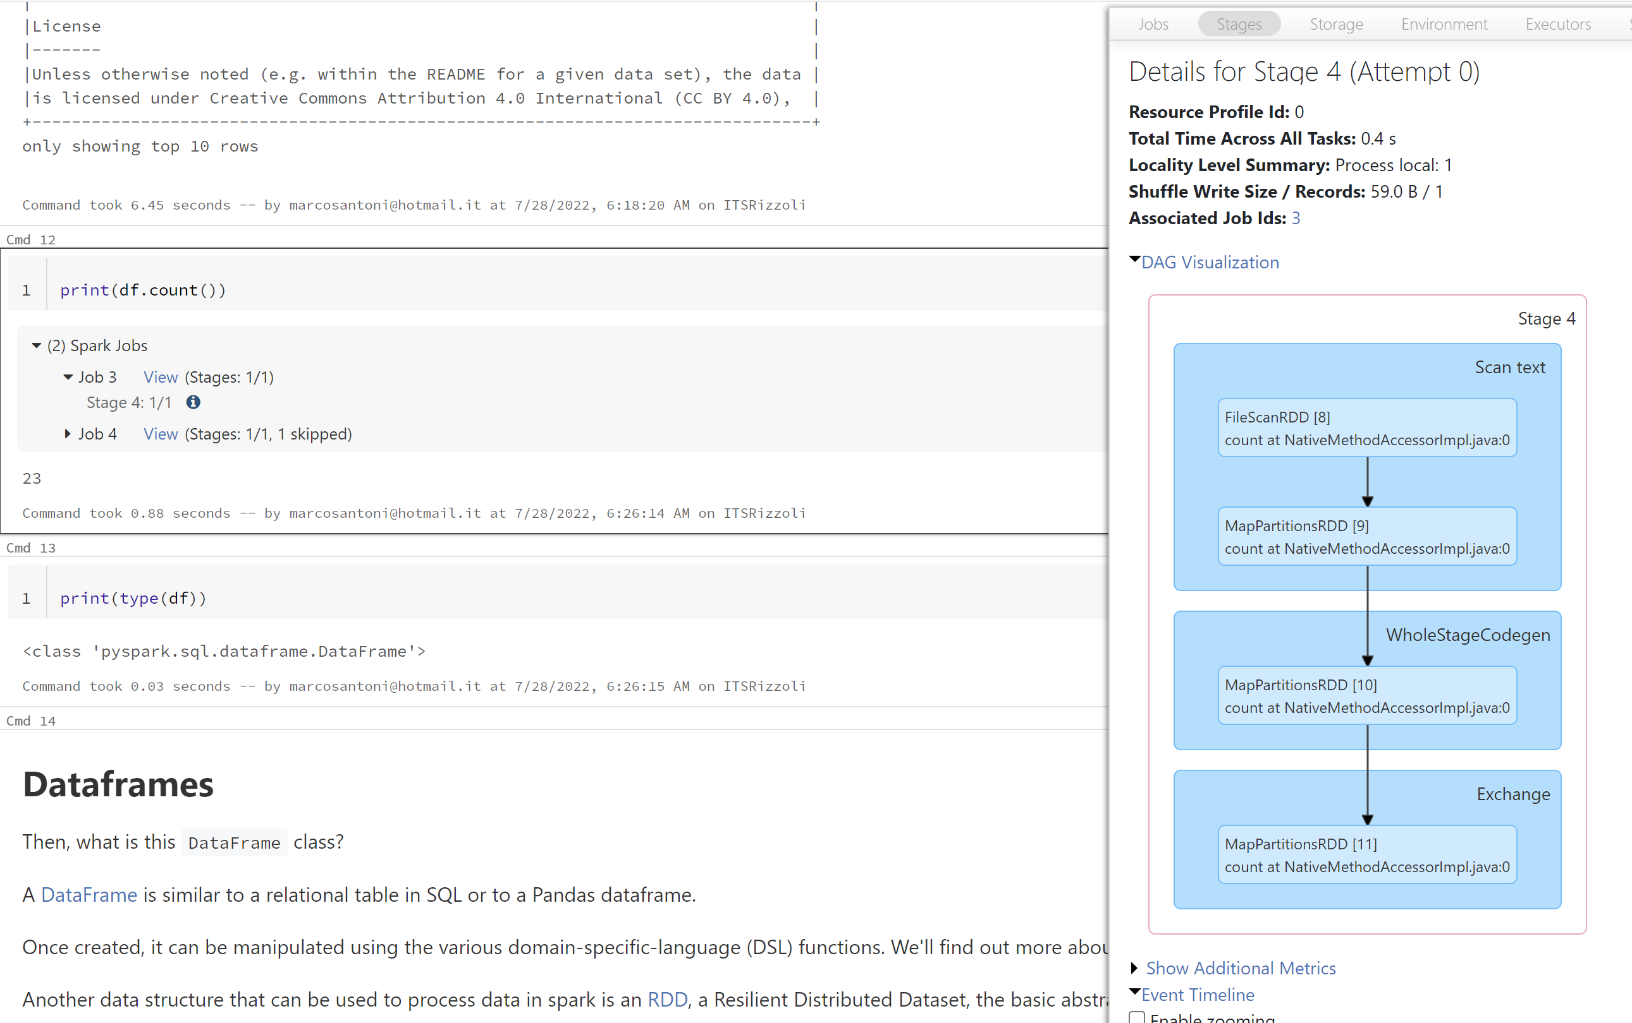
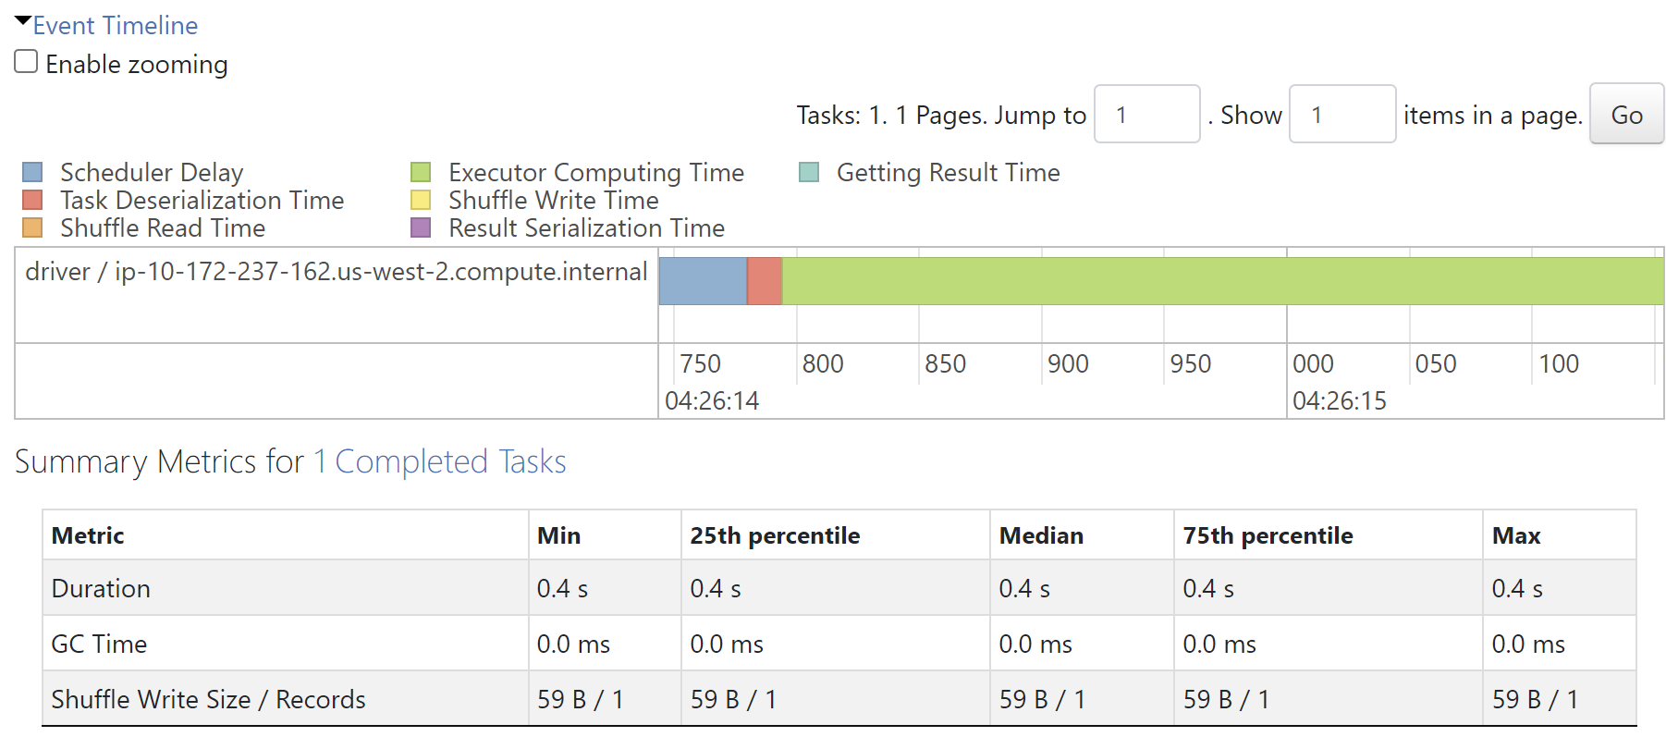
Looking at the Stages
Spark's stages represent segments of work that run from data input (or data read from a previous shuffle) through a set of operations called tasks — one task per data partition — all the way to a data output or a write into a subsequent shuffle.
Ref: Spark Jobs the Easy Way: Web UI Stage View

Slide 12
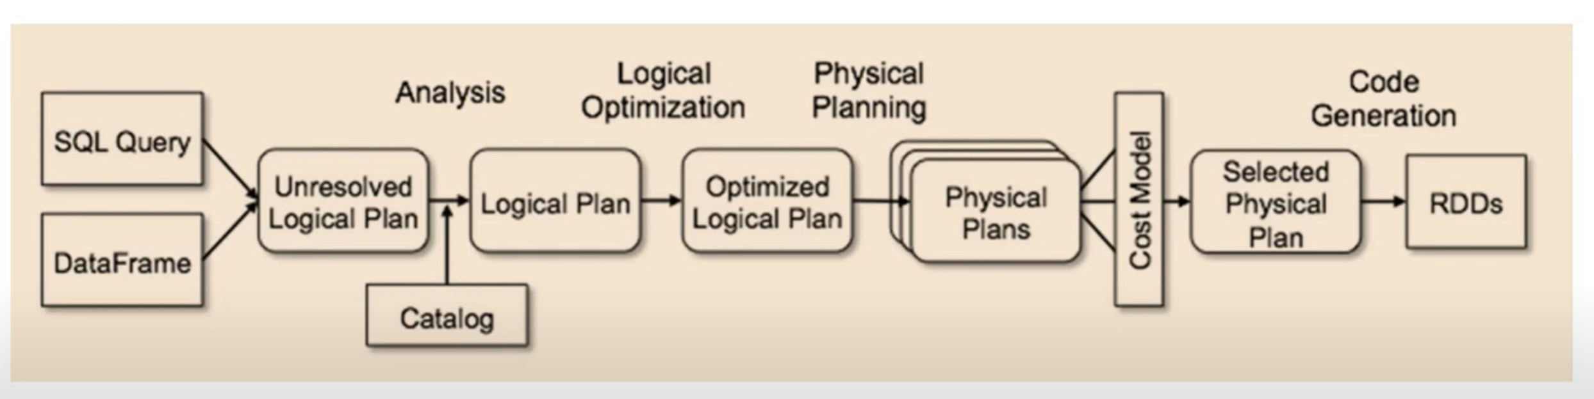
Dataframes behind the scene
Spostare in altro set di slide?
Most efficient?
Eg filters first
Ref: Spark APIs

