Slide 1
Device Based
User Based
Base 1
(B1)
Recommended Block Drivers
(Allow All, Deny specific Drivers)
Base 2
(B2)
Recommended Block User Mode
(Allow All, Deny specific lolbas applications)
Base 3
(B3)
Default
Microsoft
Allowed
(Allow Only Microsoft Signed)
Applocker
Allow All
Exclusion
Admin Apps
Allow Only for Group
EPM
Elevation
Admin Apps
Allow Only for Group
No longer needed on 24H2
Remove file references you are adding in Applocker
Supplemental
OS
(A1)
Example VPN Software
Supplemental
Default Apps
(A2)
Example Adobe Acrobat
Supplemental
Apps
(A3)
Example Bloomberg
*Rule: For a process to be allowed to run it must be added to all Base/Supp/Applocker policies.
*Rule: For Device wide settings add it to the App Control for Business policy. For Groups add it to Applocker.

Slide 2
Rules
Only when an application/process is explicitly declared in all verticals (Base or Base + Supplemental “green blocks”) it is allowed to run. Example: Allow all files in one policy is being overruled by an explicit deny or not declared in another.
For Group/User Allow/Deny it’s added to the Applocker exception list. For Device based blocks it’s added to the Supplementals of the B3 base. Supplemental for OS are not signed Microsoft binaries. Supplemental Default Apps is for example Adobe Reader. Supplemental Apps is for specific user groups like developers or HR.
Default recommended blocks are in B1 and B2. Only Allowed Apps are in the B3 Supplementals (OS/Default Apps/Apps). B1 is no longer needed on Win11 22H2 and above as it’s added automatically, in the code integrity event log you can find {<guid>} Microsoft Windows Driver Policy <version number>.
For Applications first declare it by Certificate based, then Hash based and if that is not possible Path based to keep the exception risk as small as possible.

Slide 3
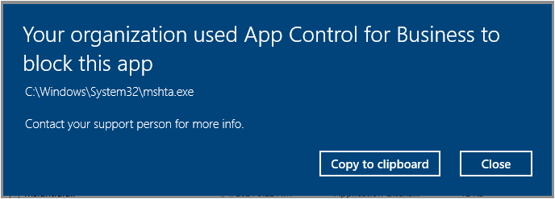
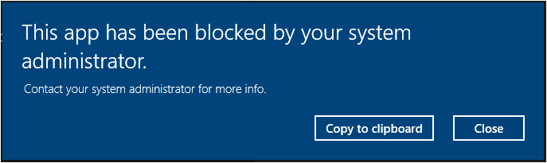
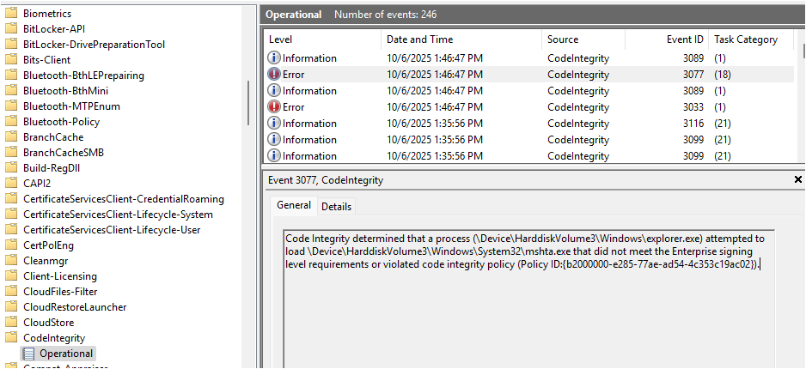
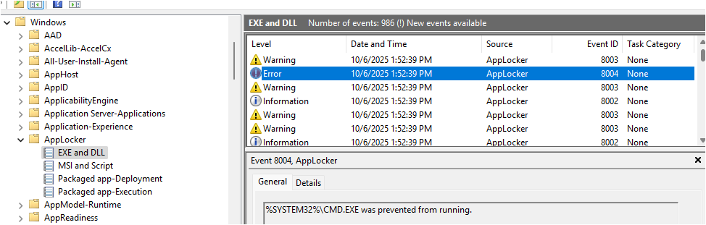
Applocker
App Control for Business

