Slide 1
Data Mining Project
Meta Dataset
Regression Tasks
Marco Sau
60/79/00028

Slide 2
Table of Contents
1
Completed Tasks
2
Work In Progress
3
Extras
4
Next Tasks
5
Scheduling

Slide 3
Table of Contents
1
Completed Tasks
2
Work In Progress
3
Extras
4
Next Tasks
5
Scheduling

Slide 4
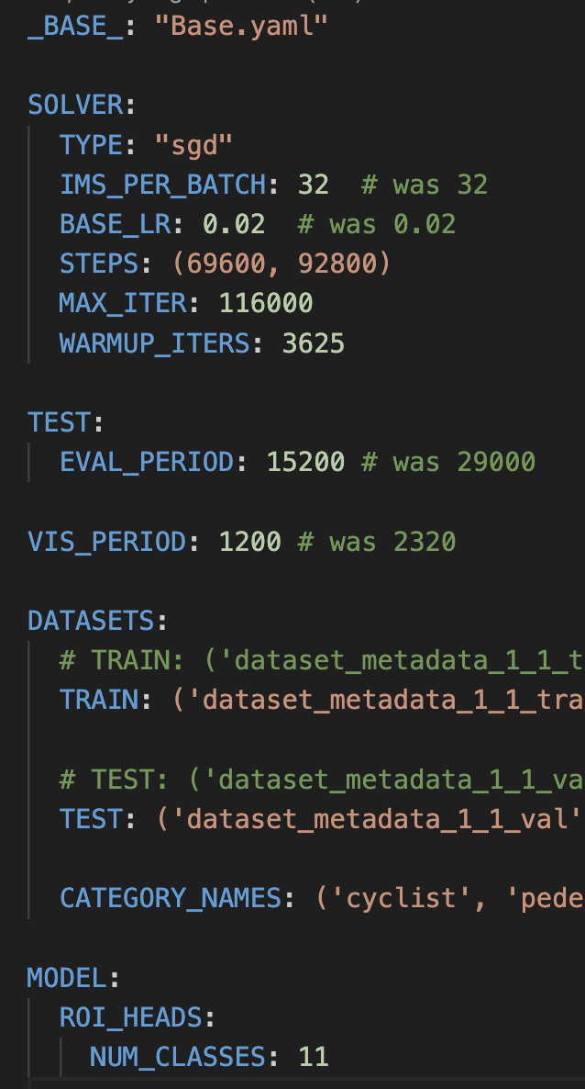
1
Completed Tasks
Tuning Training Parameters
Base_Omni3D_block_1.yaml
Created custom yaml files:
Block 1
Block 1 test
Block 2
Block 2 test

Slide 5
1
Completed Tasks
Problem Solving
train_net.py
built_in.py

Slide 6
Table of Contents
1
Completed Tasks
2
Work In Progress
3
Extras
4
Next Tasks
5
Scheduling

Slide 7
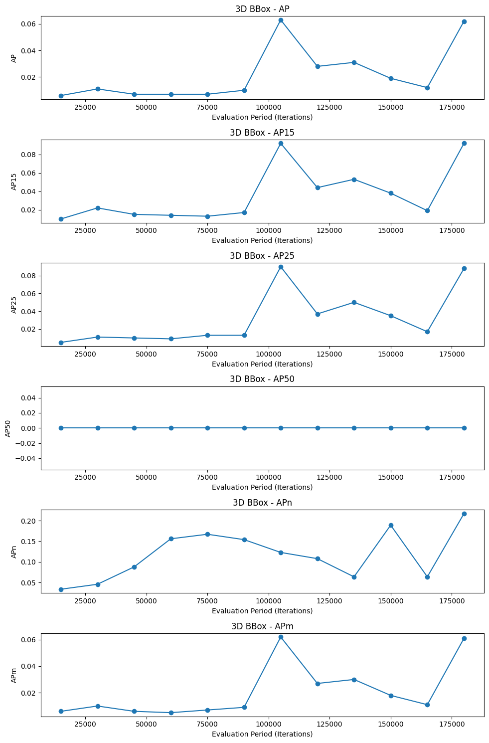
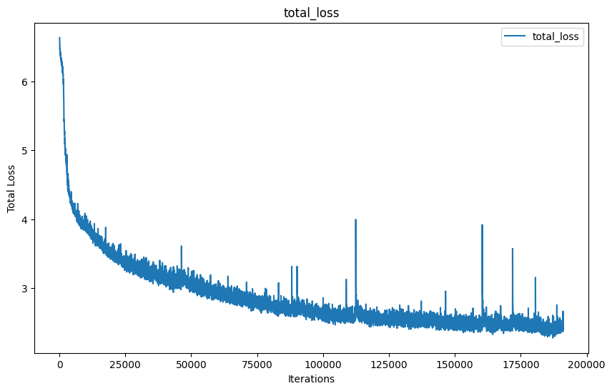
1
Work In Progress
Training Omni3D
Train_net.py
Monitor loss and AP

Slide 8
1
Work In Progress
Evaluation
Evaluation_wip.ipynb
Evaluation script: created a template
Notes:
Sondos tasks to complete this task:
- Create a conversion script from Omni3d json to Kitti json
In order to use kitti format during the evaluation.
This is the format used by the other models
- Adapt AOS for omni3D

Slide 9
Table of Contents
1
Completed Tasks
2
Work In Progress
3
Extras
4
Next Tasks
5
Scheduling

Slide 10
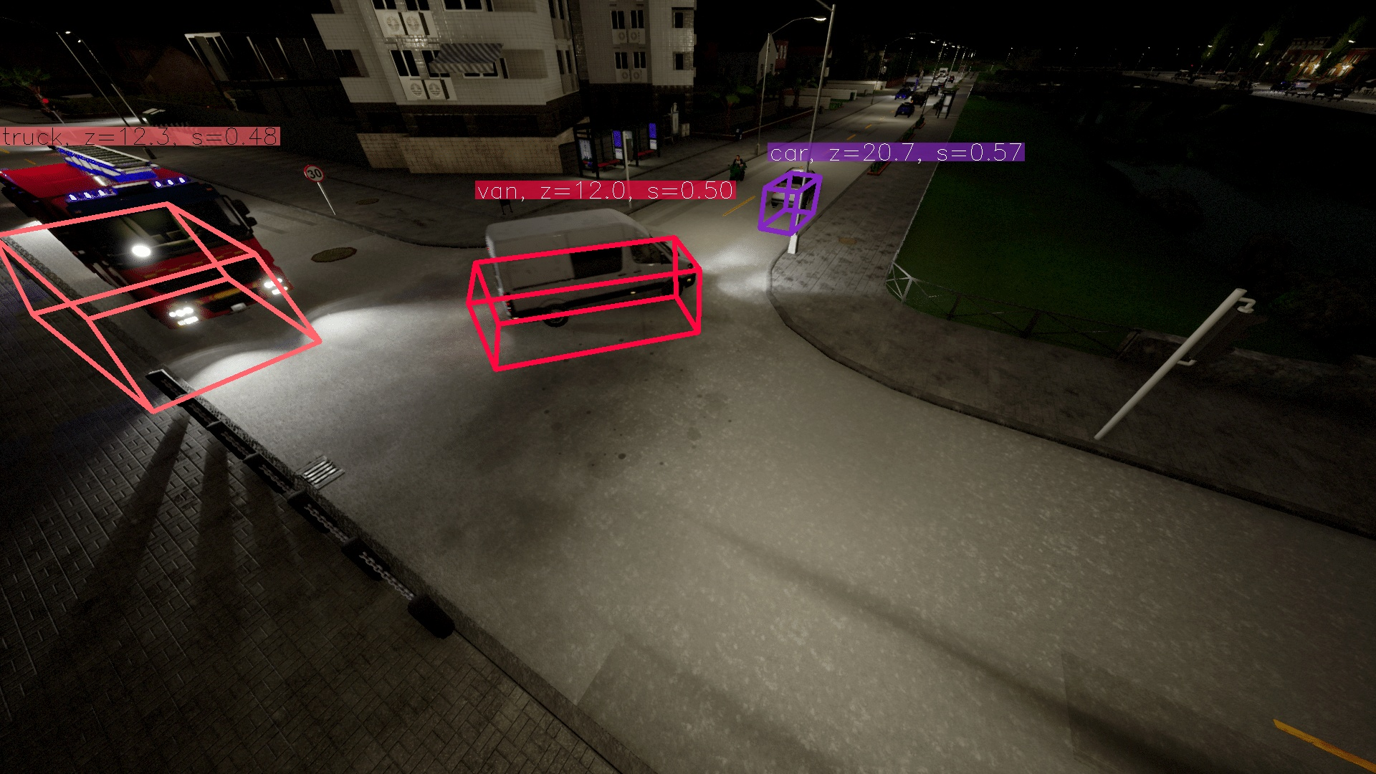
3
Extras
➛ Problems Encountered
Visualization issues
Omni3D never
tested completely

Slide 11
Table of Contents
1
Completed Tasks
2
Work In Progress
3
Extras
4
Next Tasks
5
Scheduling

Slide 12
4
Next Tasks
➛ Short Term Tasks
Test the evaluation script
Test the visualisation script

Slide 13
4
Next Tasks
➛ Long Term Tasks
Implement the GitHub repo
Folder structure
Readme file
Clean and organize the folders
Refactoring

Slide 14
Table of Contents
1
Completed Tasks
2
Work In Progress
3
Extras
4
Next Tasks
5
Scheduling

Slide 15

February 2024
Monday | Tuesday | Wednesday | Thursday | Friday | Saturday | Sunday
 |  |  | 1 | 2 | 3 | 4
5 | 6 | 7 | 8 | 9 | 10 | 11
12 | 13 | 14 | 15 | 16 | 17 | 18
19 | 20 | 21 | 22 | 23 | 24 | 25
26 | 27 | 28 | 29
Scheduling
Next Meeting

Slide 16

MARCH 2024
Monday | Tuesday | Wednesday | Thursday | Friday | Saturday | Sunday
 |  |  |  | 1 | 2 | 3
4 | 5 | 6 | 7 | 8 | 9 | 10
11 | 12 | 13 | 14 | 15 #1 | 16 | 17
18 | 19 | 20 | 21 | 22 #2 | 23 | 24
25 | 26 | 27 | 28 | 29 | 30
Scheduling
#1 Abstract Submission
#2 Paper Submission

Slide 17
Thanks!

