Slide 1
Data Mining Project
‘Meta’ Dataset
Regression Tasks
Marco Sau
60/79/00028

Slide 2

Introduction
Project’s Objectives
The dataset
‘Meta’
The primary objective
Apply regression techniques
Related objectives
Data Analysis

Slide 3
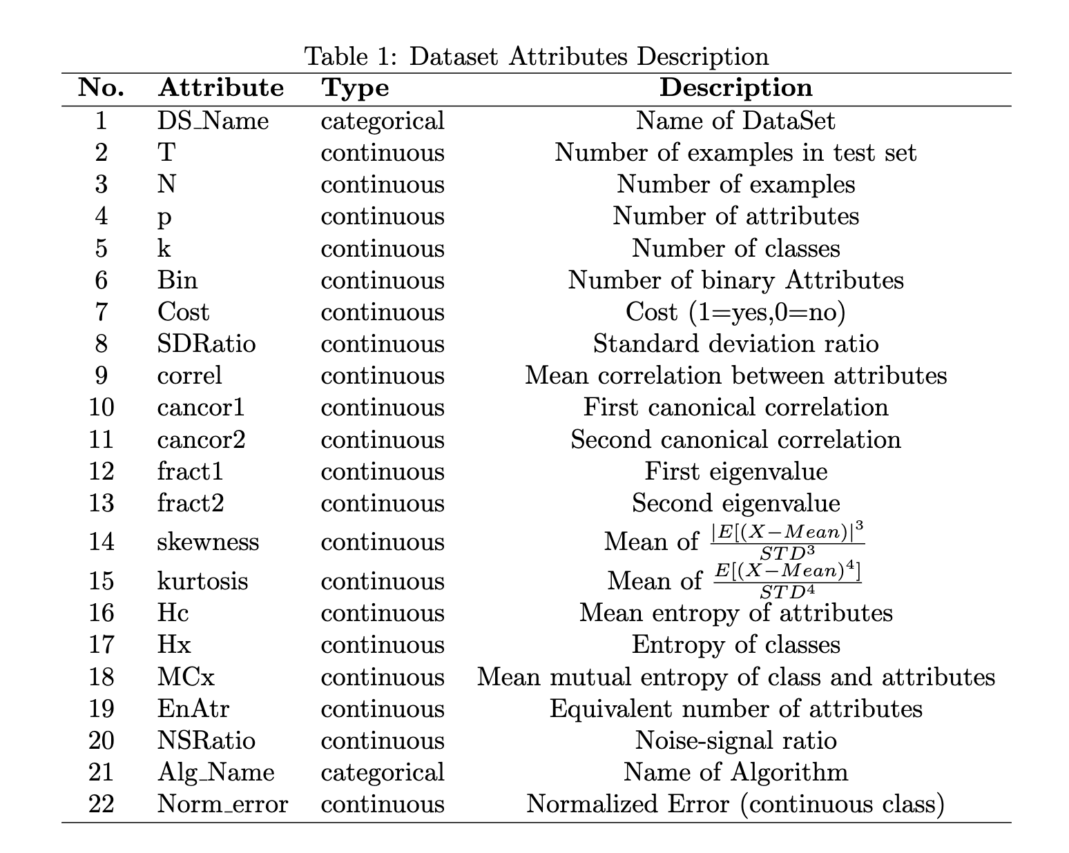
Dataset
Dataset Overview
Purpose
Attributes
22 Attributes
20 Numerical
2 Categorical
528 Instances
436 Target Values
504 Missing Values
264 Instances with Missing Values
Perform Classification Tasks

Slide 4
Pre-Processing
Data Pre-Processing
Data Elaboration
Data Transformation
Removing Categorical Data
Interpolation
Dataset D2
’DS Name’ and ’Alg Name’
Removing Instances with Missing Values
Standardization
Training
Dataset D1

Slide 5
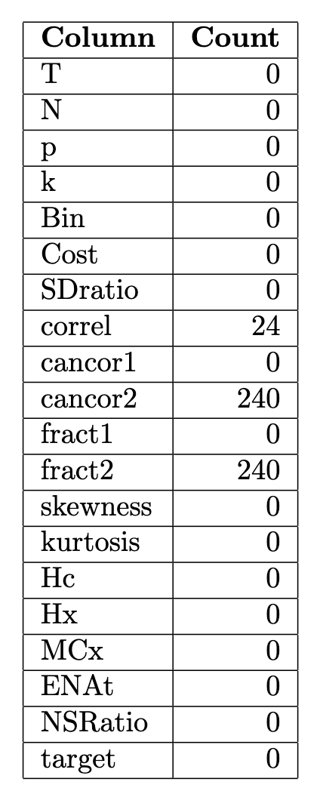
Pre-Processing
Data Pre-Processing
Finding Missing Values
Correl
Cancor2
Fract2

Slide 6
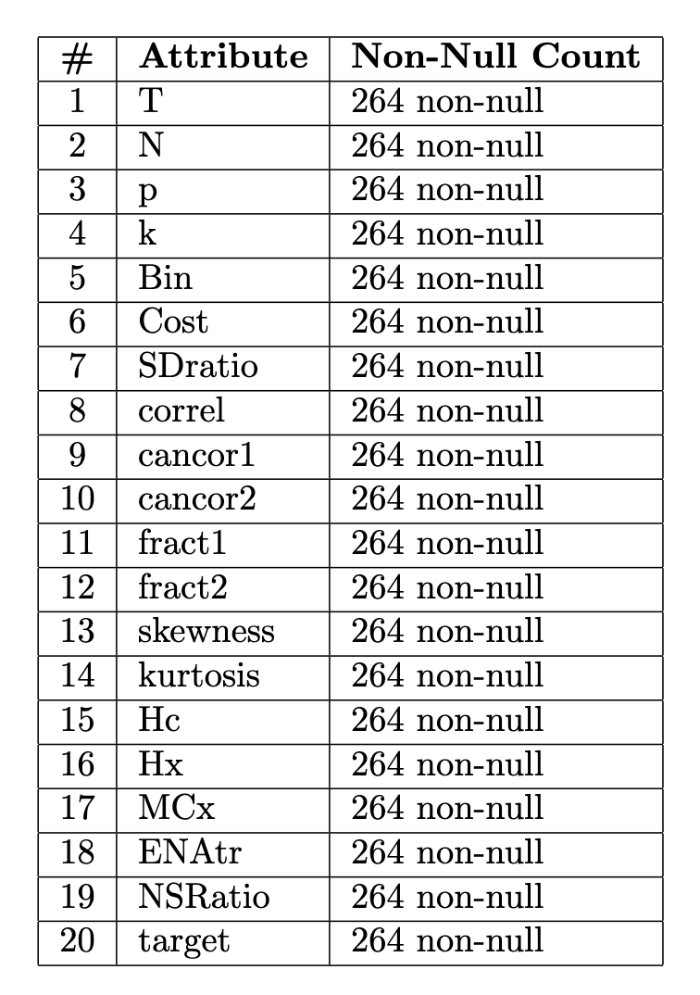
Removing Missing Data
Dataset D1
Building The Dataset
New Dataset
Removing Instances with Missing Values
Half Size of the Original Dataset

Slide 7
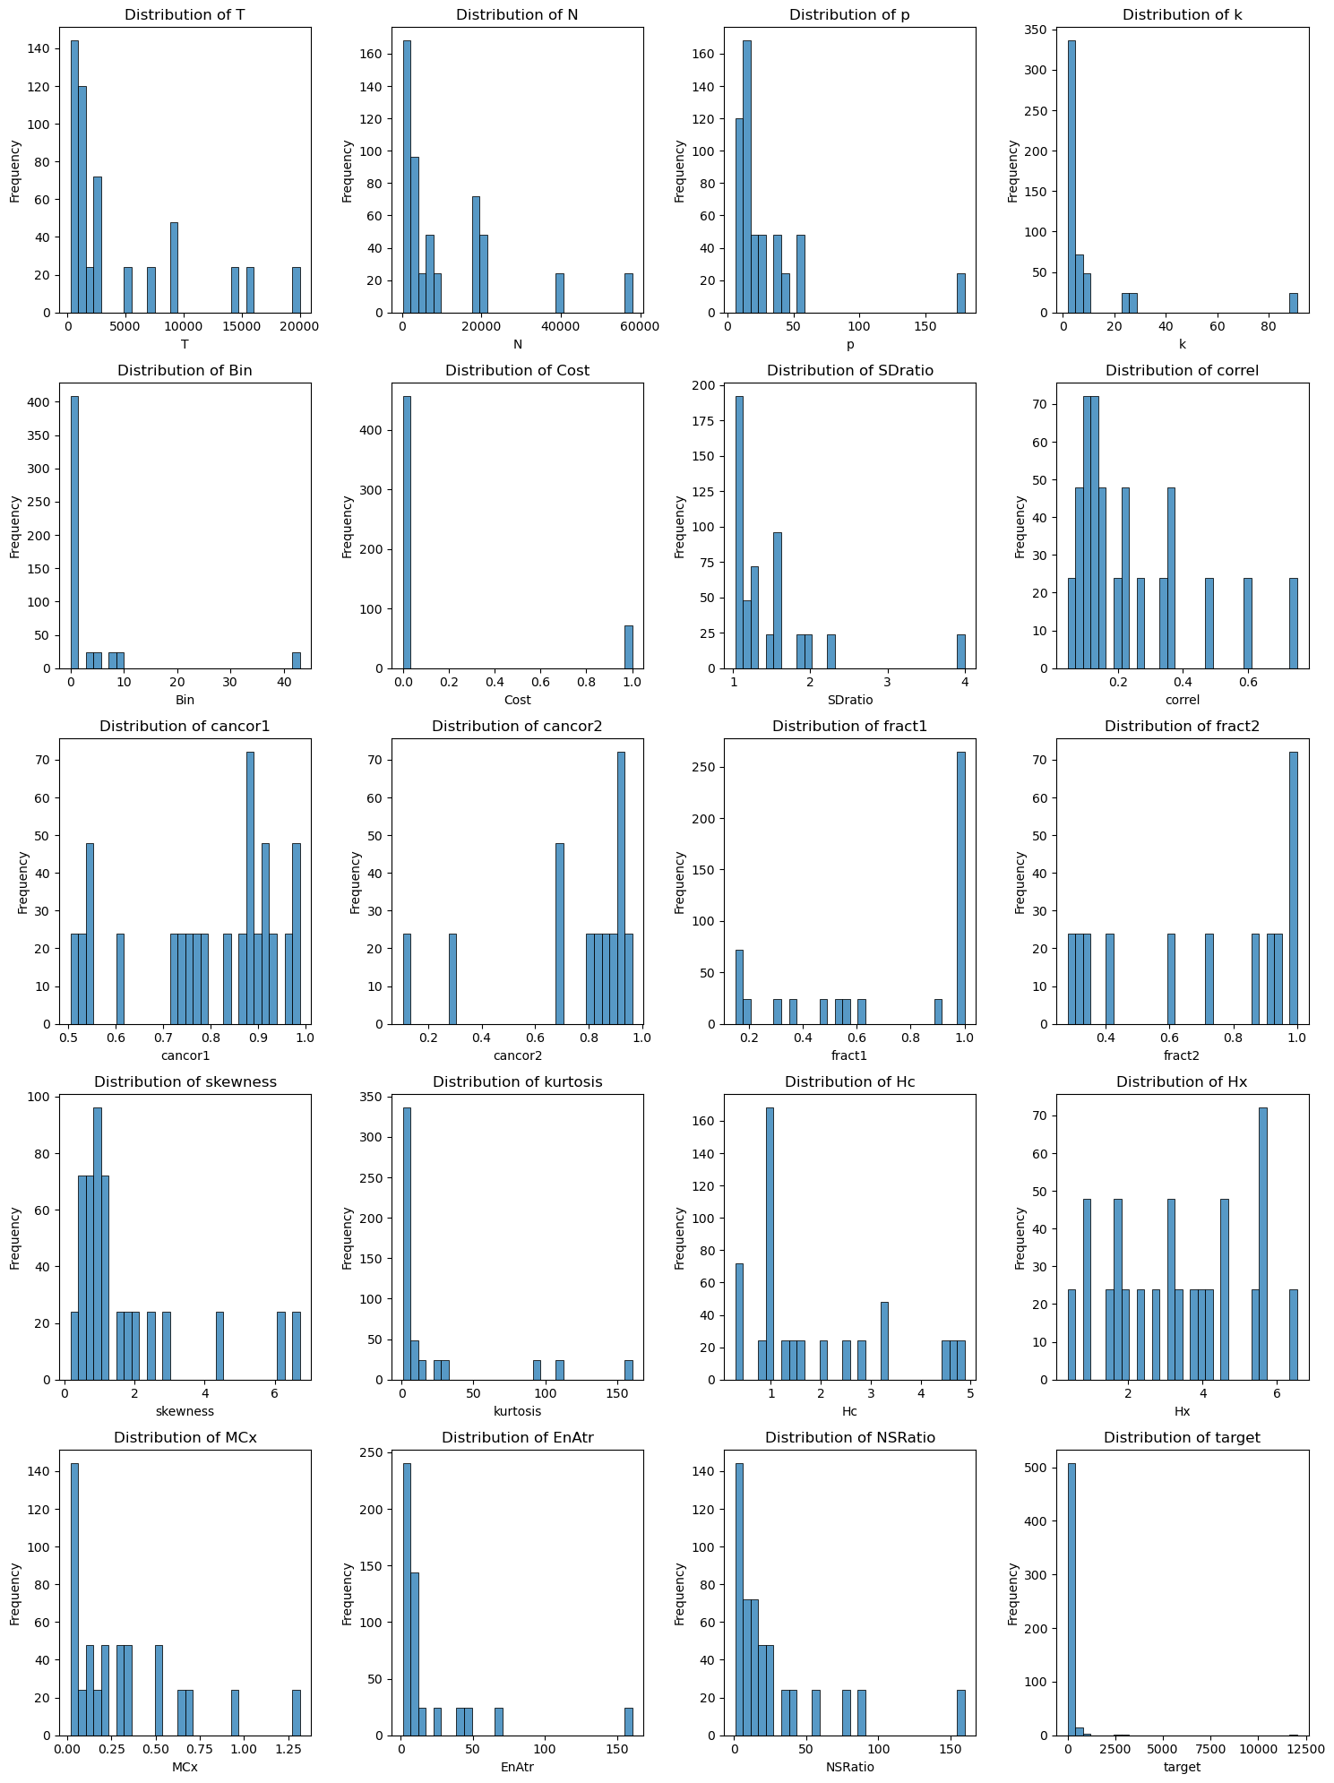
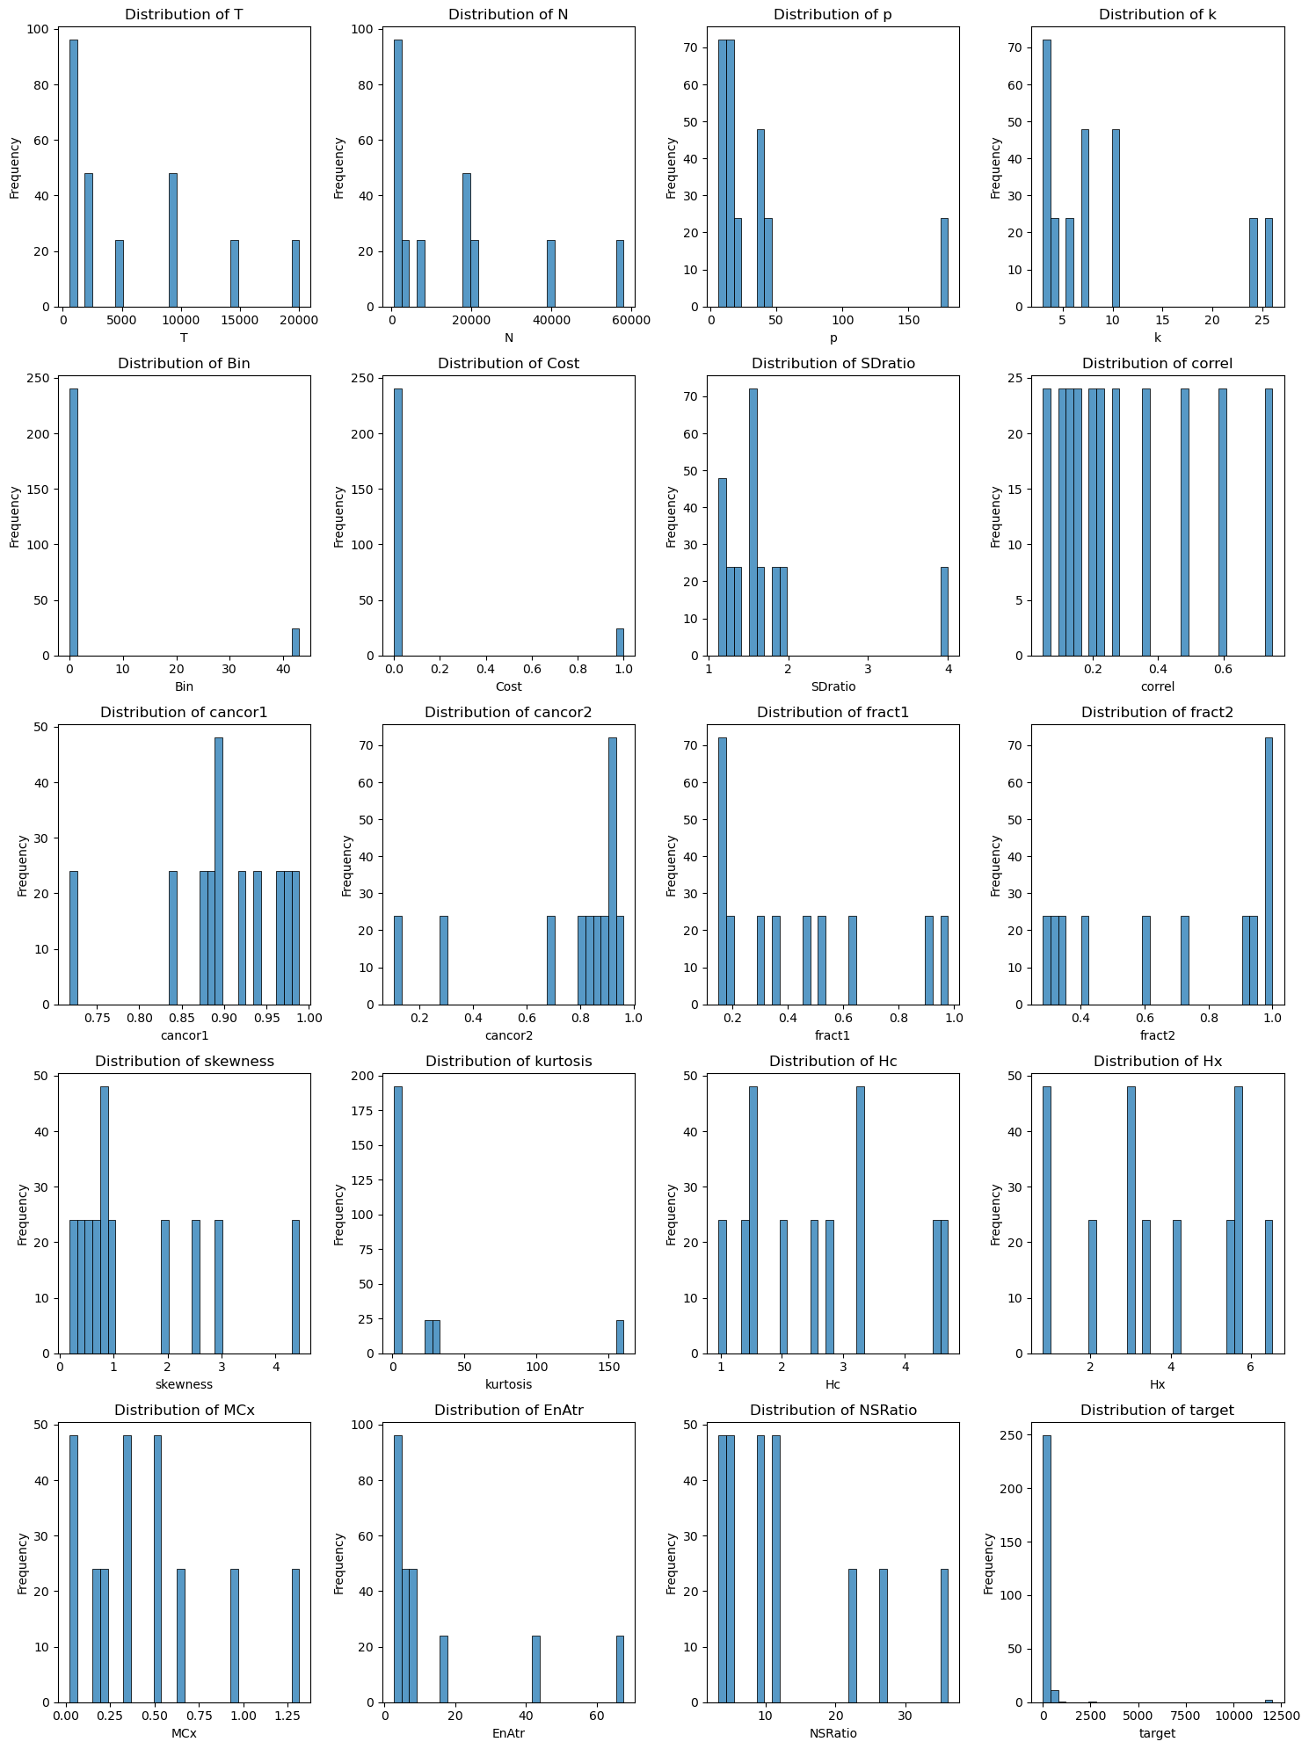
Removing Missing Data
Original vs D1
Original dataset
D1

Slide 8
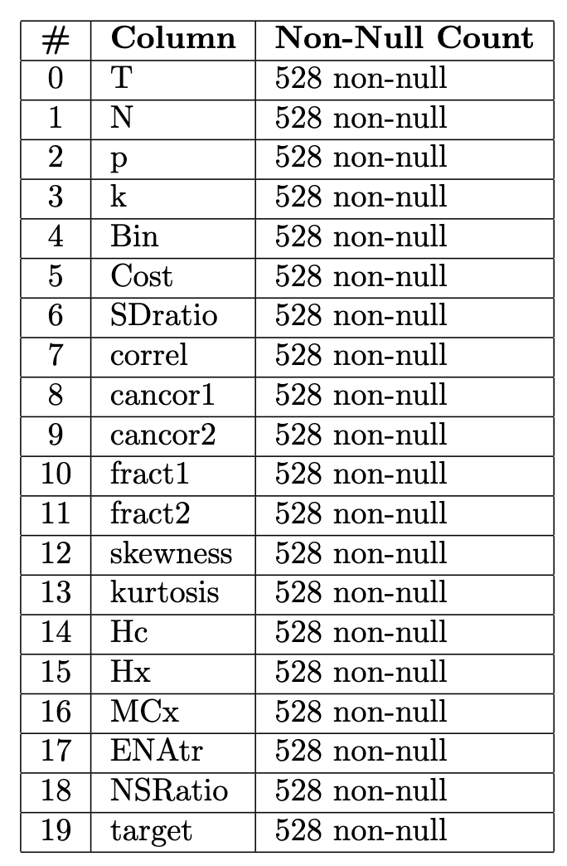
Data Interpolation
Dataset D2
Building The Dataset
New Dataset
Interpolation Process
Method:
cubicspline
Limit direction:
both
Axis:
0
Same Size of the Original Dataset

Slide 9
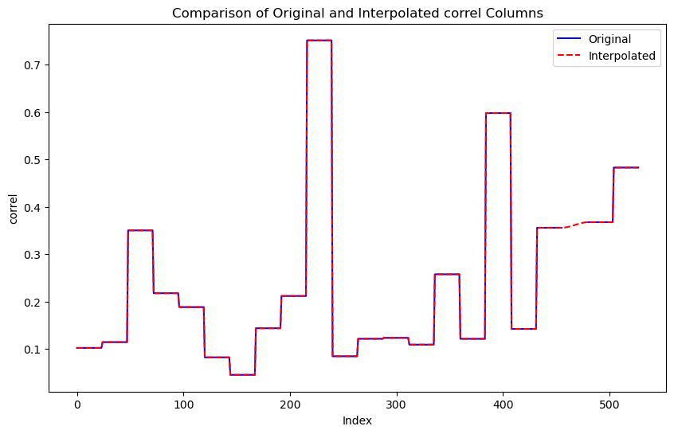
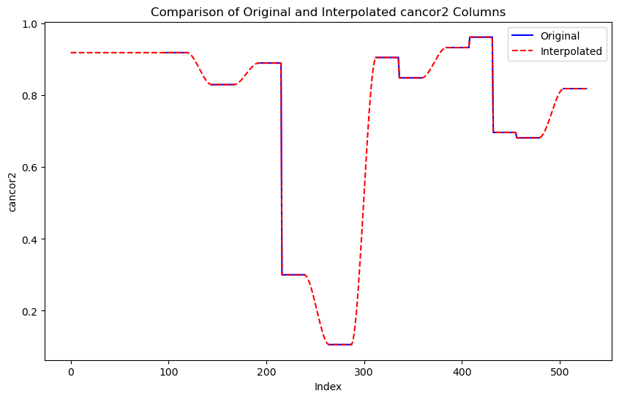
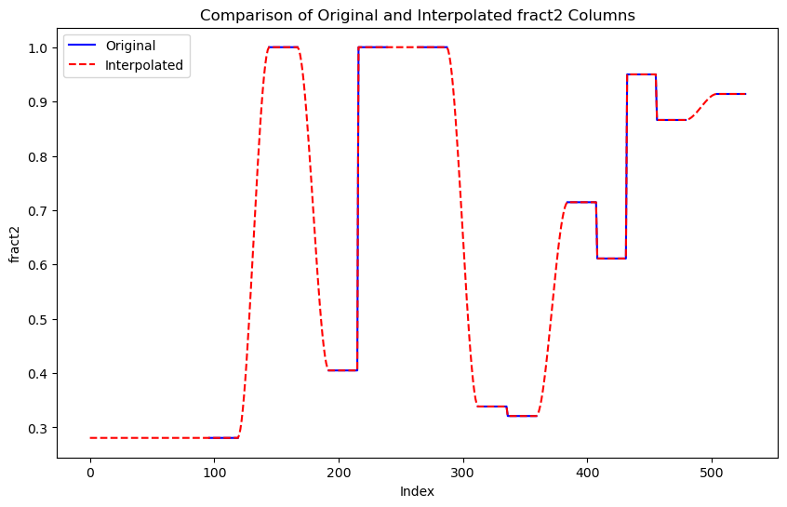
Data Interpolation
Interpolation’s Effects
correl
cancor2
fract2

Slide 10
Regression
Models & Error Metrics
Models
Error Metrics
Linear Regression
MAE
(Mean Absolute Error)
Decision Tree Regressor
MAPE
(Mean Absolute Percentage Error)
Random Forest Regressor
Support Vector Regression
SMAPE
(Symmetric Mean Absolute Percentage Error)
Gradient Boosting Regressor
Logistic Regression

Slide 11
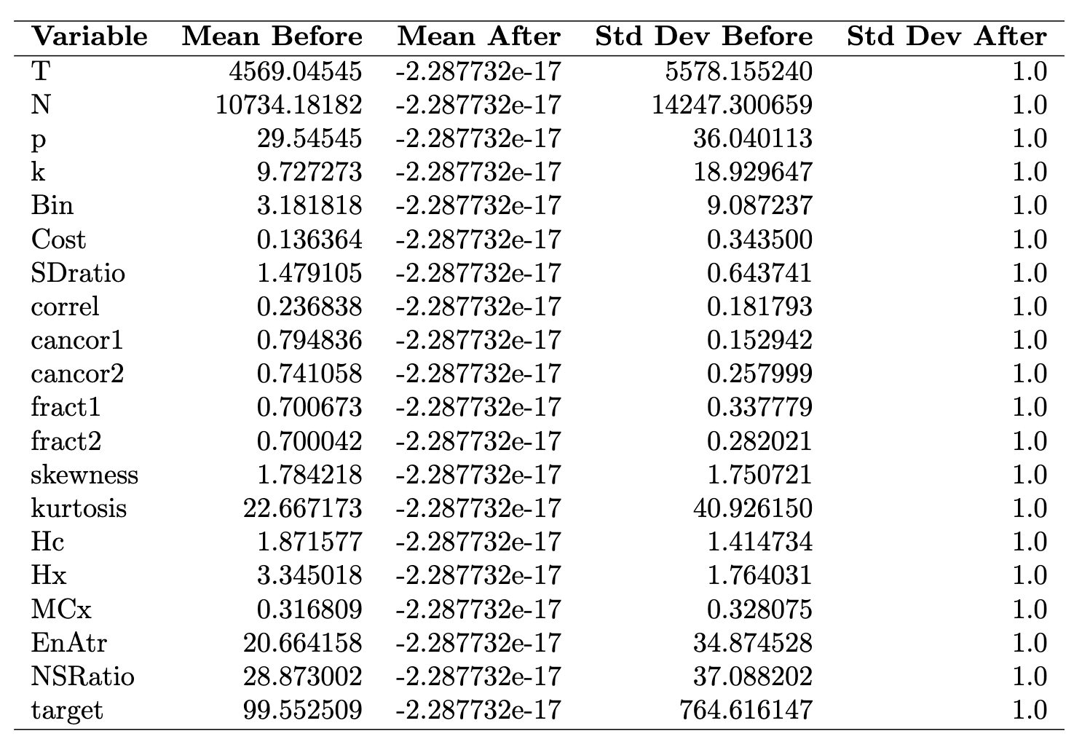
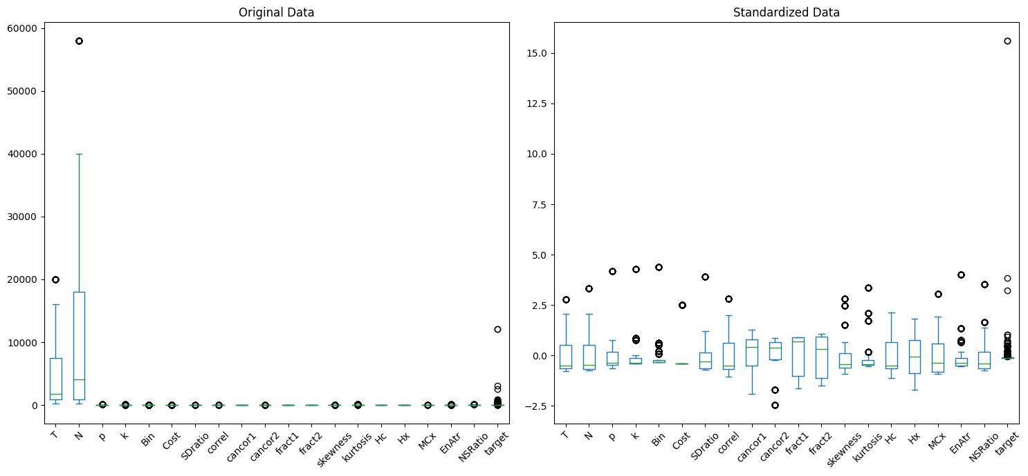
Training
Standardization
What it does
Original vs Standardized Data

Slide 12

Training
Training
Functions
Settings
Default settings
For the Models
Train 80%
Test 20%
train_test_split()
train_and_evaluate()
Set Seed for Reproducibility

Slide 13
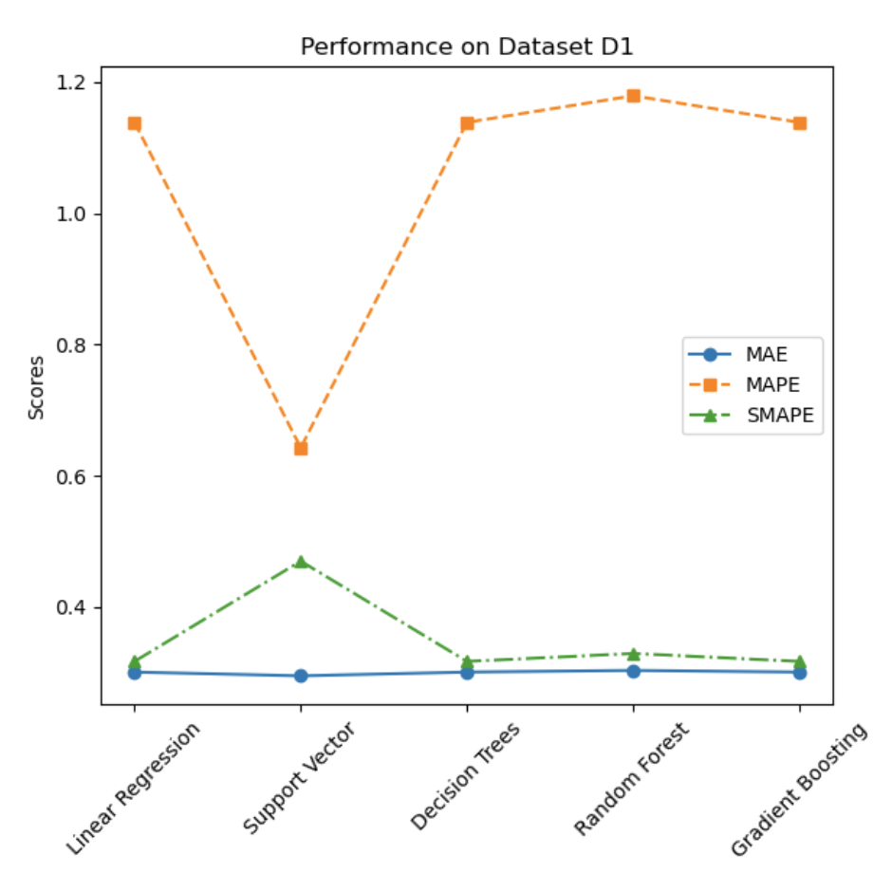
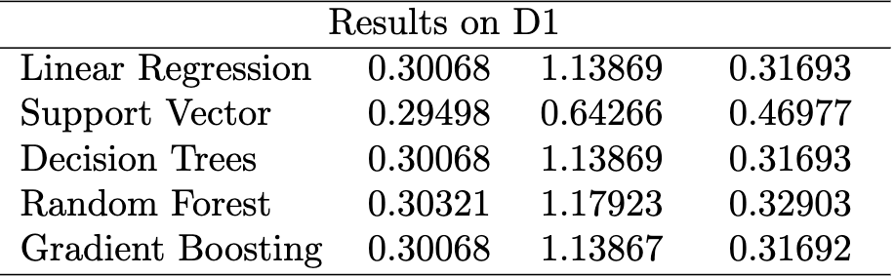
Results
Dataset D1
Results
Plot
MAE MAPE SMAPE
The best compromise
Gradient Boosting

Slide 14
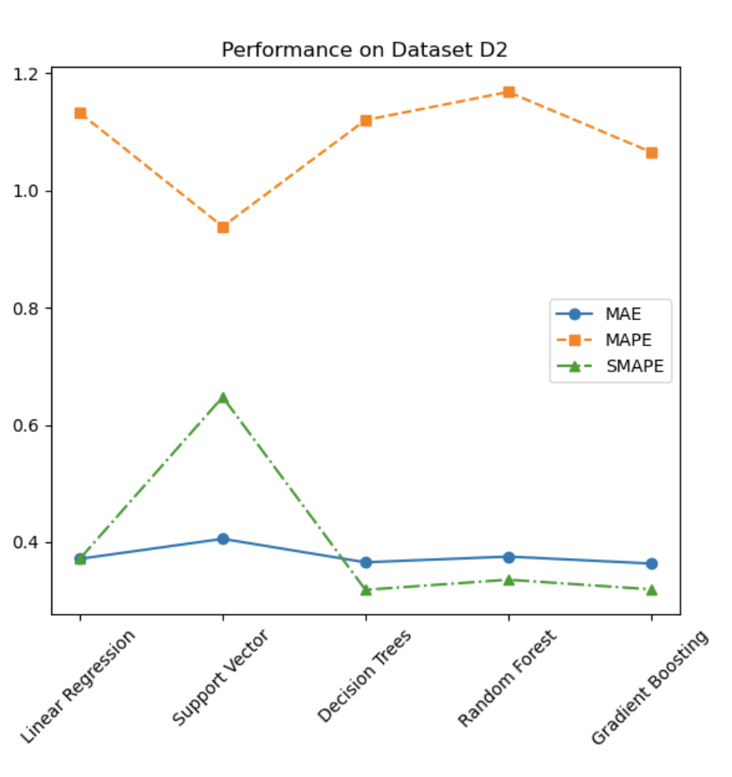
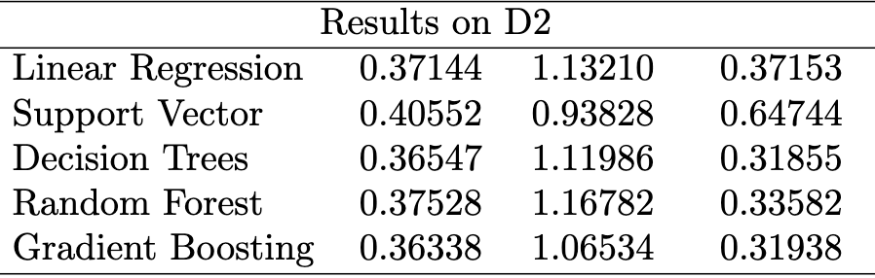
Results
Dataset D2
Results
Plot
MAE MAPE SMAPE
The best compromise
Gradient Boosting

Slide 15
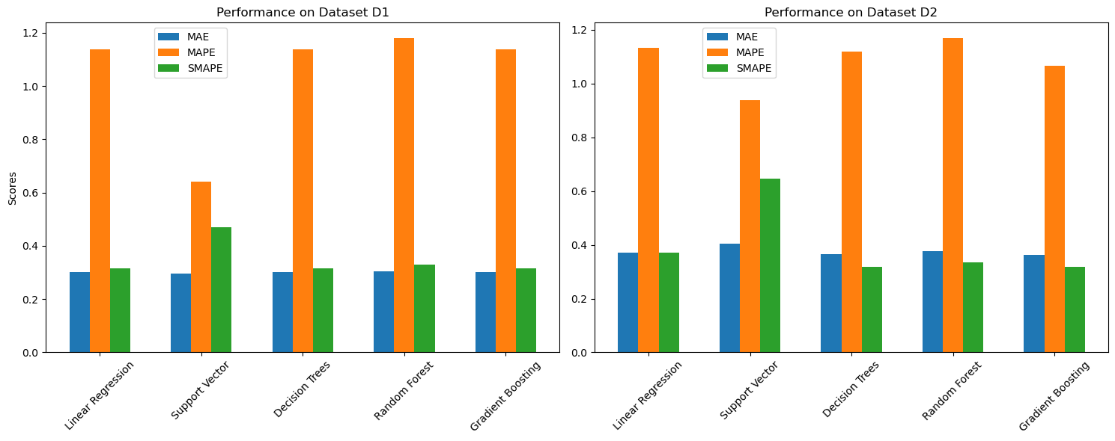
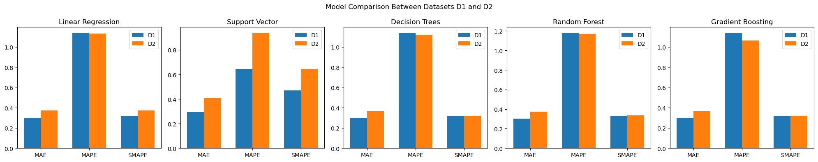
Results
Side by Side Comparison

Slide 16
Discussions
Results Analysis
Performance
Linear Regression
Average on D1, Struggle with Interpolation
Support Vector Regression
Best MAE and MAPE on D1, Worst MAE and SMAPE on D2
Decision Tree Regressor
Average on D1, Best SMAPE on D2
Random Forest Regressor
Struggle on Both Datasets
Gradient Boosting Regressor
Most Robust Overall

Slide 17
Conclusions
Conclusions and Future Directions
Conclusions
Future Directions
If Interested in Magnitude
Outliers
Gradient Boosting
Could Improve Performance
If Interested in Under and Over Estimation
Interpolation
Gradient Boosting
Different Method Could Improve D2
Second Choices
Cross-Validation
Linear Regression, Decision Tree
Improve Performance
Interpolation
Fine-Tuning
Impact Negatively the Performance
Improve Performance and Insights
Impact of Precidions
Zero’s Impact on MAPE

Slide 18
Thanks!
Q&A

