Slide 1
Data Mining Project
‘Meta’ Dataset
Regression Tasks
Marco Sau
60/79/00028

Slide 2

Introduction
Project’s Objectives
The dataset
‘Meta’
The primary objective
Apply regression techniques
Related objectives
Data Analysis

Slide 3
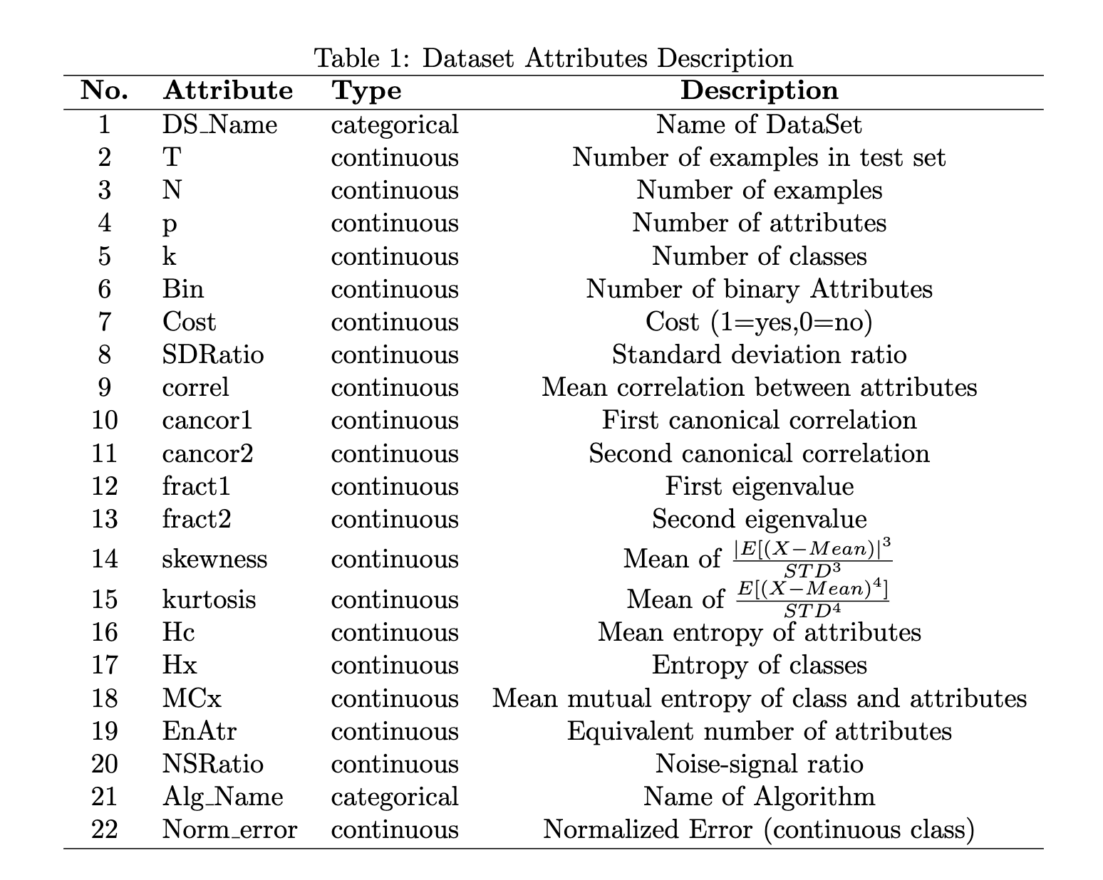
Dataset
Dataset Overview
Purpose
Attributes
22 Attributes
20 Numerical
2 Categorical
528 Instances
436 Target Values
504 Missing Values
264 Instances with Missing Values
Perform Classification Tasks

Slide 4
Pre-Processing
Data Pre-Processing
Data Elaboration
Data Transformation
Removing Categorical Data
Interpolation
Dataset D2
’DS Name’ and ’Alg Name’
Removing Instances with Missing Values
Standardization
Training
Dataset D1

Slide 5
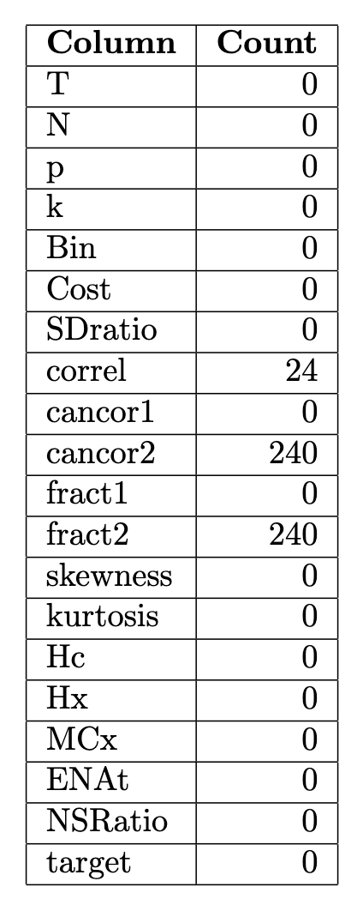
Pre-Processing
Data Pre-Processing
Finding Missing Values
Correl
Cancor2
Fract2

Slide 6
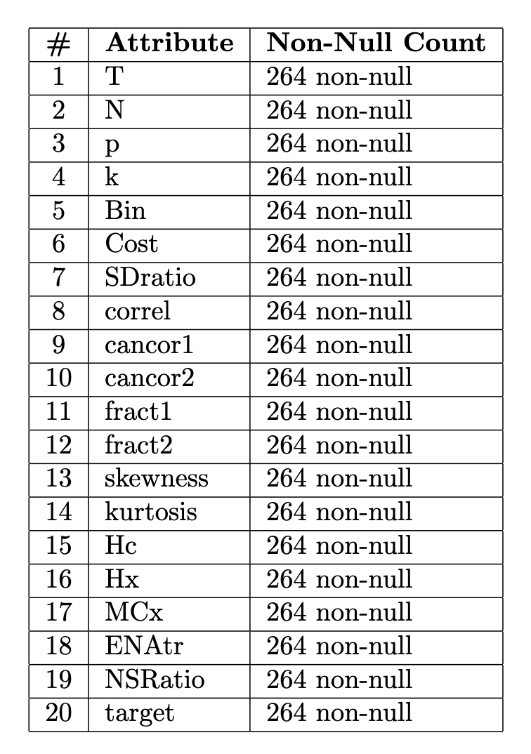
Removing Missing Data
Dataset D1
Building The Dataset
New Dataset
Removing Instances with Missing Values
Half Size of the Original Dataset

Slide 7
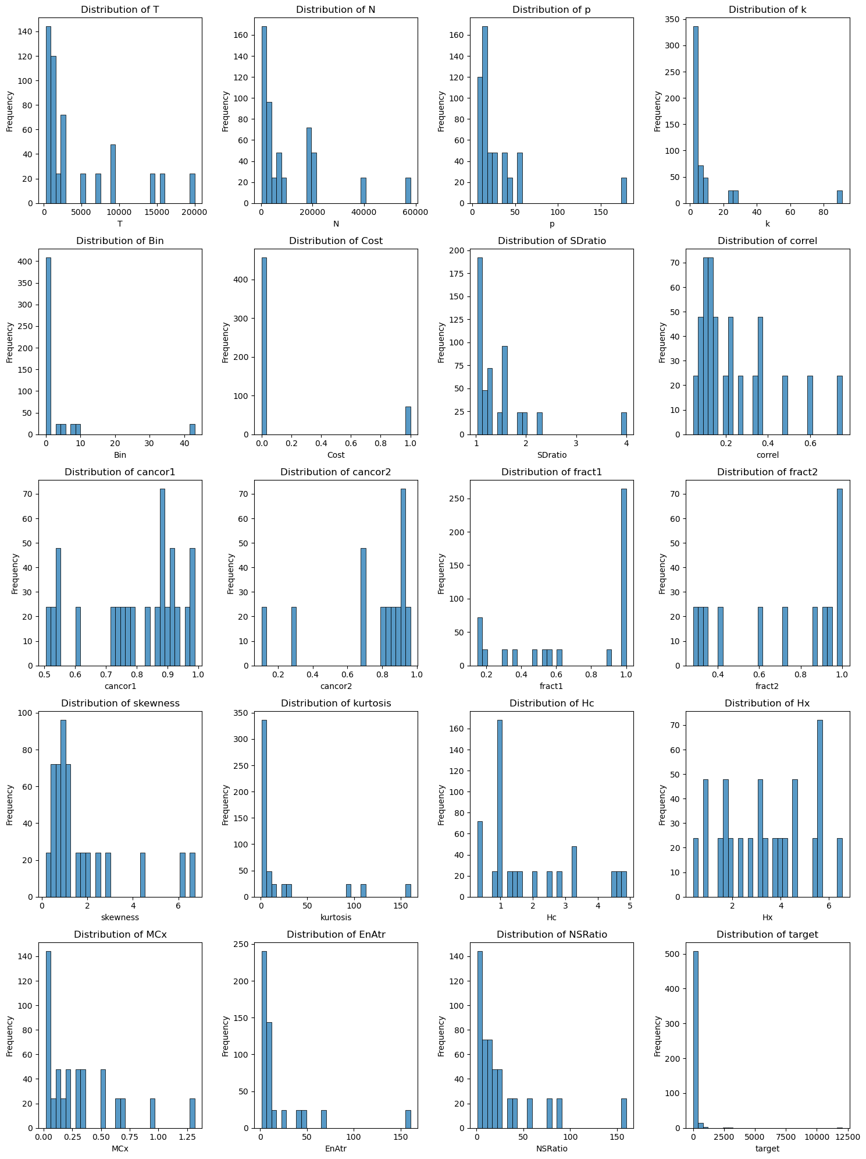
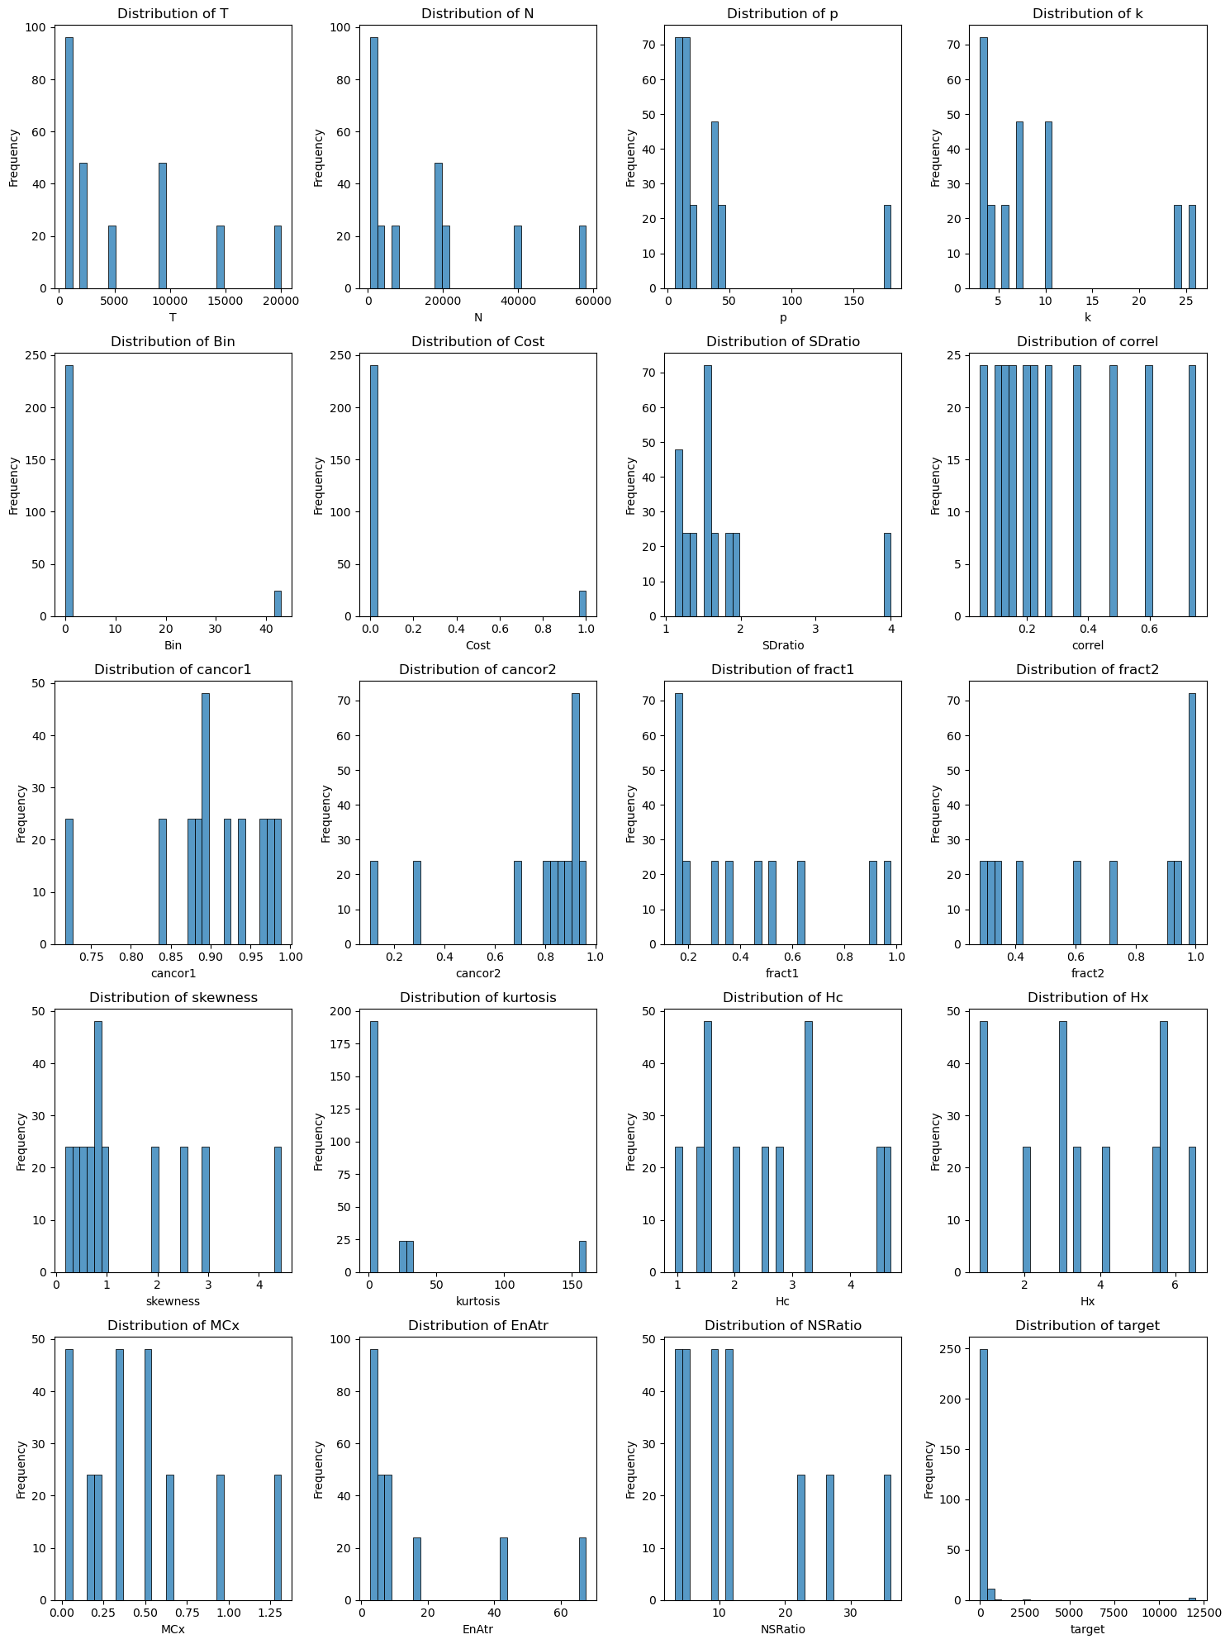
Removing Missing Data
Original vs D1
Original dataset
D1

Slide 8
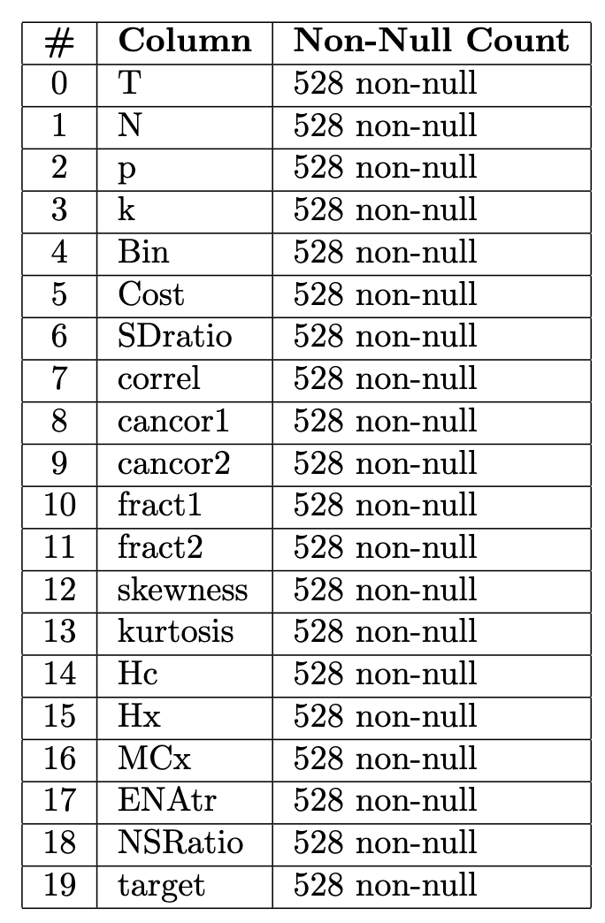
Data Interpolation
Dataset D2
Building The Dataset
New Dataset
Interpolation Process
Method:
cubicspline
Limit direction:
both
Axis:
0
Same Size of the Original Dataset

Slide 9
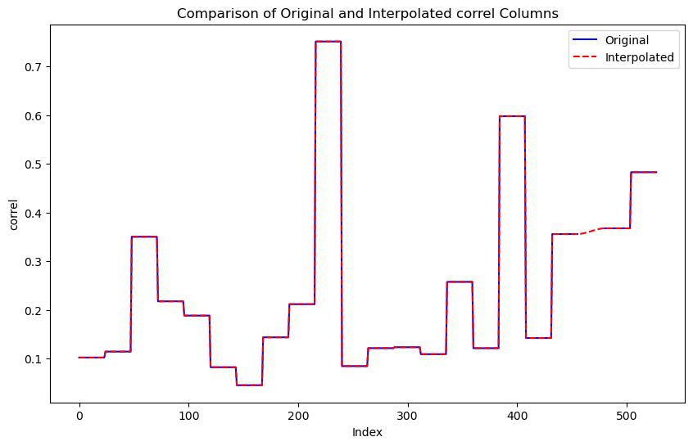
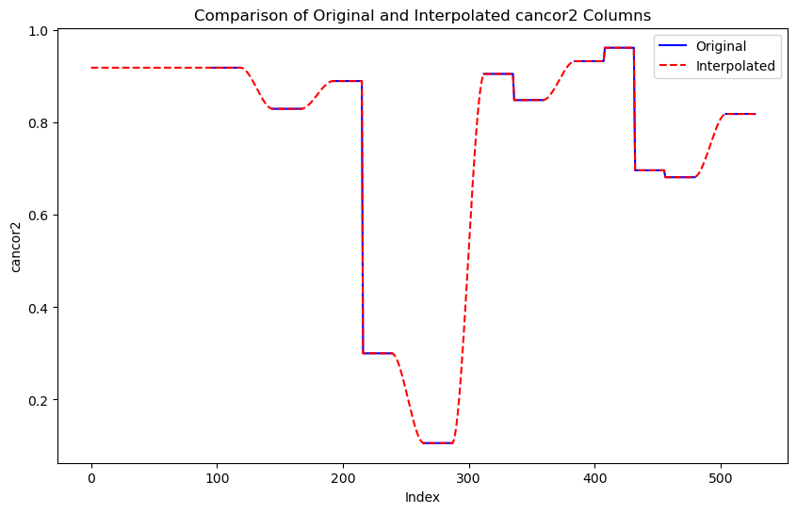
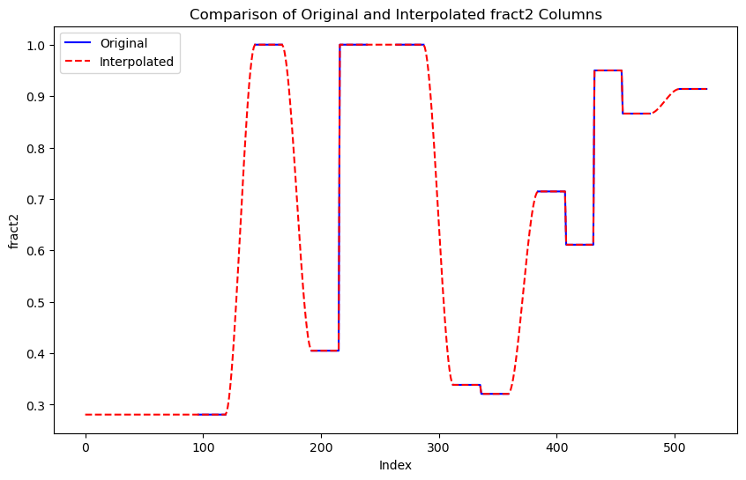
Data Interpolation
Interpolation’s Effects
correl
cancor2
fract2

Slide 10
Regression
Models & Error Metrics
Models
Error Metrics
Linear Regression
MAE
(Mean Absolute Error)
Decision Tree Regressor
MAPE
(Mean Absolute Percentage Error)
Random Forest Regressor
Support Vector Regression
SMAPE
(Symmetric Mean Absolute Percentage Error)
Gradient Boosting Regressor
Logistic Regression

Slide 11
Training
Standardization
Slide 8: Addestramento dei Modelli • Setup dell'addestramento • Divisione in training e test set
Elaboration
Removing Categorical Data

Slide 12
Training
Training and Setup
Slide 8: Addestramento dei Modelli • Setup dell'addestramento • Divisione in training e test set
Elaboration
Removing Categorical Data

Slide 13
Results
Dataset D1
Slide 9-12: Risultati e Analisi
• Slide separate per ciascun modello o gruppi di modelli
• Confronto delle prestazioni su D1 e D2 • Grafici delle performance (MAE, MAPE, SMAPE)
Elaboration
Removing Categorical Data

Slide 14
Results
Dataset D2
Slide 9-12: Risultati e Analisi
• Slide separate per ciascun modello o gruppi di modelli
• Confronto delle prestazioni su D1 e D2 • Grafici delle performance (MAE, MAPE, SMAPE)
Elaboration
Removing Categorical Data

Slide 15
Results
Comparison
Slide 9-12: Risultati e Analisi
• Slide separate per ciascun modello o gruppi di modelli
• Confronto delle prestazioni su D1 e D2 • Grafici delle performance (MAE, MAPE, SMAPE)
Elaboration
Removing Categorical Data

Slide 16
Discussions
Results Analysis
Slide 13: Discussioni
• Interpretazione dei risultati • Impatto del preprocessing sui modelli
Elaboration
Removing Categorical Data

Slide 17
Conclusions
Conclusions and Future Directions
Slide 14: Conclusioni
• Principali takeaways del progetto • Potenziali miglioramenti e direzioni future
Elaboration
Removing Categorical Data

Slide 18
Thanks!
Slide 15: Domande
• Apertura per domande e discussioni

