Slide 1

Hochschule
Bonn-Rhein-Sieg
Design Experiments for the FPGA FIR Filter Lecture
Prof. Dr. Marco Winzker, Bonn-Rhein-Sieg University, 2020
Competencies and Learning Objectives
With the lecture you learn about development of an FIR filter from algorithm to FPGA implementation including verification with a self-checking testbench.
Lecture video and this information about the experiments is available as a video lecture: https://www.youtube.com/playlist?list=PLGzeDuLmmxDr10_4zRujRBVnqij-PZyYb
Feel free to use this material for your needs
Version: 20. January 2020
This work by Marco Winzker, Hochschule Bonn-Rhein-Sieg is licensed under a Creative Commons Attribution 4.0 International License.

Slide 2
Set-Up of Design-Flow
Learning goal:
Understand the design-flow of FPGA design and remote lab usage
This experiment should be done as a preparation for all other experiments
Level of difficulty: Easy
Experiment:
Install the design software on your computer
GNU Octave
Intel Quartus including ModelSim Starter edition and device files for Cyclone V
Download the source files and perform FPGA simulation and synthesis
Find a test image and resize it to 1280*720 pixel resolution
Upload the bitfile (filetype: sof) to the remote lab and perform the experiment
Change the rounding in the filter arithmetic and repeat simulation and synthesis
Remove term “+ 16” from submodule sharp_arith.vhd (or change to “+ 15”, “+ 17”)

Slide 3
Switch for Sharpness Improvement
Learning goal:
Working with the VHDL files
Understanding the structure of the circuit design
Level of difficulty: Easy
Experiment:
Use one of the switches to change the output signal between original image and sharpness improvement
Top-level module sharp.vhd has three switches at input “enable_in”
Perform FPGA synthesis and execute the experiment on the remote lab
Observe two things
The vertical position of the output image should not “jump” between the two settings
Power consumption should be lower if sharpness improvement is disabled
Make sure, that the processing mode (sharpness on/off) does not change in the middle of an image

Slide 4
Switch for Degree of Sharpness Improvement
Learning goal:
Optimization of the signal processing algorithm
Design verification with Octave and simulation
Level of difficulty: Moderate
Experiment:
Use the switches to change the output signal between different degrees of sharpness improvement
Can be implemented by changing the amplification factor A for the highpass filter
Recommendation: Four modes low: A=1/4, medium: A=1/2, high: A=1, off: A=0
Generate verification images with Octave and perform simulation
Recommendation: Use four testbenches for the four modes
Perform FPGA synthesis and execute the experiment on the remote lab
Compare FPGA resource usage and power consumption with original implementation

Slide 5
Correct Handling of Image Borders
Learning goal:
Digital design for FPGAs
Level of difficulty: Advanced
Experiment:
The VHDL code has two simplifications for handling image borders
Pixels at the border are filtered together with pixel of the neighbouring line/frame
The output is shifted by three lines
Implement correct handling of image borders in the VHDL design
Check how Octave handles filtering at image borders
Recommendation: Octave has several options; consider which is best for hardware implementation
Perform the design flow with verification and FPGA implementation

Slide 6
Change Filter Coefficients
Learning goal:
Optimization of the signal processing algorithm
Trade-off between image quality and FPGA resources
Level of difficulty: Advanced
Experiment:
Use other filter coefficients for the highpass filter
Use Octave and modify number of taps “n” and cutoff frequency “w” in Octave function “fir1(n, w, type)”
Research literature for other filter functions
Perform the design flow with verification and FPGA implementation
Compare image quality, FPGA resource usage and power consumption
Is a 3-tap filter sufficient? How much resource can be saved?
How many taps can be implemented on the FPGA?

Slide 7
Reduce RAM Resources for Line Memory
Learning goal:
Digital design for FPGAs
Understanding usage of FPGA resources
Level of difficulty: Moderate
Experiment:
The line memories in sharp_linemem.vhd need a delay of 1280 pixel. FPGA synthesis implements this with BlockRAMs and uses 2048 memory locations.
Note: This is sensible, as long as enough FPGA resources are available.
Change the line memory so that only 1280 memory locations are used
Perform the design flow with verification and FPGA implementation
Compare FPGA resource usage and power consumption
How many line memories can be implemented with the original approach and the modification?

Slide 8
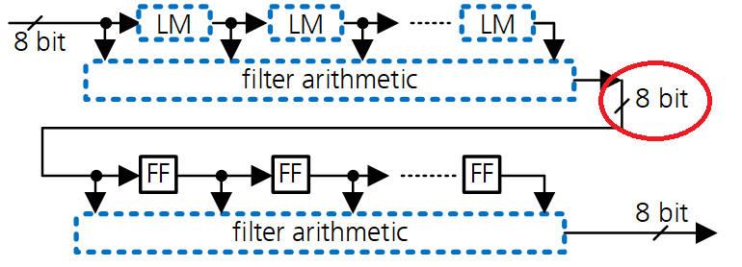
Increase Word Width for Intermediate Signal
Learning goal:
Digital design for FPGAs
Design verification with Octave and simulation
Level of difficulty: Moderate / Advanced
Experiment:
Increase the word width of the intermediate signal after the first filter arithmetic
Perform simulation and FPGA implementation
Compare image quality, FPGA resource usage and power consumption
Advanced:
Change Octave code and perform verification with self-checking testbench

