Slide 1
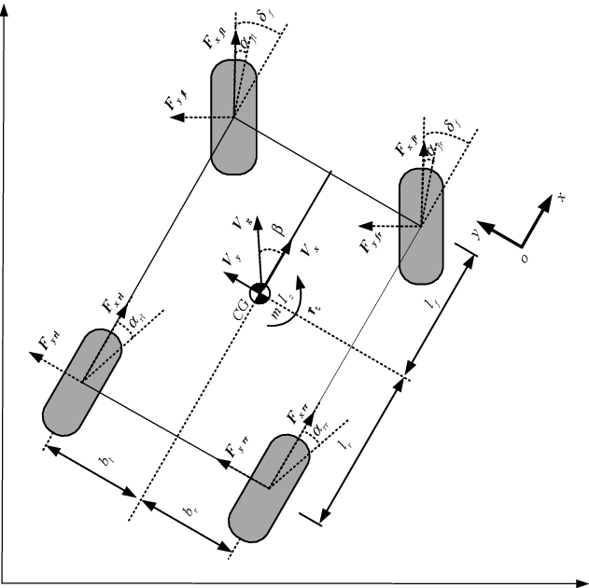
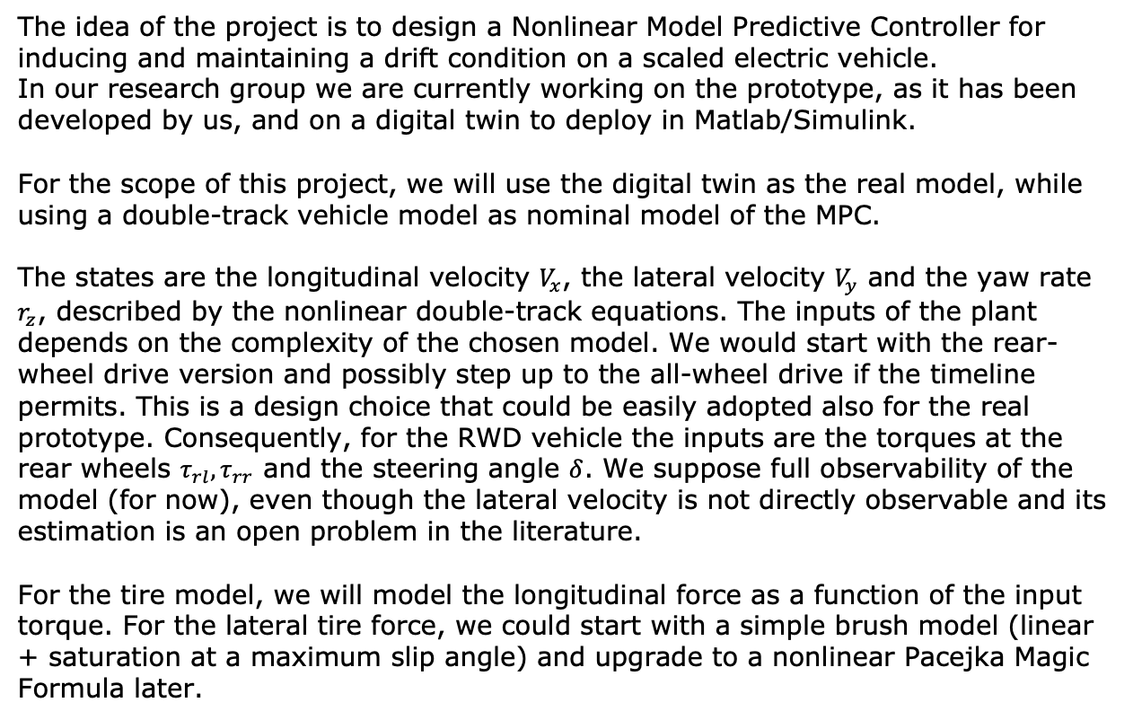
Controlled drift on a scaled vehicle with 2/4 independent electric motors
Marco Cortese, Luca Bassani. PhD’s candidates in Mechanical Engineer at the Department of Industrial Engineering
The idea of the project is to design a Nonlinear Model Predictive Controller for inducing and maintaining a drift condition on a scaled electric vehicle.
In our research group we are currently working on the prototype, as it has been developed by us, and on a digital twin to deploy in Matlab/Simulink.
For the scope of this project, we will use the digital twin as the real model, while using a double-track vehicle model as nominal model of the MPC.
The states are the longitudinal velocity $V_{x}$, the lateral velocity $V_{y}$ and the yaw rate $r_{z}$, described by the nonlinear double-track equations. The inputs of the plant depends on the complexity of the chosen model. We would start with the rear-wheel drive version and possibly step up to the all-wheel drive if the timeline permits. This is a design choice that could be easily adopted also for the real prototype. Consequently, for the RWD vehicle the inputs are the torques at the rear wheels $τ_{rl}, τ_{rr}$ and the steering angle $δ$. We suppose full observability of the model (for now), even though the lateral velocity is not directly observable and its estimation is an open problem in the literature.
For the tire model, we will model the longitudinal force as a function of the input torque. For the lateral tire force, we could start with a simple brush model (linear + saturation at a maximum slip angle) and upgrade to a nonlinear Pacejka Magic Formula later.
Fig: double-track vehicle model.

Slide 2
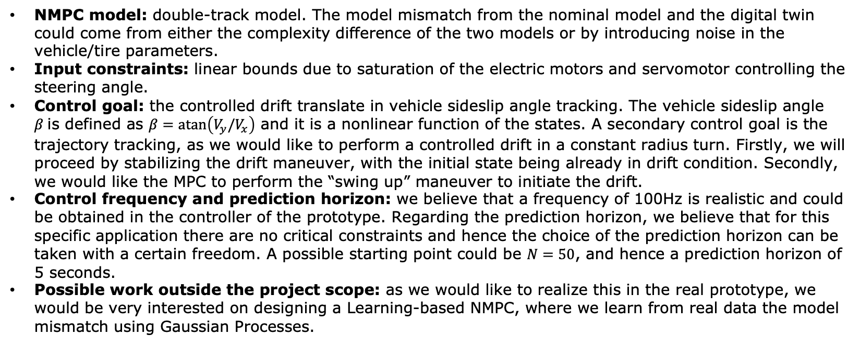
Controlled drift on a scaled vehicle with 2/4 independent electric motors
NMPC model: double-track model. The model mismatch from the nominal model and the digital twin could come from either the complexity difference of the two models or by introducing noise in the vehicle/tire parameters.
Input constraints: linear bounds due to saturation of the electric motors and servomotor controlling the steering angle.
Control goal: the controlled drift translate in vehicle sideslip angle tracking. The vehicle sideslip angle $β$is defined as $β=\operatorname{atan}\left(V_{y}/V_{x}\right)$ and it is a nonlinear function of the states. A secondary control goal is the trajectory tracking, as we would like to perform a controlled drift in a constant radius turn. Firstly, we will proceed by stabilizing the drift maneuver, with the initial state being already in drift condition. Secondly, we would like the MPC to perform the “swing up” maneuver to initiate the drift.
Control frequency and prediction horizon: we believe that a frequency of 100Hz is realistic and could be obtained in the controller of the prototype. Regarding the prediction horizon, we believe that for this specific application there are no critical constraints and hence the choice of the prediction horizon can be taken with a certain freedom. A possible starting point could be $N=50$, and hence a prediction horizon of 5 seconds.
Possible work outside the project scope: as we would like to realize this in the real prototype, we would be very interested on designing a Learning-based NMPC, where we learn from real data the model mismatch using Gaussian Processes.

