Slide 1

AUTOMATED BI REPORTING SOULTION DP_STG1ISSUES
Using Big Data Techniques
1

Slide 2


F21-10-D
Zain Sohail
Hashir Akbar
Zaeem Ansari
Dr. Ejaz Ahmed
i170016
i170080
i170353
Supervisor
.
2

Slide 3
DATAWAREHOUSE AND BUSINESS INTELLIGENCE
ISSUES IN CSV FILES
4

Slide 4
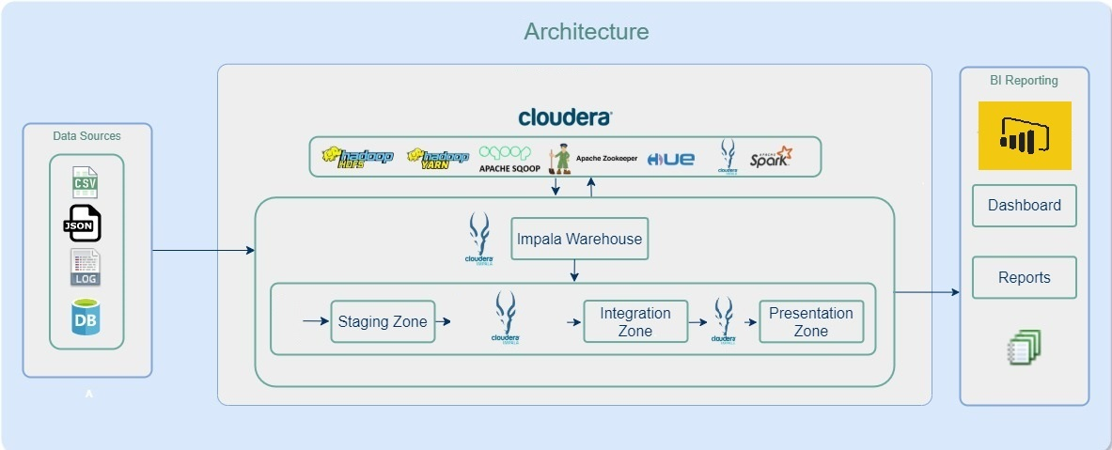
Working of data warehouse through properly engineered data model.
ETL( Extract, Transform, and Load)
Three Different Layers:
Staging layer
Integration layer
Semantic layer
5

Slide 5
HR
Total 17 Columns
Inconsistent Number of Columns at the end of file
296 row(s) affected
Duplicate “Name” Column
15

Slide 6
PERSON
Total 59 columns
Inconsistent Number of columns at the end of file
(19996 row(s) affected)
Duplicate BusinessEntityID 5 columns
Duplicate rowguid 7 columns
Duplicate ModifiedDate 10 columns
Duplicate Name 4 columns
Duplicate AddressID 2 columns
Duplicate AddressTypeID 2 columns
Duplicate PhoneNumberTypeID 2 columns
Duplicate CountryRegionCode 2 columns
Duplicate StateProvinceID 2 columns
Dragged Columns issue at row 292
15

Slide 7
PERSON CONT.
Error on piom GET ROW: 60, Text: Column length error, row
not returned !ERROR! Delimited Data Parsing error: Column
length overflow(s) in row 292 for column 10
Answer: Increase Column Length from 200 to 1000
Drag issue after columns 1705, one single column value is separated in two columns
Answer: Replace (, rue) to ((give space) then write avenue rue) and Replace (, avenue) with ((give space) then write avenue)
Same with others:
, boulevard
, place
15

Slide 8
PURCHASE
Total 76 Columns
Dragged Columns Problem
Litware and inc are in separate columns merge them by removing comma between them and same with Proseware and inc etc. Same problem exists in other rows as well
(88950 row(s) affected)
Inconsistent number of columns at the end of file
Total 76 Columns
Duplicate Columns => (PurchaseOrderDI(2), ProductID(3), rowguid(2), BuinessEntityID(2), ModifiedDate(6), ShipMethodID(2))
RDBMS error 3933: The Maximum Possible Row Length in the
Table is too Large.
Answer: You have given Varchar type very large size in fld try to reduce it.
15

Slide 9
PRODUCTION BillofMaterials_Production
2679 Rows Affected
Inconsistent Number of columns at the end of file
Total Columns 9
15

Slide 10
PRODUCTION.CSV ITSELF
“^” is the column separator
A lot of duplicate columns
Name, Title, Owner are keywords
1000 varchar size is too large reduce it
15

Slide 11
ScrapReason_Production.csv
Name is a keyword
Very Small
15

Slide 12
UnitMeasure_Production.csv
Name is a keyword
15

Slide 13
WorkOrder_Production.csv & WorkOrderRouting_Production.csv
No Errors
15

Slide 14
Customer_Sales
(19820 row(s) affected)
Inconsistent number of columns at the end of file
Table is a keyword
15

Slide 15
SalesTaxRate_Sales.CSV
29 rows affected
Inconsistent number of columns detected at the end of file
15

Slide 16
ShoppingCartItem_Sales.CSV
3 rows affected
Inconsistent number of columns detected at the end of file
15

Slide 17
Store_Sales.csv
Name is a keyword
701 rows affected
Inconsistent number of columns detected at the end of file
15

Slide 18
Sales.csv
So many duplicate Columns
Last row has half column values, either fill the rest of the columns with “NULL” or remove the complete row.
Comment, Group, Name are keyowrds
Sales, Sales_April files and Sales_May files have the same columns
15

Slide 19
Sales_2.csv
Duplicate columns
15

Slide 20
Sales_3_New
Duplicate columns
15

Slide 21
Iteration 2
Creation of Data Pipeline
Raw Data Analysis ERD and HLD
Staging layer data loading
Integration layer data loading
Semantic layer data loading
Nov-Dec
Feb-Apr
Sep-Nov
Jan
May
Implementation of Business Use Cases
Environment Setup
ETL Development
Creation of Virtual machines.
Installation and configuration of OS and Cloudera
Schema and DDL creation (Staging, integration and Semantic.
Reports and Dashboard Development on Power BI
29

Slide 22
THANK YOU
Questions?
30

