Slide 1
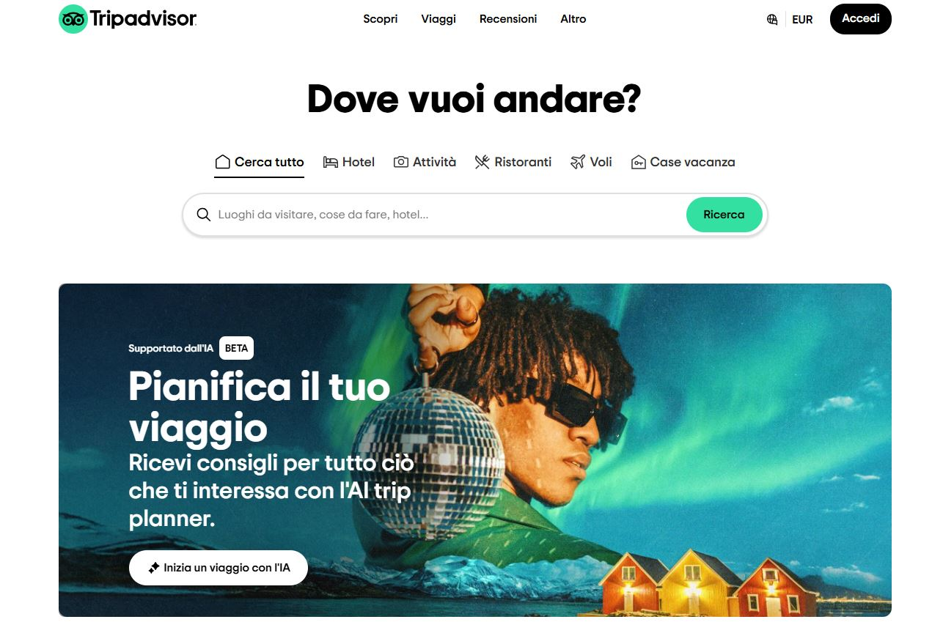
https://www.tripadvisor.it/

