Slide 1
ONERA M6 WING -CFD Analysis

Slide 2
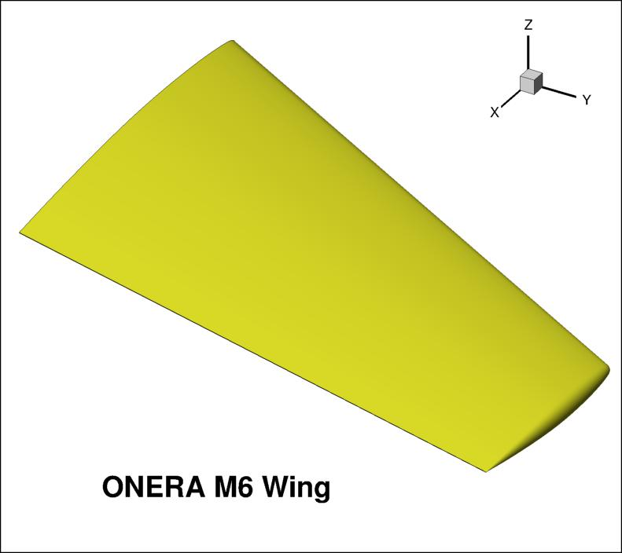
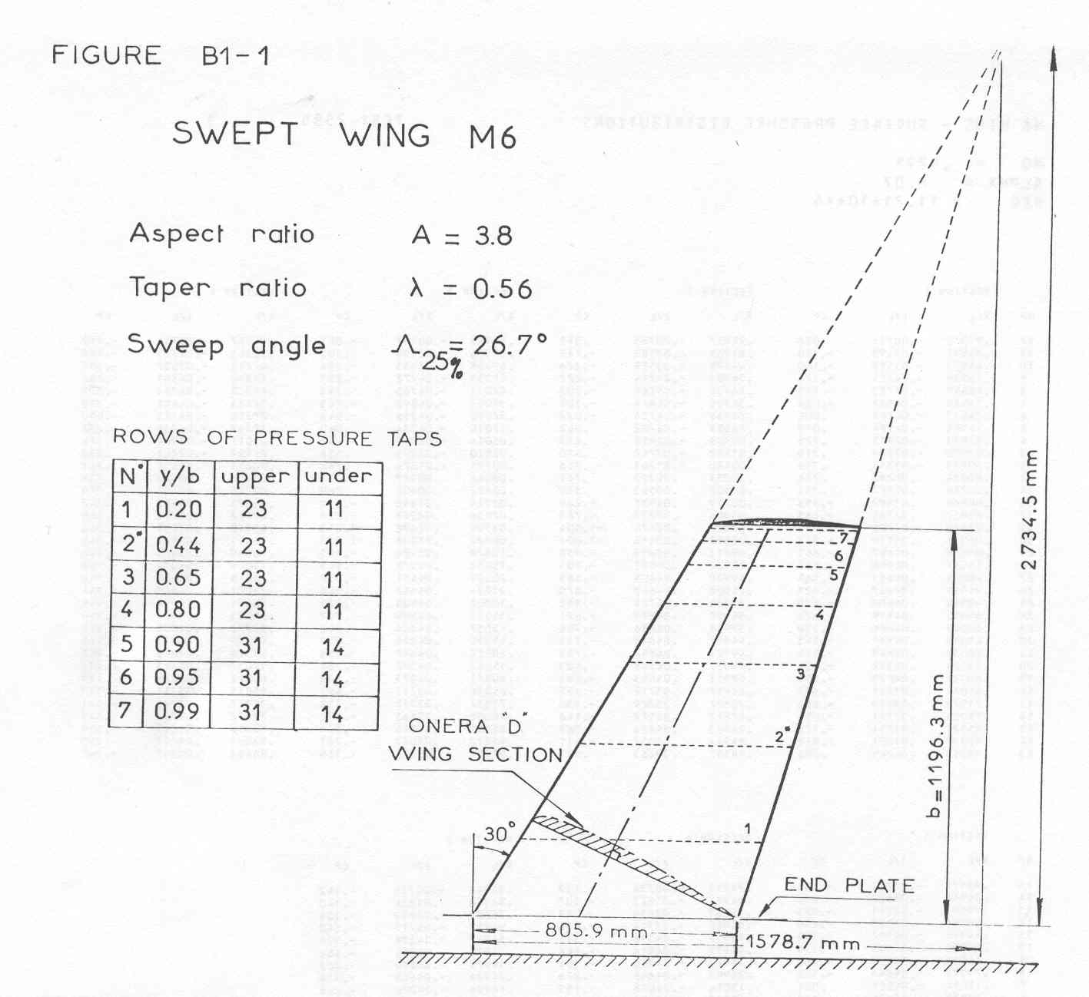
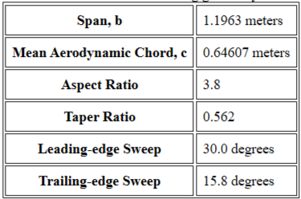
Geometry

Slide 3
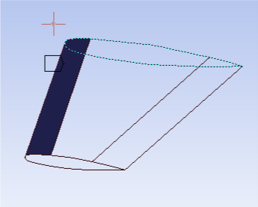
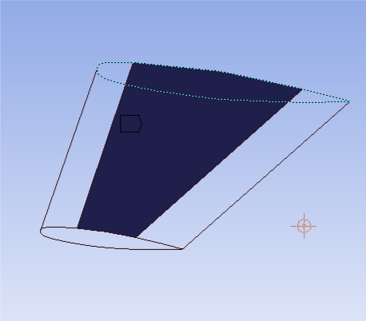
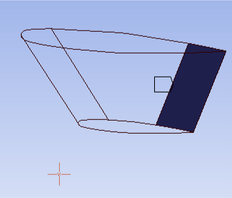
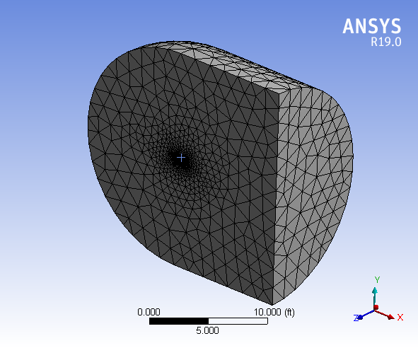
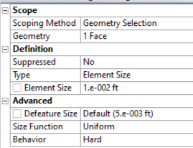
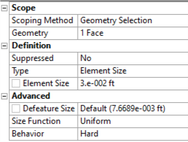
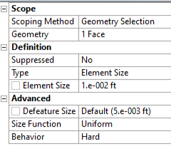
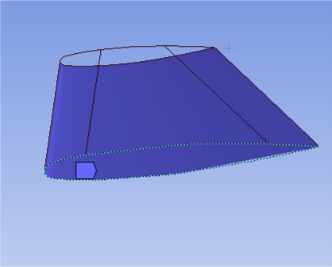
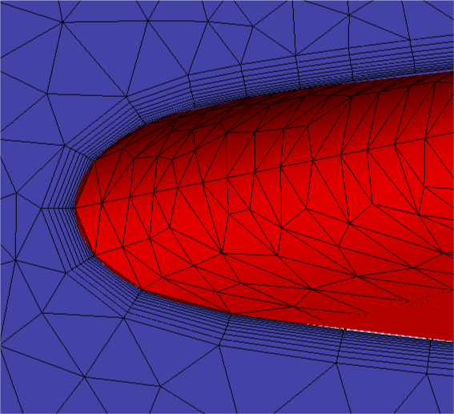
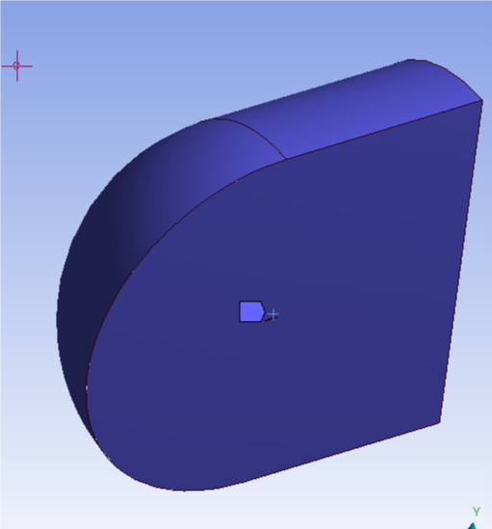
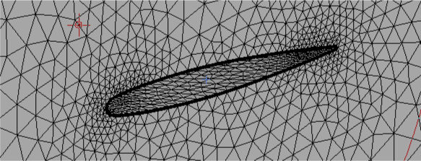
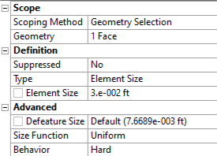
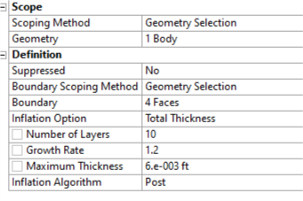
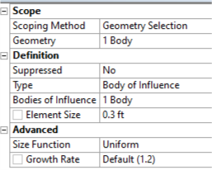
Mesh (FLUENT)
Fluent Mesh Parameters
LE
UPPER
TE
Boundary Layer
LOWER
Bullet shaped flow domain with near side, far side, inlet, outlet, wing surface
Body element size(max) = 0.3 feet
Total number of nodes = 95854
Total number of elements = 337759

Slide 4
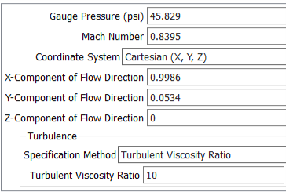
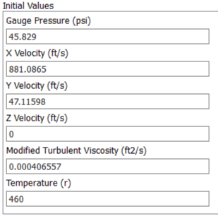
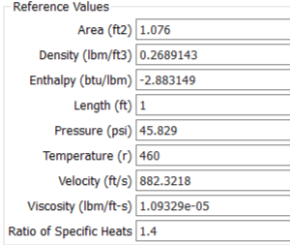
Boundary conditions (FLUENT)
TYPE OF BOUNDARY | LOCATION
Pressure-far-field | Far side, Inlet, Outlet
Symmetry | Near side
Wall | Wing surface, Wing tip
The direction of flow(angle of attack) is specified as components of flow direction
The boundary conditions can be specified directly in FLUENT
PRESSURE FAR FIELD
INITIAL VALUES
REFERENCE VALUES
MACH | REYNOLDS NUMBER | AOA | SIDESLIP
0.8395 | 11.72E+06 | 3.06⁰ | 0⁰
Flow conditions for Test 2308
Schmitt, V. and F. Charpin, "Pressure Distributions on the ONERA-M6-Wing at Transonic Mach Numbers, AGARD AR 138, May 1979.

Slide 5
Result
C_{p} vs x/l graph
20% span
65% span

Slide 6
Result
90% span
99% span

Slide 7
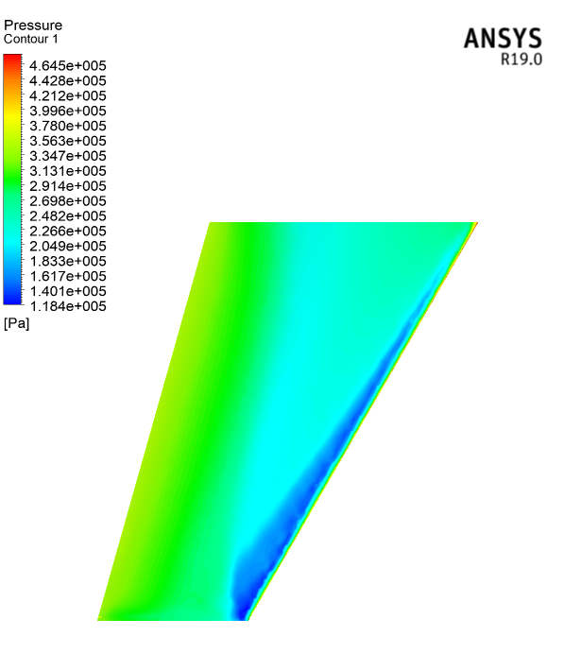
Result
PRESSURE DISTRIBUTION ON WING
FLUENT

