Slide 1

Voice Spoken Digit Recognition
Group 9

Slide 2
Overview
The general pipeline of our system is the following:

Slide 3
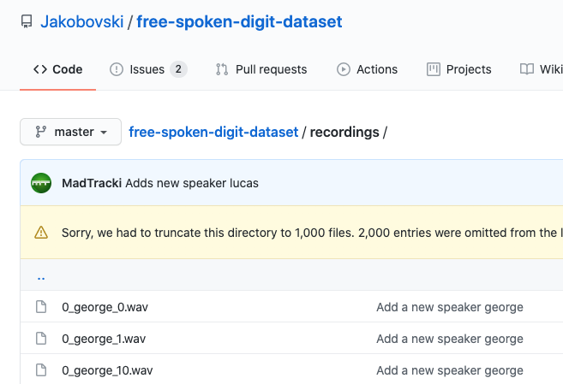
Collecting Data
As our training and test set we use the following dataset: https://github.com/Jakobovski/free-spoken-digit-dataset/
The dataset consists of:
300 .wav file sampled at 8kHz of 6 different speakers per each digit
Digit
Speaker
N.Take
We will use:
270 as training set
30 as test set

Slide 4
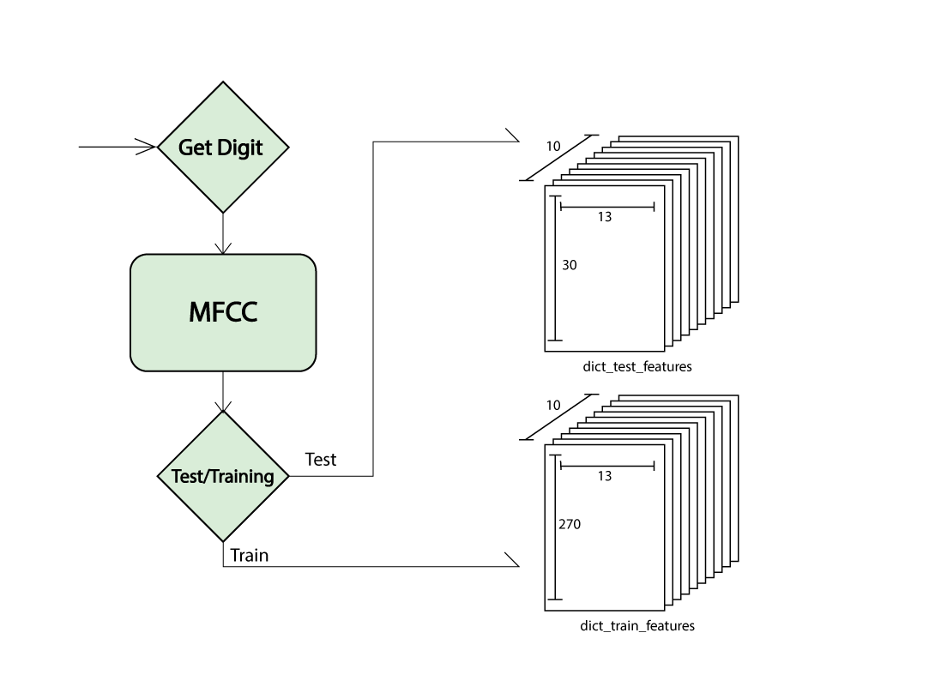
Feature extraction
After gathering the data, we cleaned it and organized our model as follows:
Listing all the files stored in the GitRepo, we check each time which digit they are and if they belong to train or test set.
Then we compute the features through MelFrequency Cepstrum coefficients of order 13.
Depending on the digit and the test/train type, the features are stored in their corresponding dictionary as shown in the scheme.

Slide 5
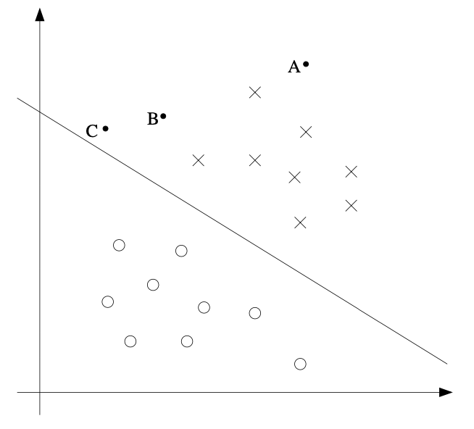
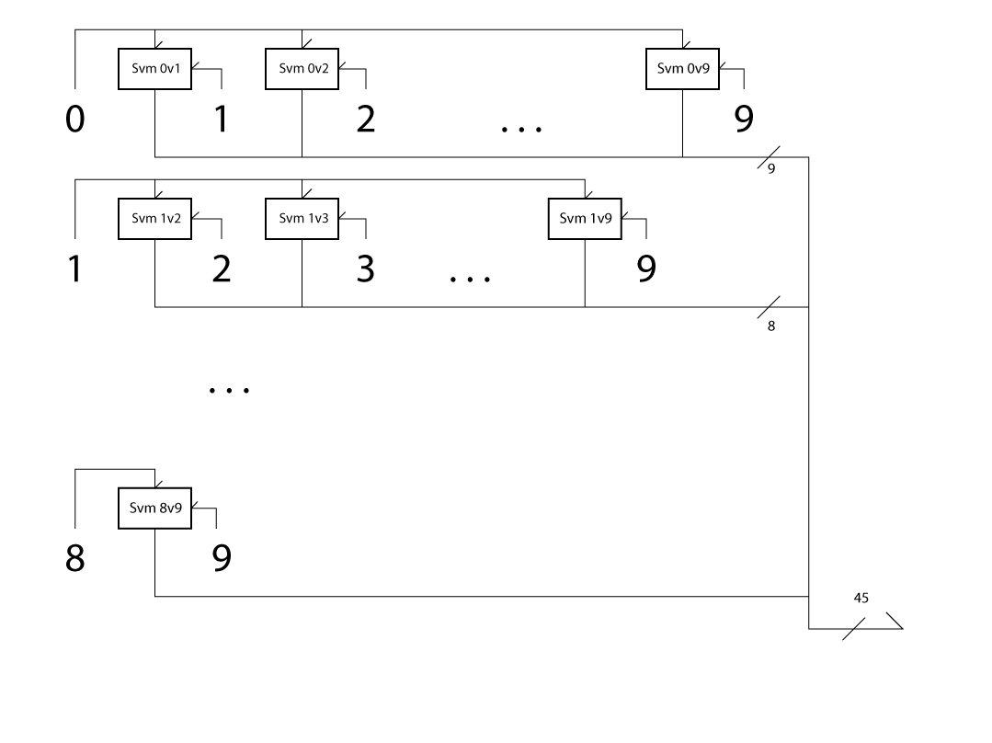
SVMs
In the SVM block we create our Support Vector Machines, infact in order to properly classify 10 digits we need multiple SVMs since these are binary classifier.
The total number will be equal to all the possible combinations between our digits:
N_comb = 0.5 * N_digits*(N_digits-1) = 45
Since the SVM class require an numpy array we generated two 3D matrix from our dictionaries and normalized them.
Now we are ready to fit our data and so to train our SVMs.
This is done by feeding the fit function of the SVM objects with the data of the 2 classes that we want to analyze.

Slide 6
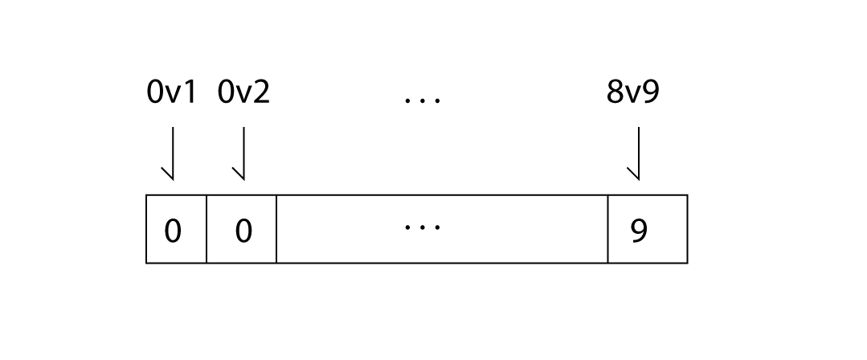
Classification
Now that we have our trained model we are ready to test it.
When we feed the system with a test sample each SVM will predict a digit and store it into an array.
Through majority voting we establish which digit is the most recurring one, taking it as our result.
SVM output array

Slide 7
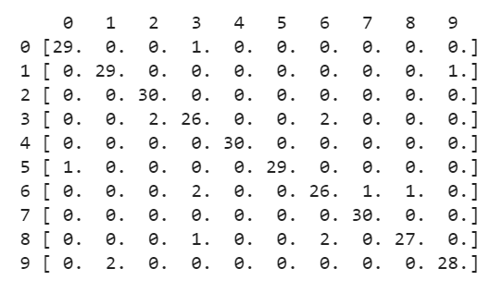
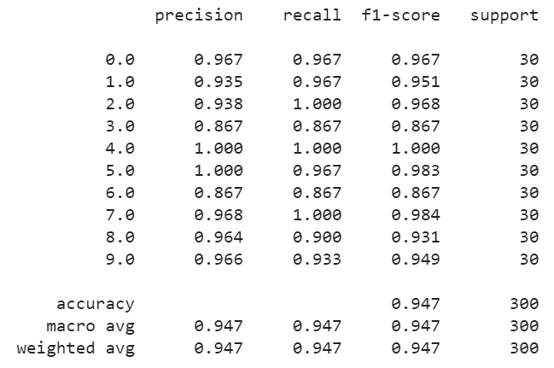
Classification
The previous computation is calculated for each file of the test set.
A good way to evaluate the result of the system is through the so called Confusion Matrix, in which we display all the predictions.
The rows corresponds to the label of the test sample
The coloumns corresponds to the digit predicted.
Computing precision, recall and f1-score we can corroborate our observation abouthaving precise results, with a total of 94,7% of accuracy

Slide 8
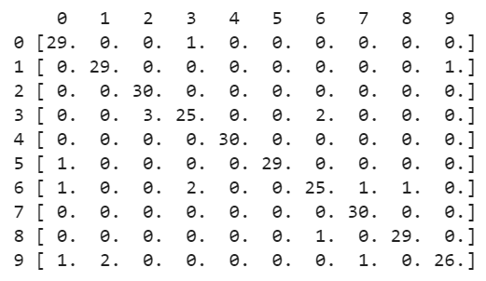

Classification
To have more than one model of classification we tried to see how the results changed using binary SVMs in a OneVsRest fashion. Namely, this time there is a binary SVM for each class that checks if the input data belongs to its class or to one of the other.
OneVsRest
OneVsOne

Slide 9
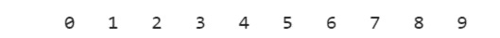
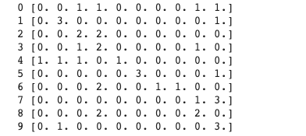
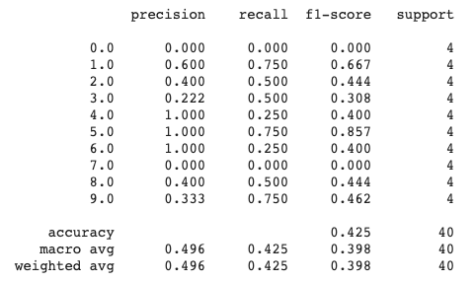
Extra
In order to test our model, we also created 40 samples with our voicen spoken digits, in order to see how robust the system is.
Here are the results:

