Slide 2
Prioritizr
Small-scale: pilot areas
National scale: entire Italian waters
Basin scale: entire Mediterranean Sea
Input: 635 species of bony fishes layers from Albouy et al 2015 (atlas 1980 of the Mediterranean Sea)
map of richness?

Slide 3
Pilot area: SoS
No cost vs with cost
No cost, no fragmentation
No cost, connectivity
different representation targets
minimum set vs maximal coverage
starting from existing plan: locked-in / locked-out

Slide 4
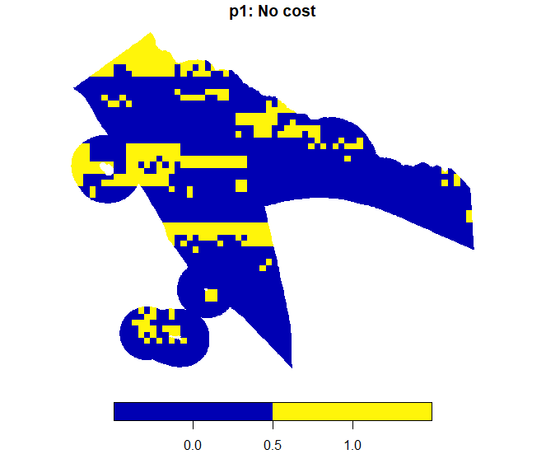

Slide 5
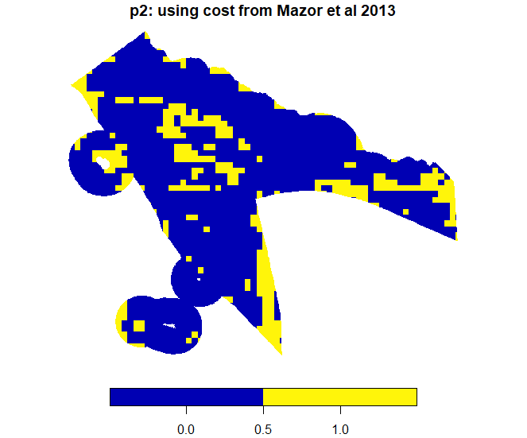

Slide 6
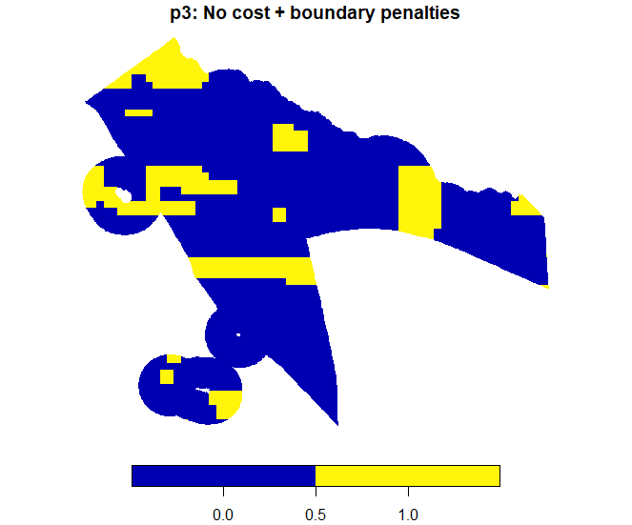

Slide 7
Basin-scale: entire Mediterranean sea
26,000 Planning units (PUs) 10 km X 10 km

