Slide 1
Classification

Slide 2
MACHINE LEARNING
SUPERVISED LEARNING
Develop predicting model based on both input and output data
UNSUPERVISED LEARNING
Group and interpret data based only on input data
REGRESSION
CLASSIFICATION
CLUSTERING

Slide 3
MACHINE LEARNING
SUPERVISED LEARNING
Develop predicting model based on both input and output data
UNSUPERVISED LEARNING
Group and interpret data based only on input data
REGRESSION
CLASSIFICATION
CLUSTERING

Slide 4
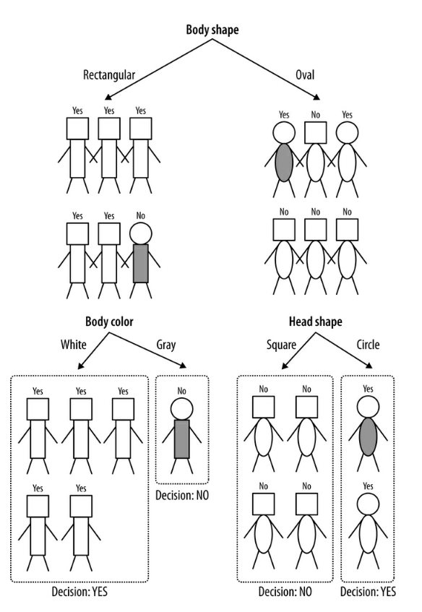
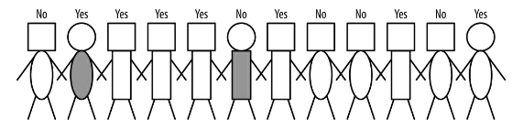
Classification tree
Classification tree is non-parametric model built by an iterative process of splitting the data into partitions, and then splitting it up further on each of the branches.
Target variable
head-shape | body-shape | body-color | Write-off
square | oval | white | No
circular | oval | gray | Yes
square | rectangular | white | Yes
square | rectangular | white | Yes
square | rectangular | white | Yes
circular | rectangular | gray | No
square | rectangular | white | Yes
square | oval | white | No
square | oval | white | No
square | rectangular | white | Yes
square | oval | white | No
circular | oval | white | Yes

Slide 5
Classification tree
Advantages:
Simple to understand and to interpret. Trees can be visualized.
Requires little data preparation. Other techniques often require data normalization, dummy variables need to be created and blank values to be removed. Note however that this module does not support missing values.
The cost of using the tree (i.e., predicting data) is logarithmic in the number of data points used to train the tree.
Able to handle both numerical and categorical data. However scikit-learn implementation does not support categorical variables for now. Other techniques are usually specialized in analyzing datasets that have only one type of variable.
Disadvantages:
Decision-tree learners can create over-complex trees that do not generalize the data well. This is called overfitting.
Decision trees can be unstable because small variations in the data might result in a completely different tree being generated. This problem is mitigated by using decision trees within an ensemble.
Practical decision-tree learning algorithms are based on heuristic algorithms such as the greedy algorithm where locally optimal decisions are made at each node. Such algorithms cannot guarantee to return the globally optimal decision tree. This can be mitigated by training multiple trees in an ensemble learner, where the features and samples are randomly sampled with replacement.

Slide 6
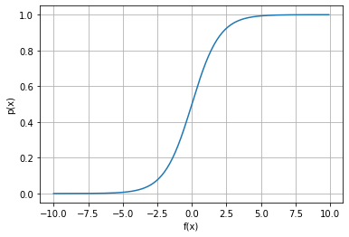
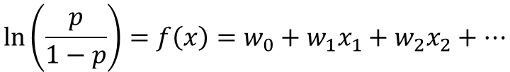

Logistic regression
The (binary) logistic model (or logit model) is a statistical model that models the probability of one event (out of two alternatives) taking place by having the log-odds (the logarithm of the odds) for the event be a linear combination of one or more independent variables ("predictors").
$$\ln\left(\frac{p}{1−p}\right)=f\left(x\right)=w_{0}+w_{1}x_{1}+w_{2}x_{2}+…$$
$$p(x)=\frac{1}{1+e^{−f(x)}}$$

Slide 7
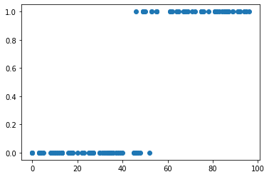
Logistic regression

Slide 8
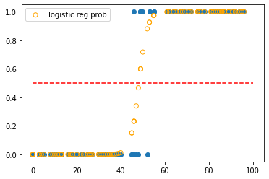
Logistic regression

Slide 9
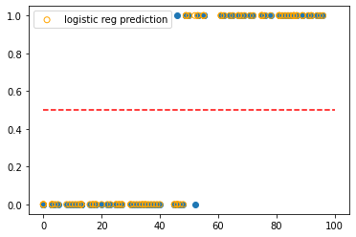
Logistic regression

Slide 10
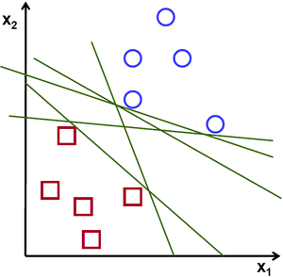
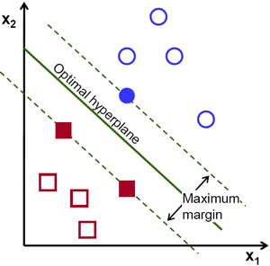
Support-vector machine
Hyperplane
A hyperplane is a decision boundary which separates a given set of data points having different class labels. The SVM classifier separates data points using a hyperplane with the maximum amount of margin. This hyperplane is known as the maximum margin hyperplane and the linear classifier it defines is known as the maximum margin classifier.
Support Vectors
Support vectors are the sample data points, which are closest to the hyperplane. These data points will define the separating line or hyperplane better by calculating margins.
Margin
A margin is a separation gap between the two lines on the closest data points. It is calculated as the perpendicular distance from the line to support vectors or closest data points. In SVMs, we try to maximize this separation gap so that we get maximum margin.

Slide 11
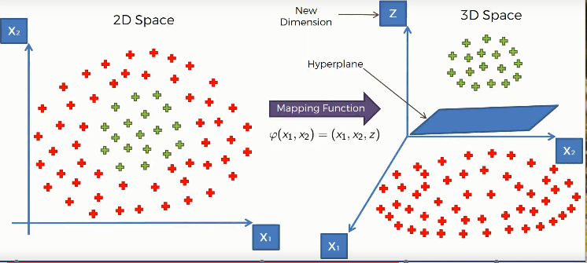
Support-vector machine
Kernel trick - transformation of input space to higher dimensional space

Slide 12
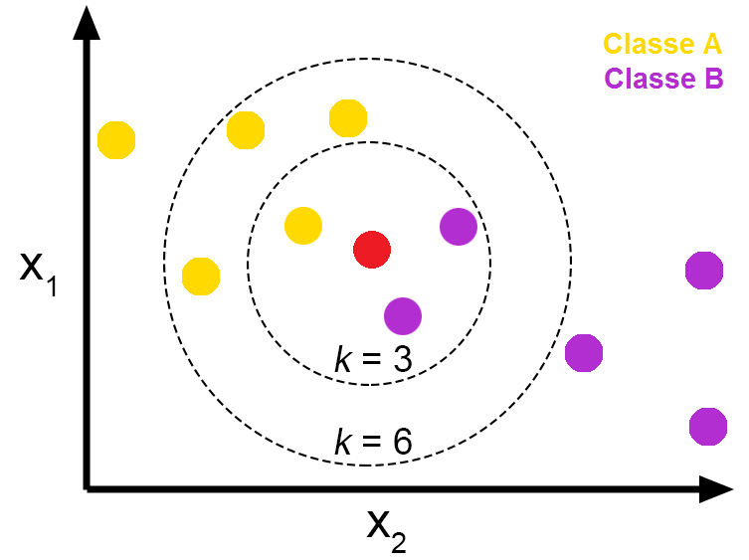
K neighbors classifier
The k-nearest neighbors algorithm, also known as KNN or k-NN, is a non-parametric, supervised learning classifier, which uses proximity to make classifications or predictions about the grouping of an individual data point.
The training phase of the algorithm consists only of storing the feature vectors and class labels of the training samples.

Slide 13
Evaluation metrics for classification model
Performance evaluation metrics are based on the total number of the following variables:
True Positives: outcome correctly predicted as positive class
True Negatives: outcome correctly predicted as negative class
False Positives: outcome incorrectly predicted as positive class
False Negatives: outcome incorrectly predicted as negative class
which are visually represented in a matrix (i.e. confusion matrix) where one of its axis is the label that the machine learning model predicted, and the other the actual label.

Slide 14
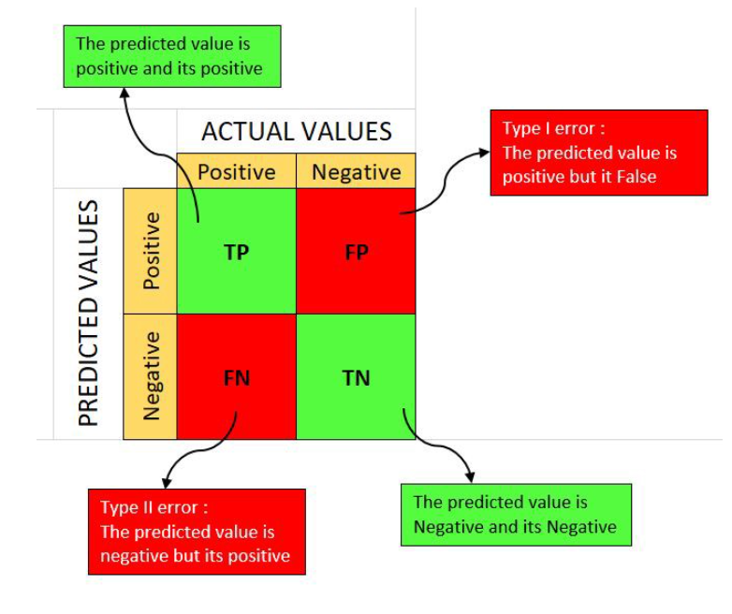
Confusion matrix

Slide 15
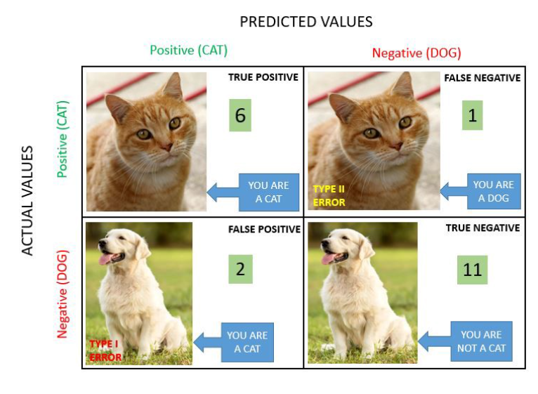
Confusion matrix

Slide 16
Evaluation metrics for classification model
Accuracy
Precision
Recall (Sensitivity)
AUC-ROC

Slide 17
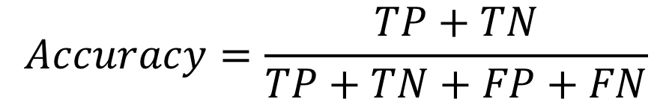
Accuracy Accuracy simply measures how often the classifier correctly predicts. We can define accuracy as the ratio of the number of correct predictions and the total number of predictions.
$$Accuracy=\frac{TP+TN}{TP+TN+FP+FN}$$
Be carefull with imbalanced classes!

Slide 18

Precision Precision explains how many of the correctly predicted cases actually turned out to be positive. Precision is useful in the cases where False Positive is a higher concern than False Negatives.
$$Precision=\frac{TP}{TP+FP}$$
The importance of Precision is in music or video recommendation systems, e-commerce websites, etc. where wrong results could lead to customer churn and this could be harmful to the business.

Slide 19

Recall (Sensitivity) Recall explains how many of the actual positive cases we were able to predict correctly with our model.
$$Sensitivity=\frac{TP}{TP+FN}$$
It is a useful metric in cases where False Negative is of higher concern than False Positive. It is important in medical cases where it doesn’t matter whether we raise a false alarm but the actual positive cases should not go undetected!

Slide 20
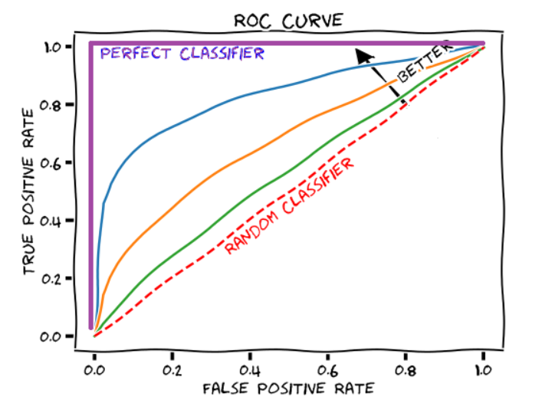


AUC-ROC (Area Under Curve – Receiver Operating Characteristics)
$$TPR=\frac{TP}{TP+FN}$$
$$FPR=\frac{FP}{FP+TN}$$

Slide 21
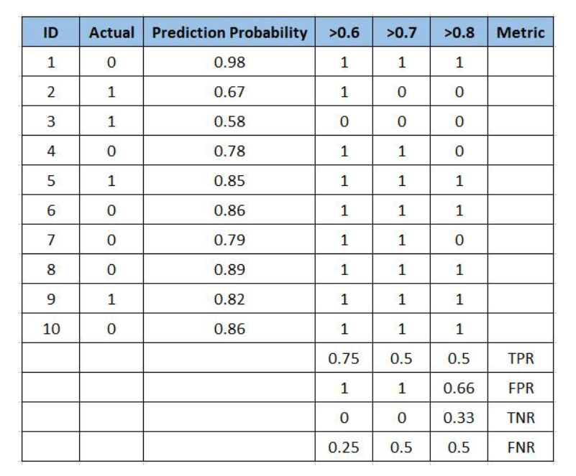
AUC-ROC (Area Under Curve – Receiver Operating Characteristics)
ROC curve can be used to select a threshold for a classifier that maximizes the true positives while minimizing the false positives.

