Slide 1
Clustering

Slide 2
MACHINE LEARNING
SUPERVISED LEARNING
Develop predicting model based on both input and output data
UNSUPERVISED LEARNING
Group and interpret data based only on input data
REGRESSION
CLASSIFICATION
CLUSTERING

Slide 3
MACHINE LEARNING
SUPERVISED LEARNING
Develop predicting model based on both input and output data
UNSUPERVISED LEARNING
Group and interpret data based only on input data
REGRESSION
CLASSIFICATION
CLUSTERING

Slide 4
Clustering
Cluster analysis or clustering is the task of grouping a set of objects in such a way that objects in the same group (called a cluster) are more similar (in some sense) to each other than to those in other groups (clusters)
Centroid-based clustering
In centroid-based clustering, each cluster is represented by a central vector, which is not necessarily a member of the data set. When the number of clusters is fixed to k, k-means clustering gives a formal definition as an optimization problem: find the k cluster centers and assign the objects to the nearest cluster center, such that the squared distances from the cluster are minimized.

Slide 5
K-means clustering
Choose the number of clusters
Specify the cluster seeds
Assign each point to a centroid
Adjust the centroid
You can run the process multiple times starting
with different initial centroids. Keep track of the
total variance and choose the result with the
lowest value.

Slide 6
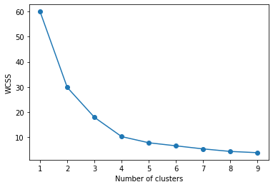
Elbow method
In the Elbow method, we are actually varying the number of clusters ( K ) from 1 – 10. For each value of K, we are calculating WCSS ( Within-Cluster Sum of Square ). WCSS is the sum of squared distance between each point and the centroid in a cluster.
As the number of clusters increases, the WCSS value will start to decrease. When we analyze the graph we can see that the graph will rapidly change at a point and thus creating an elbow shape. From this point, the graph starts to move almost parallel to the X-axis. The K value corresponding to this point is the optimal K value or an optimal number of clusters.
Elbow

