Slide 1
Probability and Statistics

Slide 2
Basic terminology
Probability distributions
Correlation
Normal distribution and Central limit theorem
Hypothesis testing

Slide 3
Data science
Data science is a multidisciplinary field which uses scientific methods, processes, and systems to extract knowledge from data in a range of forms. Statistics provides the methodology to collect, analyze and make conclusions from data.
Statistics
Statistics is the practice or science of collecting and analysing numerical data in large quantities,
especially for the purpose of inferring proportions in a whole from those in a representative sample.
Statistics uses probability theory to draw conclusions from data.
Probability
Probability theory is a branch of mathematics concerned with probability.
Probability is a numerical description of the likelihood of an event.

Slide 4

Probability example:
You have a fair coin (equal probability of heads or tails). You will toss it 100 times.
What is the probability of 60 or more heads?
Statistics example:
You have an unknown coin. You toss it 100 times and count 60 heads.
Your job as a statistician is to draw a conclusion (inference) from this data. Is it a fair coin or not?

Slide 5
Experimental probabilities
Trial: observing an event occur and recording the outcome (es. flipping a coin and recording the outcome).
Experiment: a collection of one or multiple trials (es. flipping a coin 20 times and recording the 20 individual outcomes).
An event is a set of outcomes of an experiment.
Experimental probability: probability of an event based on the experiment (preferred outcomes / sample space)
Sample space is a set of all possible outcomes from an experiment.
Events can be:
Independent, which means that they are not affected by other events. For example, if you toss a fair coin, the chance that it lands on “heads” is 1/2 no matter what.
Dependent namely, they are affected by other events. For example, as we remove cards from a deck, the probability of us choosing a king is becoming higher and higher.
Mutually exclusive that is they can’t happen at the same time. E.g. you can’t turn left and right at the same time.

Slide 6
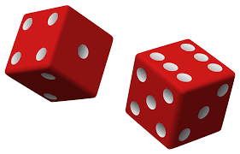
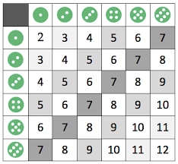
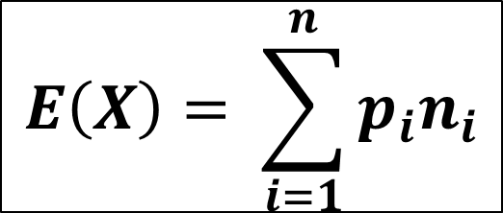
Expected value
Expected value: the average outcome we expect if we run an experiment many times.
$$E\left(X\right)= \sum_{i=1}^{n}{p_{i}n_{i}}$$
E(X) = P(2)*2 + P(3)*3 + … + P(12)*12

Slide 7
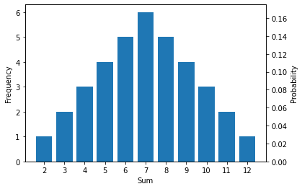
Expected value
Expected value: the average outcome we expect if we run an experiment many times.
Sum | Frequency | Probability
2 | 1 | 0.028
3 | 2 | 0.056
4 | 3 | 0.083
5 | 4 | 0.111
6 | 5 | 0.139
7 | 6 | 0.167
8 | 5 | 0.139
9 | 4 | 0.111
10 | 3 | 0.083
11 | 2 | 0.056
12 | 1 | 0.028
E(X) = P(2)*2 + P(3)*3 + … + P(12)*12 = 7

Slide 8
Complementary events
Two events are said to be complementary when one event occurs if and only if the other does not.
The probabilities of two complimentary events add up to 1.
P(X’) = 1 – P(X)
X
X’

Slide 9
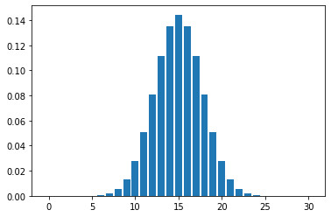
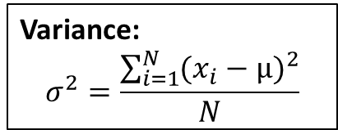
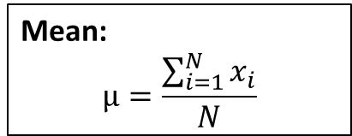
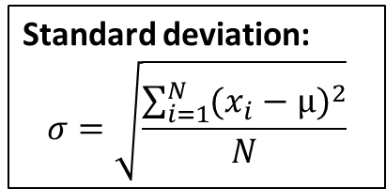
Probability distributions
A probability distribution describes all the possible values and likelihoods that a random variable can take within a given range.
Mean:
$$µ=\frac{\sum_{i=1}^{N}{x_{i}}}{N}$$
Variance:
$$σ^{2}=\frac{\sum_{i=1}^{N}{{(x_{i}−µ)}^{2}}}{N}$$
Standard deviation:
$$σ=\sqrt{\frac{\sum_{i=1}^{N}{{(x_{i}−µ)}^{2}}}{N}}$$

Slide 10
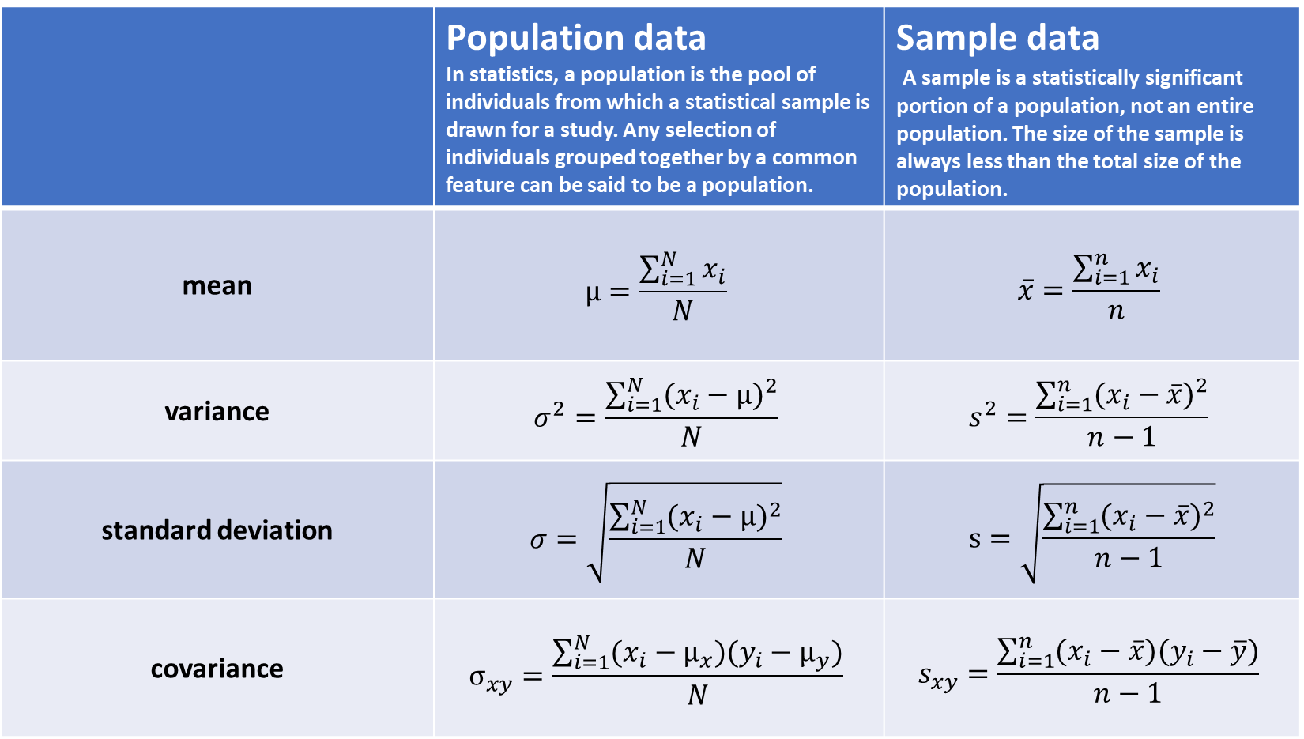
 | Population data In statistics, a population is the pool of individuals from which a statistical sample is drawn for a study. Any selection of individuals grouped together by a common feature can be said to be a population. | Sample data A sample is a statistically significant portion of a population, not an entire population. The size of the sample is always less than the total size of the population.
mean | $$µ=\frac{\sum_{i=1}^{N}{x_{i}}}{N}$$ | $$\overline{x}=\frac{\sum_{i=1}^{n}{x_{i}}}{n}$$
variance | $$σ^{2}=\frac{\sum_{i=1}^{N}{{(x_{i}−µ)}^{2}}}{N}$$ | $$s^{2}=\frac{\sum_{i=1}^{n}{{(x_{i}−\overline{x})}^{2}}}{n−1}$$
standard deviation | $$σ=\sqrt{\frac{\sum_{i=1}^{N}{{(x_{i}−µ)}^{2}}}{N}}$$ | $$s=\sqrt{\frac{\sum_{i=1}^{n}{{(x_{i}−\overline{x})}^{2}}}{n−1}}$$
covariance | $$σ_{xy}=\frac{\sum_{i=1}^{N}{(x_{i}−µ_{x})(y_{i}−µ_{y})}}{N}$$ | $$s_{xy}=\frac{\sum_{i=1}^{n}{(x_{i}−\overline{x})(y_{i}−\overline{y})}}{n−1}$$

Slide 11
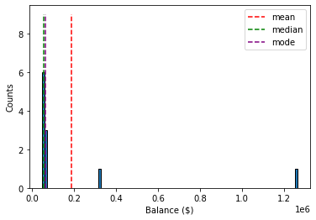
Measures of central tendency
Mean: sum of values divided by the number of values
Median: the middle number in an ordered dataset
Mode: the most frequent value
Annual income
$ 62,000.00
$ 64,000.00
$ 49,000.00
$ 324,000.00
$ 1,264,000.00
$ 54,330.00
$ 64,000.00
$ 51,000.00
$ 55,000.00
$ 48,000.00
$ 53,000.00
 | Annual income
Mean | $ 189,848.18
Median | $ 55,000.00
Mode | $ 64,000.00

Slide 12
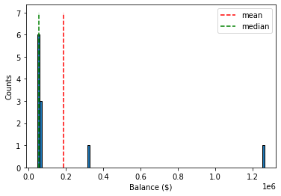
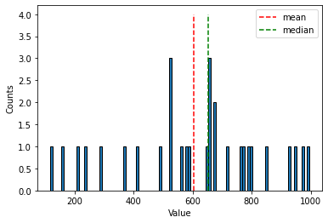
Measures of asimmetry
Skewness indicates whether the data is concentrated on one side.
mean > median → positive skew
mean < median → negative skew
Skew = 3.06
Skew = -0.37

Slide 13
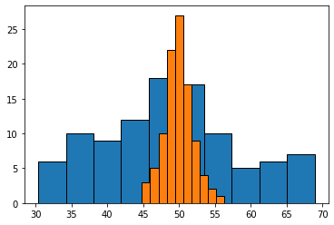
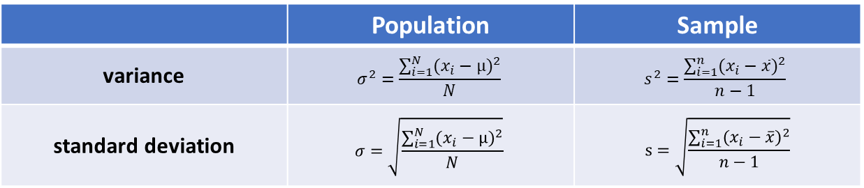
Measures of variability
 | Population | Sample
variance | $$σ^{2}=\frac{\sum_{i=1}^{N}{{(x_{i}−µ)}^{2}}}{N}$$ | $$s^{2}=\frac{\sum_{i=1}^{n}{{(x_{i}−\overline{x})}^{2}}}{n−1}$$
standard deviation | $$σ=\sqrt{\frac{\sum_{i=1}^{N}{{(x_{i}−µ)}^{2}}}{N}}$$ | $$s=\sqrt{\frac{\sum_{i=1}^{n}{{(x_{i}−\overline{x})}^{2}}}{n−1}}$$
µ = 50
σ = 10
µ = 50
σ = 2

Slide 14
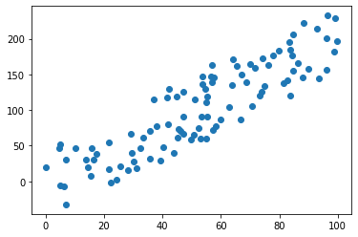
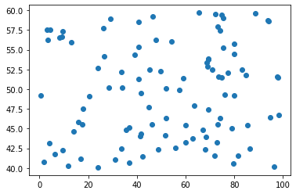
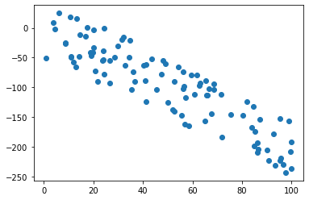
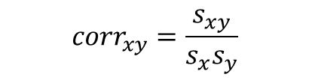
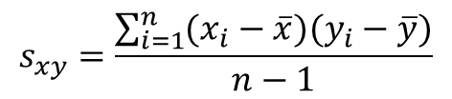
Measures of relationship between variables
Covariance
Linear correlation coefficient
$$s_{xy}=\frac{\sum_{i=1}^{n}{(x_{i}−\overline{x})(y_{i}−\overline{y})}}{n−1}$$
$${corr}_{xy}=\frac{s_{xy}}{s_{x}s_{y}}$$
corr = 0.89
corr = 0.08
corr = -0.90
Correlation does not imply causation!

Slide 15
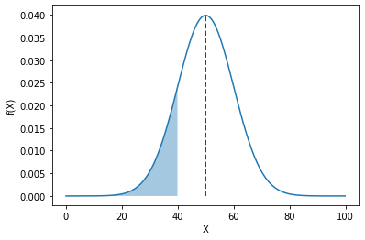
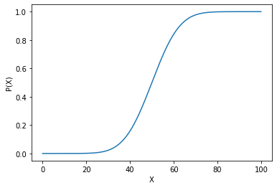
Discrete distribution | Continuous distribution
Every unique outcome has a probability assigned to it | We cannot record the frequecy (or probability) of each distinct value
Finite sample space | Infinite sample space
Sum | Frequency | Probability
2 | 1 | 0.028
3 | 2 | 0.056
4 | 3 | 0.083
5 | 4 | 0.111
6 | 5 | 0.139
7 | 6 | 0.167
8 | 5 | 0.139
9 | 4 | 0.111
10 | 3 | 0.083
11 | 2 | 0.056
12 | 1 | 0.028
Probability density function
Cumulative distribution function

Slide 16

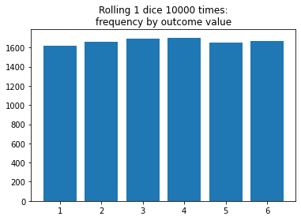
Uniform distribution
describes an experiment where there is an arbitrary outcome that lies between certain bounds.

Slide 17
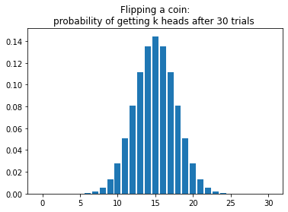
Binomial distribution
distribution of the possible number of successful outcomes in a given number of trials in each of which there is the same probability of success.

Slide 18
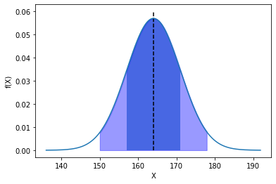
Normal distribution
In statistics, a normal distribution (also known as Gaussian distribution) is a type of continuous probability distribution for a real-valued random variable. It is symmetric about the mean, showing that data near the mean are more frequent in occurrence than data far from the mean.
µ = 164 cm
σ = 7 cm
68.3%
95.4%
* 2019, height distribution of women born in Italy in 2000

Slide 19
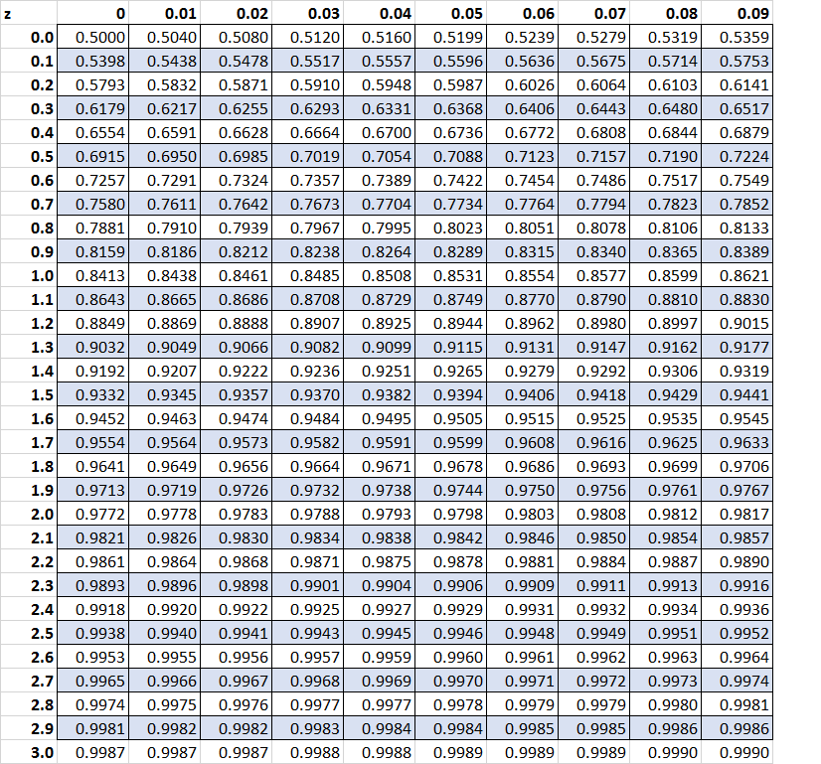
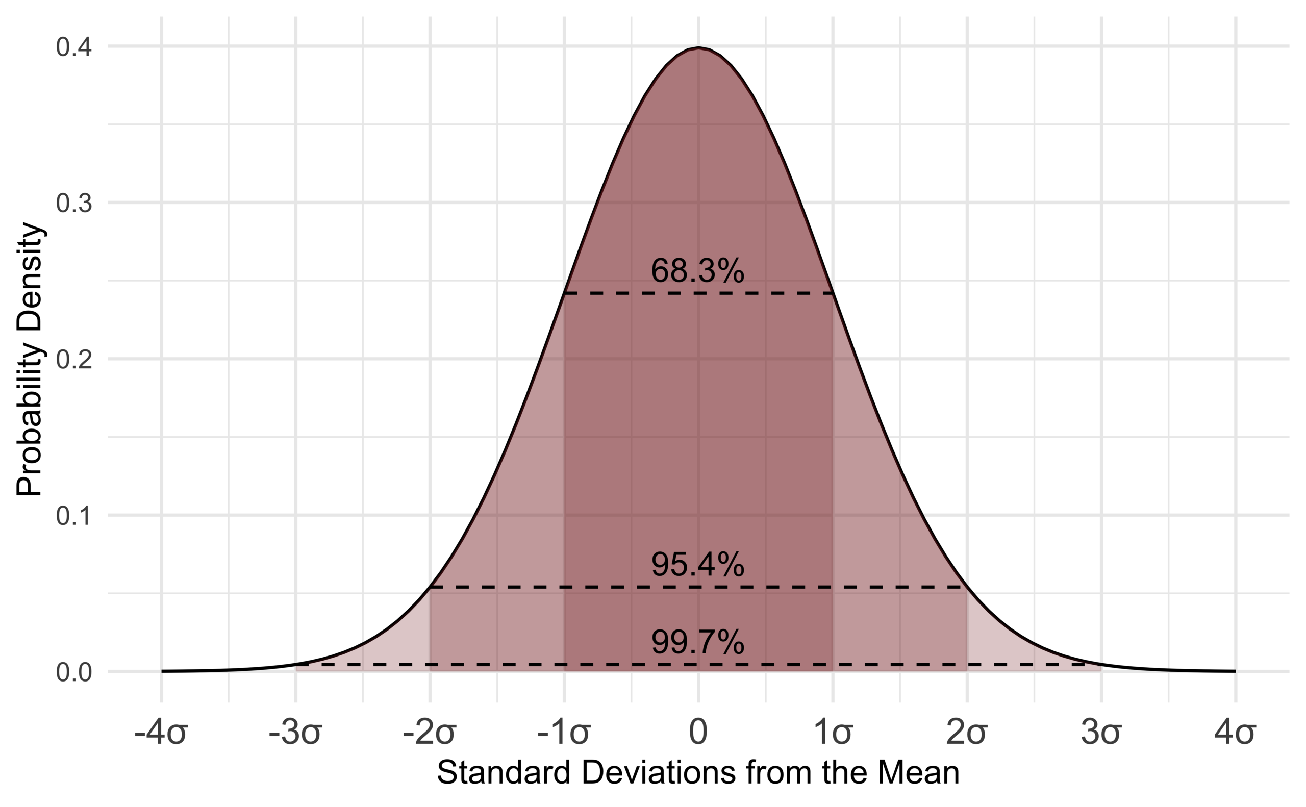

Standard normal distribution
$$f\left(X\right)→f\left(z\right), z=\frac{X−µ}{σ}$$

Slide 20
Confidence interval and confidence level
Confidence interval provides a range that is likely to contain the unknown value and a degree of confidence (confidence level) that the unknown value lies within that range.

Slide 21
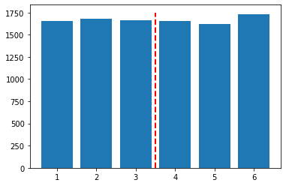
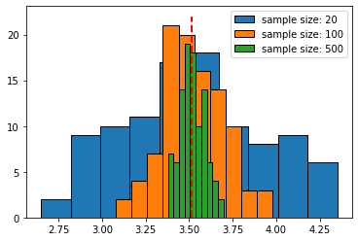
Central limit theorem
Given a set of sufficiently large samples drawn from the same population, the means of the samples will be approximately normally distributed.
The normal distribution will have a mean close to the mean of the population.
The variance of the sample mean will be close to the variance of the population divided by the sample size.
Population with 10000 elements
following uniform distribution
Take 100 samples with a fixed size and calulate
the average of each sample
Take 100 samples with a fixed size and calulate
the average of each sample
The primary value of the CLT is that it allows us to compute confidence levels and intervals even when the underlying population distribution is not normal.

Slide 22
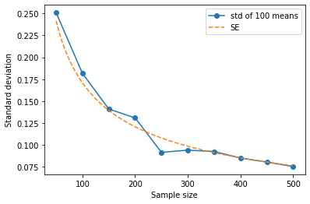
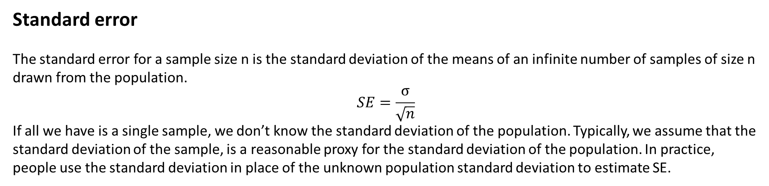
Standard error
The standard error for a sample size n is the standard deviation of the means of an infinite number of samples of size n drawn from the population.
$$SE=\frac{σ}{\sqrt{n}}$$
If all we have is a single sample, we don’t know the standard deviation of the population. Typically, we assume that the standard deviation of the sample, is a reasonable proxy for the standard deviation of the population. In practice, people use the standard deviation in place of the unknown population standard deviation to estimate SE.

Slide 23
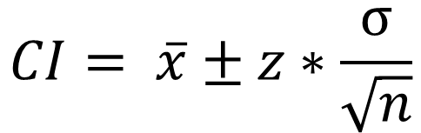
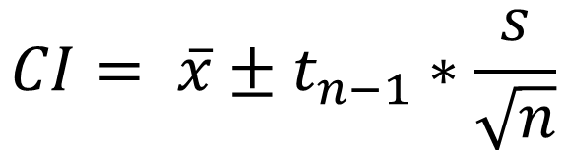
Confidence interval and confidence level
Confidence interval provides a range that is likely to contain the unknown value and a degree of confidence (confidence level) that the unknown value lies within that range.
Population variance known
$$CI= \overline{x}±z∗\frac{σ}{\sqrt{n}}$$
Population variance unknown
$$CI= \overline{x}±t_{n−1}∗\frac{s}{\sqrt{n}}$$

Slide 24
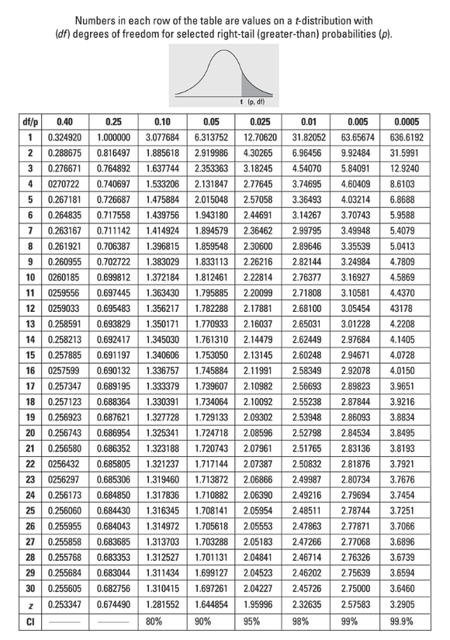
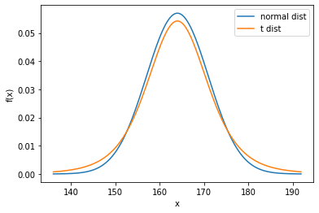
T distribution
The T distribution, also known as the Student's t-distribution, is a type of probability distribution that is similar to the normal distribution but with a greater chance for extreme values, hence the fatter tails.

Slide 25
z-score or t-score?
Do you know the population standard dev?
yes
no
Is the sample size above 30?
Use t-score
yes
no
Use z-score
Use t-score
If sample size n > 30 → t-score ~ z-score

Slide 26
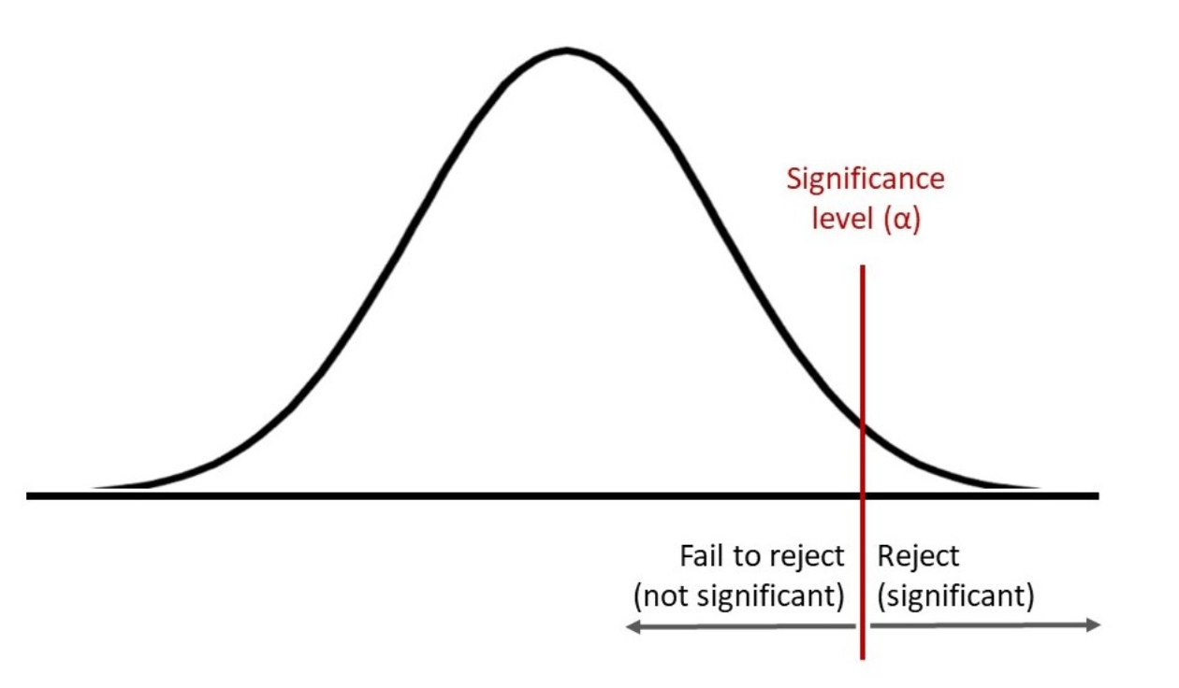
Hypothesis testing
In any experiment that involves drawing samples at random from a population there is always the possibility that an effect occurred purely by chance.
State a null hypothesis and an alternative hypothesis.
Set a significance level α.
Compute the probability (p-value) of the test statistic under null hypothesis.
Decide whether that probability is sufficiently small (p-value < α) to reject the null hypothesis.

Slide 27
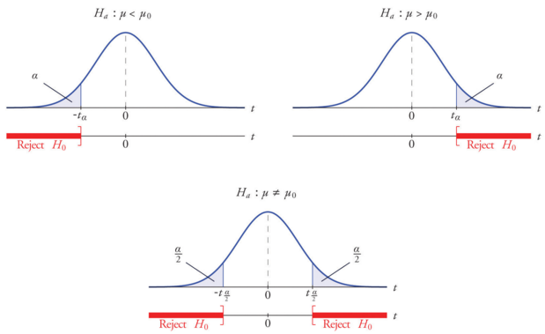
Hypothesis testing

Slide 28
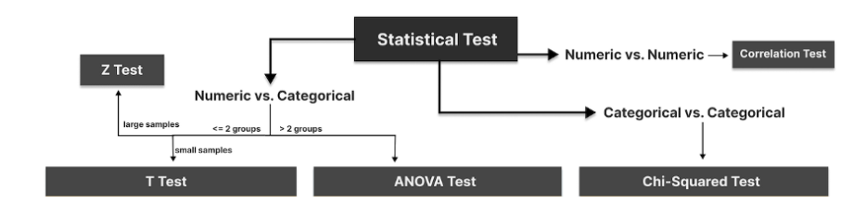
T-test: compare two groups/categories of numeric variables with small sample size
Z-test: compare two groups/categories of numeric variables with large sample size
ANOVA test: compare the difference between two or more groups/categories of numeric variables
Chi-Squared test: examine the relationship between two categorical variables
Correlation test: examine the relationship between two numeric variables
Source: https://medium.com/towards-data-science/an-interactive-guide-to-hypothesis-testing-in-python-979f4d62d85

Slide 29
Hypothesis testing
Implication of hypothesis testing:
clinical research: widely used in psychology, biology and healthcare research to examine the effectiveness of clinical trials
A/B testing: can be applied in business context to improve conversions through testing different versions of campaign incentives, website designs, etc.
feature selection in machine learning: filter-based feature selection methods use different statistical tests to determine the feature importance

