Slide 1
Time series

Slide 2
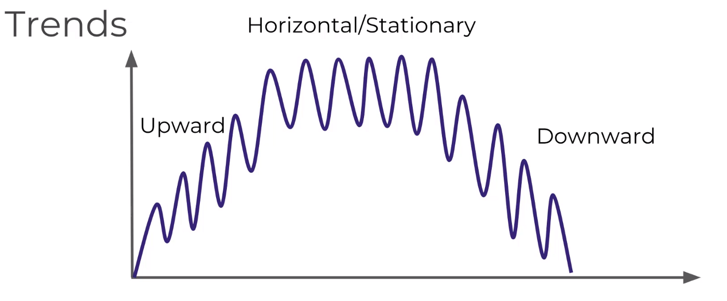
Trends

Slide 3
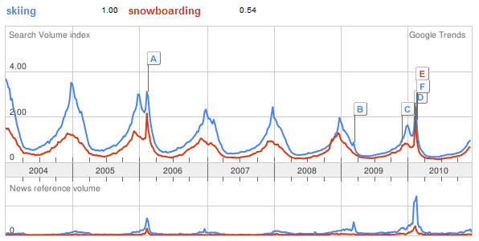
Seasonality – repeating trends

Slide 4
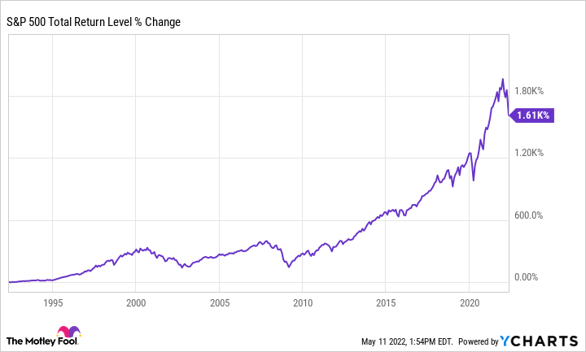
Cyclical – trends with no set repetition

Slide 5

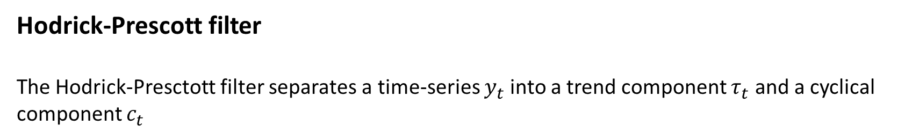
Hodrick-Prescott filter
The Hodrick-Presctott filter separates a time-series $y_{t}$ into a trend component $τ_{t}$ and a cyclical component $c_{t}$
$$y_{t}=τ_{t}+c_{t}$$
The componets are determined by minimizing the following quadratic loss function
$$\min_{τ_{t}}\sum_{t=1}^{T}{{c_{t}}^{2}}+λ\sum_{t=1}^{T}{{[\left(τ_{t}−τ_{t−1}\right)−(τ_{t−1}−τ_{t−2})]}^{2}}$$

Slide 6
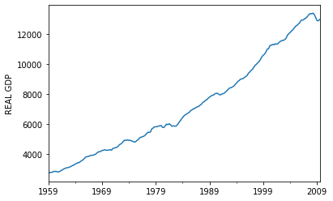
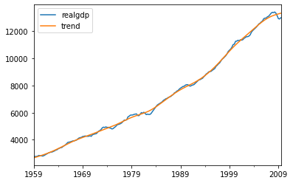
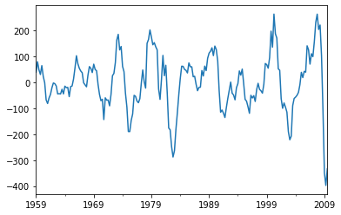
Hodrick-Prescott filter
Time series
Trend
Cyclical componet

Slide 7
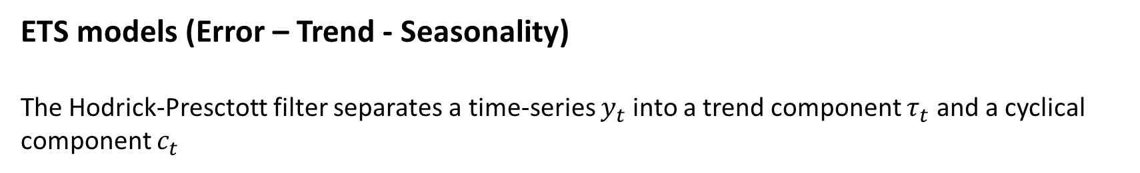
ETS models (Error – Trend - Seasonality)
The Hodrick-Presctott filter separates a time-series $y_{t}$ into a trend component $τ_{t}$ and a cyclical component $c_{t}$
$$y_{t}=τ_{t}+c_{t}$$
The componets are determined by minimizing the following quadratic loss function
$$\min_{τ_{t}}\sum_{t=1}^{T}{{c_{t}}^{2}}+λ\sum_{t=1}^{T}{{[\left(τ_{t}−τ_{t−1}\right)−(τ_{t−1}−τ_{t−2})]}^{2}}$$

