Slide 1
Linear regression

Slide 2
MACHINE LEARNING
SUPERVISED LEARNING
Develop predicting model based on both input and output data
UNSUPERVISED LEARNING
Group and interpret data based only on input data
REGRESSION
CLASSIFICATION
CLUSTERING

Slide 3
MACHINE LEARNING
SUPERVISED LEARNING
Develop predicting model based on both input and output data
UNSUPERVISED LEARNING
Group and interpret data based only on input data
REGRESSION
CLASSIFICATION
CLUSTERING

Slide 4
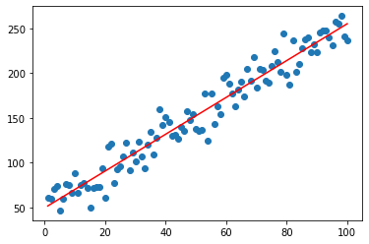
Linear regression A linear approach for modelling the relationship between a scalar response and one or more explanatory variables (also known as dependent and independent variables)

Slide 5
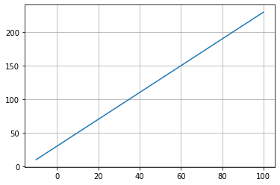

$$y=b_{0}+b_{1}⋅x$$

Slide 6
Dependent variable
Independent variable
$$y=b_{0}+b_{1}⋅x$$

Slide 7
$$y=b_{0}+b_{1}⋅x$$
Intercept

Slide 8
$$y=b_{0}+b_{1}⋅x$$
Intercept
Angular coefficient (slope)

Slide 9
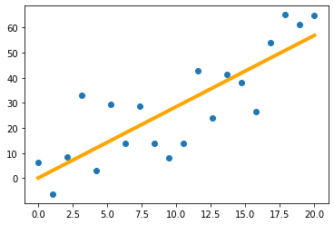
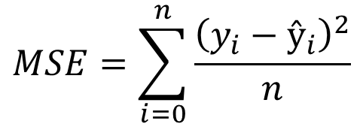

Cost function
Mean Squared Error (MSE)
$$y_{i}−ŷ_{i}$$
$$MSE=\sum_{i=0}^{n}{\frac{{\left(y_{i}−ŷ_{i}\right)}^{2}}{n}}$$

Slide 10
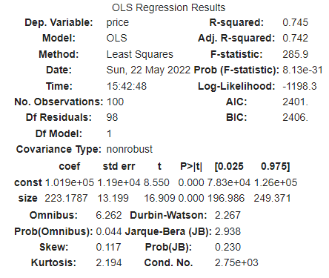
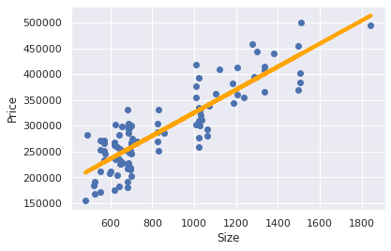
Ordinary least squares

Slide 11
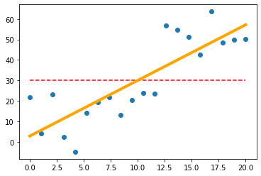
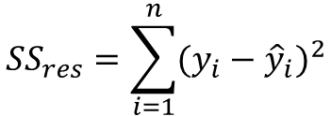

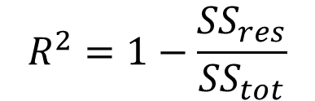

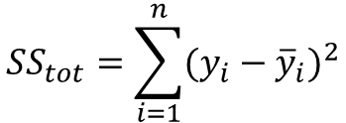
Model evaluation
$$R^{2}=1−\frac{{SS}_{res}}{{SS}_{tot}}$$
$$y_{i}−ŷ_{i}$$
$$y_{i}−{\overline{y}}_{i}$$
$${SS}_{res}=\sum_{i=1}^{n}{{(y_{i}−{\hat{y}}_{i})}^{2}}$$
$${SS}_{tot}=\sum_{i=1}^{n}{{(y_{i}−{\overline{y}}_{i})}^{2}}$$

