Slide 1
Classification

Slide 2
MACHINE LEARNING
SUPERVISED LEARNING
Develop predicting model based on both input and output data
UNSUPERVISED LEARNING
Group and interpret data based only on input data
REGRESSION
CLASSIFICATION
CLUSTERING

Slide 3
MACHINE LEARNING
SUPERVISED LEARNING
Develop predicting model based on both input and output data
UNSUPERVISED LEARNING
Group and interpret data based only on input data
REGRESSION
CLASSIFICATION
CLUSTERING

Slide 4
Classification tree

Slide 5
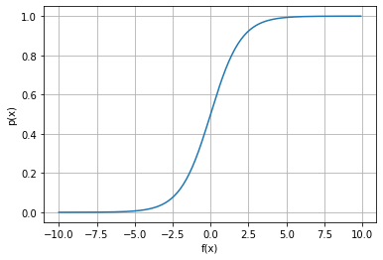
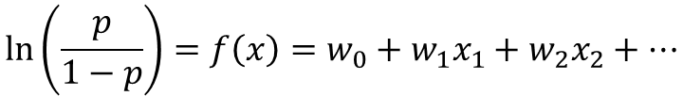

Logistic regression
$$\ln\left(\frac{p}{1−p}\right)=f\left(x\right)=w_{0}+w_{1}x_{1}+w_{2}x_{2}+…$$
$$p(x)=\frac{1}{1+e^{−f(x)}}$$

Slide 6
K neighbors classifier

Slide 7
Support-vector machine

Slide 8
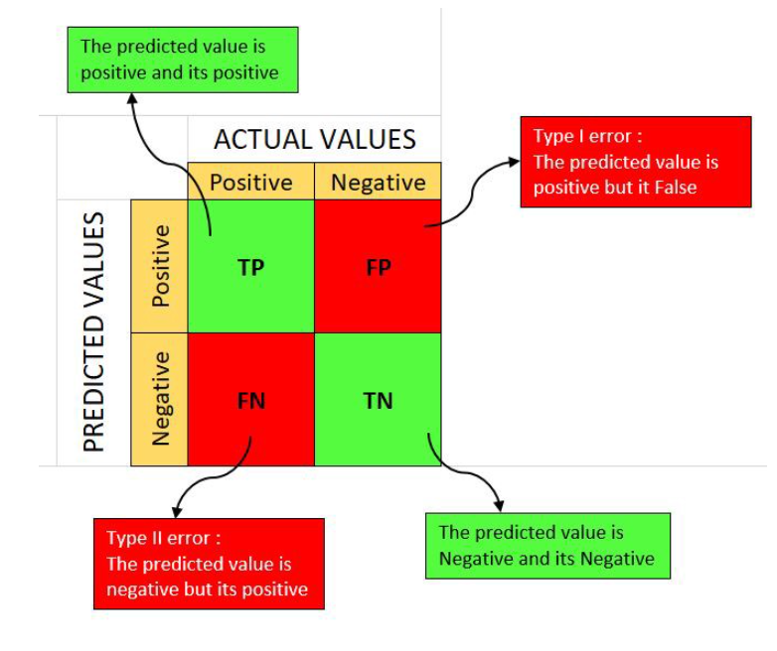
Confusion matrix

Slide 9
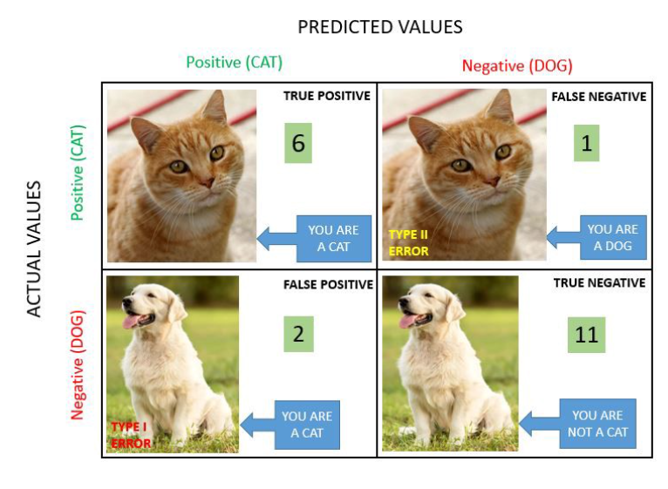
Confusion matrix

Slide 10
Evaluation metrics for classification model
Accuracy
Precision
Recall (Sensitivity)
AUC-ROC

Slide 11

Accuracy Accuracy simply measures how often the classifier correctly predicts. We can define accuracy as the ratio of the number of correct predictions and the total number of predictions.
$$Accuracy=\frac{TP+TN}{TP+TN+FP+FN}$$
Be carefull with imbalanced classes!

Slide 12

Precision Precision explains how many of the correctly predicted cases actually turned out to be positive. Precision is useful in the cases where False Positive is a higher concern than False Negatives. The importance of Precision is in music or video recommendation systems, e-commerce websites, etc. where wrong results could lead to customer churn and this could be harmful to the business.
$$Precision=\frac{TP}{TP+FP}$$

Slide 13

Recall (Sensitivity) Recall explains how many of the actual positive cases we were able to predict correctly with our model. It is a useful metric in cases where False Negative is of higher concern than False Positive. It is important in medical cases where it doesn’t matter whether we raise a false alarm but the actual positive cases should not go undetected!
$$Sensitivity=\frac{TP}{TP+FN}$$

Slide 14
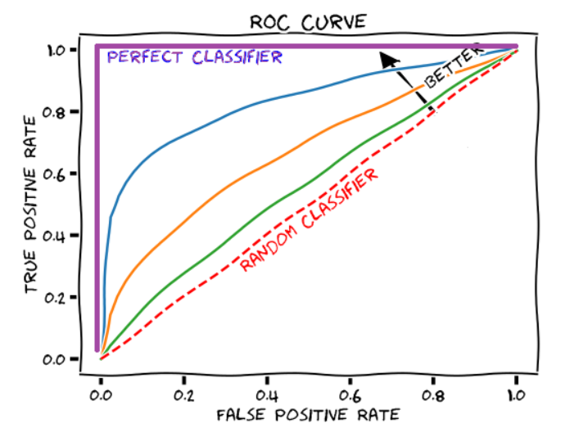


AUC-ROC (Area Under Curve – Receiver Operating Characteristics)
$$TPR=\frac{TP}{TP+FN}$$
$$FPR=\frac{FP}{FP+TN}$$

