Slide 1
Clustering

Slide 2
MACHINE LEARNING
SUPERVISED LEARNING
Develop predicting model based on both input and output data
UNSUPERVISED LEARNING
Group and interpret data based only on input data
REGRESSION
CLASSIFICATION
CLUSTERING

Slide 3
MACHINE LEARNING
SUPERVISED LEARNING
Develop predicting model based on both input and output data
UNSUPERVISED LEARNING
Group and interpret data based only on input data
REGRESSION
CLASSIFICATION
CLUSTERING

Slide 4
Prerequisites
Distance
Centroid

Slide 5
K-means clustering
Choose the number of clusters
Specify the cluster seeds
Assign each point to a centroid
Adjust the centroid

Slide 6
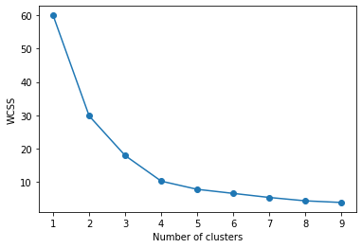
Elbow method
In the Elbow method, we are actually varying the number of clusters ( K ) from 1 – 10. For each value of K, we are calculating WCSS ( Within-Cluster Sum of Square ). WCSS is the sum of squared distance between each point and the centroid in a cluster.
As the number of clusters increases, the WCSS value will start to decrease. When we analyze the graph we can see that the graph will rapidly change at a point and thus creating an elbow shape. From this point, the graph starts to move almost parallel to the X-axis. The K value corresponding to this point is the optimal K value or an optimal number of clusters.
Elbow

