Slide 1
Laboratorio di big data, data mining e data analytics

Slide 2
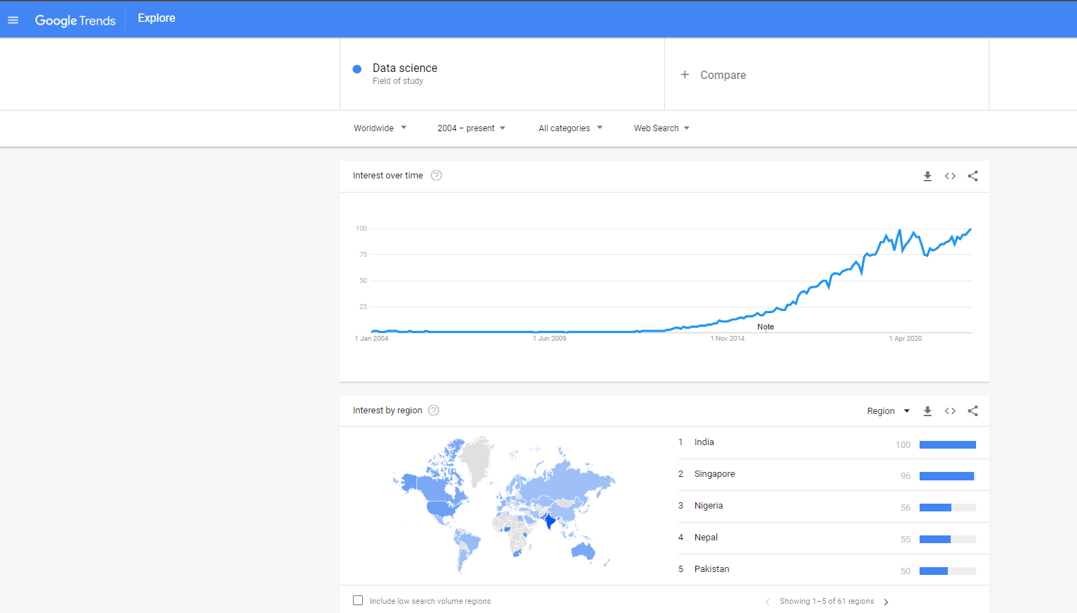

Slide 3
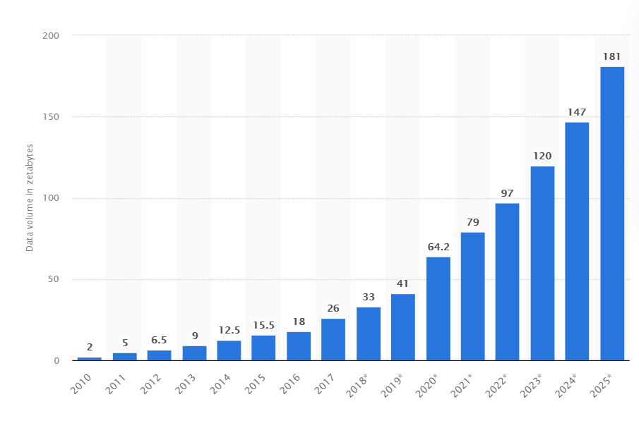
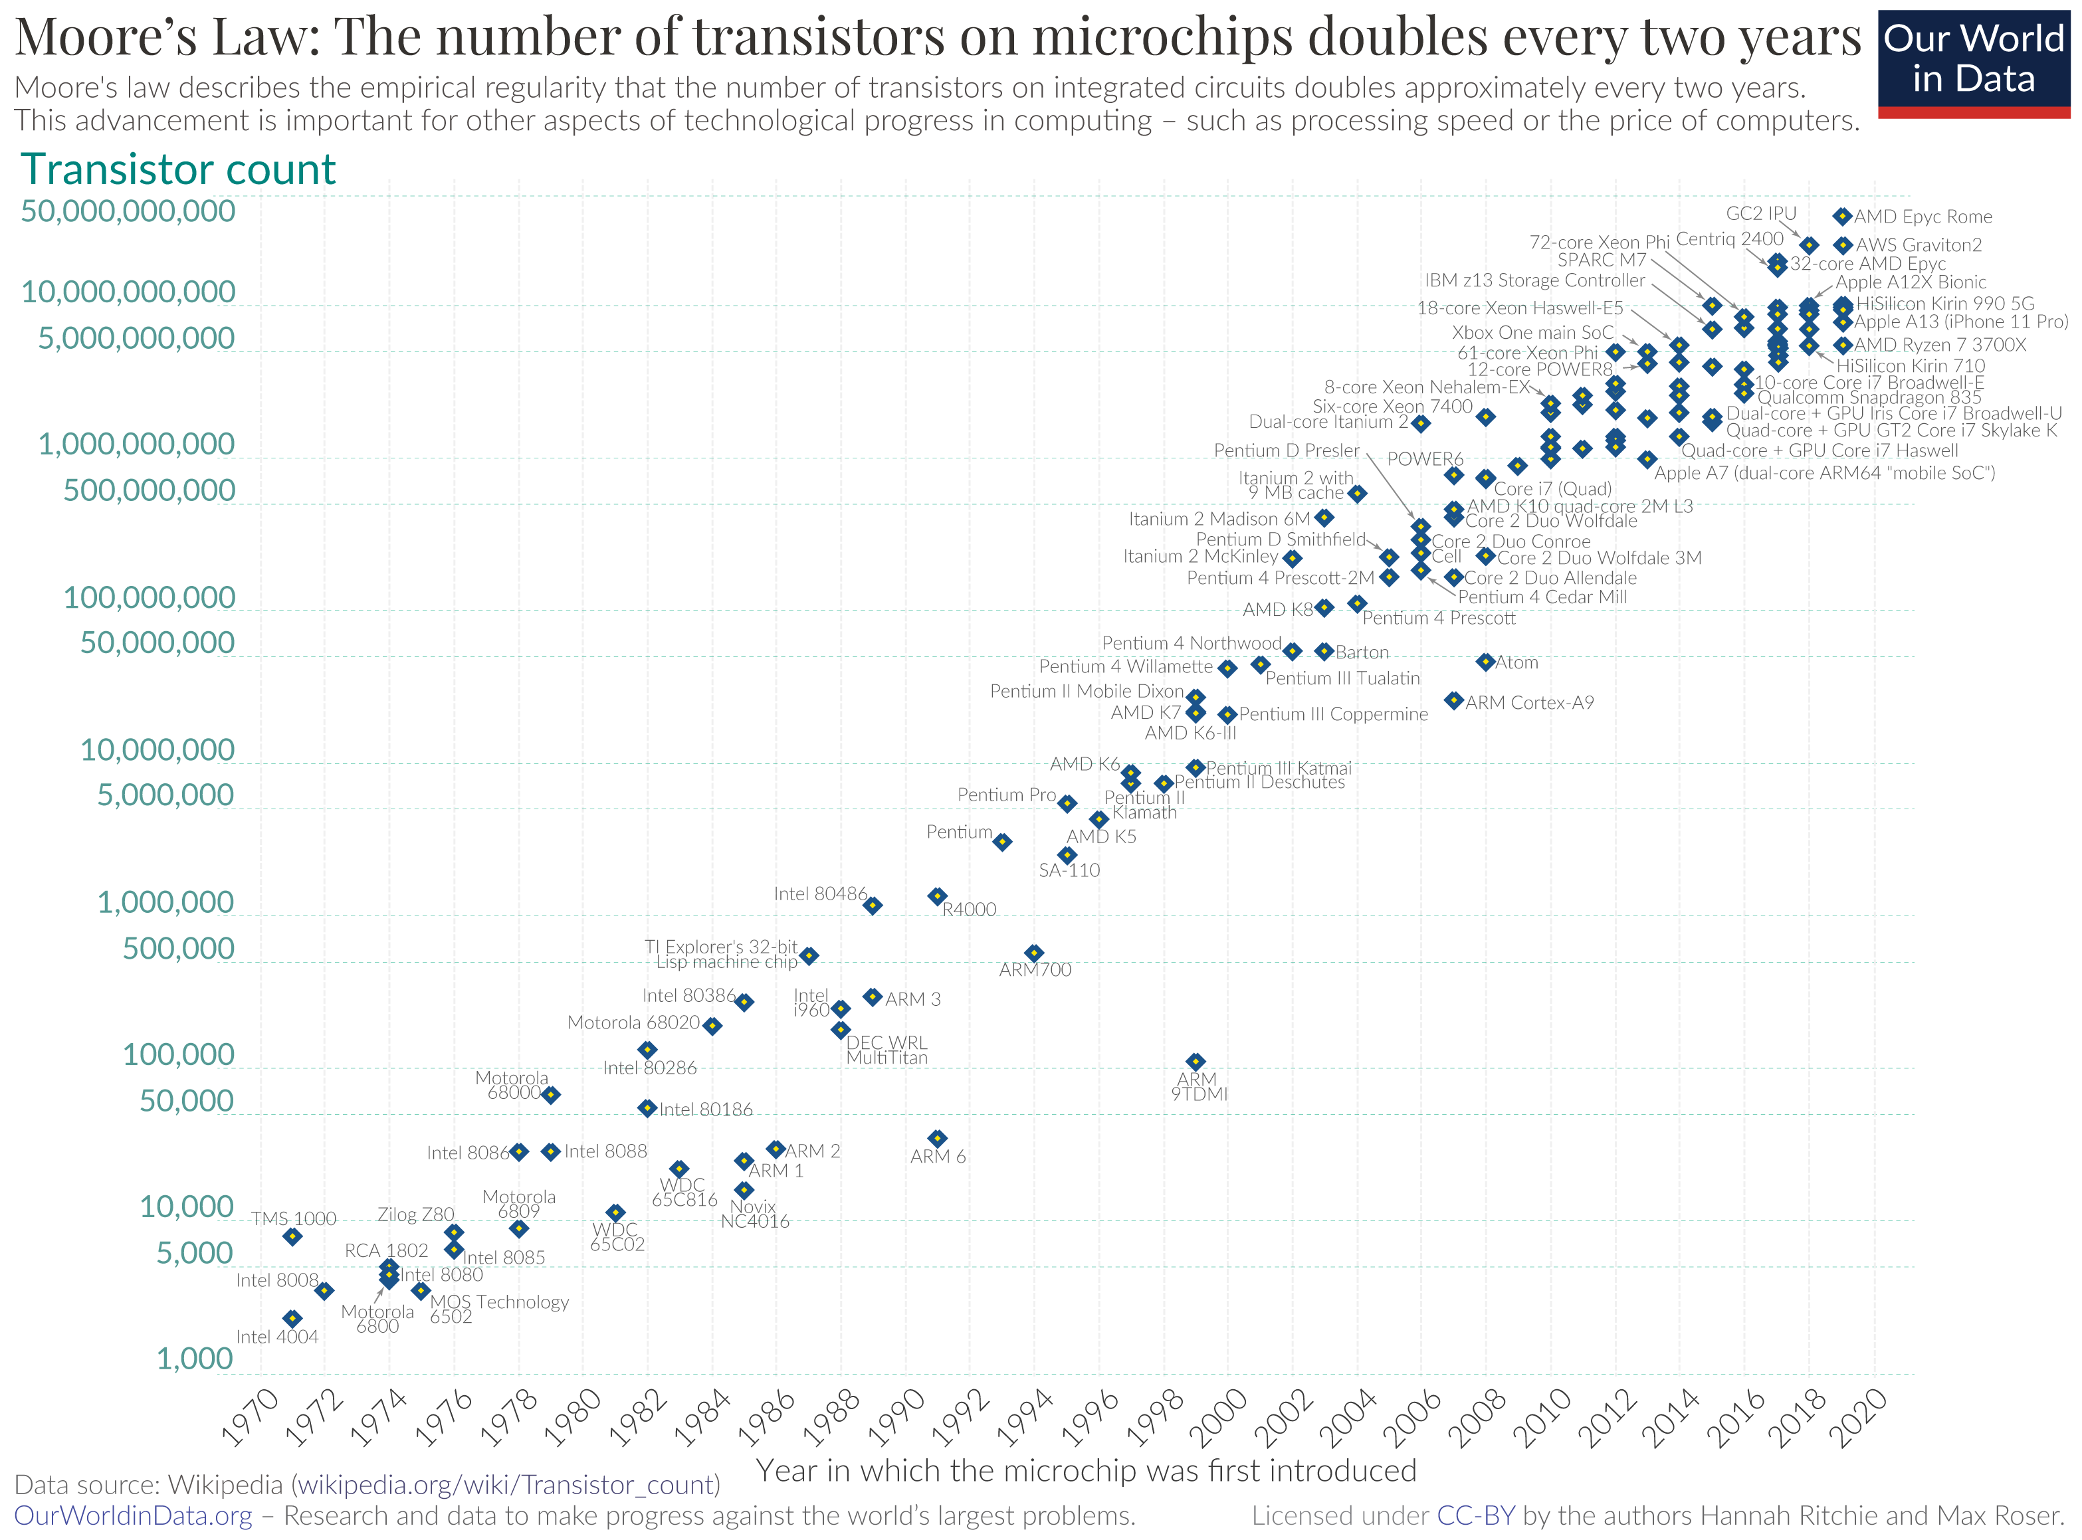
Exponential increase of data volume and computational power
Source: https://www.statista.com/
Source: https://ourworldindata.org/

Slide 4
“The world’s most valuable resource is no longer oil, it’s data”
(The Economist, 2017)
“Data Scientist: The sexiest job of the 21st century”
(Harvard Business Review, 2012)
https://hbr.org/2012/10/data-scientist-the-sexiest-job-of-the-21st-century

Slide 5
“The world’s most valuable resource is no longer oil, it’s data”
(The Economist, 2017)
“Data Scientist: The sexiest job of the 21st century”
(Harvard Business Review, 2012)
https://hbr.org/2012/10/data-scientist-the-sexiest-job-of-the-21st-century
…
“Data scientist: The sexiest job of the 22nd century”
(Cassie Kozyrkov, Chief Decision Scientist, Google)
https://towardsdatascience.com/the-sexiest-job-of-the-22nd-century-ffe753e1d155

Slide 6
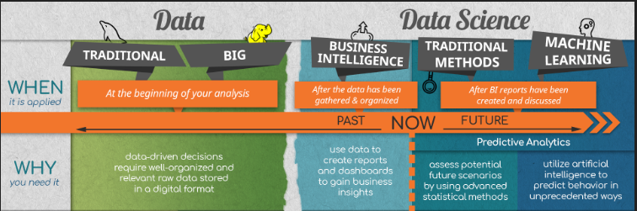
https://www.udemy.com/course/the-data-science-course-complete-data-science-bootcamp/

Slide 7
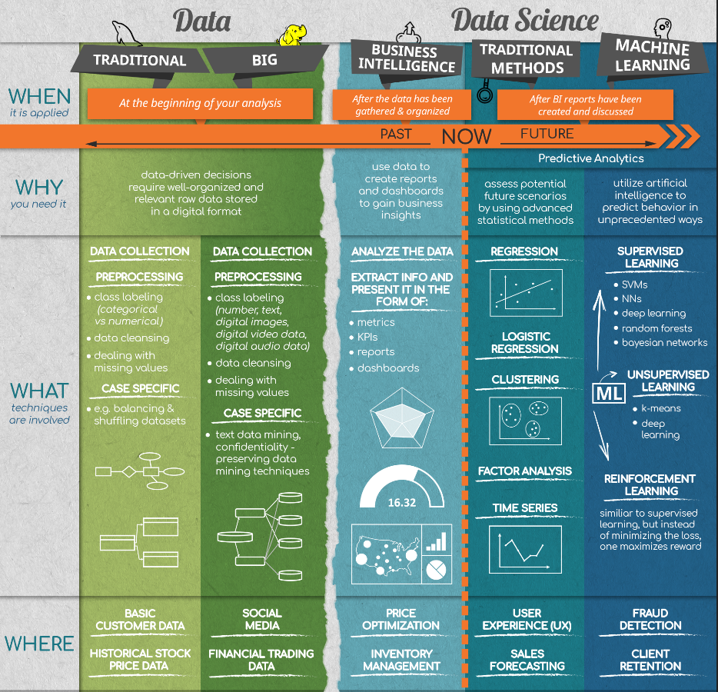
https://www.udemy.com/course/the-data-science-course-complete-data-science-bootcamp/

Slide 8
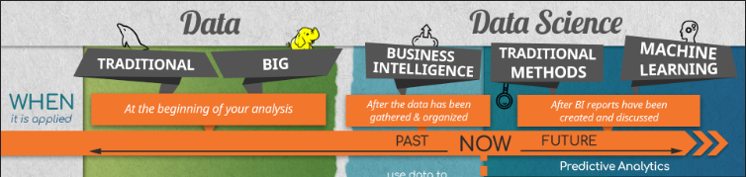


Slide 9
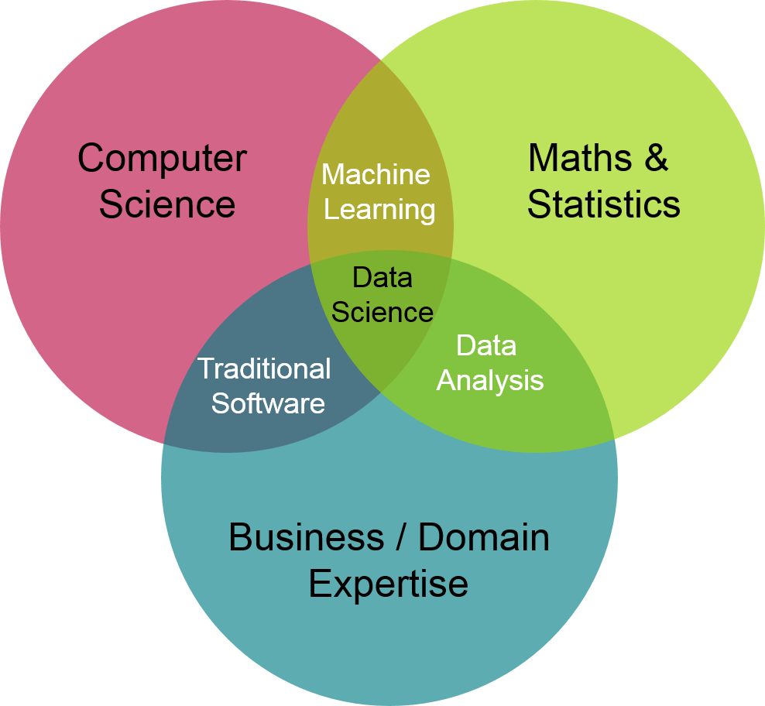

Slide 10
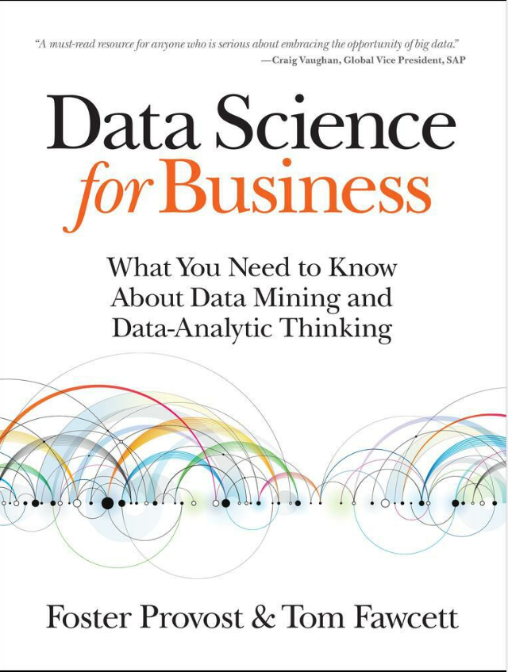
<< At a high level, data science is a set of fundamental principles that guide the extraction of knowledge from data.
Data mining is the extraction of knowledge from data, via technologies that incorporate these principles. >>
Provost, Foster; Fawcett, Tom. Data Science for Business, O'Reilly Media.

Slide 11
NumPy, Pandas, ScikitLearn
Probability and Statistics
The data mining process
Data preparation
Predictive modeling
Data visualization

