Slide 1
Classification

Slide 2
MACHINE LEARNING
SUPERVISED LEARNING
Develop predicting model based on both input and output data
UNSUPERVISED LEARNING
Group and interpret data based only on input data
REGRESSION
CLASSIFICATION
CLUSTERING

Slide 3
MACHINE LEARNING
SUPERVISED LEARNING
Develop predicting model based on both input and output data
UNSUPERVISED LEARNING
Group and interpret data based only on input data
REGRESSION
CLASSIFICATION
CLUSTERING

Slide 4
Classification tree

Slide 5
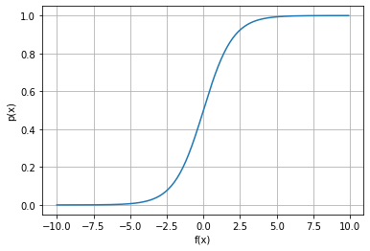
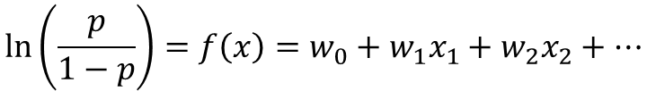

Logistic regression
$$\ln\left(\frac{p}{1−p}\right)=f\left(x\right)=w_{0}+w_{1}x_{1}+w_{2}x_{2}+…$$
$$p(x)=\frac{1}{1+e^{−f(x)}}$$

Slide 6
K neighbors classifier

Slide 7
Support-vector machine

Slide 8
Confusion matrix

