Slide 1
MuscleHub
A/B test on the gym’s Fitness Test - review by Marco Cavalazzi

Slide 2
Today’s situation
Currently, when a visitor to MuscleHub is considering buying a membership, he or she follows the following steps:
Take a fitness test with a personal trainer
Fill out an application for the gym
Send in their payment for their first month's membership

Slide 3
The problem
We want to check if the fitness test intimidates some prospective members, so we have set up an A/B test.
Visitors will randomly be assigned to one of two groups:
Group A will still be asked to take a fitness test with a personal trainer
Group B will skip the fitness test and proceed directly to the application
The hypothesis is that visitors assigned to Group B will be more likely to eventually purchase a membership to MuscleHub.

Slide 4
Our database
MuscleHub has a SQLite database, which contains several tables helpful in this investigation:
visits - contains information about potential gym customers who have visited MuscleHub
fitness_tests - contains information about potential customers in "Group A", who were given a fitness test
applications - contains information about any potential customers (both "Group A" and "Group B") who filled out an application. Not everyone in visits will have filled out an application.
purchases - contains information about customers who purchased a membership to MuscleHub.

Slide 5
Our approach
In order to best evaluate the results of our analysis, we decided to study the differences between the two groups in all the phases of the customer acquisition. Using the Chi Square test allows us to understand if the numerical differences between the groups had statistical significance or were the result of mere coincidence.
A Chi Square (X²) statistic is used to investigate whether distributions of categorical variables differ from one another.
Data Type | Question Type | Possible Responses
Categorical | What is your sex? | male or female
Numerical | Discrete - How many cars do you own? | two or three
Numerical | Continuous - How tall are you? | 72 inches

Slide 6
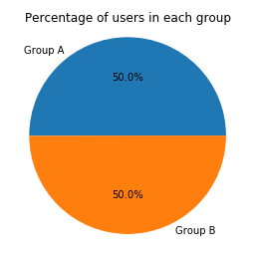
Findings
After merging all the tables in the database and analyzing the data, we know that:
About one half of the people, 2504, ended up in group A and the other half, 2500, in group B, so the groups are well balanced

Slide 7
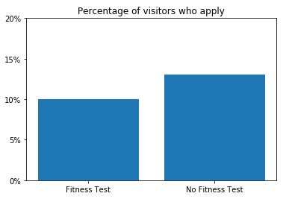
Findings
After merging all the tables in the database and analyzing the data, we know that:
The percentage of visitors who apply is higher for those who did not have an initial fitness test
Using a Chi Square test we see that the different between the groups is significant, since the result, 0.000964782760072, is lower than 0.05

Slide 8
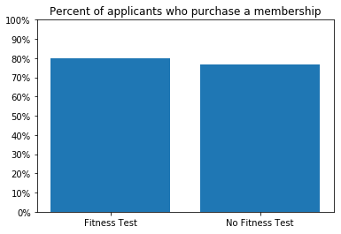
Findings
After merging all the tables in the database and analyzing the data, we know that:
A higher percentage of applicants from group A decided to purchase a membership
The numbers show that there is not a significant difference between the two, since we obtain a p-value of 0.432586460511 (> 0.05). We could say that the same percentage of applicants sign up for the membership form either group.

Slide 9
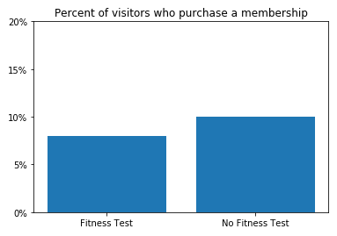
Findings
After merging all the tables in the database and analyzing the data, we know that:
Looking at the bigger picture, we notice that a fewer amount of visitors go forward to the membership when taking the fitness test.
According to our tests the difference is significant. In fact, we find the p-value to be 0.014724114645783203 (< 0.05)

Slide 10
Conclusions
Examining both the interviews with the clients and the data collected, it is clear that the majority of users prefer to skip the initial fitness test and go straight for the application and membership. The Chi Suqare test provides proof that the difference is significant and, thus, worthy of consideration.
Removing the initial test will allow the gym to have a significantly higher number of memberships while giving the new customers more time to test the machines and see if MuscleHub is what they are looking for.
The advice is to remove the fitness test and focus on providing guidelines to keep the machines clean for everybody and implement well-thought training plans for beginners, who seem to be the ones having difficulties getting used to the gym.

Slide 11
Conclusions
Removal of the initial fitness test
Apply guidelines to keep the machines clean
Implement well-thought training plans for beginners

