Slide 1
Marco Cavani assessment 2 case study
Implement an IoT environment
Explore Vulnerabilities
Perform a cyber attack
Implement relevant security countermeasures to mitigate/prevent the attack
IoT and OT Security - CSI2450.1
Student ID: 10570027

Slide 2
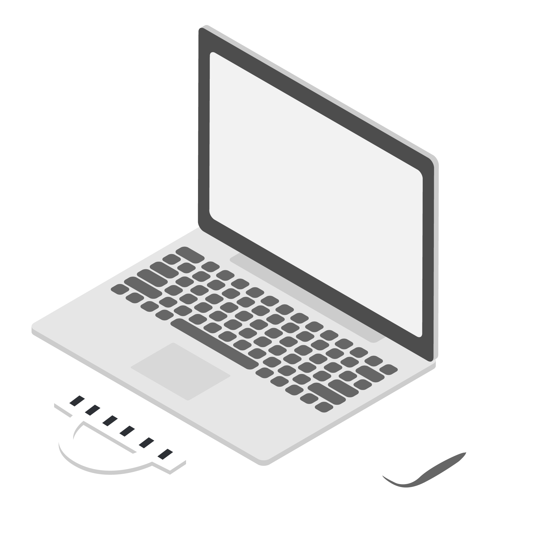

IoT Environment
Publish temperature
To Computer_lab topic
Published to Computer_lab topic
MQTT Broker
Topic: Computer_lab
Temperature Sensor
Subscribe to Computer_lab topic
Staff –rw
(username, password)
Students –r
(username, password)
IoT and OT Security - CSI2450.1
Student ID: 10570027
Notes:
The fist pocket is sent by the client to initiate MQTT connection. MQTT protocol runs over the TCP to exchanging data

Slide 3
DDOS Attack IoT Environment
Subscribe request
Subscribe request
!
Publish temperature
To Computer_lab topic
IoT
Device
MQTT Broker
Overloading
Subscribe request
Firewall
Subscribe request
DDOS Attack
Regular transmission
IoT and OT Security - CSI2450.1
Student ID: 10570027

