Slide 1
Security Products
CSG3309 IT Security Management

Slide 2



Security Information and Event Management (SIEM)
Security Information and Event Management (SIEM):
Software that provide real-time analysis of system alerts generated by network devices and applications.
SIEM software combines Security Information Management (SIM) and Security Event Management (SEM).
SEM analyses event and log data through the technology infrastructure to provide threat monitoring and incident response in real-time. SIM collects analyses and reports on log data.
Notes:
SIEM - Security Information and Event Management
What is SIEM
https://www.csoonline.com/article/2124604/network-security/what-is-siem-software-how-it-works-and-how-to-choose-the-right-tool.html
Best SIEM products
https://www.capterra.com/siem-software/
SPLUNK
https://www.splunk.com/en_us/resources/videos.html
SIEM started by log analysis, now morphed into SIEM
Security information and event management (SIEM) is an approach to security management that combines
SIM (security information management) and SEM (security event management)
functions into one security management system.
The acronym SIEM is pronounced "sim" with a silent e.
(SIEM) software products and services combine security information management (SIM) and security event management (SEM).
They provide real-time analysis of security alerts generated by applications and network hardware.

Slide 3
Security Information and Event Management (SIEM)
Generally used by public organizations and medium to large enterprise
Smaller companies tend not to invest in SIEM products due to cost and expertise required to operate SIEM effectively
SIEM products are generally used on-site as opposed to cloud based however this is changing
SIEM software as a service (SaaS) is increasing in market share offering hybrid options, allowing smaller companies to use SIEM

Slide 4

SIEM Features
Application Monitoring
Security Monitoring (minor infrastructure in real-time)
Incident forensics
Monitor privileged users – Insider threats
Network process monitoring
Fraud detection, i.e., identity theft of credentials
Incident management
Reporting and analysis

Slide 5
SIEM Software
LogRhythm
SolarWinds Threat Monitor
EventSentry
Log360
IBM QRadar SIEM
AlienVault USM
Logsign
Splunk

Slide 6
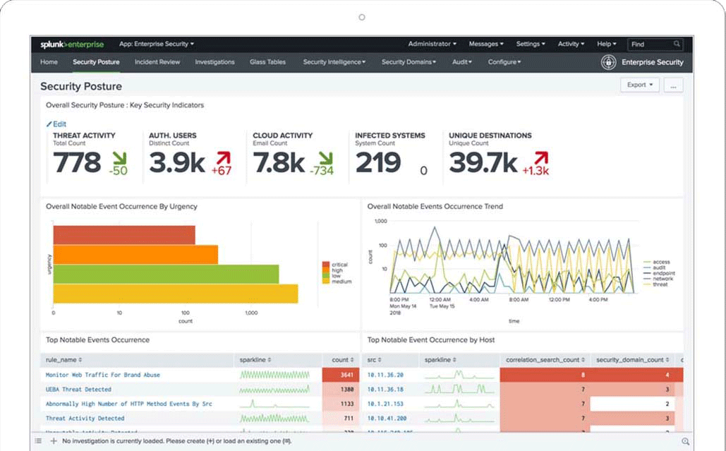
SPLUNK Software
Notes:
Example of a SPLUNK Dashboard

Slide 7

SPLUNK Software
ECU students have access to SPLUNK
https://workplus.splunk.com/universities/
Fundamentals I | Fundamentals II
This course teaches you how to search and navigate in Splunk, use fields, get statistics from your data, create reports, dashboards, lookups, and alerts. | This course focuses on searching and reporting commands as well as on the creation of knowledge objects
FREE | FREE to ECU students
Must be completed in 30 days | Instructor Course
Notes:
https://workplus.splunk.com/universities/
Fundamentals 1 approximately 12 hours
Fundamentals II – instructor lead course, virtual classroom
Next vulnerability scanners

Slide 8
Vulnerability Scanners
Network Based
Identifies potential network attacks and vulnerable systems on wired or wireless networks
Host-based
Identifies vulnerabilities on network hosts, i.e., workstations, servers, other network devices. Provide information on configuration and patch history.
Application Scanners
Detects known software vulnerabilities and configuration errors in network or web based applications
Database Scanners
Identifies database weaknesses and mis configurations to prevent attacks
Wireless Scanners
Identifies rouge access points and validate network is configured securely
Automated tools that provide organizations valuable insight into application weaknesses on a network. Leading vulnerability scanners can help organizations assess application risks and recommend mitigation techniques.
Internal vulnerability scans are performed from within the network
External vulnerability scans are performed from outside the network
Notes:
Offensive Security
Ad blockers’
Have I been pawned
Aircrack – Kali tools
Breach Alarm’ Breach Alarm crawls the deep parts of the internet to discovery if your credentials have been compromised. Simply put in your email address and it will tell you whether or not you should change your password.
https://cyberx.tech/free-cybersecurity-tools
https://owasp.org/www-community/Vulnerability_Scanning_Tools

Slide 9
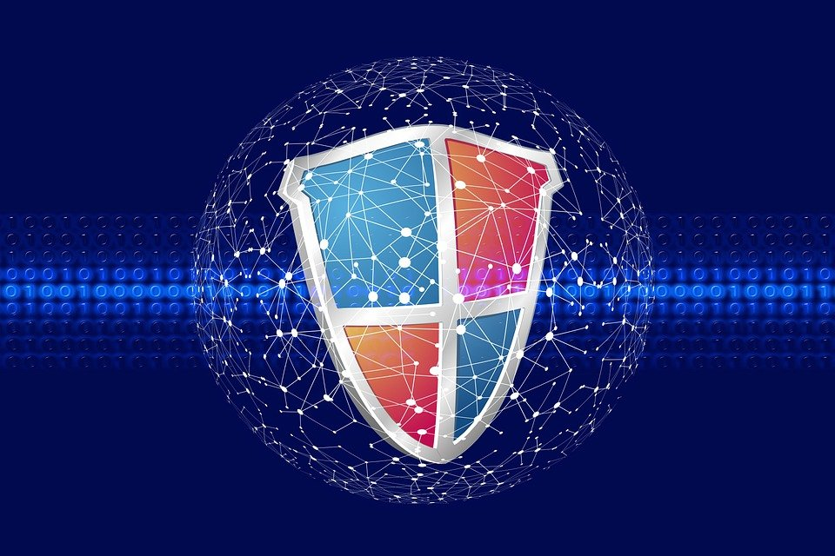
Vulnerability Scanners / Products
Nessus
SolarWinds Network Configuration Manager
Nexpose
Microsite Baseline Analyzer (MBSA)
OpenVas
Nmap
Intruder
Burp Suite
ZAP
Notes:
Next miscellaneous tools

Slide 10
Network and Auditing Tools (Miscellaneous)
Gophish
Provides a platform for simulating phishing attacks. Several email templates are available but also allows custom email templates. Tracks users who follow phishing links providing insight into employee behaviour and identify training requirements
Zenmap
Graphical user interface for the Nmap utility. Network discovery and security auditing tool to help determine what hosts are running on the network
BreachAlarm
monitors the Internet for compromised passwords posted online. Individuals are notified when their email addresses appear in a password breach.
Have I been pwned
free resource for people to check if they are at risk due to an online account compromised or "pwned" in a data breach.
Notes:
Gophish, read slide
Nmap – ZenMap, included with Kali
Nmap the “network mapper” is a great tool for network discovery and security auditing.
The tool analyzes IP packets to gain a ton of information about systems including: the services running on the system, operating system, presence and type of firewalls, and more. There is the traditional command line version, but the Zenmap graphic user interface (GUI) is a nice add-on
Breach Alarm’ third-party service – Discontinued since 2021
Breach Alarm crawls the deep parts of the internet to discovery if your credentials have been compromised. Simply put in your email address and it will tell you whether or not you should change your password.
Makes use of stolen password lists
https://breachalarm.com/
Have I been pawned - website
Developed by Troy Hunt, a Microsoft Regional Director and Most Valuable Professional awardee for Developer Security. Have I been pwned? is a free resource for anyone to quickly assess if they may have been put at risk due to an online account of theirs having been compromised or "pwned" in a data breach. Troy has managed to keep the the site dead simple to use and entirely free so that it can remain of maximum benefit to the community.
https://haveibeenpwned.com/
https://cyberx.tech/free-cybersecurity-tools
https://owasp.org/www-community/Vulnerability_Scanning_Tools

Slide 11
Reconnaissance and the Dark Web
Notes:
Important for network management

Slide 12
Open-Source intelligence (OSINT)
Open-source intelligence involves lawful information gathering practices obtained from public sources to serve a specific function.
Often, access to available data sources are free, but not always!
Data is collected and analyzed for intelligence
OSINT sources include:
Social media
Search engines
Websites
Blogs
News
CVE
Dark web
Information security analysts gather OSINT for the purposes of threat intelligence.
Notes:
CVE – Common Vulnerabilities and exposures
The Common Vulnerabilities and Exposures system provides a reference-method for publicly known information-security vulnerabilities and exposures
Show the news article for Clearview
Privacy regulators in the U.K. and Australia have announced a joint probe into Clearview AI’s “data scraping” practices.
The New York-headquartered company has built a facial recognition database by taking images from social media platforms and other websites without the consent of the people featured. It is reported that Clearview has “scraped” more than 3 billion images from the internet to build its database, which law enforcement agencies use to try and identify criminals.
https://www.cnbc.com/2020/07/09/australia-uk-launch-joint-probe-into-clearview-ais-data-scraping.html
Interesting topic
Propmted the rise of counter software
The way the software works is a little complex. Running your photos through Fawkes doesn’t make you invisible to facial recognition exactly. Instead, the software makes subtle changes to your photos so that any algorithm scanning those images in future sees you as a different person altogether. Essentially, running Fawkes on your photos is like adding an invisible mask to your selfies.
https://www.theverge.com/2020/8/4/21353810/facial-recognition-block-ai-selfie-cloaking-fawkes

Slide 13
Reconnaissance
Maltego
open-source intelligence (OSINT) and graphical link analysis tool for gathering and connecting information for investigative tasks. Integrates with Splunk and other data API’s, for example PIPL
Echosec / Beacon
Commercial threat intelligence platform solution used by corporate security teams, the public sector, and intelligence organizations that aggregates, filters, and visualizes public content across the surface, deep, and dark web
PIPL
people search application is a rapid identify verification tool used by investigators and fraud analysts to discover online identities and match to a person's real identity using open-source intelligence
The Harvester
Designed to be used in early stages of pen testing. A reconnaissance tool packaged with Kali Linux that can quickly catalogue both e-mail addresses and subdomains that are directly related to a target
Shodan
A search engine for Internet-connected devices (IoT). Use Shodan to discover what devices are connected to the Internet, where they are located and who maybe using them, for example, power plants, phones, Smart TVs, refrigerators
Notes:
Maltego
open source intelligence (OSINT) and graphical link analysis tool for gathering and connecting information for investigative tasks
Integrates with SPLUNk and other data sets for example PIPL
Uses Link analysis
Echosec
The Echosec Systems Platform gathers real-time threat intelligence from thousands of online sources so you can detect threats faster and mitigate harm
The Platform aggregates, filters, and visualizes public content across
the surface, deep, and dark web—and uses machine learning capabilities
to automatically categorize threats. Users can detect and monitor risks
online quickly to keep people and assets safe.
“Beacon is a dark web search engine that allows users to search anonymously, without the need for a TOR browser," says Echosec CTO Michael Raypold. "We’ve designed Beacon to be simple to interact with, while incorporating powerful advanced search tools, making searching unindexed data in the dark web as easy as using a surface web search engine.”
1 Billion per day
18 data sources - Twitter and VK etc
250, news sources
Clear web
Market place selling company information
https://hothardware.com/news/beacon-dark-web-search-engine-probes-the-internet-underworld
https://www.technotification.com/2019/02/beacon-dark-web-search-engine.html
Beacon
Searches deep web
Show screen shots
Pipl
people search application is a rapid identify verification tool used by investigators and fraud analysts to discover online identities and match to a person's real identity using open-source intelligence
https://pipl.com/pipl-search
SHODAN
A search engine for Internet-connected devices (IoT). Use Shodan to discover what devices are connected to the Internet, where they are located and who maybe using them, for example, power plants, phones, Smart TVs, refrigerators
Shodan.io
Breaches
Will ist off persons name and password, obfuscated passwords
The Harcester
./theHarvester.py –d domain-name.com –l 10 –b google
shodan.io

Slide 14
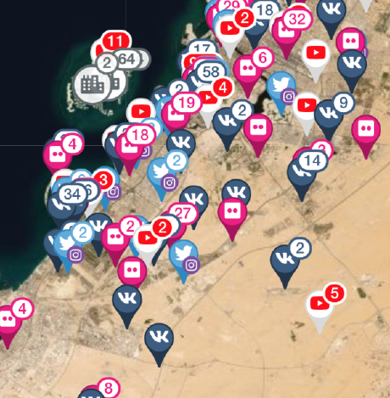
Echosec / Beacon
DARK WEB: TOR websites like marketplaces and forums, and hidden networks like I2P
DEEP WEB: Unindexed websites including classifieds and forums, chat applications like Telegram and Discord
DOCUMENTS
Common paste sites on the deep and dark web which widely used for data leaks and other nefarious activity
BREACHES: A growing, publicly-available repository of over 10 billion breached data records
SOCIAL MEDIA: Mainstream social media platforms as well as fringe networks on the deep and dark web, including imageboards like 8kun and decentralized networks like Gab
NEWS AND BLOGS:A variety of surface web news and blog sources in any language
Notes:
Maltego
open source intelligence (OSINT) and graphical link analysis tool for gathering and connecting information for investigative tasks
Integrates with SPLUNk and other data sets for example PIPL
Link analysis
Have I been pawned
The Platform aggregates, filters, and visualizes public content across
the surface, deep, and dark web—and uses machine learning capabilities
to automatically categorize threats. Users can detect and monitor risks
online quickly to keep people and assets safe.
Echo Sec
Twitter and VK
1 Billion per day
18 data sources
250, news sources
Clear web
If want darkweb use beacon
Market place selling company information
Breaches
Will ist off persons name and password, obfuscated passwords

Slide 15
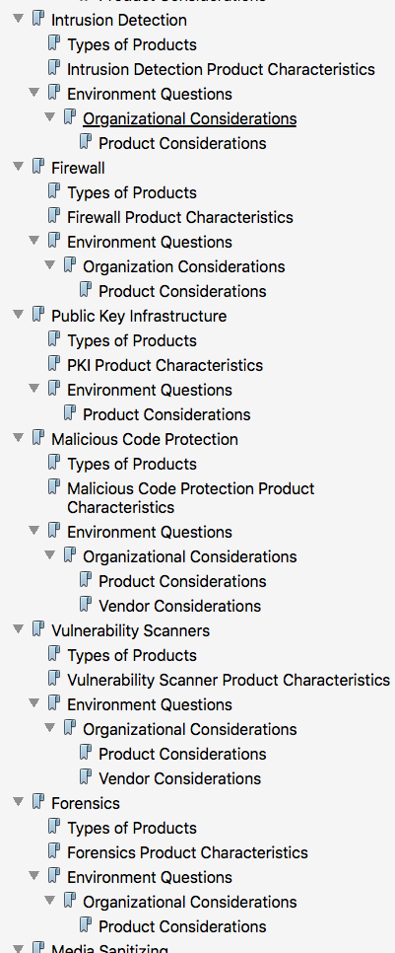
NIST SP 800-36
NIST SP 800-36 seeks to assist in choosing IT security products that meet an organization’s information security requirements. NIST SP 800-36 defines broad security product categories, specifies product types within those categories, and provides a list of characteristics and questions an organization should ask when selecting products within categories
An integral part of information security design is the selection and implementation of IT infrastructure to help ensure the confidentiality, integrity and availability of an information system.

Slide 16

Deep Web / Darknet
The deep web is comprised of websites and data sources non-discoverable by regular search engines, thus not indexed, sometimes referred to as the invisible web
It is estimated the size of the deep web is at least 400-500 times larger than the surface web
Darknet is an encrypted network built on top of the existing internet that requires specialized software to access
Darknet provides anonymity to its userbase
Common software platform TOR (The Onion Router) is required to access the darknet
Dark web and darknet are not the same but sometimes used interchangeably
Notes:
Indexed pages are surface web
Unindexed pages are deep web

Slide 17

TOR Browser
TOR makes use of onion routing, a way to use the internet with as much privacy as possible. The theory is to route traffic through multiple servers and encrypt it each step of the way, hence the name ‘Onion Router’.
Tor Browser isolates each website so third-party trackers can't follow you. Cookies automatically clear, as does browsing history.
TOR is used to access the darknet
Dark web and darknet are not the same but sometimes used interchangeably
Notes:
Indexed pages are surface web
Unindexed pages are deep web

Slide 18
Summary
SIEM software is an approach to security management that combines
SIM (security information management) and SEM (security event management)
functions into one security management system.
SIEM software provide real-time analysis of system alerts generated by network devices and applications
Vulnerability scanners are automated tools that provide organizations valuable insight into application weaknesses on a network.
Open-source intelligence involves lawful information gathering practices obtained from public sources to serve a specific function
NIST SP 800-36 seeks to assist in choosing IT security products that meet an organization’s information security requirements and defines broad security product categories together with a list of characteristics and questions organisations should ask when selecting security products
The deep web is comprised of websites and data sources non-discoverable by regular search engines, thus not indexed, sometimes referred to as the invisible web
Darknet provides anonymity to the users. Tor or The Onion Router is a browser used to access the darknet
Notes:
References
Benlein, Jim, CISA,C.I.S.M., C.R.I.S.C. (2019). An introduction to the dark web. Credit Union Management, 42(5), 9. Retrieved from https://search.proquest.com/trade-journals/introduction-dark-web/docview/2214922366/se-2?accountid=10675

Slide 19
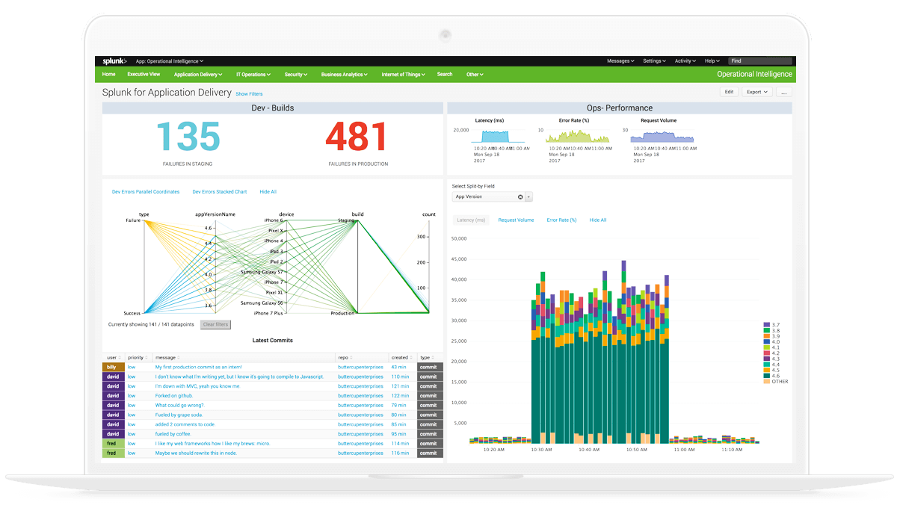
SIEM Workshop
SPLUNK Workshop
https://workplus.splunk.com/universities/

