Slide 1
Vocabulary Game Tutorial
A project of: Marco Di Giacomo, Federico Cariti, Matteo Tausch

Slide 3
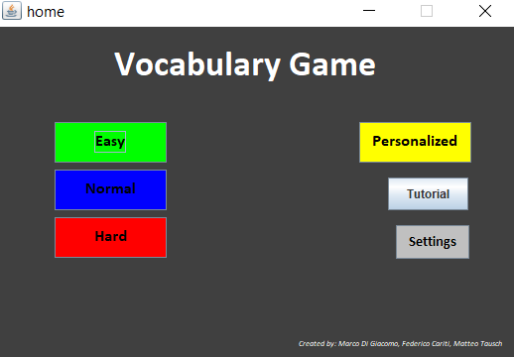
Home
This is the home page of our game.
Our game consists of answering words with their translations. when the game starts, a timer will also start. The player will have to translate as many words as possible until the timer reaches his limit.
You can choose between 3 levels of difficulties: easy, normal and hard.
By clicking on “Personalized” you will be able to play a custom mode while on “Settings” you will be able to adjust some parameters of the game.

Slide 4
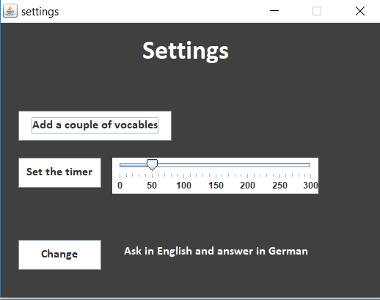
Settings
By pressing “Add a couple of vocables” you can add other vocables to the different levels
If you want to set the timer to a different value you can move the pointer and than press “Set the Timer”
If you want that the program changes the language in which it asks you for words, then press "change“.

Slide 5
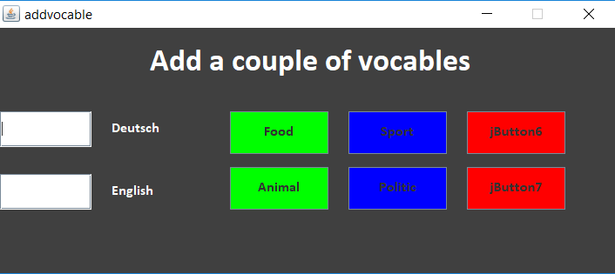
Add a couple of vocables
You can write words in empty fields and then, by pressing one of the buttons, you will add the word pair to the selected level

Slide 6
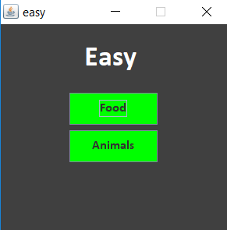
Easy
After you have selected a level of difficulty you can choose between two groups of vocables.

Slide 7
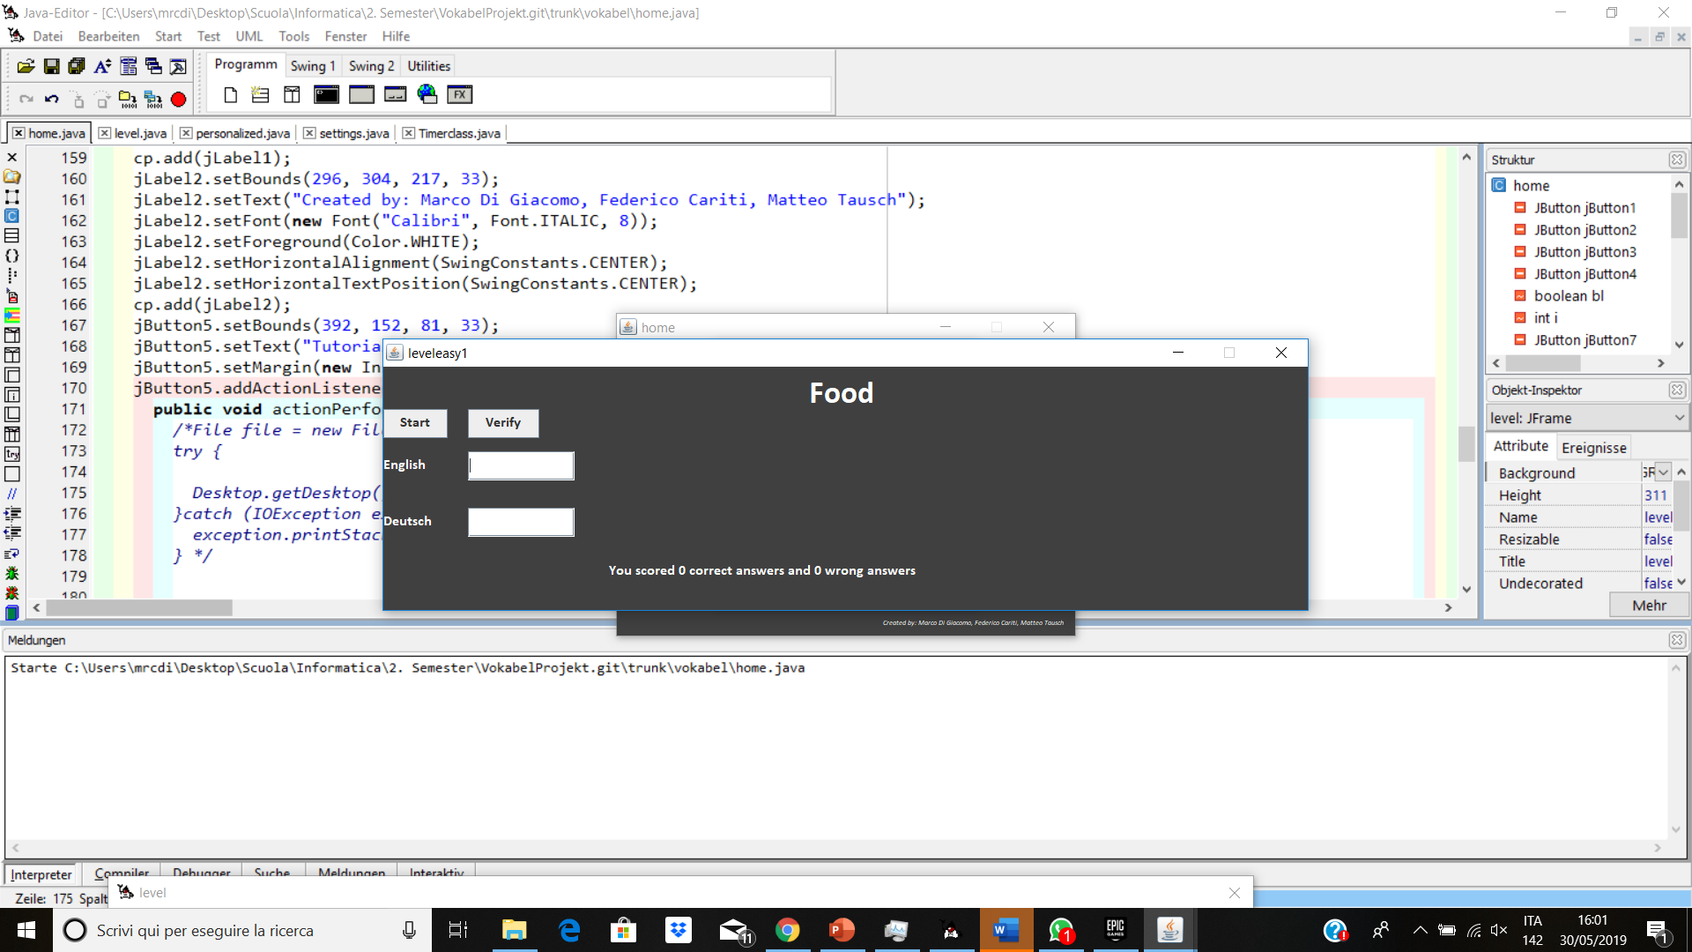
The game
By pressing “Start” the timer will begin
You must write the right vocable in German/English and than press “Verify”

Slide 8
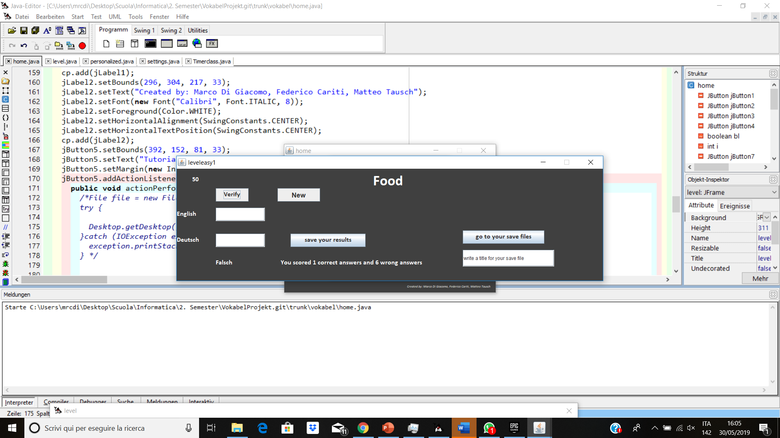
Level
After you have finished your seconds you can save your resoults with a name by pressing “save your results” and see your results by pressing “go to your save files”
You can restart the level by “New”

Slide 9
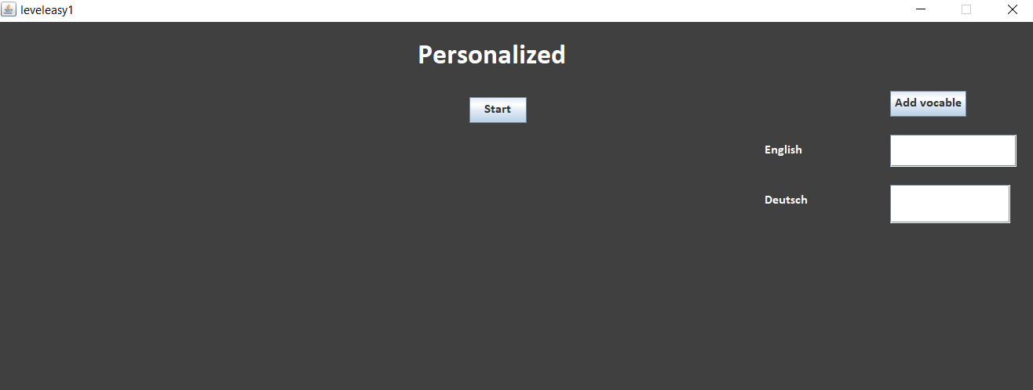
Personalized
In the level “Personalized” you can play only with vocables that you enter in the program.
Write all vocables that you want and than press “Add vocable”.
When you have finished entering the words then press “Start” to start the program.

Slide 10
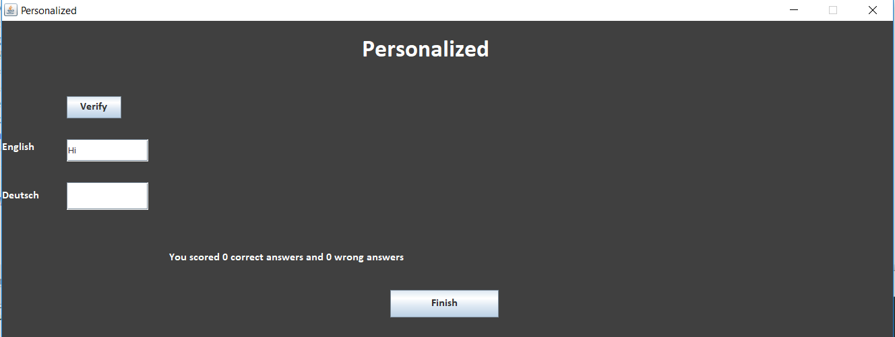
Personalized
In the level “Personalized” you have not a timer. You can play as long as you want!
The program will automatically save the number of your correct and wrong answers.
When you have finished you can press “Finish”

Slide 11
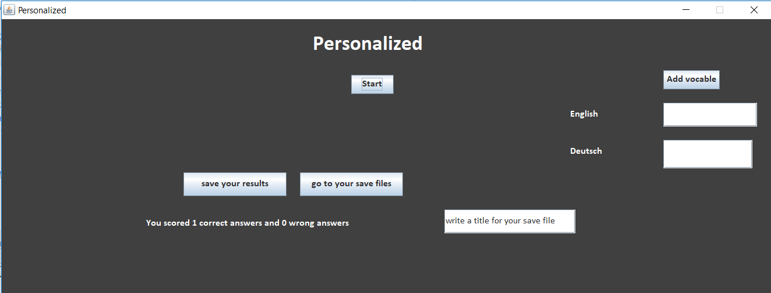
Personalized
Now you can save your results with a name by pressing “save your results”
You can see your results by pressing “go to your save files”
Now if you want you can add another vocables or restart the game again with the vocables that you previously set

