Slide 1

Data Management Project – Option 1:
Design and implementation of a software to visualize the external multi-pass sorting algorithm, with varying size of the relation and varying number of frames in the buffer.
a.y. 2021/2022
Marco De Luca - 2017104

Slide 2
Overview
Software visualizing the external multi-pass sorting algorithm
Functionalities:
Allow the user to select the size of the relation and the number of frames in the buffer;
Create the relation and the frames;
Read the relation pages, sort them in runs;
Read the runs, sort them;
Iterate until the whole relation is sorted;

Slide 3
Main goal: Be user-friendly
Avoid complex interaction
Clearly separate the space on screen
Differentiate object enough to make them understandable
Remove cluttering from screen
In general: keep it simple

Slide 4



Technologies used

Slide 5

JavaScript Libraries used
Tweenjs
Three.js

Slide 6
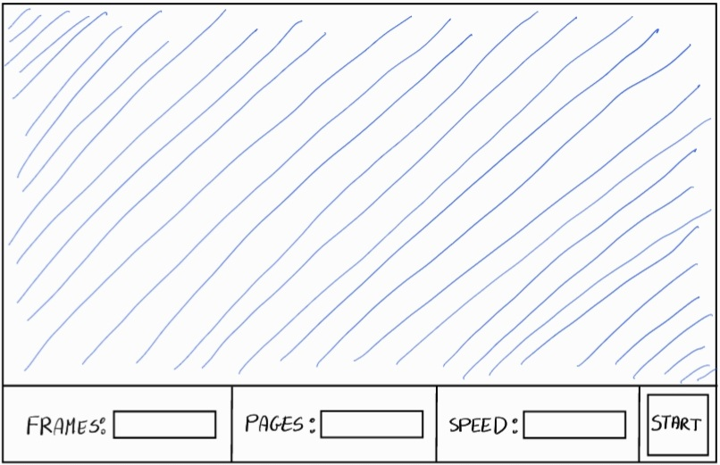
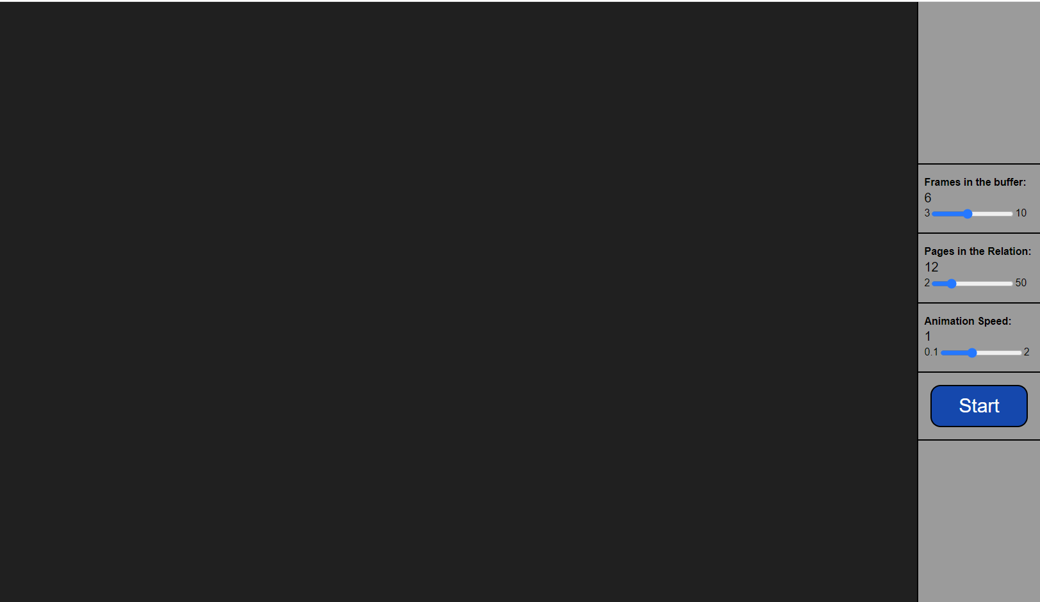
Design: UI
Initial Idea
Final Result

Slide 7
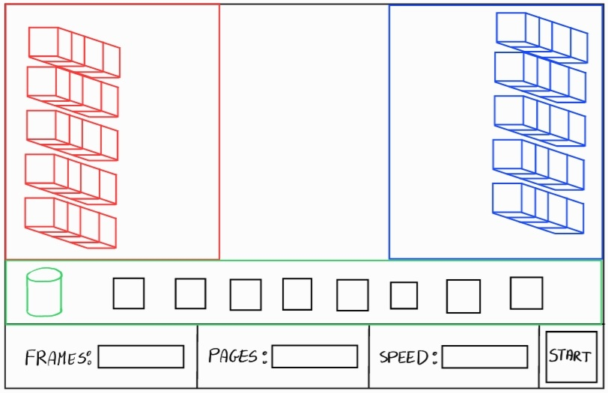
Design: Space subdivision
Three main areas:
Red: Input area
Green: Frames area
Blue: Output area

Slide 8
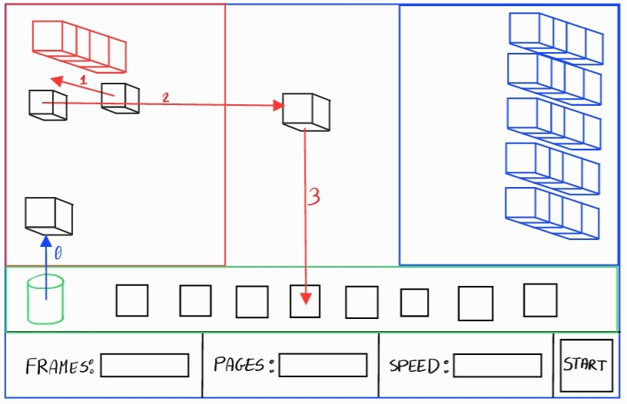
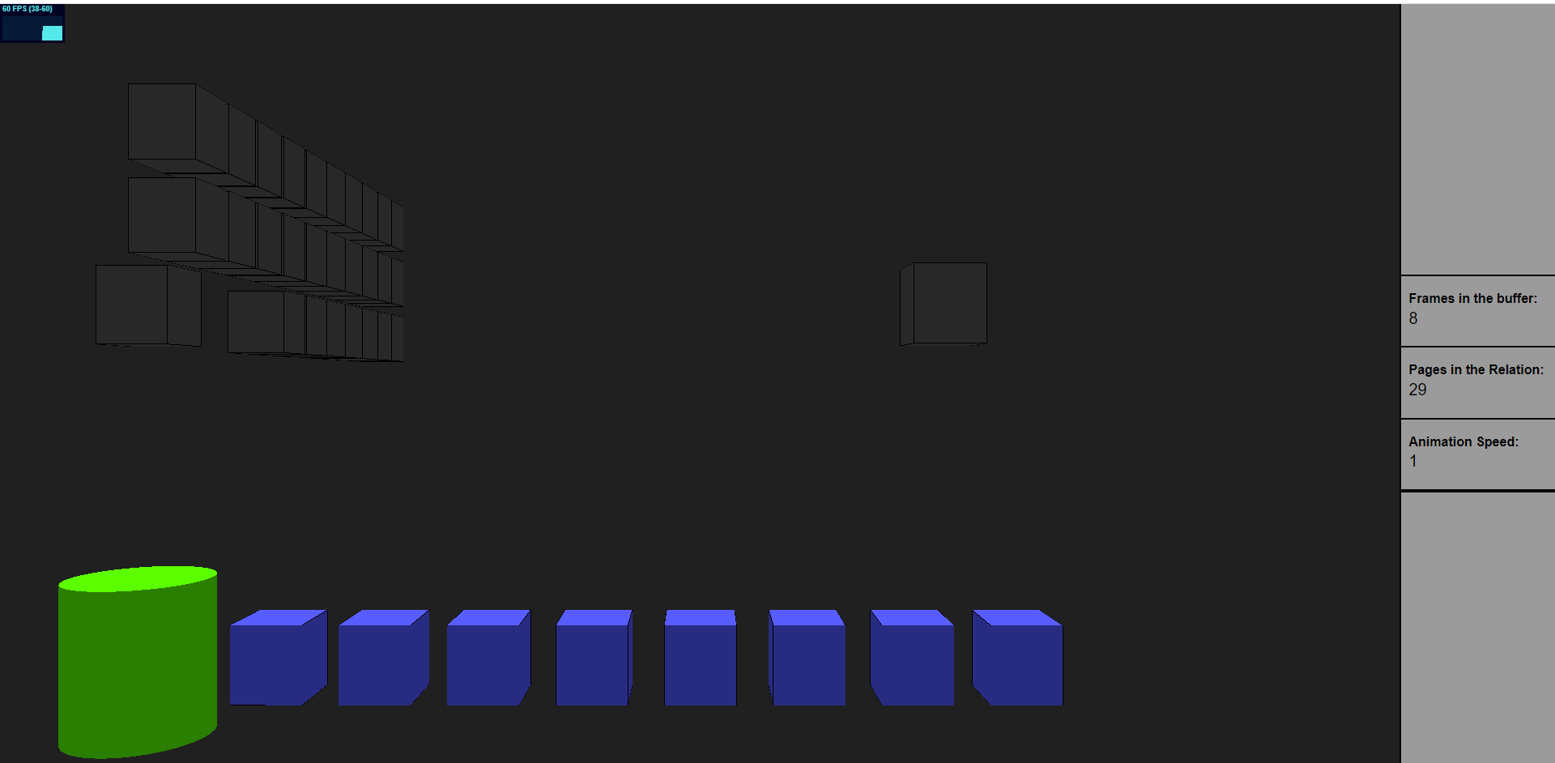
Animation: Step 0 – Load pages in frames
Initial Idea
Final Result

Slide 9
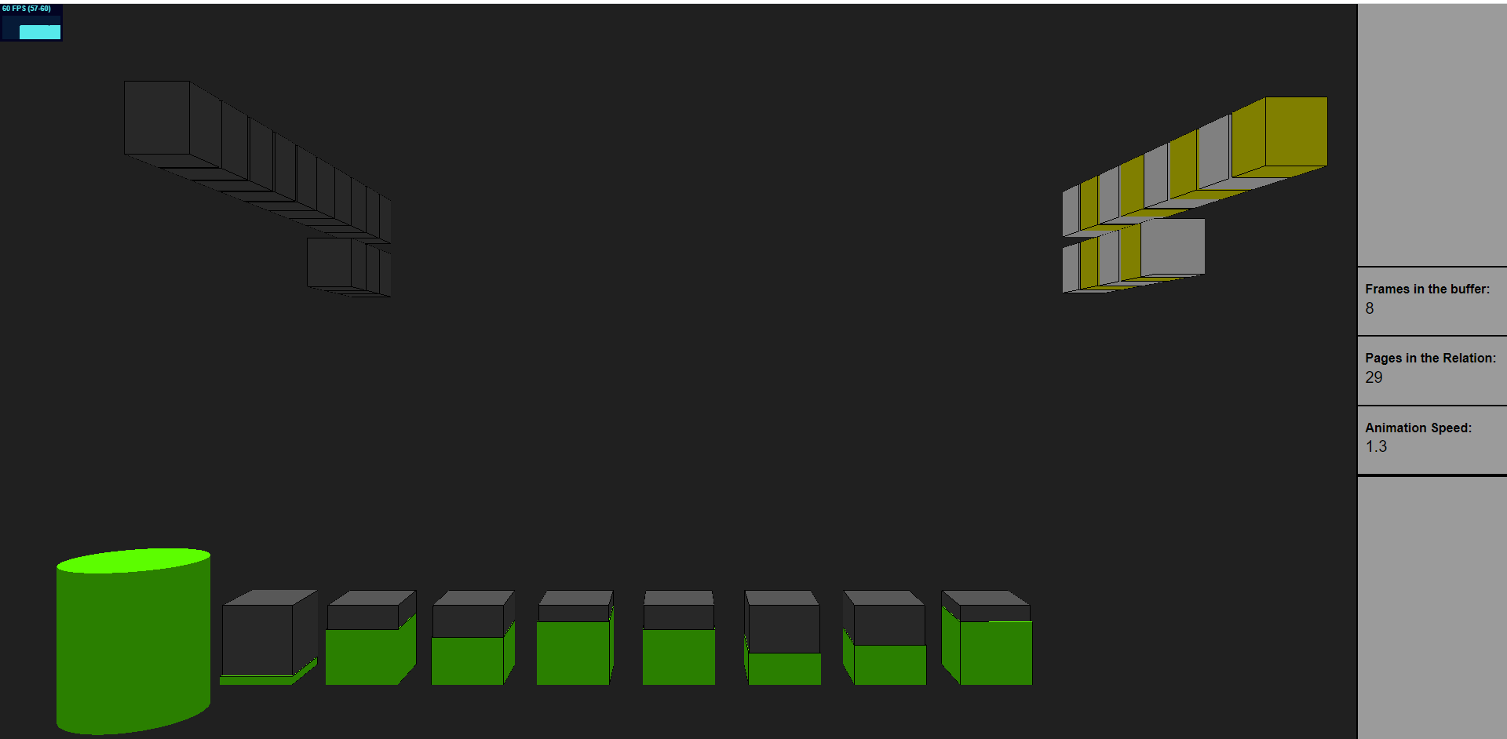
Animation: Step 0 – Read pages, create runs

Slide 10
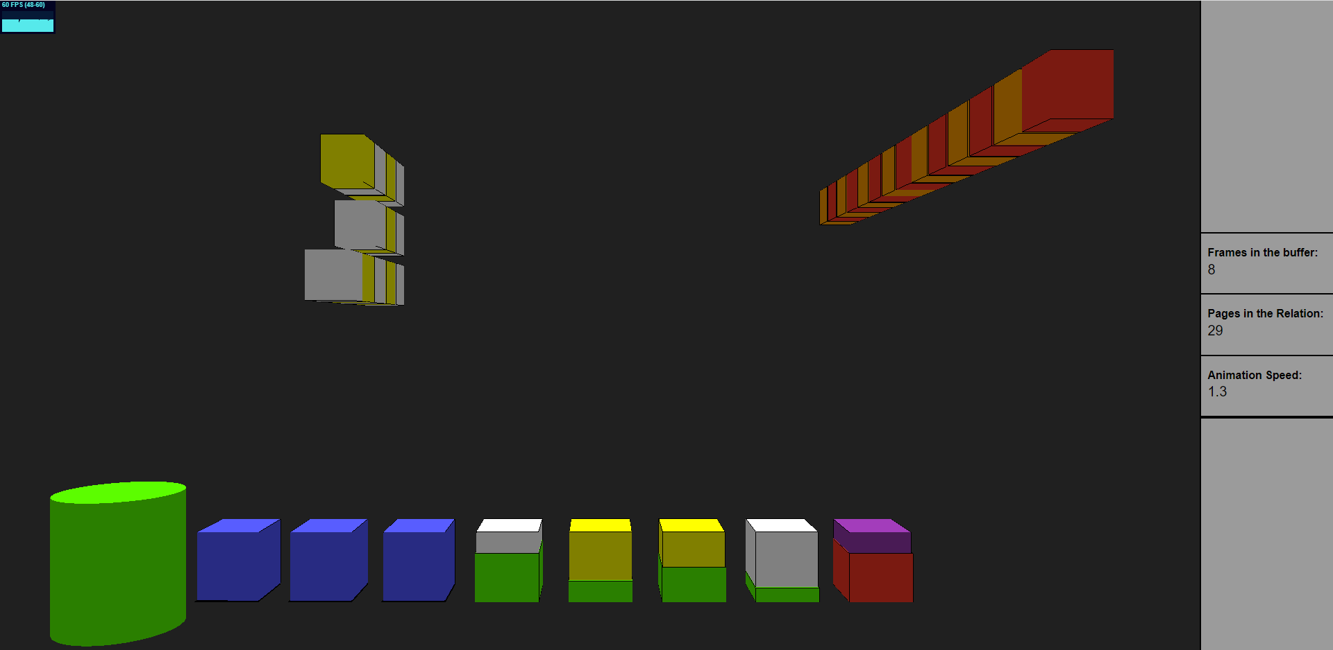
Animation: Step i – merge & sort runs
Marco De Luca - 2017104
10

Slide 11
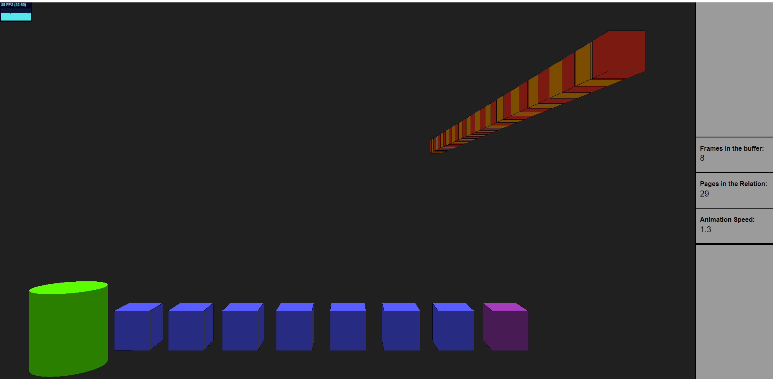
Animation: Final result
Marco De Luca - 2017104
11

Slide 12
I will now show a short demo of the application
Marco De Luca - 2017104
12

