Slide 1

Italian Internet Analysis
Visual Analytics 2022/2023
Marco De Luca - 2017104

Slide 2
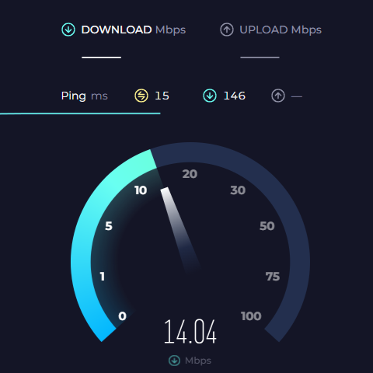

Introduction
Interactive visualization tool to analyze the Italian Internet

Slide 3
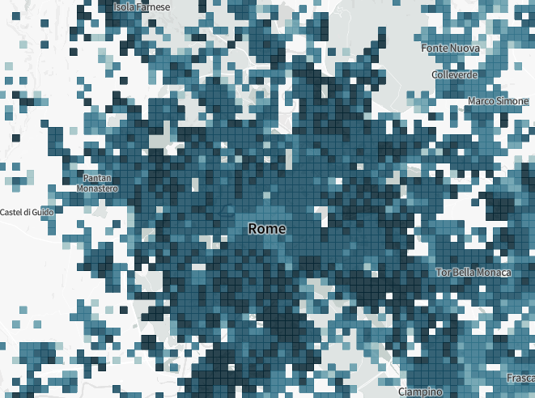
Dataset: Ookla Speedtest
Ookla Speedtest results are aggregated into tiles
Data is collected from all over the world (Updated to Q1 2023)
Everyone can perform a speedtest on their platform, populating their open Dataset
Tiles have no geographical meaning: preprocessing with GeoPandas was required
Is this dataset reliable?
avg_d_kbps, avg_u_kbps , avg_lat_ms, avg_lat_down_ms, avg_lat_up_ms, tests, devices, quadkey

Slide 4
Dataset: Strategic Plan Banda Ultralarga (BUL)
Web platform describing how the network infrastructure works proceed in Italy
Data is updated from the Italian Ministry of Enterprises and Made in Italy
Their open data gives information about the current state of works for Fiber and Mobile networks in the Italian cities
Only the Fiber networks was considered in this project
Possible states:
Unknown, In definitive planning, In executive planning, Scheduled, Being implemented, In progress, Being tested, Done

Slide 5
Final Dataset:
After preprocessing with GeoPandas, 238455 Tiles of the Ookla Dataset are in Italy
These are grouped by City, Province and Region
The states of Works from the BUL project are added
Datasets on the three levels are precomputed:
City, Province, Region, downloadSpeed_mbps, uploadSpeed_mbps, latency_ms, tests, stateOfWorks
7783 tuples, 8 attributes
Province, Region, downloadSpeed_mbps, uploadSpeed_mbps, latency_ms, tests,
Unknown, In definitive planning, In executive planning,
Scheduled, Being implemented, In progress, Being tested, Done
107 tuples, 14 attributes
Region, downloadSpeed_mbps, uploadSpeed_mbps, latency_ms, tests,
Unknown, In definitive planning, In executive planning, Scheduled,
Being implemented, In progress, Being tested, Done
20 tuples, 13 attributes

Slide 6
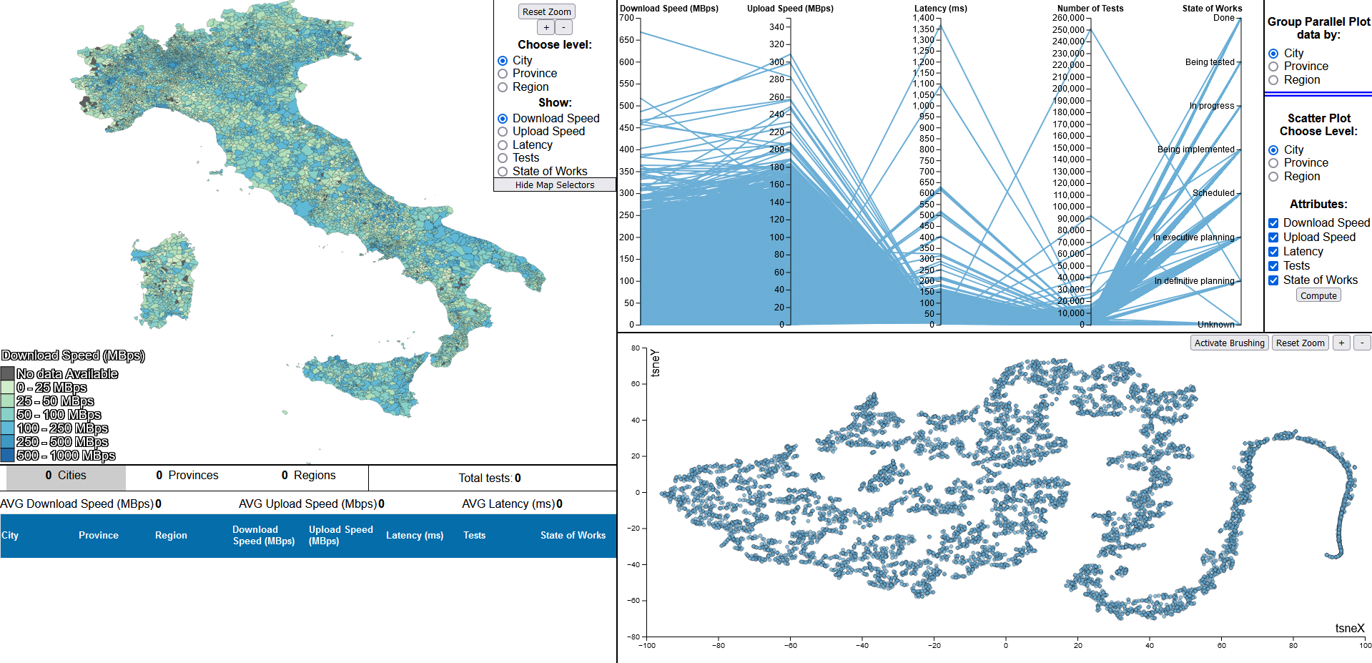
Visualizations

Slide 7
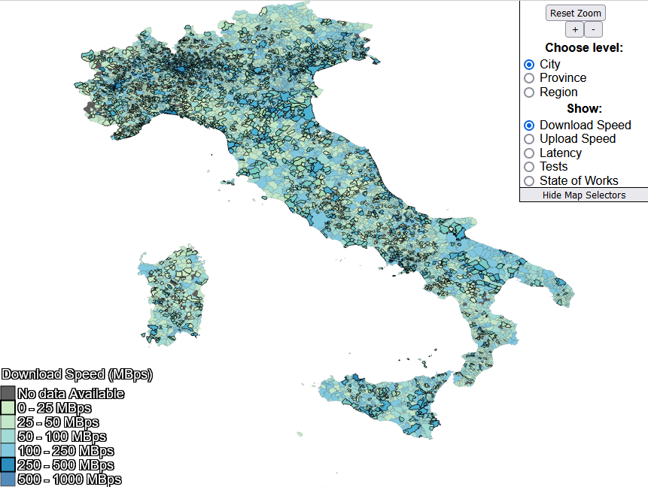
Visualization: Choropleth Map

Slide 8
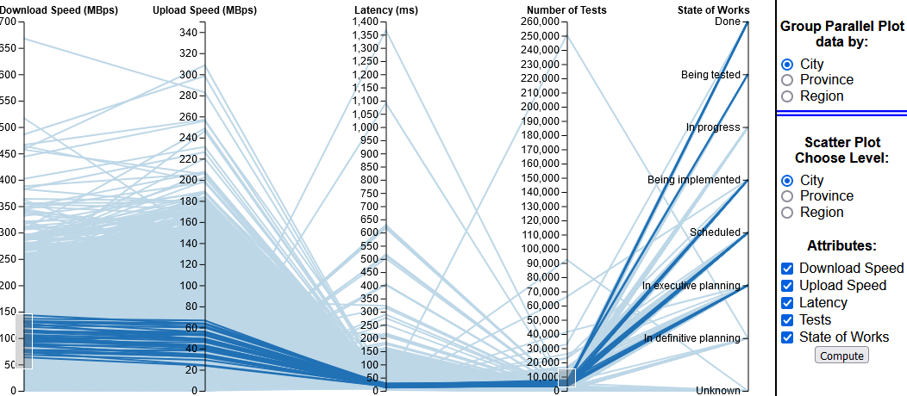
Visualization: Parallel Coordinates

Slide 9
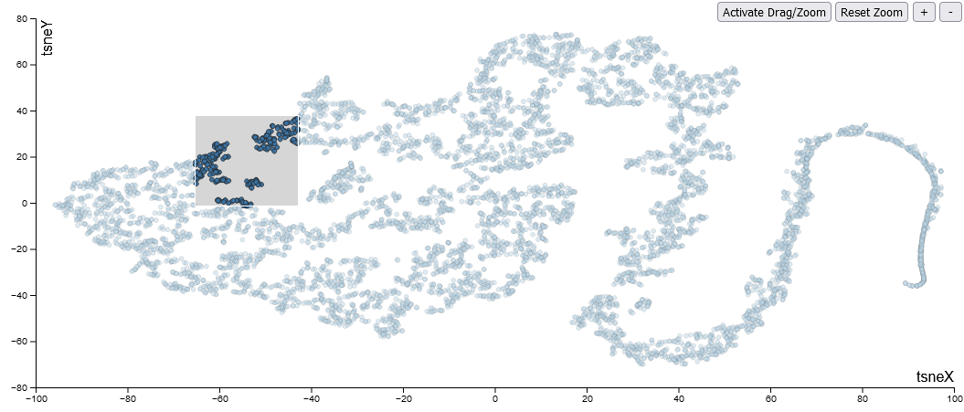
Visualization: Scatter plot

Slide 10
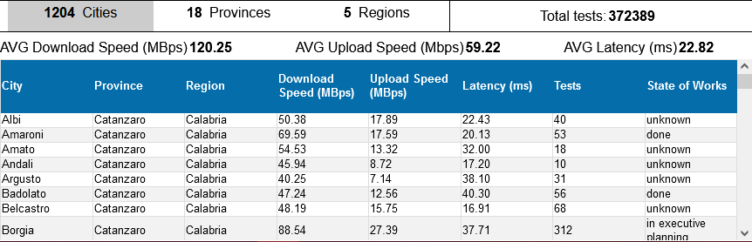
Visualization: Detail Section
Marco De Luca - 2017104
10

Slide 11



Analytics
Integrated t-SNE
Marco De Luca - 2017104
11

Slide 12
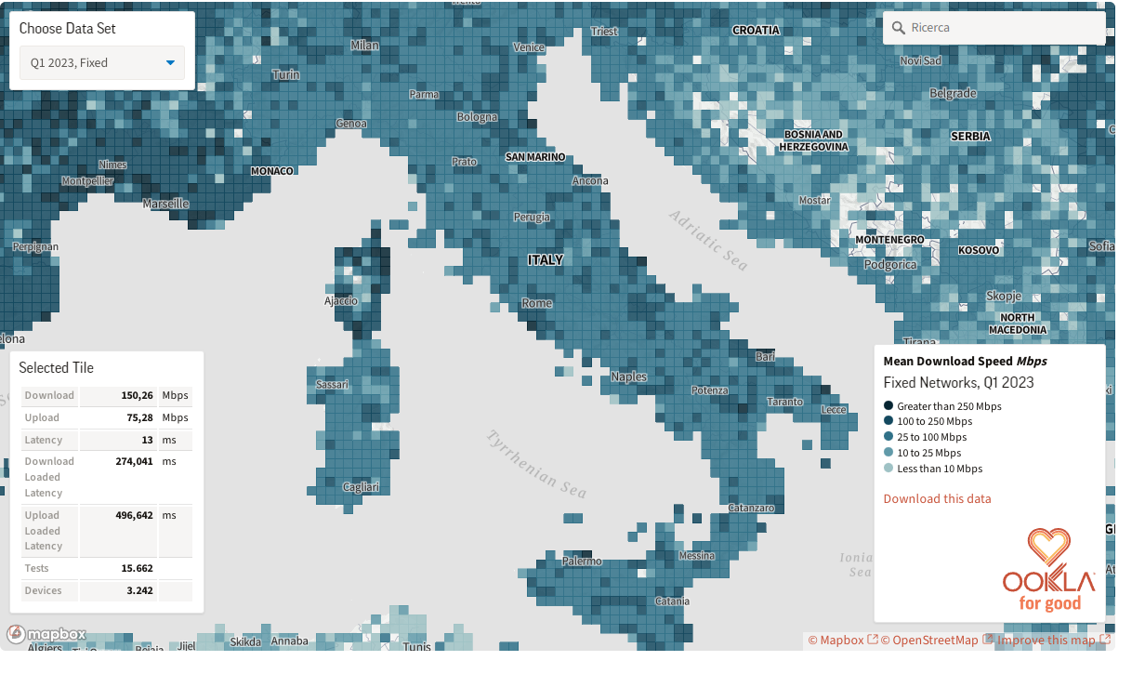
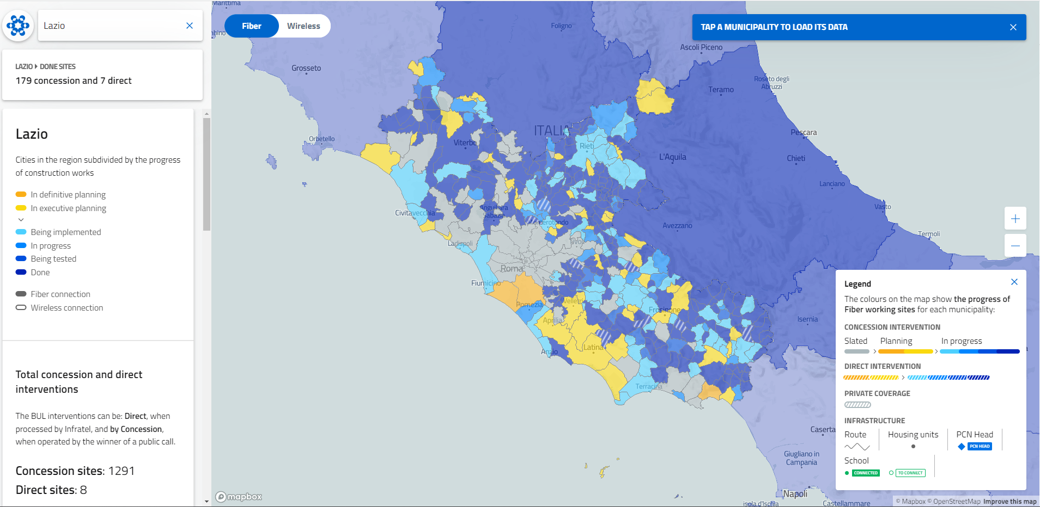
Related Works
Ookla’s Interactive Map
BUL’s Map
Marco De Luca - 2017104
12

Slide 13
Future Works
Scarcity of similar projects calls for an extension of the system:
Ookla releases a new update every quarter year
Integrate official Datasets from telecommunication companies
Add data catered to the specific needs of the user, allowing to view everything on the platform
Marco De Luca - 2017104
13

Slide 14
I will now show a short demo of the application
Marco De Luca - 2017104
14

