Slide 1
Assignment 3: Interactive Humanoid Robot II - animation and camera rotation with the mouse using the Arcball
Presented and programmed by: MarcoDotIO

Slide 2
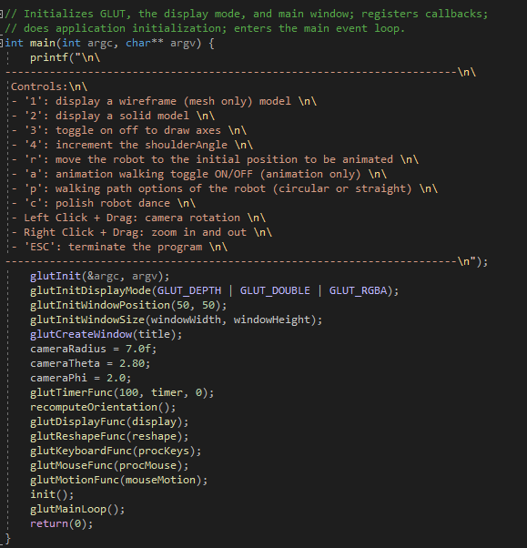
Main Function
Contains traditional functions within an OpenGL program.
New functions include glutMotionFunc():
Made for keeping track of mouse pointer movements
glutTimeFunc():
Made for initiating variables within certain key frames

Slide 3
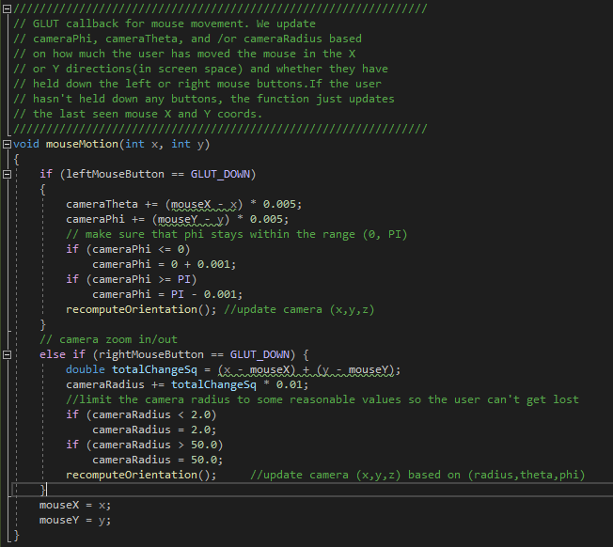
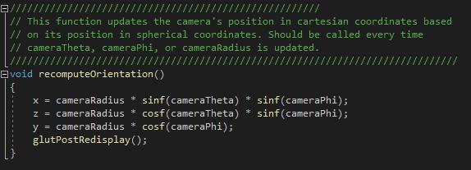
mouseMotion and recomputeorientation Functions
Contains code for conditions involving left and right mouse buttons.
Basic functionality:
If a left click happens, then the mouse’s position is saved in the theta and phi variables for use with the camera, and then ran through another new function, recomputeOrientation().
If a right click happens, the change between the mouse movements are saved and then computed later on.

Slide 4
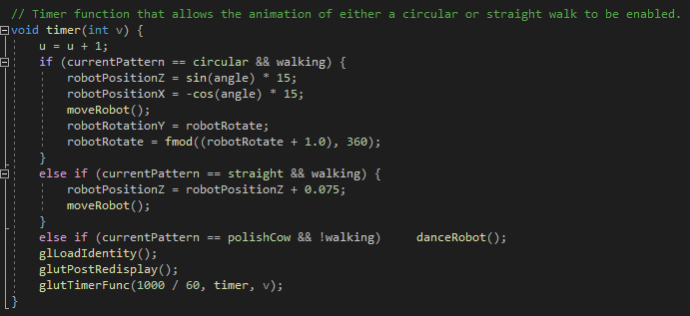
Timer Function
Contains important functionality for animation:
Enum to select type of animation: circular, straight, or the polish robot
Circular involves the robot rotating itself in accordance to it running within the circle path.
Straight just involves running in a straight line
Polish robot will be covered shortly…
And then continue to iterate over itself.

Slide 5
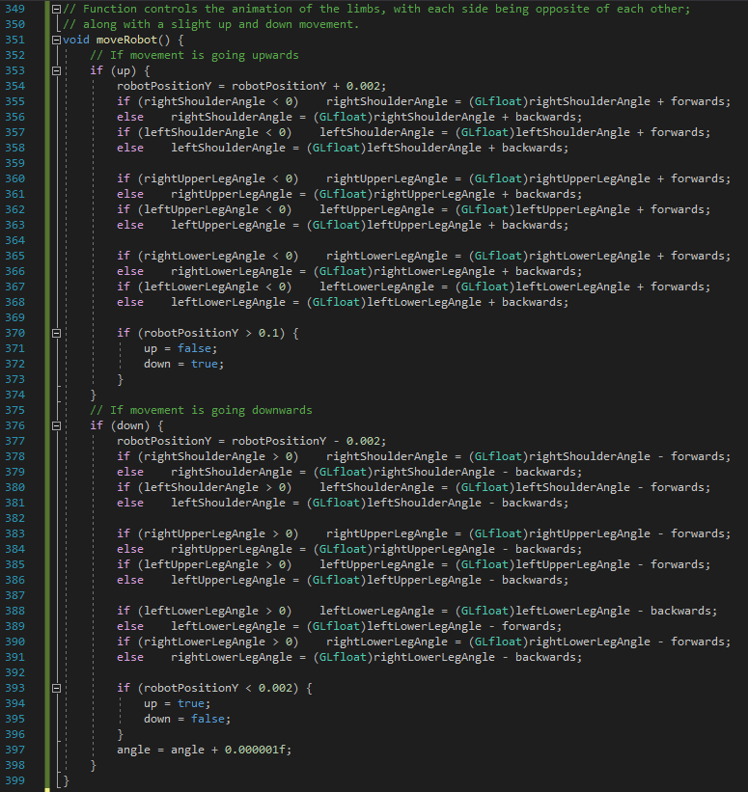
moveRobot Function
Calculates the back and forwards movement for the robot:
Bop its body up and down
Move its right side forwards / move its lower leg back
Move its left side backwards / move its lower leg forwards
Opposite way once amount of time passes

Slide 6
Main Function
Contains traditional functions within an OpenGL program.
New functions include glutMotionFunc():
Made for keeping track of mouse pointer movements
glutTimeFunc():
Made for initiating variables within certain key frames

Slide 7
Demo time

Slide 8
Questions? Archive: https://github.com/MarcoDotIO/PolishRobot

